Slide 1

​Locative relative markers in diachrony: from Late Latin to Italian
Silvia Ballarè (University of Bologna),
Luisa Brucale (University of Palermo) and
Guglielmo Inglese (University of Torino)
RoLinC
10 March 2026

Slide 2
Contents
Introduction
Relative clauses
Why dove?
Data and methods
Corpora, extraction, annotation
Analysis
Frequency distribution, semantic extension
A case of grammaticalization?
Conclusions

Slide 3
Contents
Introduction
Relative clauses
Why dove?
Data and methods
Corpora, extraction, annotation
Analysis
Frequency distribution, semantic extension
A case of grammaticalization?
Conclusions

Slide 4
Relative clauses
“A relative clause is a subordinate clause which delimits the reference of an NP by specifying the role of the referent of that NP in the situation described by the relative clause.”
(Andrews 2007: 206)
head
relativizer
I bought the house [that is close to the sea]
main clause
relative clause

Slide 5
The Accessibility Hierarchy
The Accessibility Hierarchy (AH) was formulated by Keenan & Comrie (1977) to capture the ranking of syntactic roles based on their accessibility to relativization across languages
Subj > DO > IO > Obl > Gen > Obj of comp
Predictions of the AH
1. “A language must be able to relativize subjects.
2. Any Relative Clause-forming strategy must apply to a continuous segment of the AH.
3. Strategies that apply at one point of the AH may in principle cease to apply at any lower point.”
Contiguity constraint
(Keenan & Comrie 1977: 67)

Slide 6
Locative relative markers
Locative relative markers (LOC_{REL}) are relativizers that signal that within the RC the head is syntactically an oblique that expresses a spatial relation of sorts (location, source, goal, see Stoltz et al. 2014).
The house where I live is far location
The city where I am from is Milano source
We’ve been back to the restaurants where we often go goal
Subj > DO > IO > Obl > Gen > Obj of comp

Slide 7
Locative relative markers
Several languages of Europe (and beyond) display dedicated locative relative markers
Italian dove (Serianni 2006 [1989])
French où (Price 2008)
Catalan on (Wheeler et al. 1999)
English where (Huddleston & Pullum 2002)
Dutch waar (Donaldson 1997)
German wo (Götze & Hess-Lüttich 1999; Fleischer 2004)
Breton eman (Crahe 2013),

Slide 8
The functional extension of locative relative markers
 | Locative | Oblique | Subj, DO, IO
EST kus POL gdzie RUM unde RUS gde | + | - | -
DUT waar | + | + | -
BUL deto FRE dont GER wo (dialects) GRE pu LIT/LTV kur | + | + | +
adapted from Murelli 2011: 184

Slide 9
The functional extension of locative relative markers
In corpora, LOC_{REL} are often used to encode non-spatial relations.
1) We've got the statement where you immediately said I'm hundred percent sure [this is] the guy
Santa Barbara Corpus (SBC008)
2) Voilà oui hm euh j’ enseigne dans une matière où y a beaucoup de préparation matérielle
(Larrivée & Skrovec 2016: 9)
“So, I teach this subject where there’s a lot of material preparation.”
‘Concern’ → about x, as far as x is concerned

Slide 10
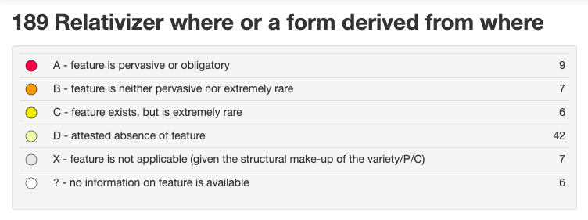
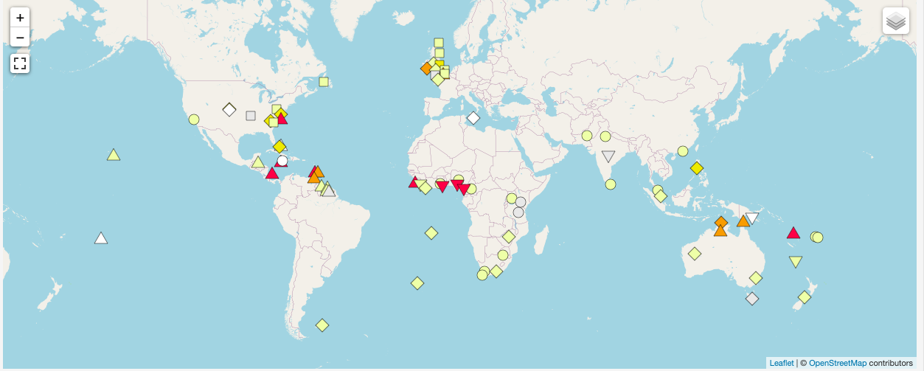
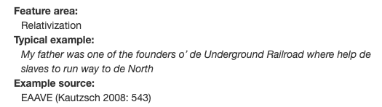
Where in English
10

Slide 11

Language | Lexifier language | General relativizer
Trinidad English Creole | English | weh
Vincential Creole | English | we
Belizean Creole | English | we
San Andres Creole English | English | we
Nicaraguan Creole English | English | we
Krio | English | we
Ghanaian Pidgin English | English | we
Nigerian Pidgin | English | we
Cameroon Pidgin English | English | we
Pichi | English | we
Tok Pisin | English | we
Bislama | English | we
Kriol | English | we
APiCS feature 92 (Michaelis et al. 2013)

Slide 12
Language | Lexifier language | General relativizer
Trinidad English Creole | English | weh
Vincential Creole | English | we
Belizean Creole | English | we
San Andres Creole English | English | we
Nicaraguan Creole English | English | we
Krio | English | we
Ghanaian Pidgin English | English | we
Nigerian Pidgin | English | we
Cameroon Pidgin English | English | we
Pichi | English | we
Tok Pisin | English | we
Bislama | English | we
Kriol | English | we
APiCS features 92-93 (Michaelis et al. 2013)

Slide 13
Dove in Contemporary Italian
Dove can be used ‘as a relative conjunction in subordinate clauses with locative value, real or figurative’ (Serianni, 2006[1989]: VII, § 247).
According to GGIC (prescriptive grammar) ‘the figurative usage of dove is rather marginal’ (Cinque, 1988: 468).
Non-standard usages have been reported in a number of varieties in more recent studies (see Cortelazzo 1972, Bernini 1989, Alfonzetti 2002, Ballarè & Micheli 2018, Ballarè & Inglese, 2022 inter al.).

Slide 14
Dove in Contemporary Italian
3) I ragazzini under sedici dove stan lì a far casino al giardinetto
(ParlaTO, PTD021)
“The kids under 16 years old where they stay there making a mess in the park.”
4) Chiaramente la FIAT è un po' come quelle madri un po' oppressive dove
non ti manca mai nulla
(ParlaTO, PTD009)
“Clearly FIAT is like one of those oppressive mothers where you don’t miss a thing.”
topic
concern
connective
comment
Ballarè & Inglese 2022

Slide 15
Social variation – data and method
ParlaTO corpus (Cerruti & Ballarè 2021)
Semi-structured interviews collected in Turin with speakers with different social characterization.
Sample:
All occurrences of dove have been annotated according to the relativized function (see Ballarè & Inglese 2022)
 | Lower educational achievements (Ed.1) | Higher educational achievements (Ed.2)
N. of tokens | 283.799 | 268.662

Slide 16
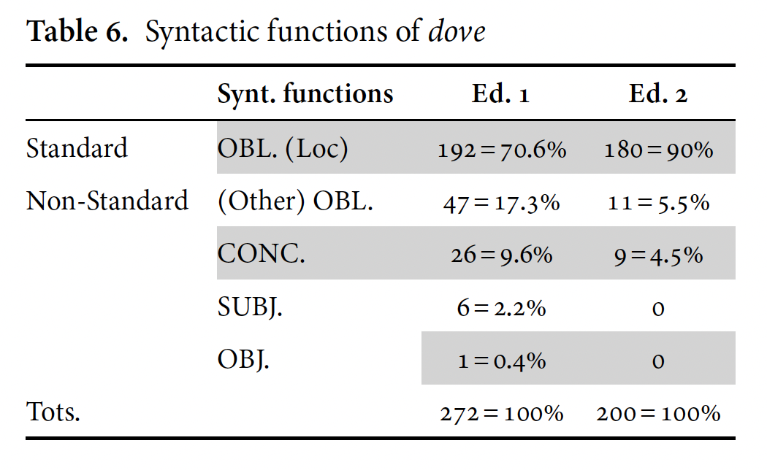
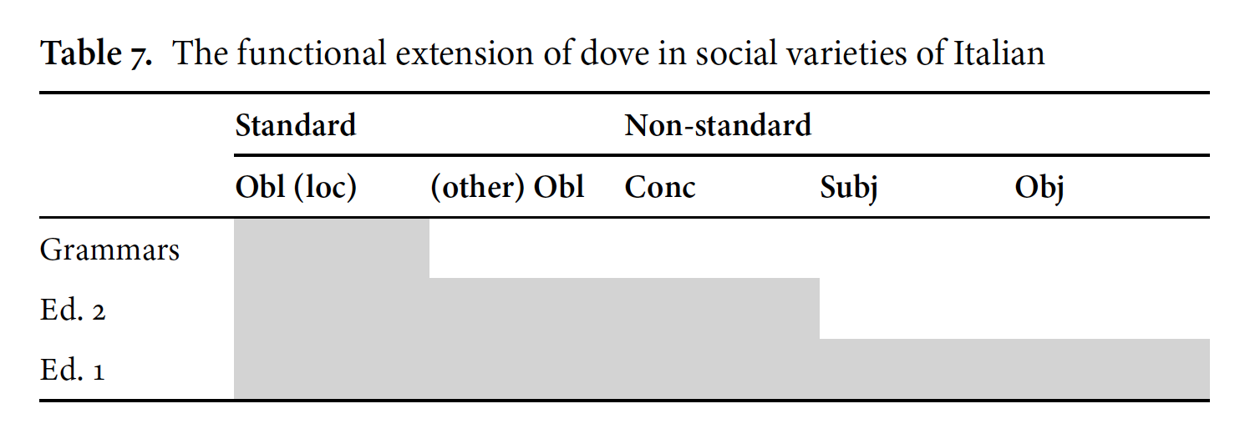
Social variation – results

Slide 17
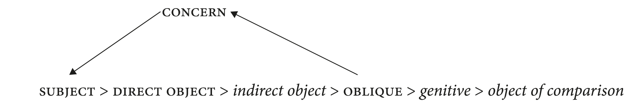
Dove and the Accessibility Hierarchy
Subj | Obj | IObj | Obl_other | (Obl_spa) | Gen | ObjComp
+ | + | - | + | + | - | -

Slide 18
Research question
The development of dove has been hypothesized on the basis of synchronic variation: what does historical evidence tell us?

Slide 19
Where does dove come from?
Latin
Old Italian
Modern Italian
*de + unde/ubi
ubi (location)
ove, onde
dove
unde (source)
dove, donde
quo (goal)
quā (path)
(Lichtenhahn 1951)
loss + paradigm restructuring
paradigm reduction

Slide 20
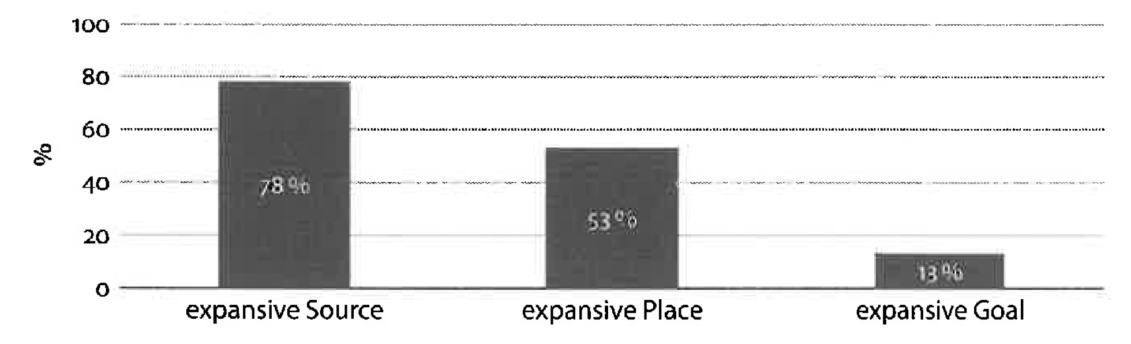
From source to location?
*de ubi ’from where’ > dove ‘where’ → semantically unlikely (e.g., De Gregorio 1912)?
Stolz et al. (2017): in 45 romance varieties the interrogative/relative marker for source extends to location/goal

Slide 21
Contents
Introduction
Relative clauses
Why dove?
Data and methods
Corpora, extraction, annotation
Analysis
Frequency distribution, semantic extension
A case of grammaticalization?
Conclusions

Slide 22
Corpora and extraction: (Medieval) Latin
Treebanks of Medieval Latin:
  Charters (LLCT)
  Dante (UD_Dante)
Name | Description | Area
MED | Memorie e documenti per servire all’istoria del Ducato di Lucca 5:2. A cura di DOMENICO BARSOCCHINI. (1837). Lucca: Francesco Bertini | Tuscany (Lucca)
CDL | Codice diplomatico longobardo 1–2. A cura di LUIGI SCHIAPARELLI. (1929–1933). Roma: Tipografia del Senato | Tuscany
CDL_nord | Codice diplomatico longobardo 1–2. A cura di LUIGI SCHIAPARELLI. (1929–1933). Roma: Tipografia del Senato | Northern Italy
CDC | Codex diplomaticus Cavensis | Campania
CDT | Codice diplomatico toscano 2:1, ed. F. Brunetti (1833) | Tuscany
Dante | Dante’s Latin works | Tuscany

Slide 23
Corpora and extraction: (Medieval) Latin
Why Medieval Latin:
Classical Latin does not showcase variation (Prieto Entrialgo, 2019);
LLCT is accessible online, lemmatized, and features text metadata (date, text type, area);
comparability with results by Prieto Entrialgo’s (2019) study on Iberian charters
Extraction: all sentences with ubi and unde (n = 1.699), including alternative spellings (hunde, huvi, hubi uvi)

Slide 24
Caveat: language formulatity in Latin charters
LLCT features legal charters, which feature a highly formulaic language
Formula = (partially) lexically filled constructions
«Residency» formula (n = 140)
casa ubi Rosfridi presbitero resede
“The house where R. the priet lives.”
Head | Rel | Verb
abitatio, casa (x106), cellula, curticella, curte, domus, ecclesia, locus (x16), monasterio, nome_località, res, sala, terra, vico | ubi | abito, resideo

Slide 25
Corpora and data extraction: Italian
Diachronic corpus - Russo (2024)
Text closer to more ‘informal’ register
 | XIII | XIV | XV | XVI | XVII | XIIX | XIX | XX
Narrative prose | 68.800 | 127.894 | 131.014 | 125.263 | 132.721 | 110.385 | 131.463 | 128.429
Argumentative text | 297.885 | 117.777 | 116.413 | 118.775 | 140.983 | 134.831 | 127.069 | 144.831
theatre | 122.114 | 128.736 | 71.403 | 126.681 | 106.814 | 91.471 | 83.414 | 107.431
Personal text | 0 | 99.679 | 139.224 | 125.991 | 98.354 | 123.158 | 122.528 | 130.130
Number of tokens | 488.799 | 474.086 | 458.054 | 496.710 | 478.872 | 459.845 | 464.474 | 510.821

Slide 26
Corpora and data extraction: Italian
Data extraction
All occurrences of ove, onde, dove, donde (+ unde, ubi) (N = 6.893);
Keeping the ratio of occurrence, we created a panchronic sample of 1000 occurrences
→ PRO: frequency differences are preserved
→ CONS: less frequent forms are underrepresented
Form | Total | Sample
donde | 232 | 34
dove | 3.689 | 535
onde | 1.853 | 269
ove | 976 | 142
ubi | 23 | 3
unde | 120 | 17
Tot. | 6.893 | 1.000

Slide 27
Annotation
Manual exclusion of occurrences where the forms investigated are not adnominal relativizers (e.g. free relatives, sentence-initial usage, adverbial subordinators) and annotation:
Form (ubi, unde, dove etc.)
Clitic retention: occurrence of clitics referring to the head within the RC (yes/no)
Verb semantics (of the RC): movement, position, communication, copula, other
Syntactic relation: subject, object, oblique, genitive, concern (Ballarè & Inglese 2022)
Semantic relation: spatial, temporal, topic, other
  When spatial: location, source, goal, path
Semantics of the head: abstract, inanimate concrete, human, location, temporal, text

Slide 28
Contents
Introduction
Relative clauses
Why dove?
Data and methods
Corpora, extraction, annotation
Analysis
Frequency distribution, semantic extension
A case of grammaticalization?
Conclusions

Slide 29
Structure of the analysis
Unde > onde, donde
Syntax and semantics
Ubi > ove, dove
Syntax and semantics
Comparison
Syntactic relation and the Accessibility Hierarchy
Diachronic trends of development
Grammaticalization

Slide 30
Unde, onde & donde: syntactic relation
Oblique
una cum bia sua carraria, unde nos semper introibimus
”(I sell the land to you) with its main street, from where we will always enter.”
Genitive (partitive)
vos qui illa rem abere videtis, unde pater eius sextam portionem in ambas ipsas ecclesias abere decrevit
“You who are known to possess this good, the 6th portion of which his father declared it belonged to the aforementioned church.”
source > partitive (Luraghi 2014)
Concern?
set easdem ecclesias, casis et rebus eorum pegiorate sunt, unde, secundum suorum repromissionem, a parte sancti Martini conponere et eisdem ecclesiis, casis et rebus eius perdere debuit.

Slide 31
Unde, onde & donde: semantic relation
Spatial usages
una cum bia sua carraria, unde nos semper introibimus
”(I sell the land to you) with its main street, from where we will always enter.”
volevano rientrare a forza nella porta, onde poi uscirne di nuovo per un altro salto
“They wanted to force the door, from which then they would exit with another jump.” (Giuseppe Baretti, XVIII)
poco stettono che giunsono alla magione, donde s’erano partiti
”In a little while they reached the mansion from which they had previously departed.” (Franco Sacchetti, XIV)

Slide 32
Unde, onde & donde: semantic relation
Non-spatial usages
Origin
filia ipsius Dammiani (…), unde iste Agiprand filio meo natus est
“The daughter of that D., from which this son of mine A. was born.”
dichiarazione de’ princípi onde nasce il valore delle cose tutte
“Declaration of the principles from where the value of all things derives.” (Ferdinando Galiani, XVIII sec.)
2) Matter
L'acquisto dell'oro e dell'argento, onde la moneta piú preziosa è costituita
“The acquisition of gold and silver, of which the most precious coin is formed.” (Ferdinando Galiani, XVIII)

Slide 33
Unde, onde & donde: semantic relation
Non-spatial usages
3) Passive agent
pro ista generatjiones barbaras saracenorum, unde in cibitate ista salernitana circumclusi sumus.
“From these barbarian people, the Saracens, by which we’re surrounded in the city of Salerno.”
4) Cause
avessi cura che non seguisse qualche pazza scena, onde l''inviato del Granduca avesse avuto a andare sulle gazzette per autore d'un mal parto.
”I took care that no crazy scenes ensued, because of which the Grand Duke's envoy should have to go to the newspapers as the author of a miscarriage.” (Lorenzo Magalotti, XVII)
NB: onde seemingly covers a wider range of non-spatial semantic relations

Slide 34
Unde, onde & donde: semantic relation
Topic
meliorata res unde hic agitur
“The improved goods about which we talk in this document.”
Parallel passages: res meliorata de quod agitur
sopra quello onde consiglio si piglia
“Upon which about which decisions are made.”
(Bono Giamboni XIII)
locative > topic (Kuteva et al. 2019: 269)

Slide 35
Ubi, ove & dove: syntactic relation
Oblique
terra nostra in loco Perariolo, ubi prato habemus
“Our land located at P., where we have a field.”
E quando si cavano di loro casa e sono portati a·luogo dove debbono essere arsi
“And when they are taken from home and brought to the place where they need to be burned.” (Marco Polo, XIII)
e così andammo di tirata sino a Revere ove si giunse alle 7 ½
“And so we went straight to R., where we arrived at 7.30.” (Ercole Trotti Estense Mosti, XIX)
Genitive (n =2) → influence of partitive unde?
id est omnis rebus substantias mea (…) ubi at mea pertene potestate.
“That is, all my goods, of which I am the possessor.”

Slide 36
Ubi, ove & dove: syntactic relation
Concern ?
Et hanc pagina dotalium ad inuice Dauid iscriuere rogauimus, ubi et pro confirmationem propria manus nostra signum sancte cruci fecimus.
“This donation page in the presence of David we require to write, where and for confirmation (of which) we ourselves did the sign of the cross.”
E così tutta quella guerra costò al circospetto Bartolo Sonaglini piccolissima cosa, dove molti altri più ricchi di lui ne rimasono disfatti. (Franco Sacchetti, XIV sec.)
“And so that whole war cost the cautious Bartolo Sonaglini very little, where many others richer than him were ruined.”

Slide 37
Ubi, ove & dove: syntactic relation
Direct object
Aunuald terra modiorum tris in loco ubi Teutpald dedet super Silice
“A. three measures of land in the location which T. gave above S./where T. gave (the measures)”
→ syntactic interpretation of the Latin examples complicated by the occurrence of null referential objects (see Luraghi 1997)
Indirect object (?)
Venne il Visconte, dove il duca di Berrì gli parlò alla presenzia del Re e di tutti
“The Viscount came, to whom the Duke of B. talked at the presence of the king and the rest of the court.” (Bonaccorso Pitti, XV)

Slide 38
Ubi, ove & dove: syntactic relation
Subject
a. in loco ubi vocitatur Lintablo
“in the place where is called L.”
b. in loco qui uocitator Limite
“in the place which is called L.”
c. in eodem loco Cumpito ubi dicitur ad Cruciccle
“in the same place C. where it is called C.”
Analyzed as subj by Prieto Entrialgo (2019) and D’Argenio & Ghezzi (2024)

Slide 39
Ubi, ove & dove: semantic relation
Spatial usages
de casa, ubi resedeo
“the house where I live”
E quando si cavano di loro casa e sono portati a·luogo dove debbono essere arsi
“And when they are taken from home and brought to the place where they need to be burned.” (Marco Polo, XIII)
e in quelle contrade àe grandi piagge, ove non è abitagione
“And in those lands there are large fields where there is no housing.” (Marco Polo, XIII)

Slide 40
Ubi, ove & dove: semantic relation
Non-spatial usages
Non-typical or abstract location
Gioco ove bisogni sedere quasi niuno mi pare degno di uomo virile.
“The game where one needs to sit are not fit for a manly man.” (Leon Battista Alberti, XV)
Come leggesi in Plinio dove son nominati li Naunes tra i soggiogati popoli alpini.
“As one reads in Plinio, where the N. are mentioned among the conquered alpine people.” (Giuseppe Pinamonti, XVII)

Slide 41
Ubi, ove & dove: semantic relation
Non-spatial usages
2. Time
veniens in die constituta, ubi nobiscum aderant sacerdotes et filii sanctae ecclesiae
“Coming to the set date, when there were with us priets and sons of the Holy Church.”
Signore, per certo che mercè sua dir si puote che sia tornato il tempo dove più abbondavano i meccenati.
“Sir, thanks to you, we can say that the time when patrons were most abundant has returned.” (Giovan Battista Andreini, XVII)

Slide 42
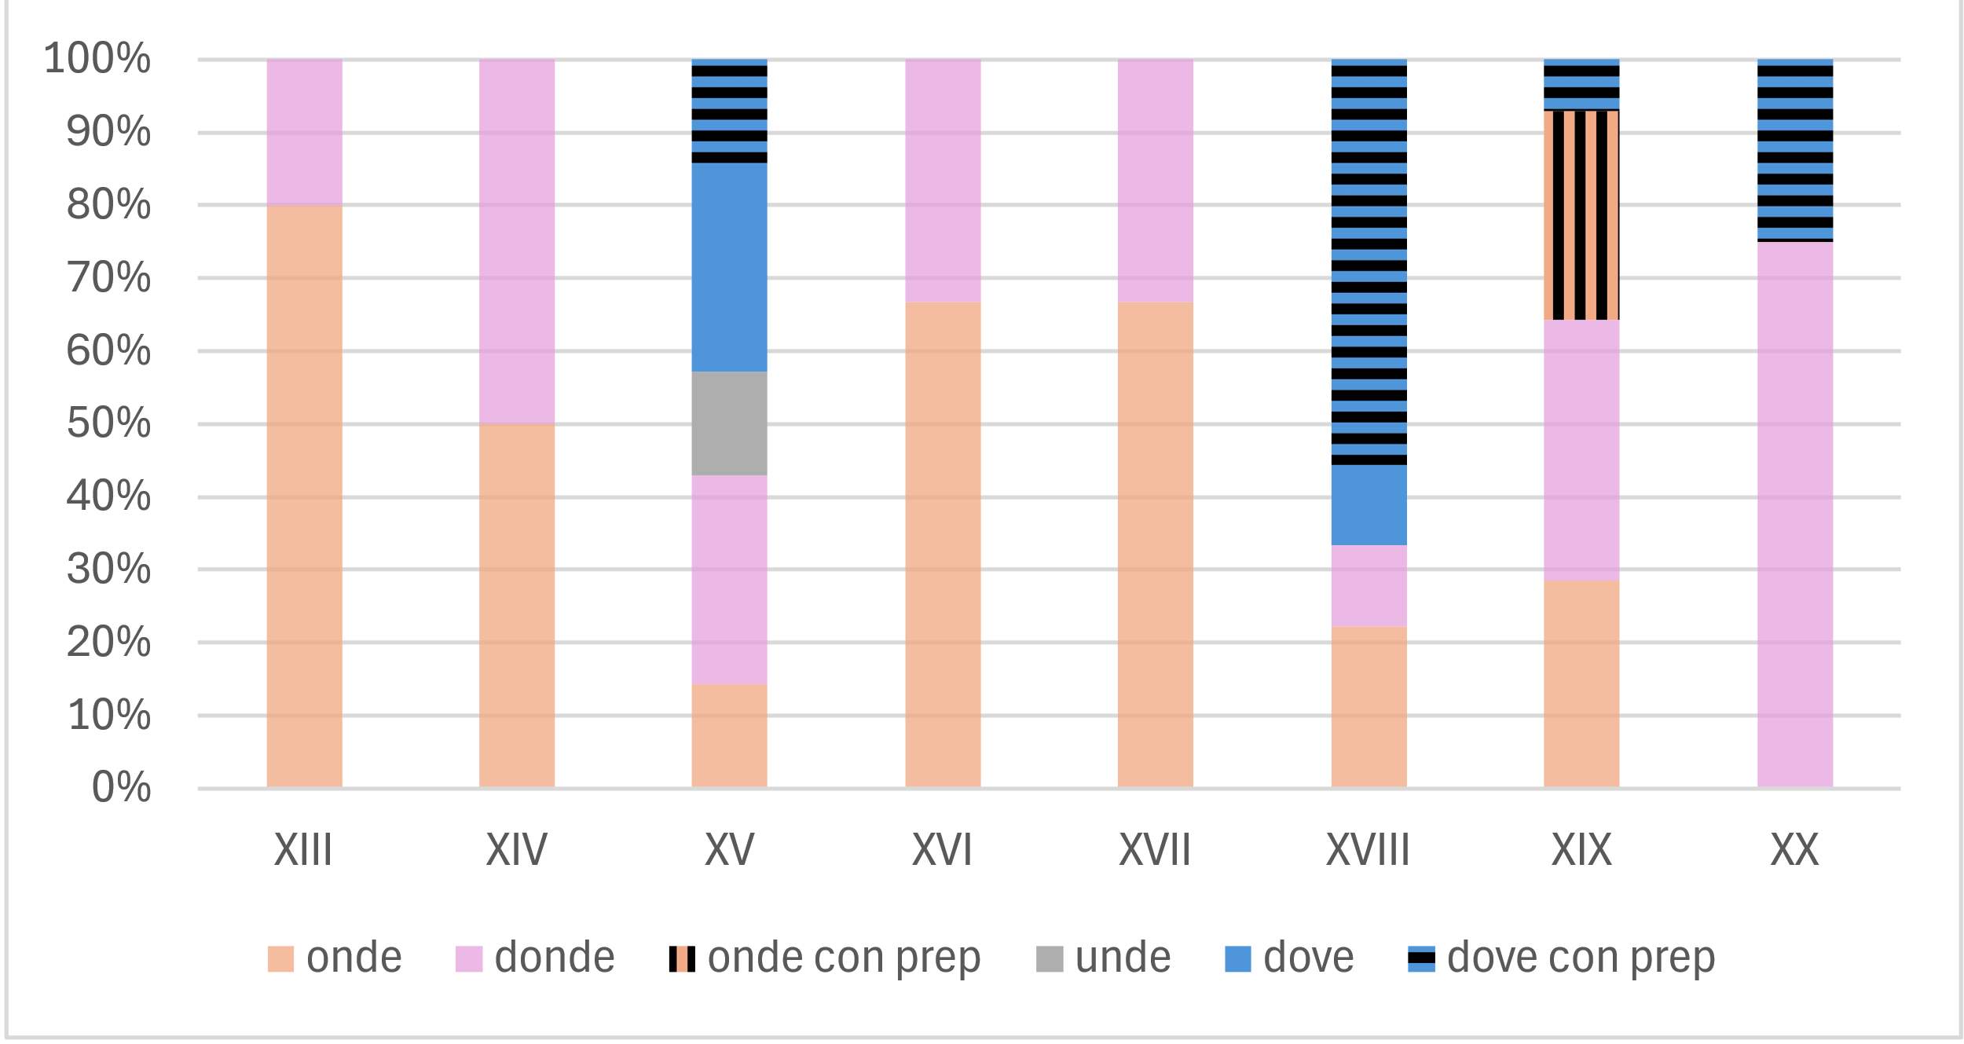
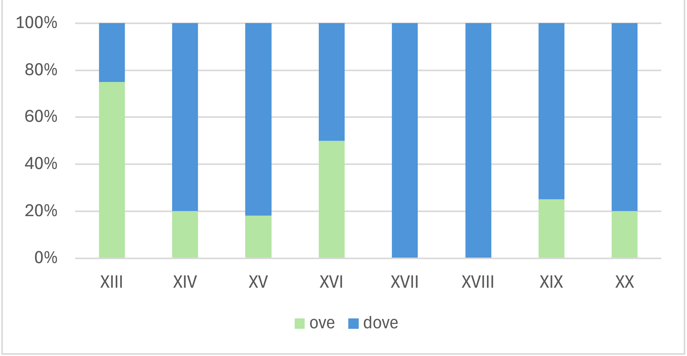
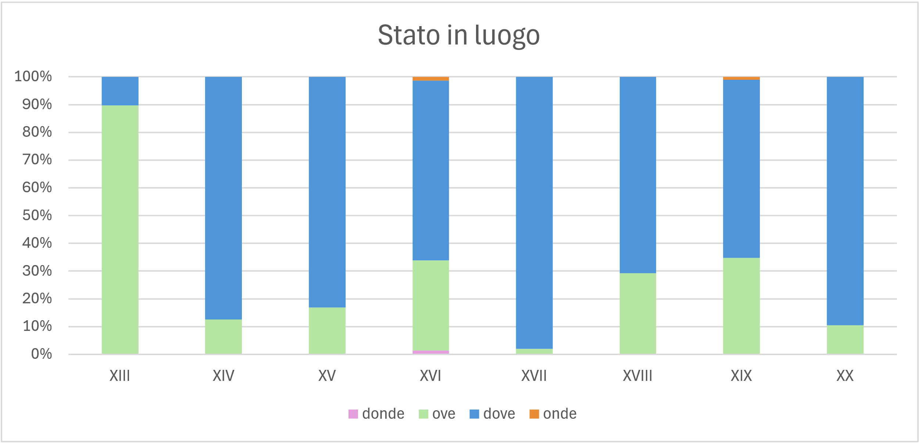
Chronology of competition: the domain of space
Source
Goal
Location
•The source is the most unstable area: inherited forms (onde, donde) are replaced by the transparent periphrasis da dove (with archaic returns in the 19th and 20th centuries).
•For location/goal, the sample data suggest a fast replacement: ove declines as early as the 14th century, replaced by dove, but reappears in the modern age as an archaism.
•The chronology of the replacement of ove > dove requires an analysis of the entire corpus.

Slide 43
Syntactic relations and the accessibility hierarchy
 | SUBJ | OBJ | IND_OBJ | OBL_OTHER | OBL_SP | GEN | OBJ_COMP |  | [CONCERN]
unde | - | - | - | + | + | + | - |  | -
donde, onde | - | - | - | + | + | - | - |  | -
ubi | + | ? | - | + | + | + | - |  | +
dove, ove | - | - | + | + | + | - | - |  | +

Slide 44
Dove: diachronic trends?
In the diachrony of dove:
we do not observe a clear expansion of non-spatial usages (if anything, concern seems to be decreasing!).
Non-standard contemporary usages are not recent innovations, but have been present since earlier stages!

Slide 45
Summary: the distribution of locative relative markers
semantic polyfunctionality
syntactic polyfunctionality
unde & onde
ubi & dove
Topic vs. concern
ubi/dove location > concern
unde/onde source > topic (e.g., De, Väänänen 1956: 10, Luraghi 2010)
What is the relation between the two functions? Independence or interference?

Slide 46
Dove: an instance of grammaticalization?
Is the development of dove a case of grammaticalization?
Grammaticalization = loss of autonomy (es. Lehmann 2016)
loss of semantic integrity : dove weakens its tie with the spatial domain;
loss of paradigmatic variability: ove/dove/onde/donde → dove/da dove.
Grammaticalization = expansion (es. Himmelman 2004)
host-class expansion: expansion to new head types (e.g., abstract, human);
syntactic expansion: expansion to new syntactic contexts (concern, gen, obj, subj);
semantic-pragmatic expansion: expansion to new discourse contexts.

Slide 47
Contents
Introduction
Relative clauses
Why dove?
Data and methods
Corpora, extraction, annotation
Analysis
Frequency distribution, semantic extension
A case of grammaticalization?
Conclusions

Slide 48
Problems and open questiosn
The study of the diachrony of relative locatives between Late Latin and Italian raises numerous questions that remain unanswered:
bad data: despite having a large amount of data available, it is not possible to trace a precise chronological path: the ‘leap’ from relative locative to concern has been documented since the earliest stages!
corpora: the Latin and Italian corpora investigated, in addition to being heterogeneous in terms of text type, are not in direct historical continuity and are therefore not easily comparable!
interference: what is the role of competition/interference between forms in the same domain in the processes of grammaticalization?
competition: why does dove win the competition?

Slide 49
Thanks!
Questions?
Silvia Ballarè (University of Bologna),
Luisa Brucale (University of Palermo) and
Guglielmo Inglese (University of Torino)
RoLinC
10 March 2026

