Slide 1



Language change, leveling and koineization in Piedmontese dialects
Alessandro Flecchia - alessandro.flecchia@unito.it
Università di Torino - Dottorato in Lettere
LMU München - Class of Language
Tutor: prof. Riccardo Regis, prof.ssa Tania Paciaroni
RoLinc, 17th February 2026

Slide 2
Structure of the talk
The ALPiOra project and the contact setting in Piedmont
Qualitative analysis: dialect leveling and Italianization of the dialects
Quantitative analysis of the questionnaire

Slide 3
1. The ALPiOra project and the contact setting in Piedmont
Main goals of the project:
To update the data currently available on selected Piedmontese varieties, highlighting the processes of change that have affected them.
Within the dynamics of language change, to assess the role of language contact, both vertical (with Italian) and horizontal (with other Piedmontese varieties).
In relation to II, to explore the possibility that Piedmontese dialects are undergoing processes of leveling and/or koineization.
To create a corpus of spoken data for Piedmontese dialects → ALPiOra (Archivio Linguistico del Piemontese Orale [Linguistic Archive of Spoken Piedmontese]).
To evaluate the internal and external vitality of the dialects of the region.

Slide 4
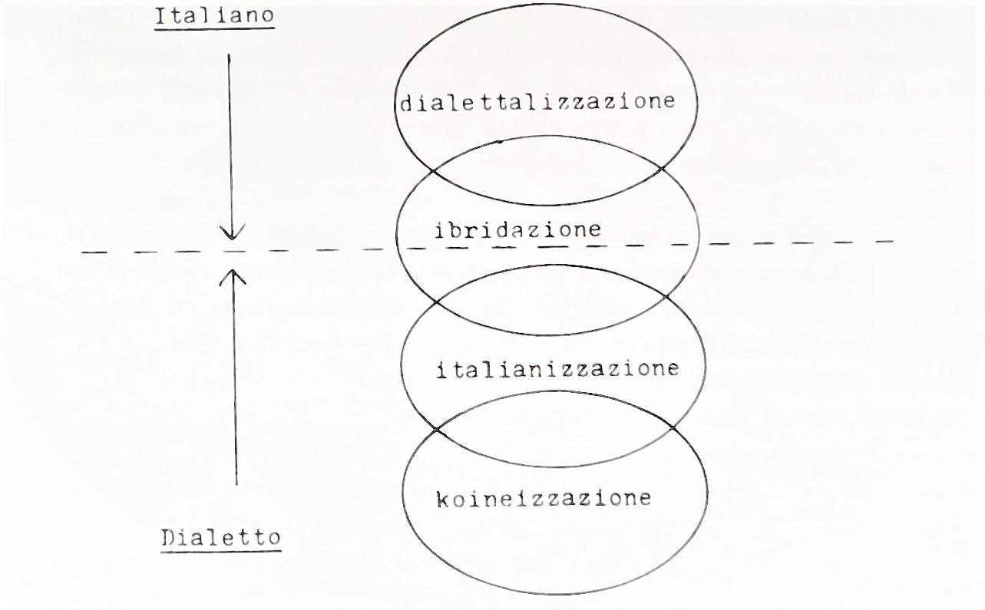
1.1. «Horizontal» and «vertical» contact
The process through which Italian dialects are gradually reducing their structural distance between Italian, under all the levels of analysis (Ricca 2010; Scivoletto 2014; Cerruti 2016; Cerruti/Regis 2020, Flecchia 2022).
«Secondary koineization» (Regis 2011): the diffusion of a prestigious variety (or at least of some of its features) following the centre-periphery direction. The concept is specular to that of dialect leveling, in that the latter represents the result of the process («the eradication of marked linguistic features»; Britain 2018: 149).
Berruto (1989: 109): Italian-dialect contact area.

Slide 5
1.1. «Horizontal» and «vertical» contact
This contact area is clearly linked to the peculiar community repertoire of the Italian peninsula, which is characterized by what Barruto (1987) called dilalia: «sono presenti due lingue strutturalmente diverse, A e B, che non hanno entrambe carattere sia di Abstandsprache che di Ausbausprache (soltanto A è anche lingua per elaborazione), e vi è una chiara distinzione funzionale tra A, destinata agli usi ‘alti’, e B, destinata agli usi ‘bassi’. Diversamente dalla diglossia, però, pur essendo indubbia la differenziazione funzionale delle due lingue, questa non è compartimentata nel modo rigido della diglossia: esistono domini in cui sono usate o accettate paritariamente entrambe le lingue; in particolare, sia A sia B sono impiegate nella conversazione ordinaria»
[there are two structurally different languages, A and B, which do not both possess the status od Abstandsprache and Ausbausprache (only A is an Ausbausprache), and there is a clear functional differentiation between A, employed in ‘high’ contexts, and B, employed for ‘low’ ones. Contrary to diglossia, however, the functional differentiation between the two languages does not bring to a rigid compartimentation; in particular, both A and B are used in everyday conversation]
(Berruto/Cerruti 2015: 89).

Slide 6
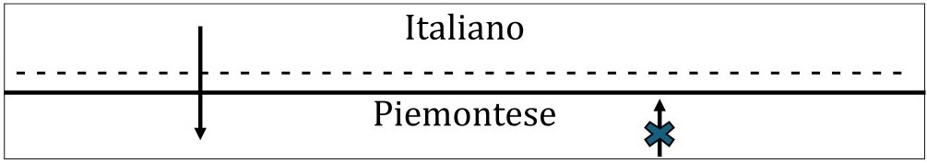
1.1. «Horizontal» and «vertical» contact
Piedmontese linguistic repertoire (adapted from Regis 2019)

Slide 7
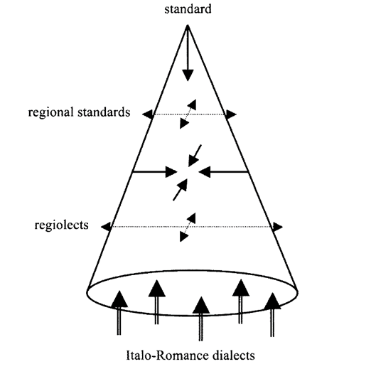
«The continuum of intermediate varieties between the base dialects and the standard is actually composed of two separate (sub)continua: the dialect continuum and the Italian continuum, each displaying intermediate varieties. For example, in the dialect continuum we can single out the so-called dialetto italianizzato ‘Italianized dialect,’ resulting from a long-term process of “Italianization of the dialects” […] from a process of “dialectization of (varieties of) Italian”».
(Cerruti/Regis 2014: 90-91).
Cerruti/Regis (2014: 92).

Slide 8
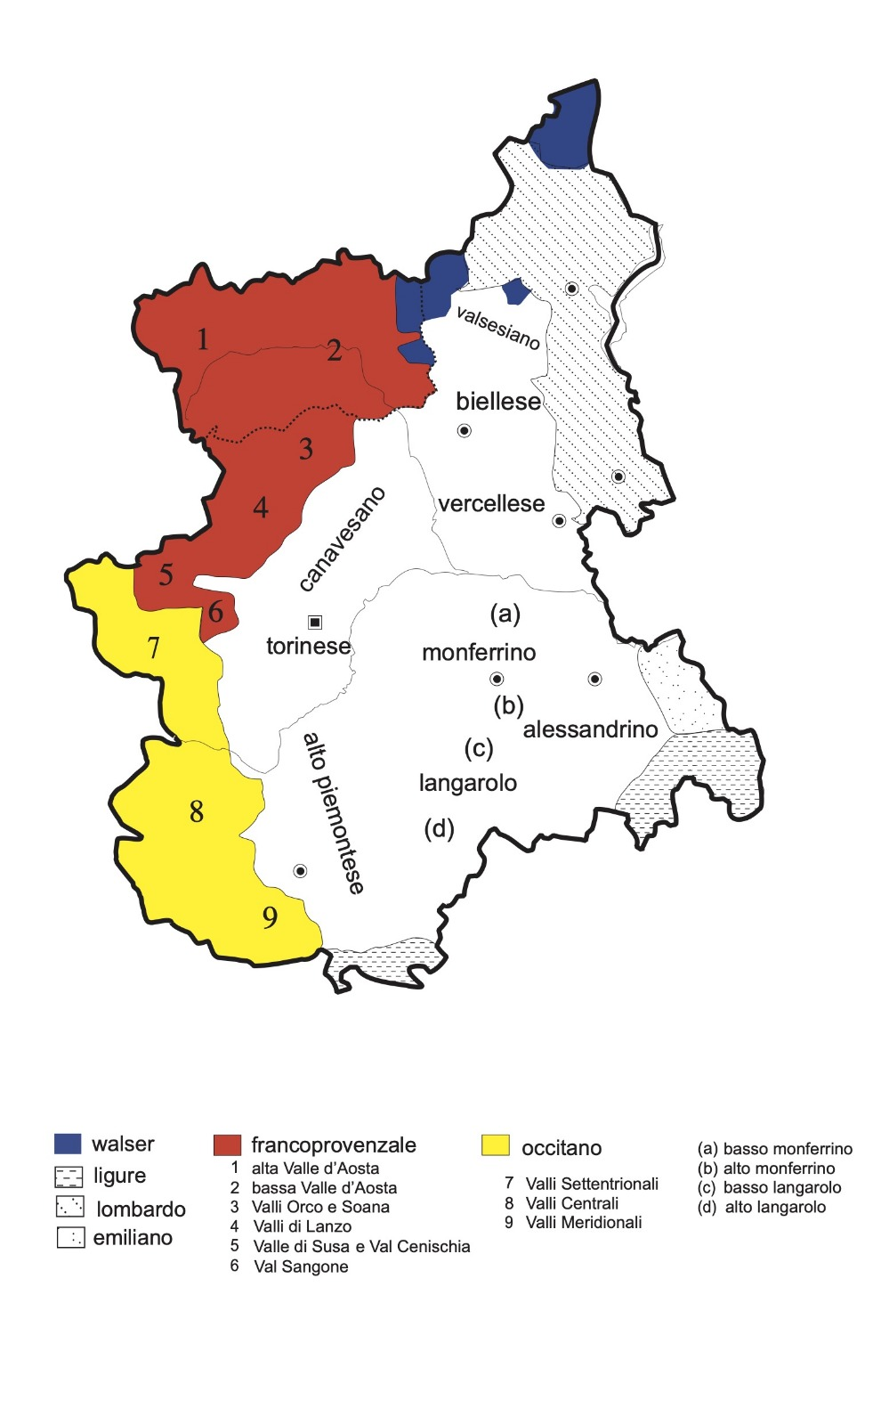
1.2. Survey points and Piedmontese dialectal subgroups
Berruto (1974): Turinese, 4 «varieties of Piedmontese» (canavese, biellese, langarolo-monferrino and alto-piemontese) and 2 intermediate areas (vercellese and alessandrino).
Telmon (2001), Regis/Rivoira (2023): 9 subgroups (torinese, alto-piemontese, canavesano, biellese, vercellese, valsesiano, alessandrino, monferrino e langarolo).
Tosco/Miola/Duberti (2023): 15 sub-varieties belonging to 3 bigger groups, and 9 «transitional varieties» with Lombard, Ligurian and Emilian.
Regis/Rivoira (2023: 12)

Slide 9
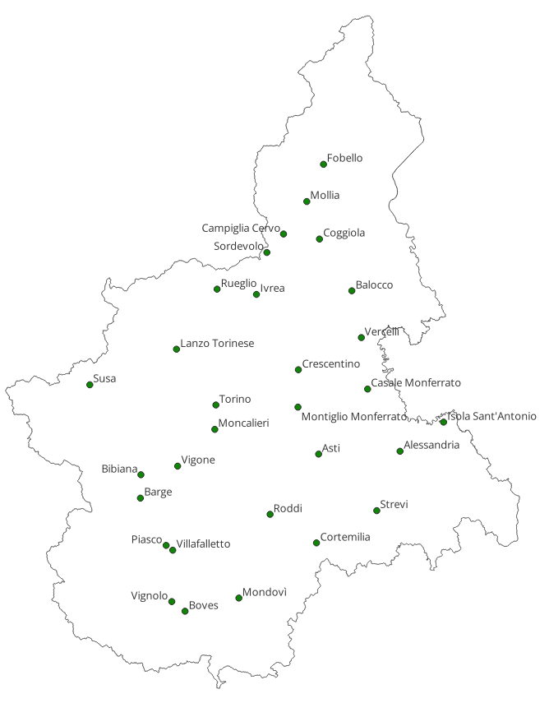
Biellese: Campiglia Cervo, Coggiola, Sordevolo;
Vercellese: Balocco, Crescentino, Vercelli;
Valsesiano: Fobello, Mollia;
Canavese: Ivrea, Lanzo Torinese, Rueglio;
Turinese: Moncalieri, Susa, Torino;
Monferrino: Asti, Casale Monferrato, Montiglio;
Langarolo: Cortemilia, Mondovì, Roddi;
Alessandrino: Alessandria, Isola Sant’Antonio, Strevi;
High-Piedmontese: Barge, Bibiana, Boves, Piasco, Vignolo, Vigone, Villafalletto.
AIS points
ALI points
ALEPO points
Points with no preceding surveys
This assures a diachronic comparison, in order to study language change

Slide 10

1.3. Data collection
4 informants for each point, polarized for age and sex (under 45 and over 70).
This has not always been possible in the cities.
A sociolinguistic questionnaire
A translation task made up of 40 sentences of morphological and syntactic interest.
A semi-structured interview. Quite often the interviews were conducted with more than one people, making them even more interesting.
Cortemilia (CN)

Slide 11
2. Qualitative analysis: dialect leveling and Italianization of the dialects
Dialect leveling: «the eradication of marked linguistic features, marked (a) in the sense of being in a minority in the ambient feature pool after the contact “event,” (b) in the sense of being over(t)ly stereotyped, or (c) marked in the sense of being found rarely in the world’s languages and/or learned late in child language acquisition» (Britain 2018: 149; also see Britain 2013, Kerswill and Williams 2000).
The case of Piedmontese dialects is peculiar, because the dialects in contact belong to the same sub-group and are very close to each others. The result of ‘canonical’ leveling is the birth of a new variety (cf. Trudgill 2004): in the case of Piedmont, for now what we can observe is a reduction of internal differentiations due to the loss of locally marked features (see Ferrarotti/Flecchia forth.).

Slide 12
2.1. Phonetic leveling through dialect contact
It is often the case that a rural dialect lost some of its features, substituting them with the corrispondent variants from urban centres:
Lat. ŏ > [ye], [e] > [ø]: [fyˈek] > [føk] ‘fire’ (Fobello, Valsesia, VC)
[fe] > [fø] ‘fire’ (Campiglia Cervo, BI)
[be] > [bø] ‘ox’ (Campiglia Cervo, BI)
[edʒːo] > [øtʃ] ‘eye’ (Campiglia Cervo, BI)
The examples show a re-orientation of these varieties toward the phonetic of urban centres. It was often the case that a variant spread in the local system following the gravitational model in Chambers/Trudgill (1998): from the biggest urban centres (e.g., Turin) to smaller ones (e.g., Biella and Borgosesia), and finally from them to the rural villages.

Slide 13
2.1. Phonetic leveling through dialect contact
Strevi (AL), in the South of the region, followed a different pathway. The original outcome was here [ø], like in Turin and in Acqui Terme, which once represented the urban centre toward which Strevi was oriented for commercial activities (see Tagliacarne 1973).
The major centre of the area is Alessandria, which growing importance caused the penetration in the dialect of Strevi of the outcome [o]: [fø] > [fo] ‘fire’, [bø] > [bo] ‘ox’.
This claims for a major ‘independence’ of this area from the influence of Turin. In fact, some other features are retained (cf. infra).

Slide 14
2.1. Phonetic leveling through dialect contact
Loss of palatal plosives [c] e [ɟ] in the dialect of Coggiola (BI), in the North of the region. They were the outcomes of Latin -ct-, cl- and -cl-, gl- respectively:
lactem > [lac] ‘milk’, clavem > [caf] ‘key’
auric(u)lam > [uˈrəɟːa] ‘ear’, glarea > [ˈɟera] ‘gravel’
Contemporary Coggiolese in the same contexts manifests [tʃ] e [dʒ], which represents the outcomes common in the variety of Biella, the urban centre toward which Coggiola now gravitates: [latʃ] ‘milk’, [uˈrədʒa] ‘ear’ (Ferrarotti/Flecchia, forth.). In the past, Coggiola was more similar to the dialect of the neibouring Valsesia, and still shares with them some features, e.g. the selection of to be as the only possible auxiliary verb.

Slide 15
2.1. Phonetic leveling through dialect contact
Most of Northern Italian dialects does not present a distinction between the outcomes of ᴄ, ɢ + ᴇ, ɪ in strong position with those of *ᴛᴊ and *ᴅᴊ: ᴄᴇɴᴀᴍ > [tsena] ‘dinner', *ᴀᴅᴍᴀᴛᴛɪᴀʀᴇ > [maˈtse] ‘to kill’ (with the subsequtn spirantization of /ts/ and /dz/ in /s/ and /z/).
An area encompassing Western Lombard, Valsesia and Biella does not show this fusion: these dialects deaffricate /tʃ/ and /dʒ/ in /ʃ/ e /z/: ᴄᴇɴᴀᴍ > [ˈʃena] 'cena', ɢᴇʟᴜᴍ > [ʒel] 'gelo'.

Slide 16
CL, CT
C + E,I
-CL-, GL
J-
G + E,I
*tj
*dj
kj
it
gj
ɟ
Mainstream dialects (Biella, Milan etc.)
c
ɟ
Valsessera, Valsesia
1
tʃ
1
dʒ
2
2
ts
dz
The extended data from the Biella area show that a drag chain process was at play
1) /t͡ʃ/ /d͡ʒ/ deaffricate into /ʃ/ /ʒ/
2) /c/ /ɟ/ can move forward to /t͡ʃ/ /d͡ʒ/
Some dialects of the Biella area show the intermediate phase /ʃ/ /ʒ/ and /c/ /ɟ/
Hints about a more general historical process that has to be happened on a wider area
ʃ
Ʒ
The contemporary Valsesia dialects and Coggiola take another path: /c/ /ɟ/ are merged to /t͡ʃ/ and /d͡ʒ/, which are not deaffricated
The overextension found in several places could mean hypercorrection in a first stage of the loss of these sounds
s
z

Slide 17
2.2. Morphological leveling
In the Canavesano variety of Lanzo Torinese (TO), secondarykoineization is evident in the loss of the traditional endings in the Ipl and IIIpl: -[aŋ]/-[eŋ], which were substituted by -[ˈuma] and -[u] (Cf. Telmon 2001 torinesizzazione ‘Turinesization’).
ALI data (‘30s):
1092 [ˈnduma ˈdrømi] ‘we go sleeping’, 1387 [i ˈfuma laˈmur] ‘we make love’
1764 [i ˈsɛrku] ‘they look for’, 1765 [i ˈtrovu] ‘they find’
Carta dei Dialetti Italiani (CDI), ‘60s:
[ˈteɲaŋ] ‘teniamo/tengono’,
[ˈpjuraŋ] ‘piangiamo/piangono’.

Slide 18
2.2. Morphological leveling
Nowadays, we only find these endings in the IIIpl, and only in speakers from the rural hamlets of Lanzo, which, however, alternate with -[u]:
[a ˈvøleŋ] ‘they want’, [am ˈpi̯azeŋ] ‘they please me’
vs
[a preˈtendu] ‘they demand’, [a ˈparlu] ‘they speak’.
Canavesan endings are maintained in the rural dialect of Rueglio (TO), which is much more isolated and independent from Turin from a commercial point of view:
[i aŋ] ‘we have’, [i vaŋ] ‘we go’
[a ˈseraŋ] ‘they were’, [i l ˈaveŋ] ‘they had’

Slide 19
2.2. Morphological leveling
 | ’30s (ALI) | ’60s (CDI) | Today (ALPiOra)
Lanzo (city centre) | -oma ; -u | -an / -en ; -an | -oma ; -u
Lanzo hamlets | nd | nd | -oma; -u / -en

Slide 20
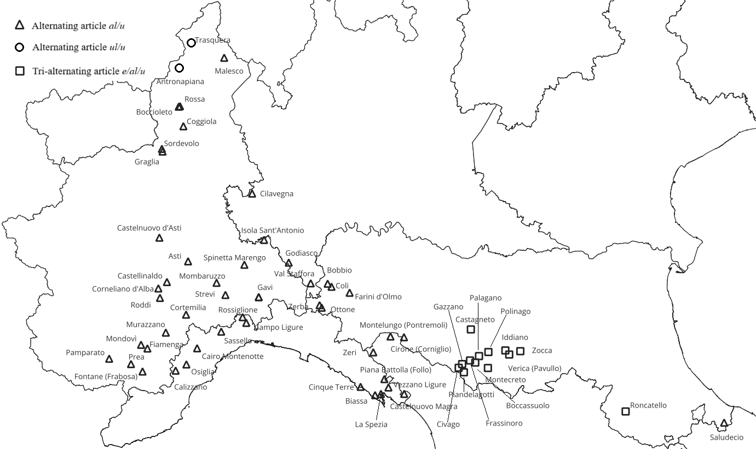
2.2.1. Morphological leveling: the alternating paradigm of the definite article
Two allomorphs for the definite article in some Northern Italian dialects: [u] _C [+coronal] vs [al]/[əl] _C [-coronal]
Ferrarotti/Flecchia (forth.)

Slide 21
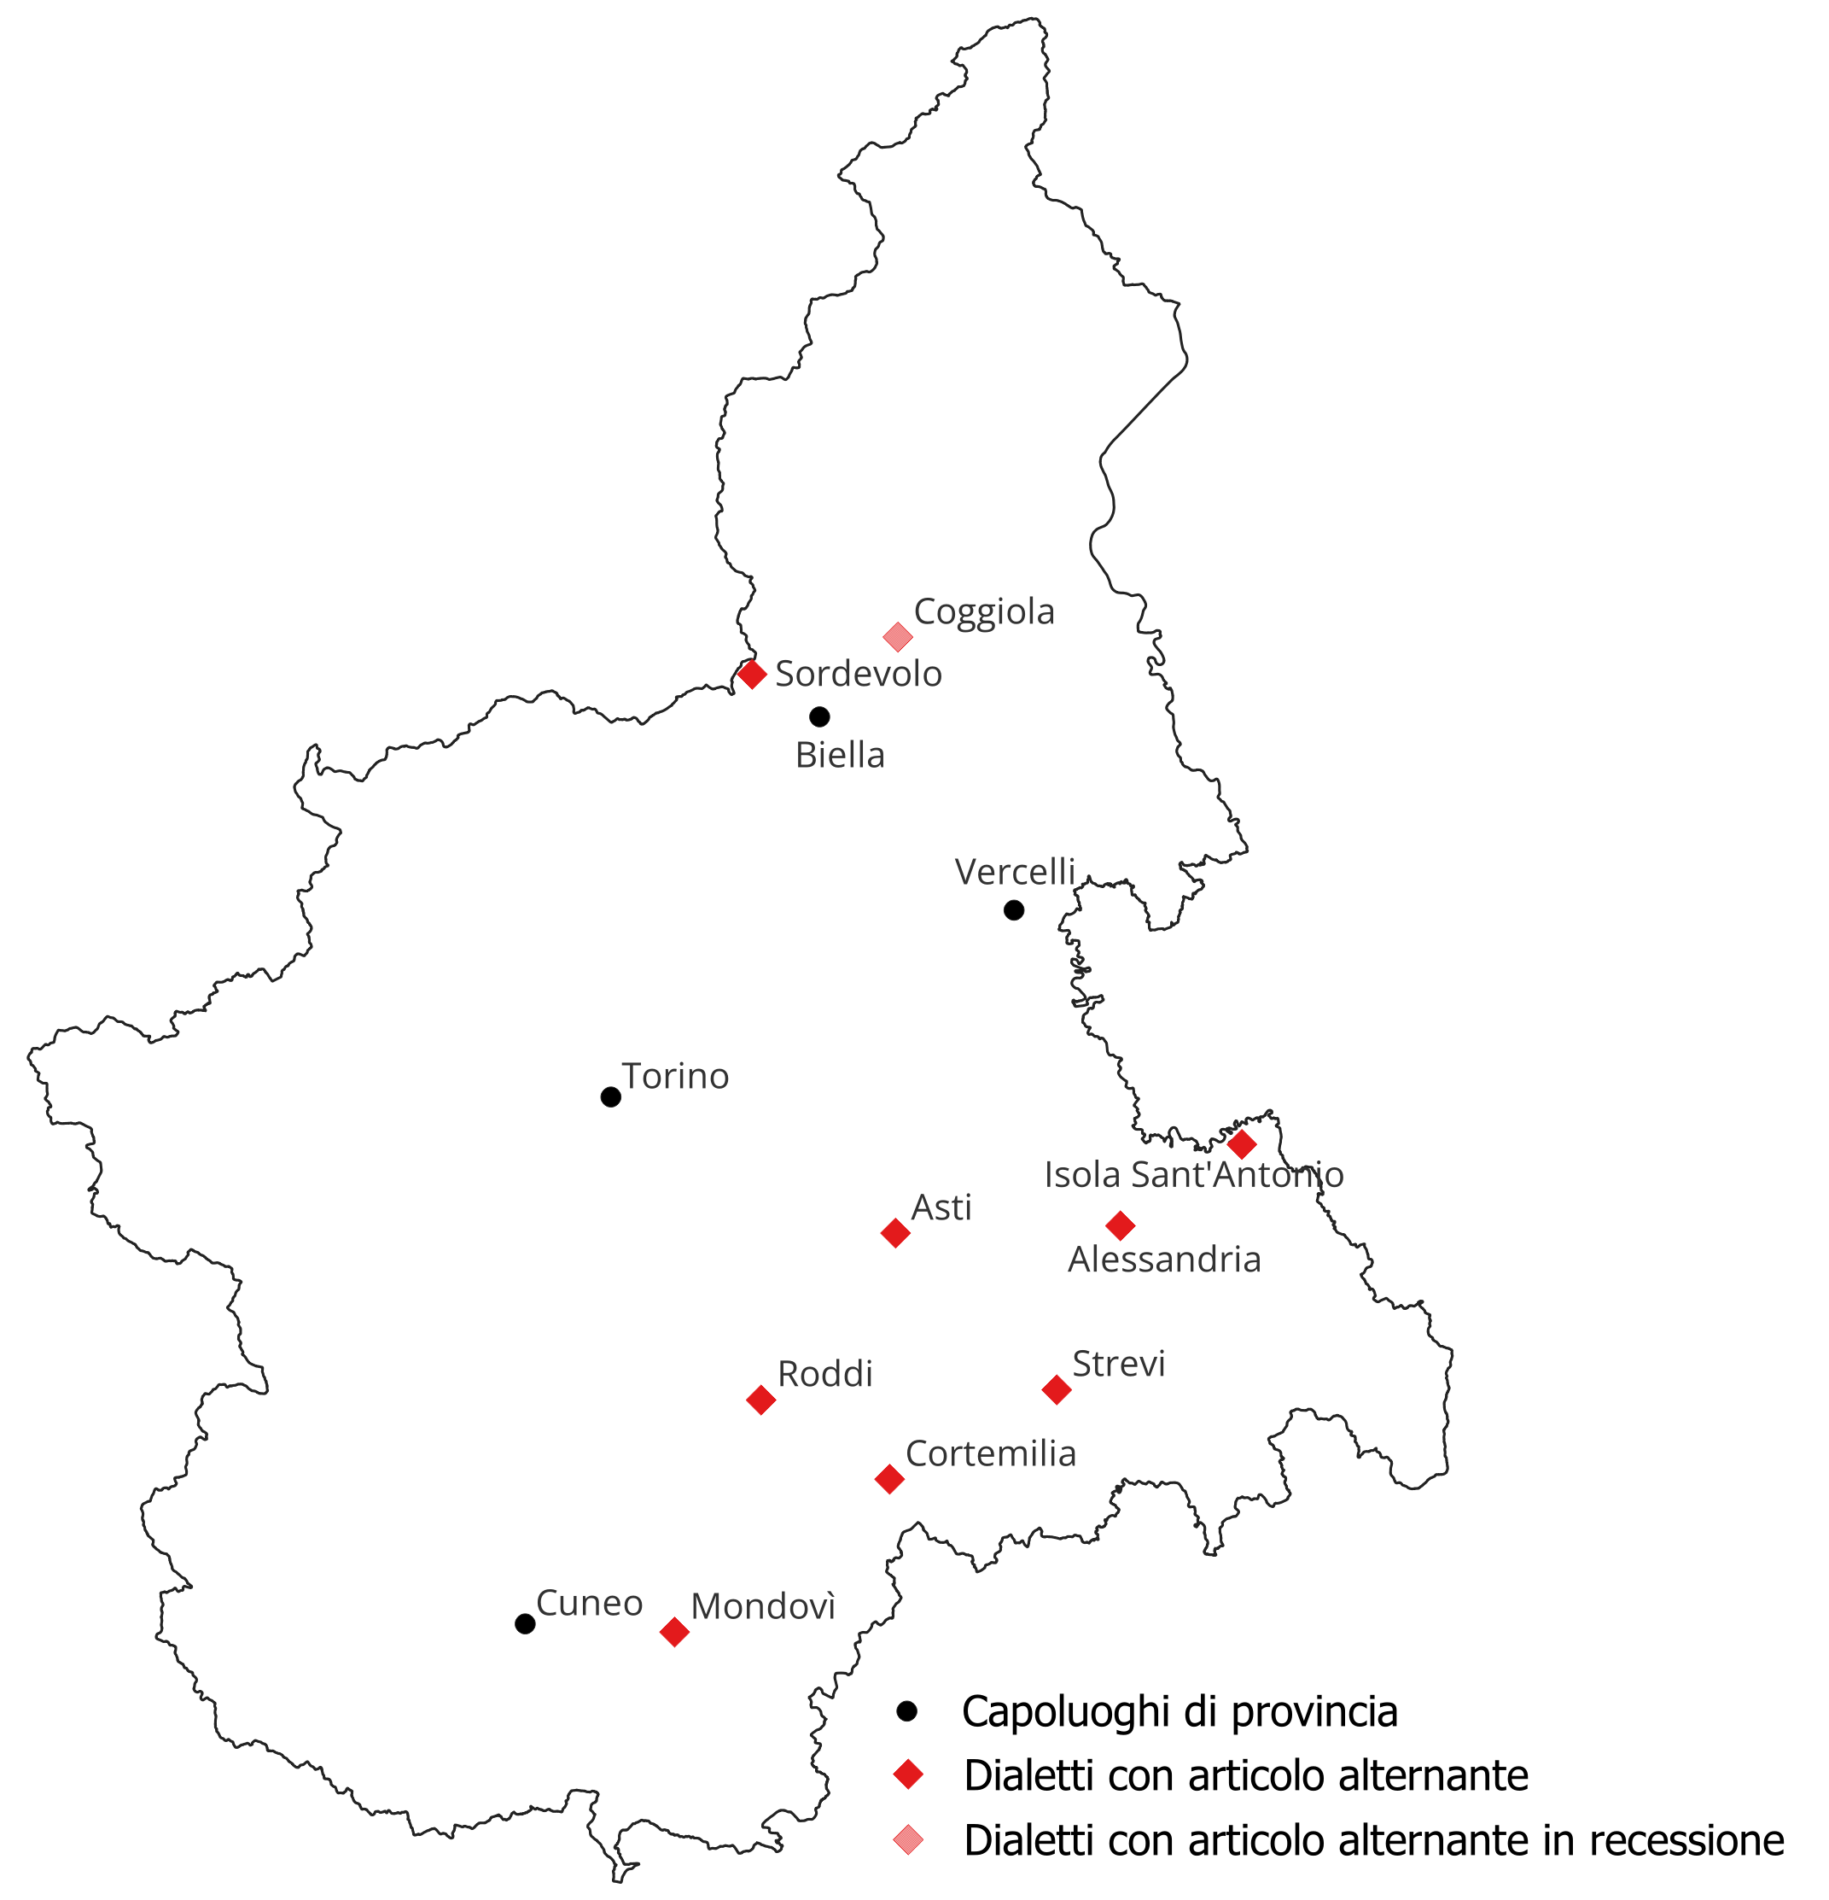
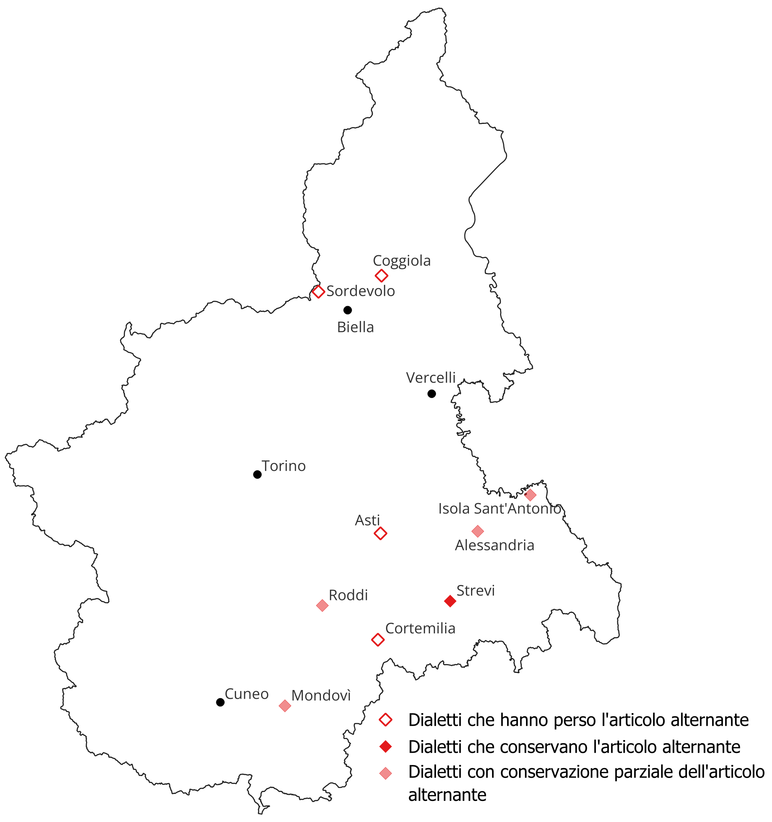
Language change in Piedmont: leveling of the alternation (→ marked feature)

Slide 22
2.3. Italianization and leveling
An important phenomenon involving dialect leveling is what we can call ‘upward leveling’, i.e. the Italianization process. Gradually reducing their distance from Italian, Piedmontese dialects are also becoming more and more similar to each other.
Italianization is mostly evident in morphology, syntax and semantics.
[la kau̯t] ‘the heath.F’ > [əl kau̯t] ‘the heath.M’
[la frei̯d] ‘the cold.F’ > [əl frei̯d] ‘the cold.M’
(Lanzo Torinese, Canavese, TO)
This is an example of semantic change fueled by Italian.

Slide 23
2.3.1. Italianization in morphology
Introduction of new inflectional paradigms: masculine nouns in -[o]/-[o] (or -[i]): they are loanwords from Italian, e.g. tren[o], frig[o] and semafor[o].
Inflectional classes in Piedmontese:
Feminine:
-a / -e (o -i): bota/bote ‘bottiglia/e’
-a / -a: strà ‘strada/e’
Masculine:
Invariable (-C): bicér ‘bicchiere/i’
Invariable (-[u]): asu ‘asino/i’
-al / -aj: caval/cavaj ‘cavallo/i’
invariable (in -[o]): treno ‘treno/i’
-o / -i: treno/treni
(Italianized)

Slide 24
Changes of inflectional classes: la caud, la frèid ‘la caldo, la freddo’ > al caud, al frèid ‘il caldo, il freddo’.
Loss of morphological categories: loss of metaphonic plurals. This phenomenon probably started as an effect of dialect contact, since urban varieties do not possess metaphony. Italian probably worked as a reinforcement (contact-induced stability, Kühl/Braunmüller 2014).
 | Singular | Plural
Italian | can-e | can-i
Urban Piedmontese | [kaŋ] | [kaŋ]
Rural Piedmontese | [kaŋ] | [keŋ]

Slide 25
2.3.3. Italianization in syntax
Existentials and presentatives: alongside the traditional structures lacking agreement between the verb and the postposed subject, there is also an Italian-based calque featuring plural agreement, with or without a postverbal locative clitic in compound tenses (see (4) vs (5); cfr. Bentley/Ciconte 2024):
(1) A j’ è di cassiëtte vërde ant l’armare.
sbj.3sg loc to be.prs.3sg some green boxes in the cabinet.
(2) A ij son di cassiëtte vërde ant l’armare.
sbj.3pl loc to be.prs.3pl some green boxes in the cabinet.
‘There are some green boxes in the cabinet’

Slide 26
(3) A l’ è riva=je di can e di gat ant la stra.
sbj.3sg to be.prs.3sg to arrive.inf=loc some dogs and cats in the street
(4) A son riva=je di can e di gat ant la stra.
sbj.3pl to be.prs.3pl to arrive.inf=loc some dogs and cats in the street
(5) A son rivà=Ø di can e di gat ant la stra.
cls.3pl to be.prs.3pl to arrive.inf=Ø some dogs and cats in the street
‘Some dogs and cats arrived in the street’

Slide 27
3. Quantitative analysis of the questionnaire
Comparison between the questionnaire of ALPiOra and those of ALI, AIS and ALEPO, and creation of a list of 39 shared words.
Working with IPA transcriptions of the wordlist for the 28 points shered by linguistic atlases and ALPiOra, I developed a dialectometric analysis using the software GabMap (Nerbonne et al. 2011).
Then I calculated the Cophenetic Correlation (Nerbonne et al. 2011) and the Aggregate Dialect Distances (Nerbonne 2006, 2009). For now, the comparison was made between data in the atlases and data gathered from older male informants for the ALPiOra (which are expected to be the most conservative ones).

Slide 28
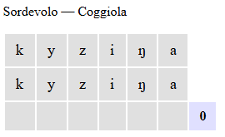
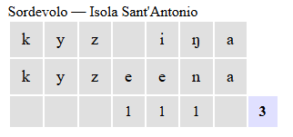
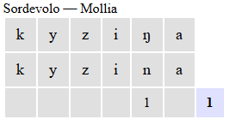
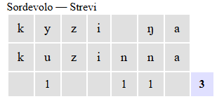
3.1. Clustering and cophenetic correlation
String edit distance (Levensthtein distance): minimum number of operations (insertion, cancellation or substitution) needed to ‘transform’ the first word into the second one (Nerbonne et al. 2019). Each operation counts as one. Distances are then normalized by dividing the total number of operation for the maximum lenght (in number of sounds) of the longest word in each couple, obtaining a number between 0 and 1. Finally, for each couple of places the medium of the distances from all words in the list is calculated.

Slide 29
3.1. Clustering and cophenetic correlation
Here some examples of the kind of language changes detected by the method:
‘Fire’: [fyˈek] > [føk] (Fobello, Valsesia, VC) → leveling phonetic change
‘Twins’: [buˈsyỹ] > [dʒemej] (Rueglio, Canavese, TO) → lexical Italianizing change
‘Cats’: [gɛt] > [gat] (Campiglia Cervo, Biellese, BI) → leveling morphonological change
Notes:
In altre parole, ci dice con quanta affidabilità il dendrogramma preserva le distanze originali fra i punti.

Slide 30
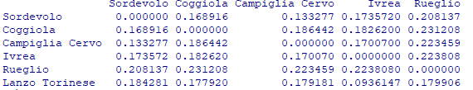
3.1. Clustering and cophenetic correlation
In this table we can see the mean distances between some of the dialects in the ALPiOra corpus. They show the degree of internal differentiation between them (Nerbonne 2006, 2009).
On the basis of the distances between each pair of dialects, it is possible to perform hierarchical clustering, transforming the distance matrices into a tree graph that represents the similarity relationships among the varieties. The procedure begins by treating each variety as an independent cluster and then progressively merging, pair by pair, the most similar clusters (i.e., those with the smallest dialect distance).

Slide 31
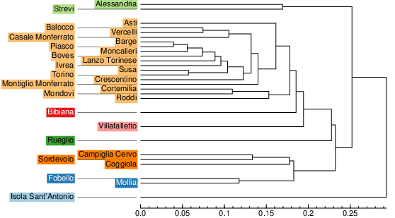
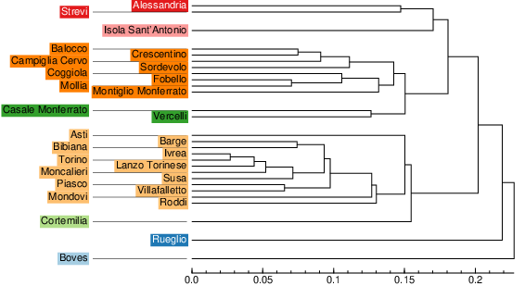
3.1. Clustering and cophenetic correlation
Atlases data
ALPiOra
Cophenetic correlation: 0, 833233 (p < 0,001)
Cophenetic correlation: 0, 70473 (p < 0,001)

Slide 32
3.1. Clustering and cophenetic correlation
Cophenetic correlation mesures the internal coherence between the original distances and the structure of the dendrogram (Nerbonne et al. 2011).
There is a marked decrease between historical and contemporary data (0.833 → 0.705). This suggests that the dialectal structure, which appeared clearly delineated in the 1930s, has since become less robust and less hierarchically structured.
This claims for an ongoing dialect leveling process, which leads to a decresing of internal differentiation between the varieties as a whole. If we plot aggregate dialect distances on a boxplot, the result is the same.
Notes:
In altre parole, ci dice con quanta affidabilità il dendrogramma preserva le distanze originali fra i punti.

Slide 33
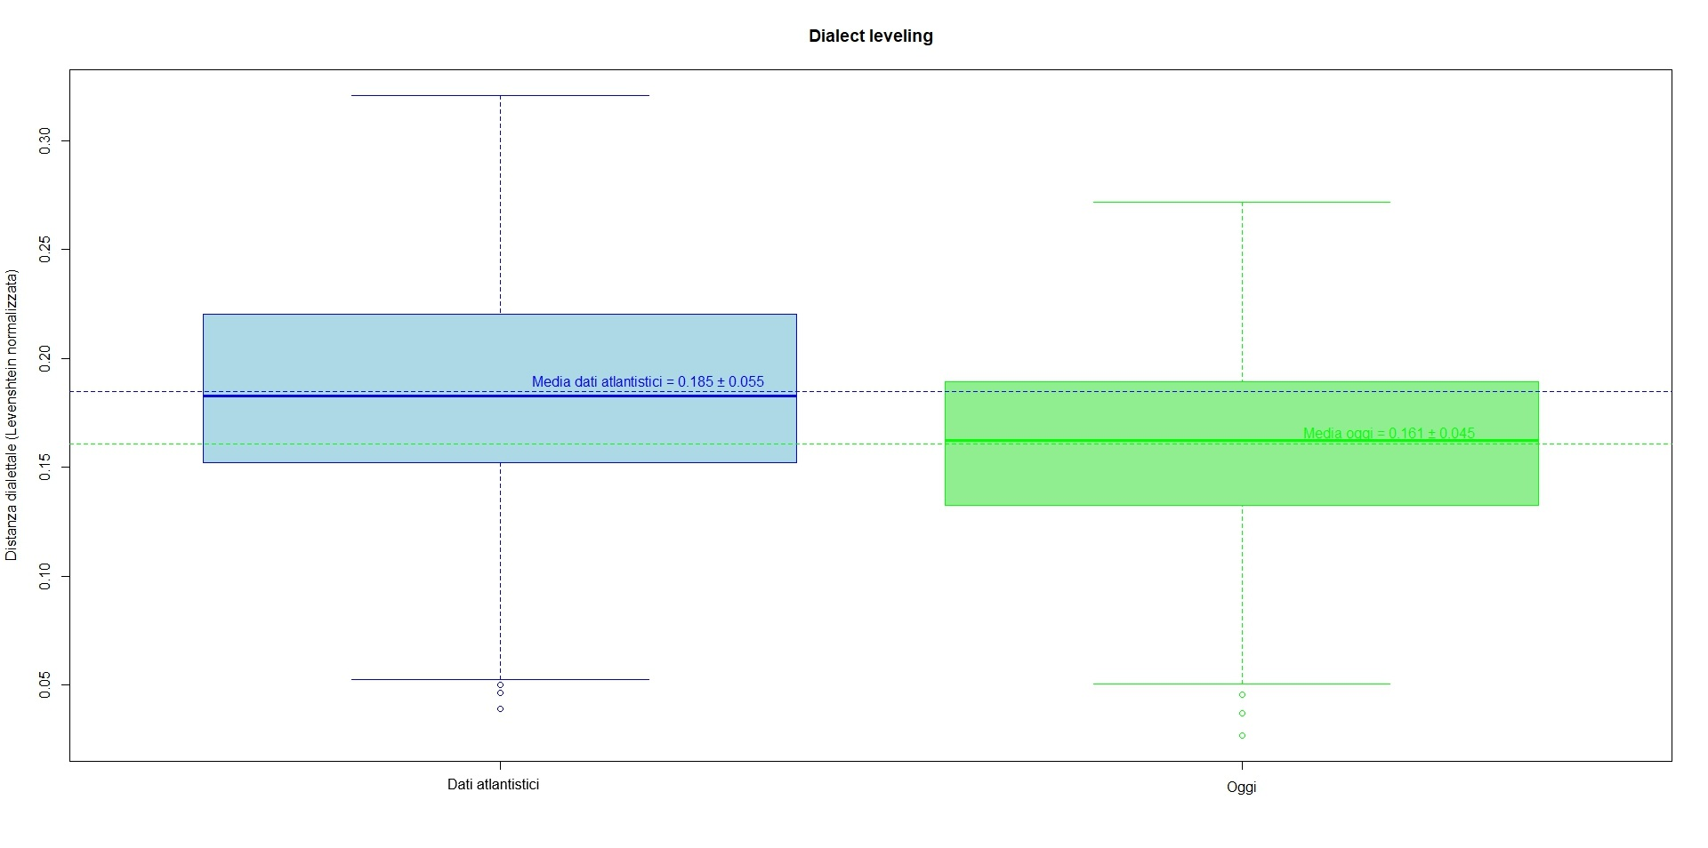
3.2. Aggregate Dialect Distances
Welch Two Sample t-test
data: vals_1930 and vals_today
t = 6.6055, df = 726.59, p-value = 3.827e-11
Notes:
I boxplot visualizzano la distribuzione delle distanze Levenshtein normalizzate tra tutte le coppie di punti d’indagine.
La media (aggregate dialect distance) riflette la divergenza complessiva del sistema. La linea tratteggiata segna la distanza media complessiva: negli anni ’30 era più alta, oggi è più bassa.
Questo significa che le varietà si sono avvicinate — un chiaro segno di livellamento dialettale.

Slide 34
3.2. Aggregate Dialect Distances
The boxplot shows the distribution of normalized Levenshtein distances between the couples of survey points. The higher the box, the greater the distances.
The mean (→ aggregate dialect distance) of each ‘box’ reflects the overall divergence in the system. By comparing these means, we see that the mean distance was higher in the past than nowadays. That difference is statistically significant.
Notes:
In altre parole, ci dice con quanta affidabilità il dendrogramma preserva le distanze originali fra i punti.

Slide 35
Conclusions
Piedmontese dialects have undergone a leveling process of linguistic change, driven both by “classical” dynamics of dialect contact and by vertical contact with Italian. More specifically, Italianization appears to be most evident in morphology and syntax, whereas phonetics seems to be more strongly affected by contact with Italian.
The lexicon has been deliberately excluded from the analysis; however, it clearly shows how Italianization and dialect contact are often closely intertwined. Major urban centers, such as Turin, act as conduits for borrowings from Italian to smaller towns, which in turn disseminate them to peripheral areas:
It. [kuˈkːjajo] ‘spoon’ > Tur. [kyˈtʃar] (which substitues, e.g. the local [kyˈdʒe] / [kyˈɟe] in the Biella area)
Some evidence from the area of Biella showed the possibility to consider Italianized Piedmontese as a variety on its own, associated with some classes of speakers or with some sociolinguistic features (Flecchia, in c.d.s.). However, considering the situation of Piedmont as a whole, the situation appears much more complex, since traditional and Italianized variants are very often in free distribution.
This claims for a low external vitality of the dialect, together with a good internal one: if dialects reacts to external pressures by integratingchanges in their system, their structure are then vital and autonomous (Flecchia 2023).
Notes:
In altre parole, ci dice con quanta affidabilità il dendrogramma preserva le distanze originali fra i punti.

Slide 36
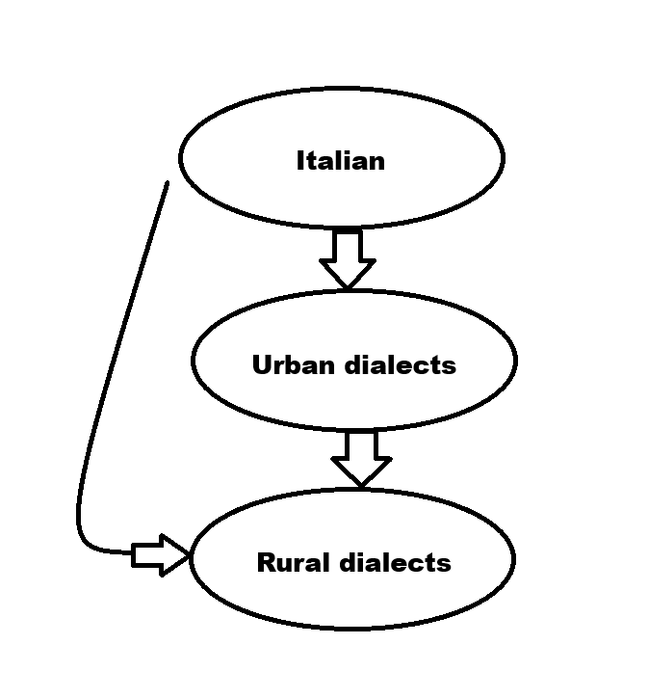
Conclusions
The result is not properly a koineization process, but rather the diffusion of features. Features deriving from dialect contact are more stable and acclimatised, while Italianized features are more instable and often in free variation with traditional variants.
Notes:
In altre parole, ci dice con quanta affidabilità il dendrogramma preserva le distanze originali fra i punti.

Slide 37
References
AIS = Jaberg K. & J. Jud, Atlante Italo-Svizzero (Sprach- und Sachatlas Italiens und der Südschweiz), Zofingen, Bern 1928-1940, online version NavigAIS ed. by Graziano Tisato (URLhttp://www3.pd.istc.cnr.it/navigais/).
ALI = Atlante Linguistico Italiano, 10 voll., Istituto Poligrafico e Zecca dello Stato, Roma.
ALEPO = Atlante Linguistico ed Etnografico del Piemonte Occidentale.
Bentley, Delia & Francesco Maria Ciconte (2024), «Microvariation at the Interfaces: The Subject of Predication of Broad Focus VS Constructions in Turinese and Milanese”, Languages 9: 37, https://doi.org/10.3390/languages9020037.
Berruto, G. (1974), Piemonte e Valle d’Aosta, Pacii, Pisa.
Berruto, G. (1989), Tra italiano e dialetto, in G. Holtus / M. Metzeltin / M. Pfister (eds.), «La dialettologia italiana oggi. Studi offerti a Manlio Cortelazzo», Narr, Tubingen: 107-122.
Berruto, G., Cerruti M. (2015), Manuale di sociolinguistica, Il Mulino, Bologna.
Britain, David. 2013. "The role of mundane mobility and contact in dialect death and dialect birth." In Daniel Schreier and Marianne Hundt, English as a Contact Language, 165–181. Cambridge: Cambridge University Press.
Britain, D. (2018) Dialect Contact and New Dialect Formation, in Charles Boberg, John Nerbonne, and Dominic Watt (eds.), «The Handbook of Dialectology» Hoboken, NJ, Wiley-Blackwell: 143-158.
Cerruti, M. (2016), L’italianizzazione dei dialetti: una rassegna, in «Quaderns d’Italià» 21: 63-74.
Cerruti, Massimo & Riccardo Regis (2014), «Standardization patterns and dialect/standard convergence: A northwestern Italian perspective”, Language in Society 43: 83-111.
Cerruti, M. & Regis R. (2020), Italiano e dialetto, Carocci, Roma.
Chambers, Jack & Peter Trudgill (1998), Dialectology, Cambridge University Press, Cambridge.
Coseriu, Eugenio (1980), «“Historische Sprache” und “Dialekt”», in J. Göschel, P. Ivić & K. K
Gusmani, R. (1993), Saggi sull’interferenza linguistica, Le Lettere, Firenze.
Ferrarotti, L. & Flecchia, A. (forth.), A hint of a larger change? Internal and external factors in the loss of local and marked features through dialect contact in Coggiola (Northwestern Italy) between the 19th and 20th centuries (capitolo di libro sottoposto a revisione).
Flecchia, A. (2022), Fenomeni di italianizzazione in alcuni dialetti biellesi, in «Bollettino dell’Atlante Linguistico Italiano» 46: 33-64.
Flecchia, A. (2023), Italianizzazione e vitalità del dialetto nel sistema di selezione degli ausiliari di alcune varietà biellesi, RID 47: 157-184.

Slide 38
Flecchia, A. (forth.), Variation and Italianization processes in the Piedmontese dialects of Biella: a description based on Multiple Correspondence Analysis.
Kerswill, Paul, and Williams, Ann. 2000. "Creating a new town koine: Children and language change in Milton Keynes." Language in Society 29: 65–115
Kühl, Karoline & Kurt Braunmüller (2014), «Linguistic stability and divergence: An extended perspective on language contact, in K. Braunmüller, S. Höder & K. Kühl (eds.), Stability and Divergence in Language Contact. Factors and Mechanisms, John Benjamins, Amsterdam & Philadelphia: 13-38.
Nerbonne, J. (2006), Identifying Linguistic Structure in Aggregate Comparison, in «Literary and Linguistic Computing» 21(4): 463-476.
Nerbonne, J. (2009), Data-Driven Dialectology, in «Language and Linguistics Compass» 3(1): 175-198.
Nerbonne, J. et al. (2011), Gabmap – a Web Application for Dialectology, in «Dialectologia», Special Issue II: 65-89.
Nerbonne, J. et al. (2019), Dialectology for computational linguists, in M. Zampieri & P. Nakov (eds.), «Similar languages, varieties, and dialects. A computational perspective», Cambridge University Press, Cambridge: 96-118.
Regis, R. (2011), Koinè dialettale, dialetto di koine, processi di koinizzazione, in RID 35: 7-36.
Regis, Riccardo (2019), «Intorno alla vitalità del francoprovenzale nell’Italia di nord-ovest», in Regards croisés sur la standardisation du francoprovençal, in Actes de la conférence annuelle sur l’activité scientifique du Centre d’Études Francoprovençales (Saint‑Nicolas, 11 novembre 2017), Tipografia Duc, Aosta: 47‑62.
Regis, R. & Rivoira (2023), M., Dialetti d’Italia. Piemonte e Valle d’Aosta, Roma, Carocci.
Ricca, D. (2010), Italianizzazione dei dialetti, in R. Simone (a cura di), «Enciclopedia dell’italiano – Encit», Istituto dell’Enciclopedia Italiana Treccani, Roma.
Scivoletto, G. (2014), L’italianizzazione dei dialetti come caso di convergenza linguistica, in RID 38: 75-101.
Tagliacarne, G. (1973), Atlante delle aree commerciali d’Italia, Milano, Mondadori.
Telmon, T. (2001), Piemonte e Valle d’Aosta, Laterza, Roma-Bari.
Tosco, M., Miola. E. & Duberti, N. (2023), A Grammar of Piedmontese, Brill.

Slide 39
Grazie per l’attenzione
Alessandro Flecchia - alessandro.flecchia@unito.it
Torino, Seminario dottorale 27 ottobre 2025

