Slide 1


The Influence of
Italo-Romance on the
Arbëreshë variety
of Piana Degli Albanesi
RoLinC, 21-10-2025
Jessica Rita Messina

Slide 2
Overview
Historical and Ethno-linguistic framework
Sociolinguistic background
Linguistic background
Data analysis results
Conclusions

Slide 3

GOALS
The divergences observable in Piana system – such as the preference for Romance DPs in lexicalizing definiteness, the ongoing reanalysis of tə as a P head in genitive constructions, and the incipient generalization of tɛ in locative contexts, – point to a broader realignment in the domain of definiteness.
The observable shift in lexicalization strategy, characterized by variability and optionality, suggests convergence with the Romance system, particularly in the way definiteness and case are expressed.

Slide 4
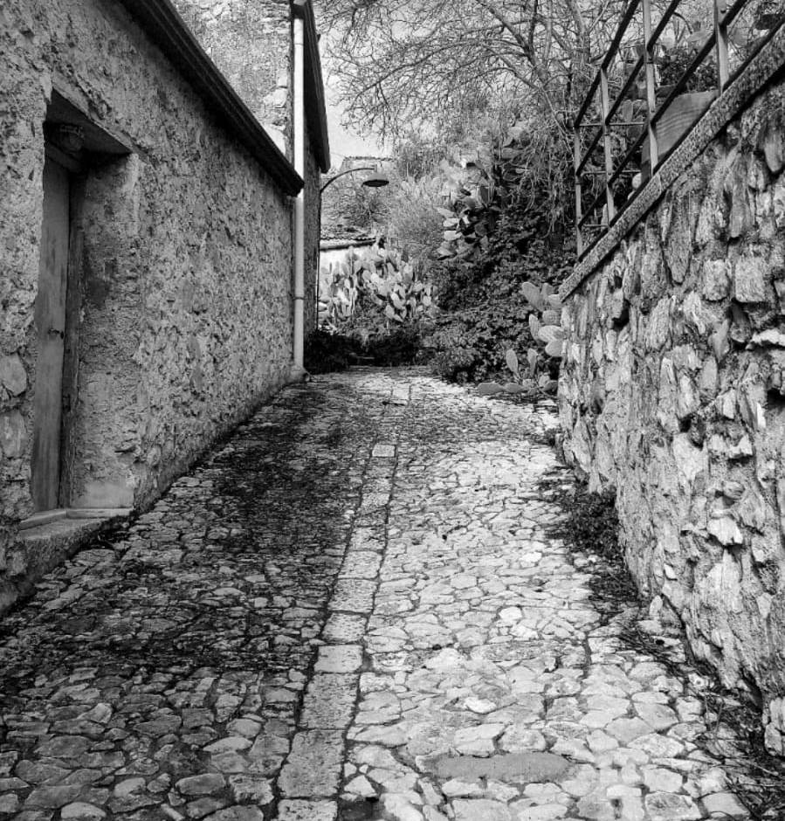
Piana degli Albanesi (Piana dei Greci until 1941) is an Italo-Albanian community, in the province of Palermo, Sicily.
Since the XV century this variety is in close contact with the Italo-Romance local dialects and, only recently, with Italian, after the Second World War.
This centuries-long coexistence has led to the emergence of a multilingual context in which all speakers are bilingual or trilingual, depending on their active or passive competence in the local dialect.
The spoken variety is defined ‘interlanguage’, a kind of ‘grammatical compromise’ between these three codes (cf. Matranga 2015, 2019).
This ‘language level’, due to its instability over time, has been considered by many as an ‘endangered language’ (cf. Derhemi 2002, 2003, 2006), recurring to borrowings for filling internal ‘linguistic gaps’.

Slide 5
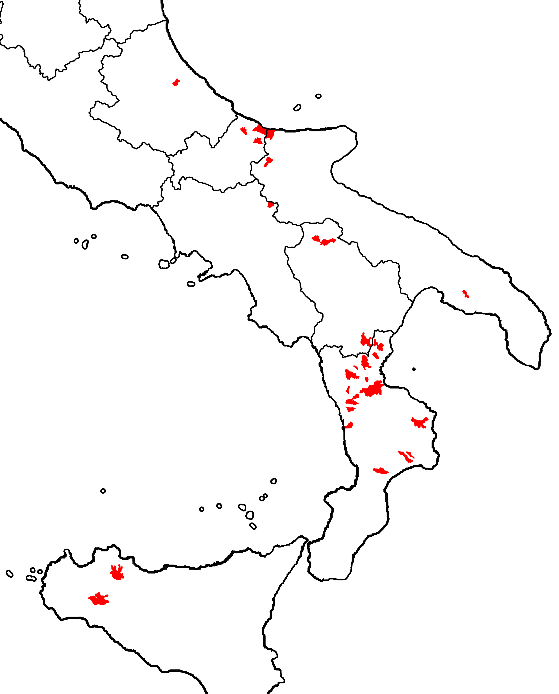
Historical and Ethno-linguistic framework
Arbëreshe is an alloglot dialectal variety of Albanian origin, spoken in approximately 50 residual settlements scattered across southern Italy.
These are a result of multiple migratory waves (15th and 18th cent.) of exiles from Albania, Greece and Morea to escape from the violent Ottoman domination.
Arbëreshe has its roots in the Tosk dialect spoken in the regions of Çamëria and Labëria (Southwestern Albania).

Slide 6
Mixed ethnic composition
Homogeneous and heterogeneous groups founding new settlements, repopulating abandoned areas, moving multiple times from their first location (forced relocations as well)
Settlements in mountainous and hilly areas better preservation of Albanian identity traits
Settlements in flat areas more rapid assimilation
From isolation to interaction with the host culture and language, through commercial exchanges and later through matrimonial unions
Arbëreshë varieties show a complex and multi-layered character determined by Multiculturalism, Multilingualism and linguistic heterogeneity that have defined these linguistic enclaves from their origins.

Slide 7

Piana degli Albanesi (Hora e Arbëreshëvet)
Its foundation dates to approximately 1479-1481 (Giunta 1984:24), just after the death of the commander Giorgio Castriota Scanderbeg.
It is located just 24 km from Palermo, on the eastern slope of Monte Pizzuta.
In 1590, intermarriage with locals – the ‘Litiri’ (Latins) – were allowed, beginning the socio-cultural and linguistic hybridization.
Eparchy of Piana degli Albanesi was the major factor in the preservation of the Arbëreshë linguistic and cultural heritage for over five hundred years.
Piana is the largest and most populous Arbëreshë center in Sicily and one of the largest and most active Italo-Albanian communities in Italy.

Slide 8
SOCIOLINGUISTIC BACKGROUND
The linguistic vitality and social dynamism, depending on its geographical proximity to the capital, along with a strong sense of identity preserved through mechanisms involving the maintenance and use of the Albanian language and Greek religious tradition, have ensured the success of the community of Piana degli Albanesi.
Despite the demographic decline occurring, particularly over the last two decades, across all Italo-Albanian communities, the general decrease in linguistic competence and a gradual reduction in communicative situations and contexts where Arbëreshe is used (cf. Cane 2022), Piana can be counted among non-endangered linguistic minorities according to UNESCO criteria (Treccani 2010).
Sociolinguistic compromise between the two coexisting worlds (the Albanian one and the Italo-Romance one)
Grammatical compromise resulting in the creation of an unstable interlanguage
Vitality of a diglossic or multilingual environment, where language contact increases the frequency and productivity of variation.

Slide 9
Cultural and linguistic openness played a huge role in the preservation of Albanian throughout 500 years
Nowadays, Piana is a multilingual setting:
speakers are bi-/trilingual and they can easily switch between the three codes of their own linguistic repertoire (Arbëreshe/Italian/Sicilian) in their daily social interactions (Matranga 2005).
A community with a complex sociolinguistic profile
Sequential Bilinguals (Italian or Arbëreshe as L2)
Simultaneous Bilinguals
L2 learners (children and adults) of Arbëreshe or Italian
Daily intensive exposure both to L1 and L2 inputs
Different types of relations intercurring between codes (Diglossia / Dilalia)
Different kind of family composition
(endogamous, exogamous, multilingual)
Different degree of bilingualism
Intensive code-switching
CS is a pragmatic strategy of bilinguals with a good command of the two languages;
CS may lead to Convergence of the L1 system with the L2 system.

Slide 10

Law n. 482/99 for the protection of the historic linguistic minorities
Introduction of Arbëreshe lessons in Piana’s primary school (IV°-V°) and lower secondary school.
The taught language is a standard-like variant based on the local linguistic tradition, tending to reach convergence with the Standard Albanian (Belluscio 2004).
The main textbooks are: «Udhëtimi» (2000) and «Udha e Mbarë» (2001).
- 1-2h per week by means of folk songs and traditional poems;
- The variety is not the one spoken at home or with the in-group;
- Teachers’ language proficiency is not guaranteed

Slide 11
LINGUISTIC BACKGROUND
Pre-diaspora situation:
Multiculturalism, Multilingualism and linguistic heterogeneity
Post-diaspora, during long-term contact with Romance:
code-switching
borrowings
convergence
hybridization
an extensive Romance relexification in conditions of Arbëreshe-Sicilian bilingualism and code-switching between dialect, regional Italian and Standard Italian (cf. Savoia 2008).
Loans, code-switching and code-mixing as proper strategies of a multilingual environment, signs of language vitality rather than language weakening evidences.

Slide 12
Cases of morphosyntactic convergence
The Italo-Albanian varieties have been influenced, to varying degrees, by the Italo-Romance languages with which they have been in contact:
Contact has resulted in the preservation of original elements or the dominance of certain structures due to their similarity to local Romance constructs
future tense with kam (‘to have’)+ subjunctive
durative (stative) construction (u jam e shkruanj (‘I am writing’, literally ‘I am and write’)
Causative constructions with bënj (‘to do’)
Contact has led to innovative structural calques with Albanian material
passive constructions like vjen thritur (‘is called, is named’)
vëhem (M/R of vë ‘I put’) + conjunction + aorist (vëhet e qan for ‘he/she starts crying’)
kam + besë (‘faith’), sprënxë (‘hope’), or ligj (‘law’, ‘right’) for ‘to believe’, ‘to hope’ and ‘to be right’.

Slide 13
Declension impairment
(Shkurtaj 1994)
a phenomenon of morphological impoverishment affecting the determiner system (postposed article or definite morphology) in some Arbëreshë varieties
An increasing reliance on uninflected Italian constructions within Arbëreshë
In some varieties definite inflection is morphologically expressed by the acquired Romance structure D+N
Contessa Entellina (PA): zbëllij la televisione “accendi la televisione” ‘Turn on the television’ (Sciambra 1964: 414);
Piana degli Albanesi: zura u filu dhi a televisioni “ho preso il cavo della televisione” ‘I took the TV cable’ (cfr. Mandalà 2005).
Piana community systematized the Romance definite article use, proclitic on sicilian Ns (Matranga 2015):
*marr birun but marr a/la biru/biro ‘take the pen’

Slide 14
RESEARCH QUESTIONS
Has the systematic and normed-like use of Romance DPs led to a morpho-syntactic reorganization within the arbëreshe Noun Phrase, in terms of a functional items new distribution?
Since functional items can serve as indicators of language variation in a contact context, what about their distribution in both Piana’s nominal and verbal domain with respect to Albanian and other Arbëreshë varieties?

Slide 15
RESEARCH
Nominal domain:
Subject/object NPs (nominal inflections, determiners)
Pre-adjectival and pre-genitival Linkers
field research during January-February 2023, followed by a secondary survey in October 2024.
10 informants (5F, 5M) native speakers with the same educational degree + 1 for the second inquiry
Data gathering through a guided interview based on a questionnaire
Translation task of 120 sentences (italian oral stimuli) – 40 for each domain of interest – + 26 sentences during the secondary data collection
Verbal domain:
Object clitics in specific environments (lexical verbs, imperatives, middle-reflexive constructions, …)
Subordination markers (non-modal /modal declarative complementizers and the subjunctive particle) depending on factual/non-factual predicates.

Slide 16
DATA ANALYSIS RESULTS
Nominal Domain
Një skolinë ‘a tie’
Një monopatinë ‘a scooter’
Një felpa / ‘na felpa ‘a hoodie’
Skolin-a ‘the tie’
Monopatin-u /Ai monopatinë /
‘u monopatinu / stu monopatinu ‘the scooter’
felp-a / ‘a felpa ‘the hoodie’
Four morphosyntactic properties defining the Albanian NP:
Indefinite/Definite distinction
Case+Definiteness
Complementary distribution between Definite Inflection and Determiners
Definiteness vs Indefiniteness in Nominal modification (pre-adjectival/ pre-genitival Linkers)
Indefinite Inflection:
Indefinite Article një;
zero-marked N (arbëreshë and morphologically adapted Romance loans);
Non-adapted Romance N preceded by një and (occasionally) by Romance indefinite article (‘na ‘a’).
Definite Inflection: alongside arbëreshe finite morphology, also used for regularly morphologically integrated borrowed Ns, there is an alternative structure: Romance D (article and demonstrative) + Romance N (një makina / ‘a makina ‘a car’/ ‘the car’)

Slide 17
DATA ANALYSIS RESULTS
Nominal Domain
Mark-u blɛ ɲə tɛ'lɛfɔn / un tɛ'lɛfɔn-u /
  Marco-def.msg buy.3sg a mobile phone/ a mobile phone-msg/
  u tɛ'lɛfɔn-u /stu tɛ'lɛfɔn-u
  the.msg mobile phone-msg /this.msg mobile phone-msg
  ‘Marco buys a mobile phone/the mobile phone’
Mar'iɛ-ja i bun ɲə tɔrtə /(u)n-a 'tɔrt-a Luk-ə-s
  Maria-def.fsg to-him make.3sg a cake.fsg /a-fsg cake-fsg Luca-def-OBL
  ‘Maria is making a cake for Luka’
Mar'iɛ-ja z'biɣ u frigɔrifɛr-u
  Maria-def.fsg open.3sg the.msg fridge-msg
  ‘Maria opens the fridge’
Mark-u ʧɛl (l)a makin-a / makin-ə-n
  Marco-def.msg start.3sg the.fsg car-fsg / car-def.fsg-ACC
  ‘Marco starts the car’

Slide 18
DATA ANALYSIS RESULTS
Nominal Domain
In indefinite contexts: preference for the Albanian noun phrase type, thus most Romance (non-)adapted loans are preceded by the indefinite Albanian article; the Romance indefinite structure appears as an alternative structure that can be freely used in everyday communication.
In definite contexts, more variability → a continuum ranging from the exclusive use of Albanian nominal morphology to the exclusive use of Romance nominal morphology, with intermediate cases showing a coexistence of the Albanian N-D structure and the Romance D-N structure.
In all cases, speakers exhibit a clear preference for the Romance noun phrase (D+N).
Romance Ds are increasingly selected as a tool of Definiteness lexicalization

Slide 19
DATA ANALYSIS RESULTS
Nominal Domain
Definiteness vs Indefiniteness in Nominal modification (pre-adjectival/pre-genitival Linkers)
Albanian:
Pre-adjectival and pre-genitival Linkers →
i/e for masculine/feminine singular definite Ns, të for plural definite Ns and for sg/pl indefinite Ns.
Arbëreshë:
Pre-adjectival Linkers NO → i/e for masculine/feminine singular Ns, të for plural Ns;
Pre-genitival Linkers in other arbëreshë varieties YES (to some extent)→ i/e/të def. vs të indef.

Slide 20
DATA ANALYSIS RESULTS
Nominal Domain
Vena di Maida (CS)
Kɐmb-a ɛ maʧ-ə-sə
paw-Nom.fs Art cat-fs-Gen
‘the cat’s paw’
Njə/ ajɔ kɐmb tə maʧ-ə-sə
Art/ Dem paw-fs Art cat-fs-Gen
‘a/that cat’s paw’
Casalvecchio
Kɐmb-a tə maʧ-ə-sə
paw-Nom.fs Art cat-fs-Gen
‘the cat’s paw’
kɐmb-a tə ati-j / njə cən-i
paw-Nom.fs Art that.ms-Gen / Art dog-Gen.ms
‘the paw of that/a dog’

Slide 21
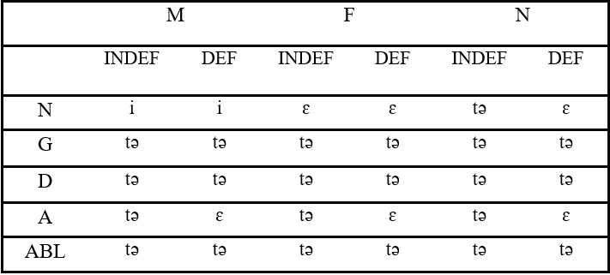


DATA ANALYSIS RESULTS
Piana’s pre-adjectival linkers (cf. Gerbino 2009):
a reduced paradigm characterized by form syncretism
Forms sensitive to φ-features (gender and number)
Forms sensitive, to some extent, to case and the definiteness of the head noun

Slide 22
DATA ANALYSIS RESULTS
Pre-adjectival linkers in collected data:
ɲə ʃkɔ'lin / ʃkɔ'lin-a ɛ kukj-ɛ tə taʦ
  Art tie.fsg / tie-NOM.def.fsg Lnk red-fsg Lnk father.OBL.def.msg
  ‘a red tie / the red tie of my father’
ɲə fɛlpə /a fɛlp-a ɛ ɲɔmə
  Art sweatshirt.fsg/the.fs sweatshirt-fsg Lnk soft
  tə/(ɛ) mik-ɛ-s jim-ɛ
  Lnk friend-OBL.def.fsg my-nom.fsg
  ‘my friend’s soft sweatshirt’
rɔtɛl-ɛ-t tə ɲəi biʧi'klɛt-jɛ ɛ ʧarə /
  wheel-pl-NOM.def.fpl Lnk Art.OBL bicycle-OBL.fsg Lnk broken /
  tə /(ɛ) biʧi'klɛt-ɛ-s ɛ ʧarə
  Lnk bicycle-sg-OBL.def.fsg Lnk broken
  ‘the wheels of a broken bicycle / the wheels of the broken bicycle’
Mark-u blɛ ɲə tɛ'lɛfɔnə /un tɛ'lɛfɔn-u /
  Marco-def.msg buy.3sg a mobile phone / a mobile phone-msg /
  u tɛ'lɛfɔn-u /stu tɛ'lɛfɔn-u i ri
  the.msg mobile phone-msg /this.msg mobile phone-msg Lnk new.msg
  ‘Marco buys a new mobile phone/the new mobile phone’
Pre-adjectival linkers: They agree in gender and number with the modified noun, not showing any sensitivity to definiteness or case

Slide 23
DATA ANALYSIS RESULTS
Pre-genitival linkers in collected data:
(i) a noun inflected for genitive case or containing a demonstrative/indefinite determiner; (ii) an uninflected noun in the nominative, or (iii) an unintegrated Romance DP.
a. ɲə stanʦə / stanʦ-a ɛ mað-ɛ tə ʃpi-s(ə)
Art room.fsg/ room-def.fsg Lnk big-fsg Lnk house-OBL.def.fsg
tə /(ɛ) nɔn-ə-s
Lnk grandmother-sg-OBL.def.fsg
  ‘a big / the big room in grandmother’s house’
b. a plɛjs'tɛʃɔn tə a't-ij djal-i-t /
Art playstation Lnk that-OBL.msg boy-def-OBL.msg/
ɲə-i djal-i
a-OBL boy-OBL.msg
  ‘the Playstation of that boy /a boy’
c. ɲə kambrə tə ʃpi-a tə /(ɛ) nɔn-ə-s
Art room.fsg Lnk house-NOM.def.fsg Lnk grandmother-sg-OBL.def.f
  ‘A room in grandmother’s house’
d. 'kjɛrki tə u kljɛntɛ
glass-NOM.def.msg Lnk the.msg costumer.msg
  ‘the costumer’s glass’
Pre-genitival linkers: The increasing substitution of tə for other vocalic linkers in the singular and its generalization in most contexts, with or without oblique case marking on the complement noun.
Piana’s tə is no more sensitive to the presence of oblique case marking through nominal inflection →
In Piana’s system, tə alone seems to function as the dyadic ⊆ operator in a genitive construction, like a prepositional head (e.g. di in Romance).

Slide 24
The substitution of tə for other vocalic morphemes in the singular or its generalization is recorded in the variety of Vena (M&S 2011a:269) and in the variety of Casalvecchio (Savoia 2008:83-85), but also in other Tosk/Geg Albanian varieties in Albania, as well as in the Albanian communities in Kosovo, North Macedonia, and in Arvanitika varieties in Greece (Trudgill 1977:45)
this phenomenon appears to be linked more to internal variation within the Albanian system rather than being driven by language contact
the syntactic behavior of tə, similar across these systems, is tightly determined by its inherent semantic properties → the denotational property ⊆ (inclusion/possession) endowed by tə (cf. Manzini & Savoia 2018) explains its increasing use in possessive contexts (the morpheme t in Albanian possessive forms, both adjectival and pronominal), justifying its potential reanalysis as a preposition introducing the genitive complement.

Slide 25
DATA ANALYSIS RESULTS
tə is no longer a Linker (D element), but it is undergoing a reanalysis as a P head
tə, which no longer agrees in φ-features with the modified head noun, should no longer be seen as linker. Rather, it can independently establish the possession/inclusion relationship (⊆), functioning similarly to prepositional elements (like ‘di’) → ongoing reanalysis of tə as a P head.
Genitival constructions show a lot of variability:
Four different strategies:
(i) an Albanian-type strategy characterized by the co-occurrence of multiple D elements (determiner, linker, oblique inflection) in Agreement relation, denoting a single referent – when i and e are employed;
(ii) a Romance-type strategy involving Romance material (ði + Romance nouns);
(iii) an ‘Aromanian-type’ strategy (cf. Savoia & Baldi 2024), when tə introduces arbëreshë and integrated Romance nouns as a PI;
(iv) a ‘hybrid’ strategy involving tə as a P-head that renders the embedded NP oblique.

Slide 26
Verbal domain: Subordination markers
Double Complementation System
In other arbëreshë varieties → Double Complementation System: se/që and të
a. me 'θa:n sɛ 'vijin me'nat
to.me they.said that they.came tomorrow
‘They told to me that they came tomorrow’
b. fiɾ'nɔva t ɛ diɛ'vasja
I.finished Prt it I.read
‘I finished reading it’
c. dua mɔs tə 'vitʃ
I.want not Prt you.come
‘I want you not to come’
d. dua tə ɛ 'beɲ a’i
I.want Prt it does(subj.) he
‘I want him to do it’
Manzini and Savoia (2007)
Non-modal vs. modal
Selected by predicates as verbs of assertion and those expressing propositional attitude (‘inform’, ‘say’, ‘believe’, ‘think’) → indicative mood;
Selected by predicates (‘can’), phasal verbs (‘begin/continue’), those that convey obligation (‘must’, ‘need’, ‘should’, ‘it is necessary’),desideratives expressing the speaker’s will (‘wish’, ‘try’, ‘menage’, ‘understand’, ‘hope’), manipulatives that express imposition of will (‘order’, ‘permit’, ‘request’, ‘pray’, ‘forbid’) or a speaker’s inner state (‘know’, ‘want’, ‘love’, ‘doubt’, ‘think’, ‘like’, ‘prefer’, ‘decide’) → subjunctive mood
Të subjunctive particle indicating higher degree of agent control

Slide 27
Verbal domain: Subordination markers
Double Complementation System in Piana
a. θɔm sɛ vijən
say-1SG COMP come-3PL
‘I say that they are coming’
b. kam bɛsə sɛ Ma'riɛja ɛ pa 'djɛ
have-1SG trust COMP Maria-NOM him saw-3SG yesterday
‘I believe that Maria saw him yesterday’
c. 'gɛrgi (ɲgə) dɔ sɛ/*tə ma'riɛja (ɲgə) ʃɛx (mɔs)ɲɛ'ri
Giorgio (Neg) want-3SG COMP Maria (Neg) see-3SG (no)one
‘Giorgio does not want that Maria see anybody’
d. (sɔt) diʃi'rɔjən/ dɔ *sɛ/tə 'vɛmi Pa'lɛrmə (sot)
(today) wish-1PL/ want-1PL PRT go-1PL to.Palermo (today)
‘We wish/want to go to Palermo today’
e. pru'var/ kər'kɔn tə i-a 'θuaʃ sɛ
try-2SG/ seek-2SG PRT to.them-it say-SUBJ.2SG COMP
dɔ vɛʧ Pa'lɛrmə
want-2SG go-SUBJ.2SG to.Palermo
‘Try telling them that you want to go to Palermo’
Semantic refunctionalization of se and të markers, determining a reduction and specialization of occurrence contexts.

Slide 28
Verbal domain: Subordination markers
Double Complementation System in Piana
Factual verbs select se+indicative, introducing an embedded proposition, but they can also select të+subjunctive, functioning as an embedded predicate, where të seems to operate similarly to the Italo-Romance prepositions that govern the infinitive.
Non-factual verbs select të+subjunctive in coreferential contexts, in all obligatory and arbitrary control contexts, but se+indicative for signaling the lack of coreference between the main clause and the subordinate clause (disjoint reference).
a. Luka pin'ʦar sɛ ʃər'bɛn mirə
Luca think-3SG that work-3SG well
‘Luca thinks he is working well’
b. Luka pin'ʦar të ʃər'bɛɲə mirə
Luca think-3SG to work-SUBJ.3SG well
‘Luca thinks about working well’
Manzini and Savoia (2018): the selection of an embedded predicate, as opposed to an embedded proposition, by the matrix verb involves an element that establishes the (⊆) relation → të functions as a P(⊆) head capable of embedding an inflected verb interpretable as an infinitive, following the Romance model.

Slide 29
Causative constructions
u binɛ diɔ'vasi 'libr-in kria'tur-i
  I make he.read book-the(acc) boy-the(nom)
  ‘I made the boy read the book’ Firmo
'bɐɲɲa (pə) tə 'harə di'aλ-i
  make for PRT he.eats boy-the(nom)
  ‘I make the boy eat’
u 'bɐɾɐ (ɲə'ri-unə) pə tə 'ikənə (ɲə'ri-unə)
  I made man-the(acc) for PRT he.runs man-the(acc)
  ‘I made the man run’ Vena di Maida
buɲ tə 'fləɲ di'al-in
  I.make PRT he.sleeps boy-the(acc)
  ‘I make the boy sleep’
tə bujən tə 'vdɛʧ pi'tit-it
  you they.make PRT you.die hunger-the(gen)
  ‘They make you die of hunger’ Piana degli Albanesi

Slide 30
Verbal domain: Subordination markers
Direct overlap between se + indicative(/subjunctive) - che + indicative/subjunctive and të + subjunctive - infinitive/di,a + infinitive, has contributed to the functional specialization of the two Arbëreshë structures.
Shift in strategy in both the nominal and verbal domains: the proclitic morpheme të begins to be interpreted as an operator of nominal and clausal obliquization.
Obliquizing sentential complements is made possible by the re-categorization of të as a P head, analogous to the Romance infinitival introducer di.

Slide 31
Verbal domain: Subordination markers
In Piana, there is a complete convergence of the two structures (të + subjunctive and the Romance infinitive/di + infinitive) in all predicative contexts, including causatives or purpose clauses, where other varieties typically introduce të with a prepositional head. → In Piana’s system, no prepositional introducer is involved: të has begun to be reanalyzed as a preposition
The variation leading to an almost identical structure with Romance infinitives can be interpreted as a realignment process of morphosyntactic devices, facilitated by intense contact and language mixing conditions.
The current coexistence of different interpretations for the same structure (të + subjunctive), comparable to the coexistence of alternative structures for the same function (Lnk + NGEN / të + NGEN / të + N), is a natural manifestation of linguistic variation in progress, before the change stabilizes in the speakers’ grammar.

Slide 32
CONCLUSIONS
The divergences observed in the Piana system in terms of micro-variation point to a broader realignment in the domain of definiteness (involving case)
The observable shift in lexicalization strategy, characterized by variability and optionality, suggests convergence with the Romance system, particularly in the way definiteness and case are expressed
The consistent use of non-integrated Romance nouns, in which the vocalic segments a, u, i (remnants of l-a, l-u, l-i) overtly lexicalize definiteness in the pre-nominal space, may have altered the conditions of visibility for the D properties within the Albanian noun phrase: these are beginning to be satisfied by a lexical item inserted before the noun.
Similarly, the Romance genitival construction, in which the possessive relation (⊆) is established solely by the prenominal preposition, may have altered the visibility conditions of the ⊆ properties (case), which are satisfied by the insertion of a lexical item in the specific pre-nominal position.

Slide 33
GHRACJI
THANKS

