Slide 1
Person features and non-specific readings of speech participants
Antonio Fábregas
NTNU
antonio.fabregas@ntnu.no

Slide 2
The goal
To what extent do we codify ‘pragmatic’ notions through formal features? Do we have specifically pragmatic features or do we use more abstract formal features that, combined with cognitive operations, produce the intended result?
The granularity of formal features: the higher the syntactic domain of a feature, the more coarse-grained the notion expressed by that feature is (eg., noun classification systems, [count / mass], [individual / collective] in the NP domain, vs. [specific] and [definite] in the DP domain).

Slide 3
How to explore this goal
Spanish has different strategies to graduate the level of speaker involvement and the specificity of the subject ((Aijón Oliva 2019, Aijón Oliva & Serrano 2013, Barrajón López 2005, Briz 1998, Cameron 1993, Enríquez 1984, Gómez Torrego 1992, Guirado 2011, Hernanz 1990, Kluge 2010, Serrano 2006, 2022a, Travis & Torres- Cacoullos 2018)

Slide 4
Leaving impersonal SE we have:
a. Llama-n a la puerta.
knock.3pl at the door
'Someone is knocking at the door’
b. Uno vive bien aquí.
‘one lives well here’
En Italia llegas a una tienda y te ponen de comer.
in Italy arrive.2sg to a shop and you give of eat
'In Italy you enter any shop and they give you some food'

Slide 5
Specific puzzles
The same feature 'plural' that is required to get the non-specific reading in (a) blocks the non-specific reading in (c), and the same feature 'addressee' which makes (c) non-specific is unavailable for (b), which has to be linked to a 1st person and can never be used as a concealing form for the 2nd person. The same features that seem to license the non-specific reading in one case block the non-specific reading in other cases.

Slide 6
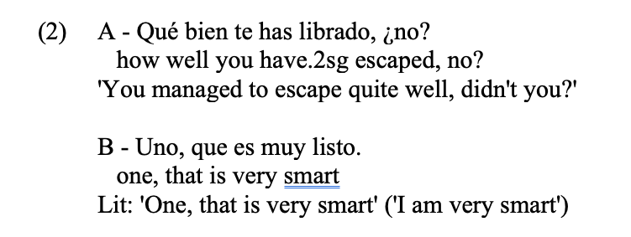
Addressees or speakers
‘Uno’ encubridor (Gómez Torrego 1992)

Slide 7
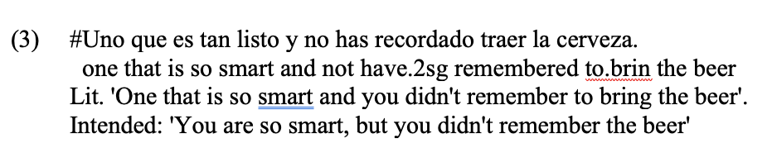

Slide 8
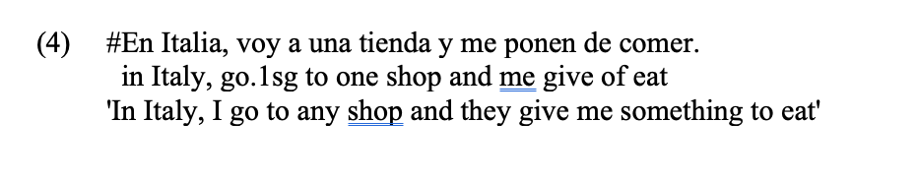

Slide 9
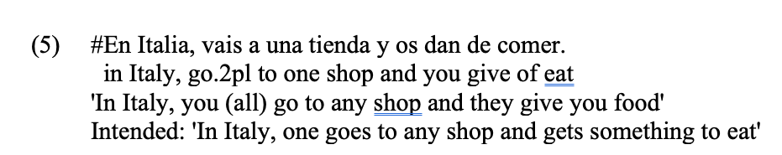
Plural or singular
2sg can be non-specific (even as an overt pronoun), 2pl cannot.

Slide 10
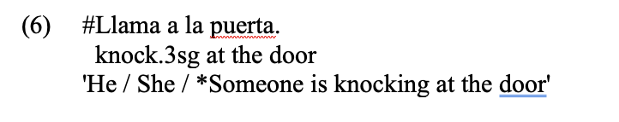
But the 3pl pro can be non-specific while the 3sg pro cannot:

Slide 11
My conclusion
Pragmatic effects are not codified by single features, but emerge from the global interpretation of whole semantically-interpretable structures

Slide 12
Empirical patterns
Let us see them.

Slide 13
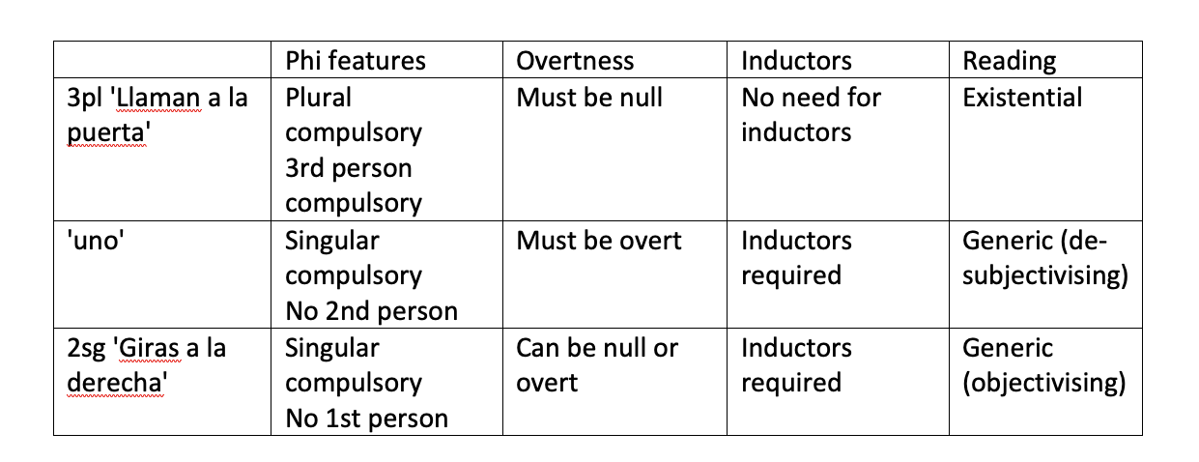

Slide 14
3pl: empirical properties
From a syntactic and semantic perspective, the use of the 3pl to convey non-specific subjects (Aijón Oliva 2020, Alarcos 1994: §328, De Miguel 1999, Gómez Torrego 1992, Posio 2015, RAE & ASALE 2009: §33,4t, §41.9f) has the following properties:
a) It does not denote a generic or universal referent, in contrast to uno 'one' and the 2sg, which under certain conditions can have this interpretation. The sentence in (8) is not interpreted as 'everybody says that', but as 'there is at least someone that says that', which has been called an arbitrary or existential reading (cf. Sánchez López 2002 for its se equivalent).
(8) Dicen que el Rey está en Abu Dhabi.
say.3pl that the king is in Abu Dhabi
'Someone says that the king is in Abu Dhabi'

Slide 15
b) Note that the existential interpretation means that plural marking in this form is not interpreted as semantic plurality. (8) does not entail or imply that there must be more than one person saying that; in (9), for instance, the most salient reading is one where only one person is knocking at the door.
(9) Llaman a la puerta.
knock.3pl at the door
'Someone is knocking at the door'
(10) Me gusta leer novelas.
me likes to.read novels
'I like reading novels' (true even if he reads only one novel)

Slide 16
c) In contrast with 2sg forms, the arbitrary or existential reading is incompatible with an overt pronominal subject.
(11) Ellos dicen que el Rey está en Abu Dhabi
they say.3pl that the Kind is in Abu Dhabi

Slide 17
d) In contrast with the other two forms, the non-specific reading of 3pl is not blocked by perfective or perfect tenses, and does not require any mark of genericity in order to be obtained. Like (8), the cases in (12) are interpreted as existentials: someone, possibly one person, that we might not know, did something.
(12) Dijeron que el Rey estaba en Abu Dhabi.
said.3pl that the king was in Abu Dhabi
'Someone said that the King was in Abu Dhabi'

Slide 18
e) However, the non-specific reading of the 3pl inflection is restricted to subject positions: (13) cannot be interpreted as 'he saw someone, possibly only one person'. It is more controversial whether the subject must be an agent or an external argument for the non-specific reading to obtain, a matter that we will leave aside (see Aijón Oliva 2006, 2020).
(13) Los ve en este momento.
them see in this moment
'He is seeing them in this moment'

Slide 19
f) From a pragmatic perspective, Aijón Oliva (2020) notes that there are three distinct functions of the 3pl.
(14) a. Han atracado a mi padre.
have.3pl robbed DOM my father
'Someone has robbed my father'
b. Nos piden mucho este tipo de tela.
us ask-for.3pl a-lot this type of fabric
'People ask us a lot for this type of fabric'
c. Suben los impuestos cuando quieren.
raise.3pl the taxes when want.3pl
'The authorities raise taxes whenever they want'

Slide 20
g) Crucially, 1st and 2nd person reference is excluded from all uses of 3pl as a non-specific form. In (8), for instance, the speaker implies that he is not one of the people saying that the king is in Abu Dhabi and would be surprised to know that the addressee is one of them.

Slide 21
Uno
a) In contrast to 3sg forms, the interpretation of uno as a desubjectivizing device or a space builder is not existential, but generic. The singular form is, therefore, not interpreted as 'there is one and only one', and utterances involving this form are interpreted as generalized statements about all humans belonging to a particular relevant set, perhaps because the reference of uno is built always from the speaker, who has to be human.

Slide 22
b) The generic reading covaries, although not in a compulsory way, with certain expressions that could be considered genericity markers. Serrano (2022b) notes that among these properties one can include when and if clauses, imperfective aspect or a impersonal se, another well-known defocusing strategy (Serrano 2021).
(15) a. Cuando uno tiene fiebre, va al médico.
when one has fever, goes to.the doctor
'When one has a fever, one goes to the doctor'
b. Si uno se enfada, no piensa lo que hace.
if one SE gets.angry, not thinks it that does
'When one gets angry, one doesn't think clearly’
c. Uno vive bien aquí.
one lives well here
'One lives fine here'

Slide 23
(16) a. #Uno tiene fiebre.
one has fever
'One of them has a fever'
b. #Uno se enfada.
one SE gets.angry
'One of them is getting angry'
c. #Uno vivió bien aquí.
one lived.3sg fine here
'One of them lived well here'.

Slide 24
c) In contrast to 3pl forms, the pronominal must be overtly expressed. Absence of the pronominal blocks the generic reading, as in (17), which can only be interpreted specifically.
(17) Cuando tiene fiebre, va al médico.
when has fever, goes to-the doctor
'When he or she has a fever, he or she goes to the doctor'
d) In contrast to 3pl forms, this pronoun can appear in an object position.
(18) Cuando lo ven a uno, lo saludan.
when CL see.3pl DOM one, CL greet
'When they see anyone, they greet that person'

Slide 25
e) Interestingly, in the object function clitic doubling is compulsory to obtain the generic reading (RAE & ASALE 2009: §15.8). (19), in contrast to (18), is rather interpreted in a specific, partitive sense 'one of them'.
(19) Cuando ven a uno (de ellos), lo saludan.
when see.3pl DOM one (of them), CL greet
'When they see one of them, they greet that person'

Slide 26
f) From a cognitive-functional perspective, as Serrano (2022b) has studied in detail, uno 'one' acts as a desubjectivizing device that, starting from the experience or stance of the speaker, defocuses his or her involvement and presents it as a generalisable experience. In this sense, uno starts always from a 1sg experience, as witnessed by the contrast in (21):
(21) a. Uno vive bien aquí.
one lives well here
b. Se vive bien aquí.
SE lives well here
[Serrano 2022: 4]

Slide 27
Uno encubridor
a) While the generic use strongly prefers the masculine form of the pronoun (uno), in the concealing use the gender inflection of the pronoun correlates with the gender that the speaker uses to define him or herself. Like this, if the speaker identifies herself with feminine gender, the form una will be used.
(22) Una viene a un congreso y no espera que la ataquen.
one.f comes to a conference and not expects that her attack.3pl
'I come to a conference and do not expect to be attacked'

Slide 28
b) We have seen that in order to make the generic use salient, in opposition to a partitive interpretation of uno 'one', generic inductors are frequently used. In contrast, the concealing use of uno 'one' does not require such inductors:
(23) Una vino a este país llena de sueños.
one.f came to this country full.f of dreams
'I arrived to this country full of dreams'

Slide 29
2sg
The use of the 2sg form in non-specific contexts has been extensively studied (Aijón Oliva & Serrano 2014, Beinhauer 1968, Briz 1998, Enríquez 1984, Haverkate 2004, Hernanz 1990, Hidalgo 1996, Kluge 2010, RAE & ASALE 2009: §16.2, Serrano 2006, 2021, among many others). The properties that define this use are the following:
Although related initially to experiences of the speaker, this form is similar to uno 'one' in that the non-specificity is interpreted in a generic, and not an existential reading.
(24) Si vives en Francia, aprendes francés.
if live.2sg in France, learn.2sg French
'If one lives in France, one learns French'

Slide 30
b) Like uno 'one', the generic use of the 2sg is favored by some additional markers which promote the gradual inclusion of other referents beyond the speaker –something I will treat in what follows as 'genericity inductors
(25) a. Si tienes mucho dinero te puedes permitir esto.
if have.2sg much money you.2sg can.2sg afford this
'If one has a lot of money, one can afford that'
b. Tuviste mucho dinero y te pudiste permitir esto.
had.2sg much money and you.2sg could.2sg afford that
'You [specific] had a lot of money, so you could afford it’
c. Si tuviste muchas oportunidades, pudiste ir a la universidad.
if had.2sg many opportunities, could.2sg go to the university
'If one had a lot of opportunities, one could go to the university'

Slide 31
c) In contrast to uno 'one' and 3pl, the non-specific reading can emerge both with an overt pronoun and without it, provided that the inductors of genericity are present.
(26) Cuando tú no entiendes algo, lo normal es preguntarlo.
when you not understand.2sg something, the usual is to-ask-it
'When one doesn't understand something, the normal thing to do is asking'
d) In contrast to 3pl, and like uno 'one', 2sg can get a non-specific reading also in the object position.
(27) Si te pillo copiando, te suspendo.
if you catch.1sg cheating, you fail.1sg
'If I catch someone cheating, I fail that person'

Slide 32
e) In pragmatic terms, 2sg is not just a desubjectivizing strategy, but rather an objectivizing one, which presents the stance or experience of the speaker as a generalisable situation that involves the addressee and anyone who is potentially an addressee (Serrano 2021).

Slide 34
Analysis
Two independent systems are employed here:
  DP-internal number
  Clause-external situational anchoring

Slide 35
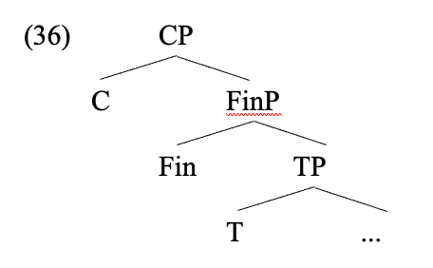
Analysis
Logophoric center (Sells 1987) of the clause in Finiteness (Bianchi 2003, pace Giorgi 2009).

Slide 36
Bianchi (2003)
The amnesiac firefighter.
John is a firefighter that saved a little girl from a house in flames. In doing so, he gets injured and loses all his memories. The morning after, he wakes up in hospital and on TV a reporter is talking about him, although he does not know it. He tells his mother: ‘That guy is a hero’.
The mother tells her husband:
My son believes that he is a hero. [true]
My son believes himself to be a hero [false]

Slide 37
Finiteness encodes situational anchoring: if you are finite, you can get anchored to the speaker [externally]; if you are non-finite, you must get internally anchored to the holder of the atttitude reported.

Slide 38
Let us start with ‘uno’
I take ‘uno’ to be associated to the speaker of the speech situation (‘uno encubridor’ as more basic than ‘generic uno’)
The generic use is obtained when the inductors generalise the situation, allowing for distinct speakers in each situation.

Slide 39
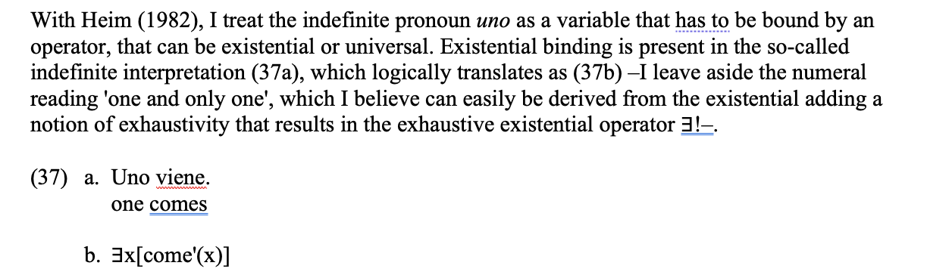
Uno

Slide 40
Uno encubridor
I treat [speaker] as a possible operator that can bind ‘uno’ (cf. Harbour’s 2016 theory of person as a semilattice, like number)

Slide 41
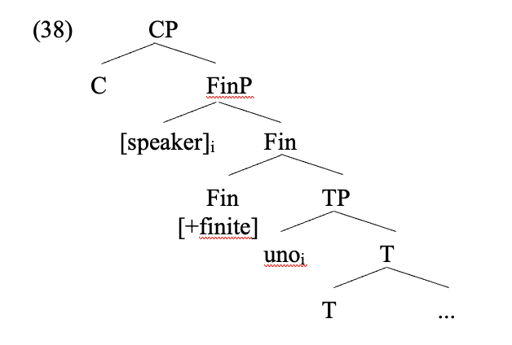

Slide 42
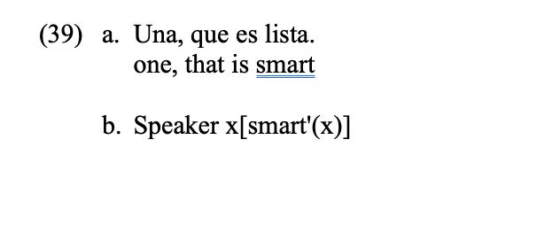

Slide 43
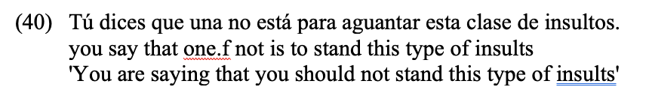
Prediction: internal logophoric center

Slide 44
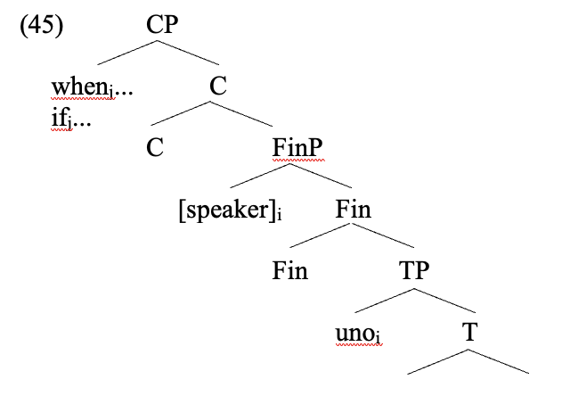
Generic use

Slide 45
Why not ‘uno’ for 2person?
There is no [addressee] feature in grammar (cf. No language resolves [1 + 2] agreement as a 2pl; Harbour 2016)

Slide 46
2sg
If [speaker] is a feature but [addressee] is not a feature, syntactically the 2sg pronoun is defined as a participant.
The second person pronoun, when present, is not a variable.
The generic use is obtained when the situation is generalised by the inductors, thus allowing for distinct addressees.

Slide 47
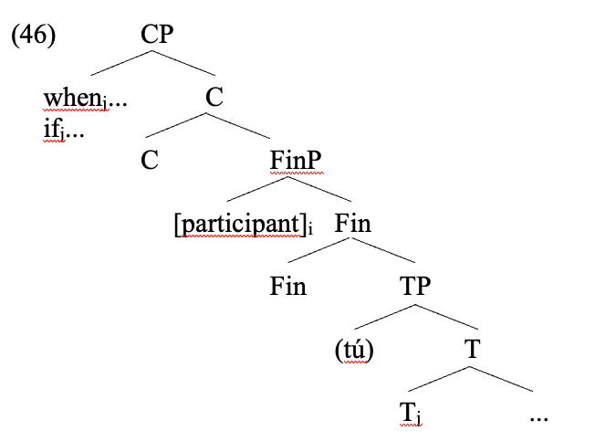

Slide 48
The participant, however, is generalised by introducing quantification over temporal periods, worlds, etc. The result, then, is that a generic reading emerges.
So what about number?

Slide 49
Number in 3pl
There is a parallelism between absence of an overt pronoun and bare plurals without DP.
In contrast to bare nouns, the plural morpheme forces a plurality reading with determiners and pronouns, as in the cases in (48).
(48) a. Tengo unos libros.
have.1sg some books
b. Veo las películas.
see.1sg the movies

Slide 50
As soon as we include material relevant for reference assignment or quantification, plural becomes semantic plural.

Slide 51
(50) a. Ellos dicen eso.
they say.3pl that
'They (specific) are saying that'
b. Dicen eso.
say.3pl that
In the absence of a determiner or pronoun, in fact, the reading that we obtain with 3pl (50b) is precisely the one that we obtain with a plural bare noun: there is at least one, and possibly, but not necessarily, more.

Slide 52
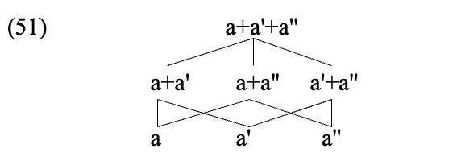
'plural’ as the semilattice
Fábregas (2024): the Spanish ‘plural’ is actually a feature that builds a semilattice.

Slide 53
The semilattice contains singulars. In itself, the semilattice is non-specific.

Slide 54
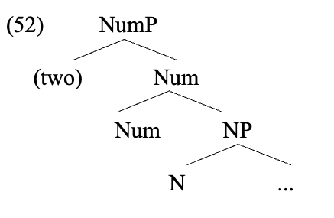
Semantic plural requires selecting portions within the semilattice:

Slide 55
'plural’ as the semilattice
‘two’ selects the row of the semilattice where there are two atoms (the middle row).

Slide 56
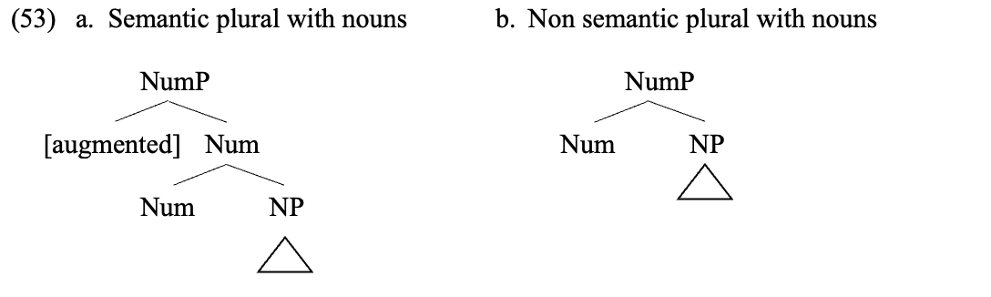

Slide 57
2pl cannot get a non-specific reading because plural with them contains [participant] in the semilattice.
‘Unos’ cannot get a non-specific reading because ‘uno’ is a quantifier, and that material involves quantification over the semilattice.
Overt ‘ellos’ involves quantification over the semilattice through the D part of the pronoun.

Slide 58
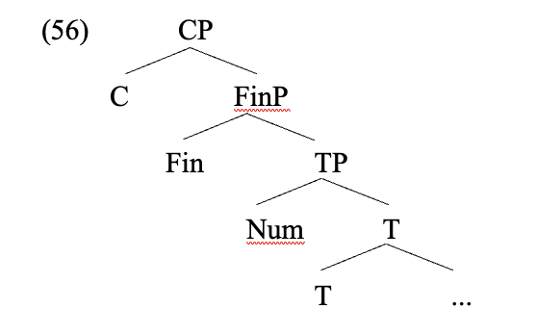
In other words: there is no ’pro’ in 3pl non-specific

Slide 59
Conclusions
The different devices that Spanish uses in discourse in order to define non-specific subjects emerge from the complex interaction between three (in principle independent) formal components:
(i) a logophoric center, defined in Finiteness, which can be externally anchored to the speaker, as the most salient participant in the utterance, or internally to a main clause participant,
(ii) operator-variable structures that bind certain pronominals to participants defined in the logophoric center and
(iii) genericity inductors that treat the content of the proposition as not linked to a specific time period or world and make the situation generalisable to other humans that may have the same speaker or addressee role in other contexts.
The non-specific interpretation is not due to the presence of any specific feature, which explains that the same feature [plural] or [speaker] may be both a facilitator or a blocker of the non-specific interpretation, depending on the global properties of the structure.

Slide 60
Like this, the defocalizing nature of the three devices that we have discussed in this article emerges from the complex interaction between the three elements just described, and of course the intention of the speaker of avoiding forms that would identify the subject or would define it as a 1st person.
In my analysis, this intention is manifested as avoiding a pronominal variable in 3pl cases, where I have argued that only a Number feature is introduced, or as using 3rd or 2nd person pronominal forms, depending on whether the speaker wants to desubjectivize the utterance or to objectivize it.

Slide 61
The (pragmatic) interpretation of utterances requires a global evaluation of the semantically-interpretable syntactic structures, not based on single features that could have been proposed –features like [non-specific subject], [desubjectivizing] and so on, whose existence in syntax is doubtful– but on the global output that these features, together, have on the status of the proposition, and the identification of its logophoric center.
Secondly, syntax must have grammaticalized some type of structure to allow anchoring of the propositional content to a context of utterance, where at a minimum the source of the information, the self and the pivot must be identifiable within the structure.

