Slide 1
Subjects and Topics
A complicated relationship
Cecilia Poletto
(Goethe Universität Frankfurt, Universitá di Padova)

Slide 2
Are subjects topics?
The idea that subjects are topics is rather widespread in the literature:
Already Givon (1986) states that in 80% of the cases the subject is the topic of the clause.
Subjects are recognized to possess pragmatic topic-like properties, since they typically are „what the sentence is about“.
Feldhausen (2017) shows that in Spanish topics and preverbal subjects have the same prosodic contour.
What about their syntax? If they are topics, shouldn´t the occur in the left periphery?

Slide 3
The availability of SpecT
If pro exists, it should always occupy the SpecT position and be licensed by T.
If pro does not exist and T is itself pronominal (see Manzini and Savoia 2011) then SpecT does not need a DP subject.
This means that SpecT is not available for hosting preverbal DP subjects.

Slide 4
No subjects in SpecT
Subjects can indeed be shown not to be in SpecT, since there can be elements intervening between the subject and the inflected verb:
Mario doman compra na casa Venetian
Mario tomorrow buys a house
‘Mario is going to buy a house tomorrow’

Slide 5
Are preverbal subjects dislocated?
This problem has long been spotted in the literature, at least since Benincá and Cinque (1985), who propose that preverbal subjects in the pro drop Romance languages are always left dislocated.
This proposal has been followed by Giupponi (1987), Barbosa (1995) among others

Slide 6
The problems
Preverbal subjects do not always have the typical properties of left dislocated XPs:
Quantifiers are not good topics, but quantifiers can be subjects.
If subjects were always topics, resumption should be obligatory, as it is the case for direct objects, but this is not true.

Slide 7
Test on doubling
In Venetian, subject clitic resumption is not obligatory:
Mario (l) compra na casa
Mario (he) buys a house
‘Mario is going to buy a house’
It becomes obligatory if there is another dislocated element intervening between the subject and the inflected verb:
Mario, na casa, no*(l) la compra
Mario a house not (he) it will buy
‘Mario is not going to buy a house’
Na casa, Mario, no (l) la compra
A house Mario not (he) it will buy
‘Mario is not going to buy a house’

Slide 8
Subject are not left dislocated
Subjects can indeed be shown not to be in SpecT, since there can be elements intervening between the subject and the inflected verb and at the same time not be left dislocated, because no subject clitic occurs:
Mario doman compra na casa Venetian
Mario tomorrow buys a house
‘Mario is going to buy a house tomorrow’

Slide 9
Where are preverbal subjects?
Taking stocks, subjects can be shown:
Not to be in SpecT.
Not to be in a regular left dislocated position.
This means that subjects can have topic properties but cannot be equated to regular topics and cannot be in the position where pro is licensed.
What is the position of preverbal subjects?

Slide 10
Specialized positions
Hypothesis: They have specialized positions in the left periphery, lower than left dislocated items (see above) but higher than the lowest complementizer position.
Quantified preverbal subjects occupy an A‘ position. Definite DP preverbal subjects occupy a higher position (Beghelli & Stowell 1997).

Slide 11
Quantified subjects
Quantified subjects do not necessarily have the same agreement pattern as definite subjects:
Nisun ze partio
Nobody is left
‘No one left’
Nisuni ze partio
Nobody is left-agr
‘No one left’
*Nisuni ze partii (Venetian)
Nobody is left+agr
Although the quantifier is plural, no past participle agreement

Slide 12
Different doubling patterns
In the Lombard dialects, definite preverbal subjects are obligatorily doubled, quantifiers are not:
El bagai *(el) mangia el pom. (Lecco)
the boy (he) eats the apple
‘The boy eats the apple.’
Nisogn (*el) me capess.
Nobody (he) me understands
‘No one understands me.’

Slide 13
Old Venetian
I will now concentrate on a special pattern found in Old Venetian (OVen) and analyze possible subject positions.
Old Venetian has preverbal and postverbal subject, but it is a V2 language.
The problem with V2 is that postverbal subjects can be due to V to C (V2) or be in the VP in the thematic position.
One might also wonder if postverbal focalized subjects in the vP periphery are available (Belletti 2004).

Slide 14
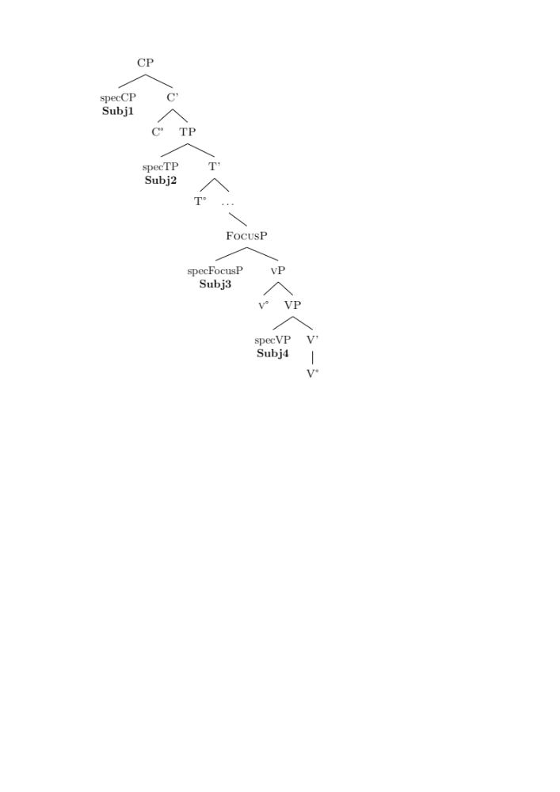
Four different positions?
Subjects in a V2 language can be in:
1. A SpecC position (preverbal in main clauses)
2. A SpecT position (G-inversion in main clauses)
3. A vP peripheral position for subjects of transitive and intransitive verbs (Belletti´s low Focus position)
4. A VP internal position for subjects of unaccusatives and passives.
When we see a postverbal subject, how can we decide where it sits?

Slide 15
An ambiguous structure
E così domandà Pero d'Ésol li bocali a queli homini […]
and so asked Pero d’Ésol the cups to those men
‘And Pero d’Ésol alsked the cups to those men [...]’ (Lio Mazor, 24)
This sentence is ambiguous between a vP peripheral subject and a SpecT subject, because the verb is in C and does not mark any boundaries inside the IP domain

Slide 16
An unambiguous structure
Me savres-tu menar a casa de Catarina del Tos […]?
me knows-you lead to home of Catarina del Tos
‘Could you bring me to the house of Catarina del Tos […]?’ (Lio Mazor, 17)
This case is not ambiguous, because there is a modal auxiliary and a non-finite verb form. On a Cinquean monoclausal structure of modal constructions, the subject must be in SpecT.
Hence, to distinguish between a postverbal subject in SpecT and one in the vP we have to consider compound tenses: if the subject is after the past participle/infinitival verbs, it is in the vP.

Slide 17
A clear asymmetry
En la taverna del Ros fo acusà Perinça dre' la terça canpana.
in the tavern of.the Ros was accused Perinça after the third bell
‘In Ros’ tavern Perinça was accused after the third bell rang’ (Lio Mazor, 8)
e così er' e' rivà a casa de Marcho de Robin […].
and so was I arrived to home of Marcho de Robin
‘and so I arrived at Marcho de Robin’s house […].’ (Lio Mazor, 2)
→ Postverbal pronouns are in SpecT, postverbal DPs are in VP

Slide 18
Main/embedded asymmetry
We then expect to find a clear asymmetry between main and embedded subject inversion:
only pronominal inverted subjects should be a main clause phenomenon
postverbal nominal subjects should be equally distributed in main and embedded clauses.

Slide 19
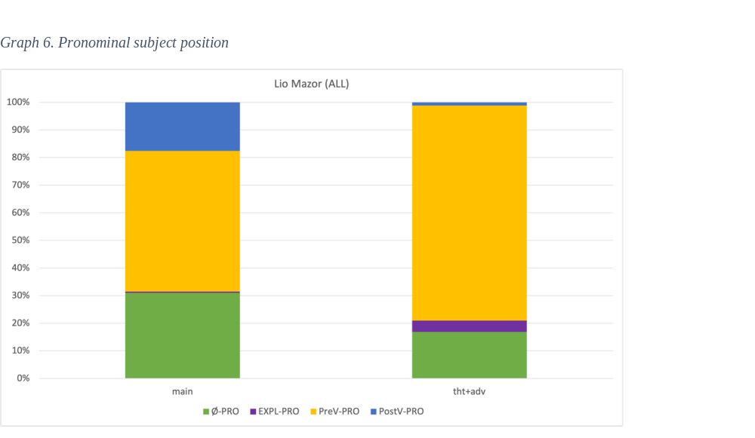
…and this is actually the case
Pronominal subjects show a strong preference for being post-V in main clauses rather than in subordinates.

Slide 20
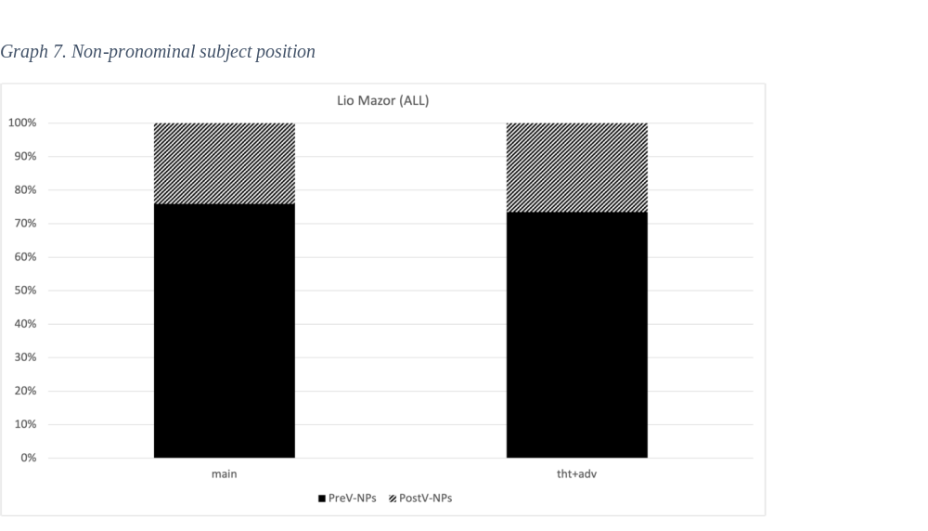
On the other hand…
Non-pronominal subjects do not show a strong preference for being post-V in main clauses rather than in subordinates

Slide 21
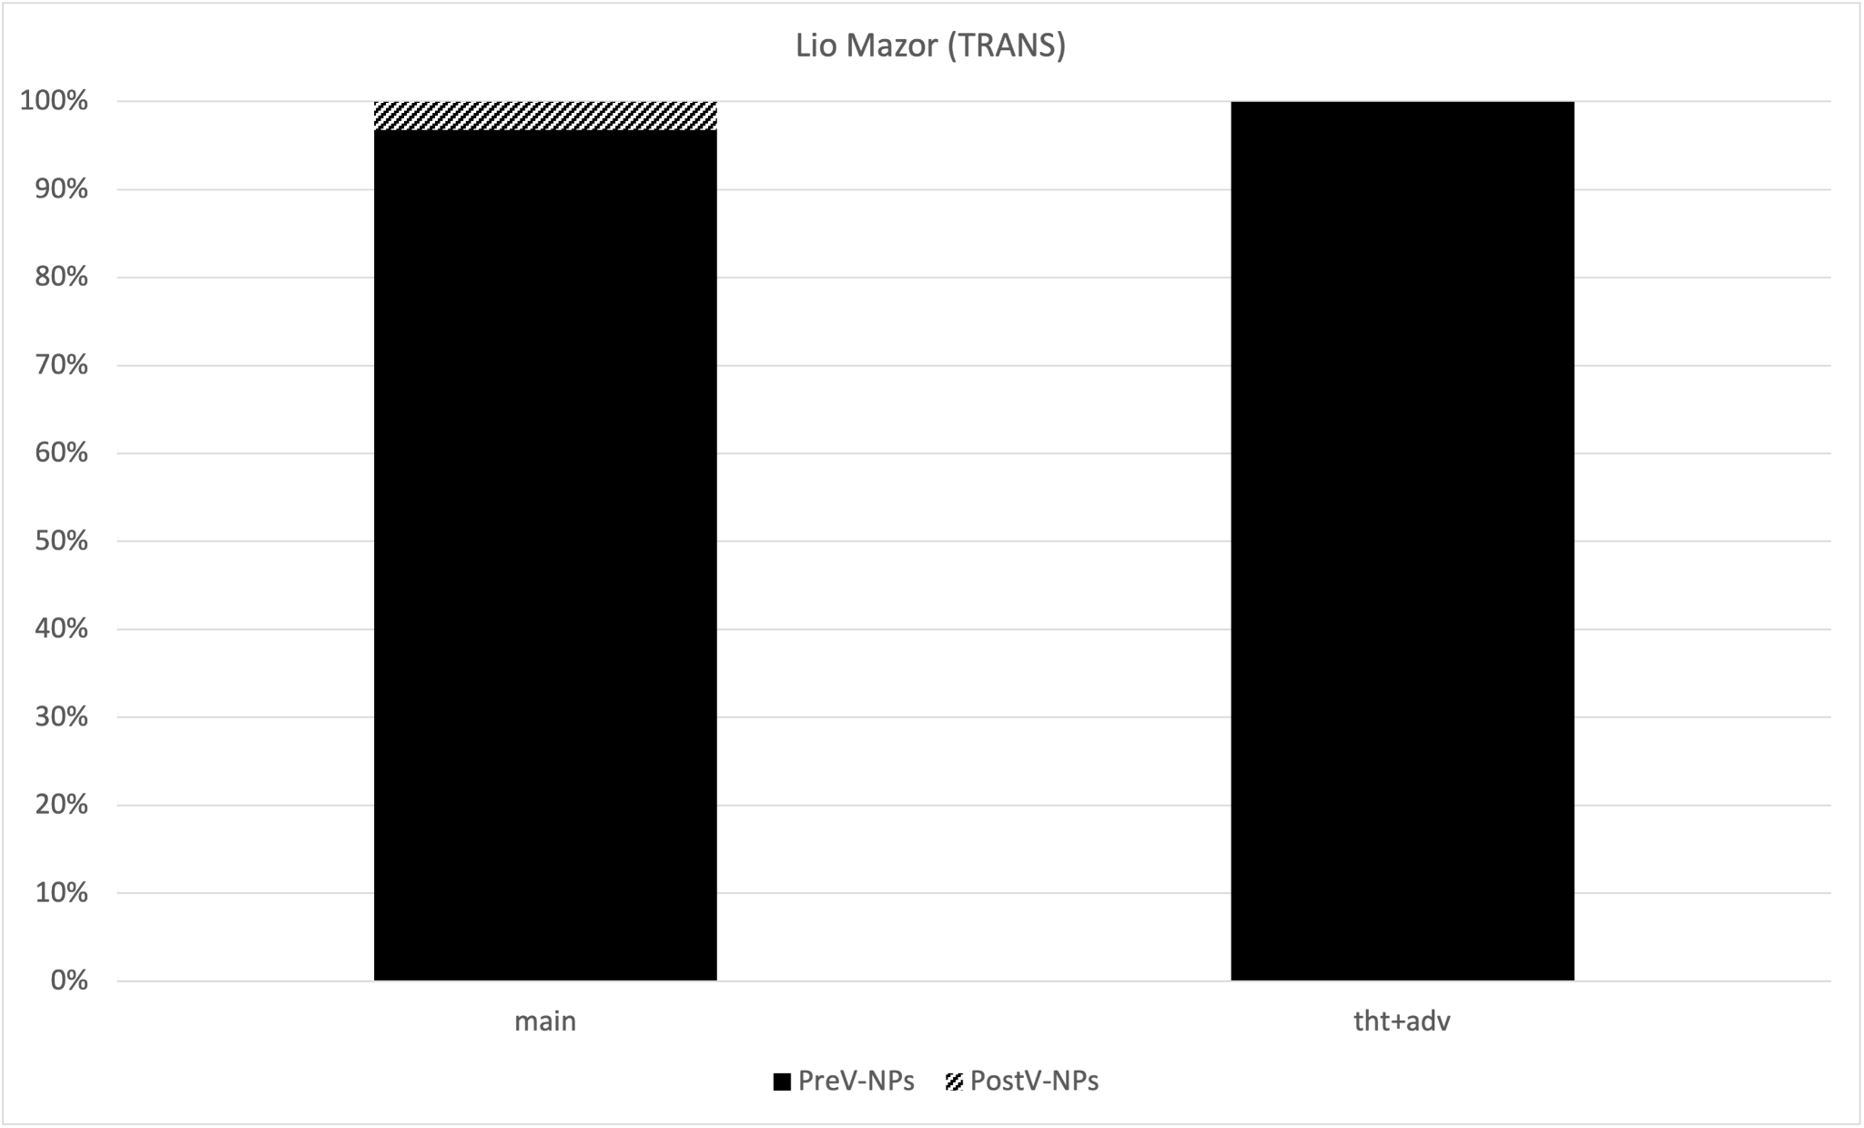
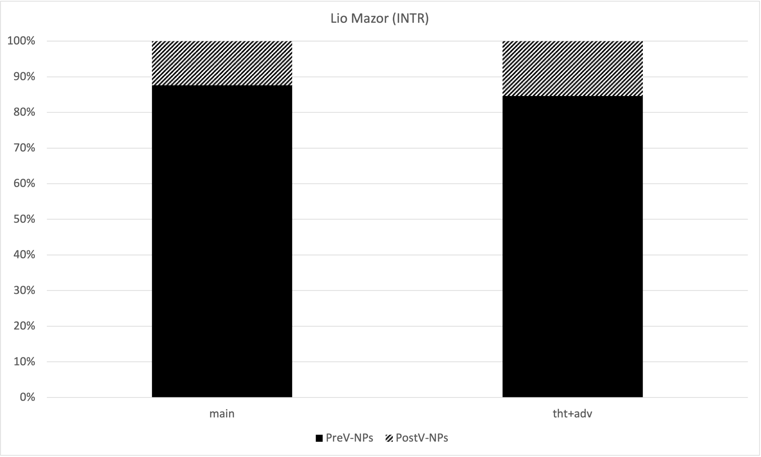
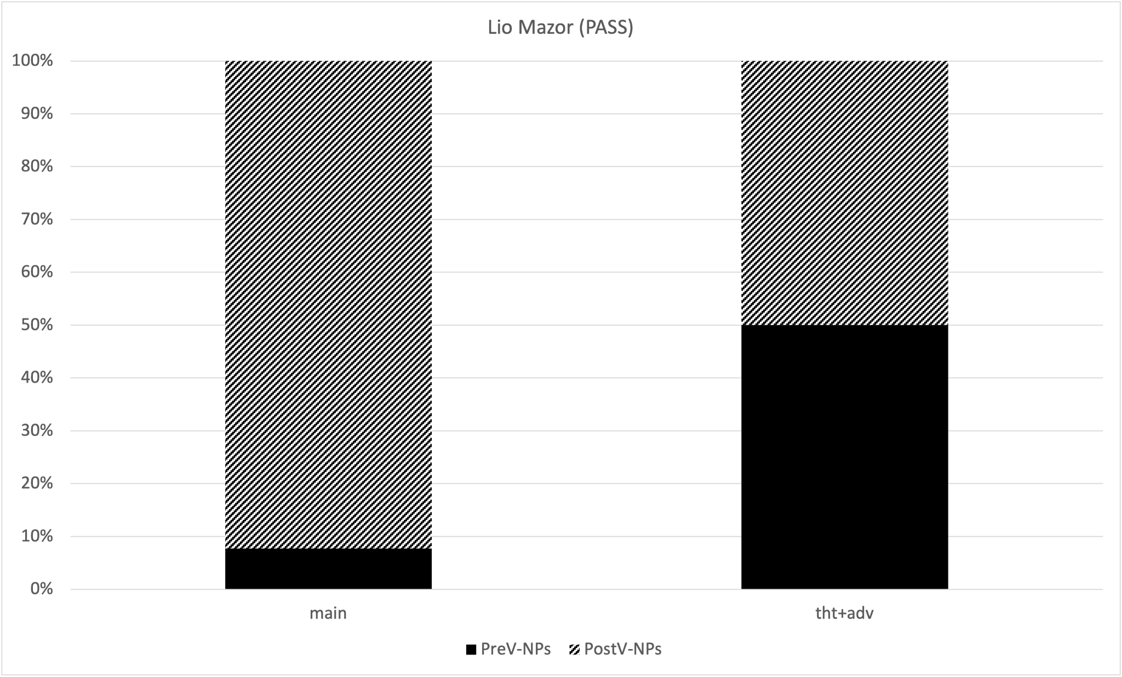
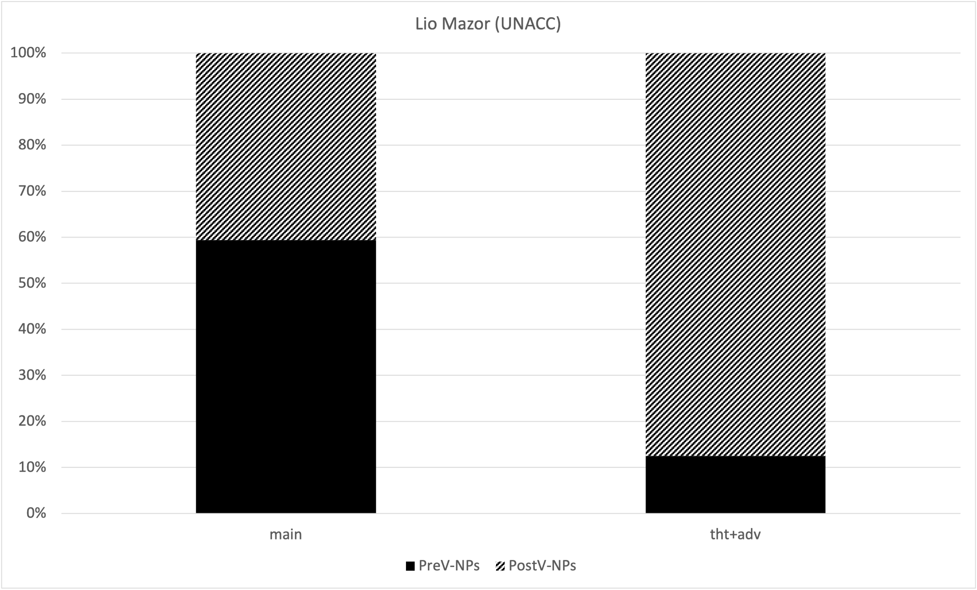
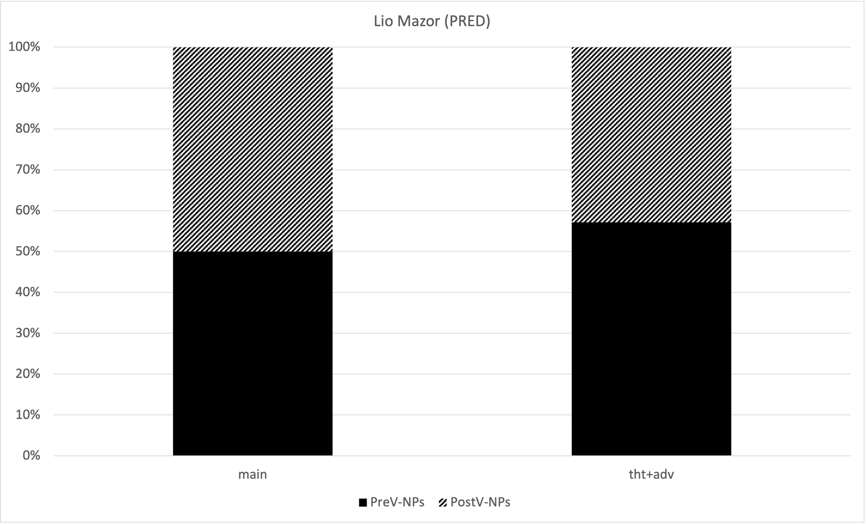
Verb type
The post-V position of non-pronominal subjects is driven only by verb-type:
Transitives
Intransitives
Pre-V NPs
Post-V NPs
Passives
Unaccusatives
Predicatives

Slide 22
Summing up
We have a clear asymmetry between pronominal and DP subjects:
Postverbal pronominal subjects are only found in main clauses and only in front of the past participle
→ high position
Postverbal DP subjects are found in both main and embedded clauses depending on the verb type (only unaccusatives, passives etc.) and are equally distributed in main and embedded clauses.
→ low subjects in the VP
No clear evidence for focused postverbal subjects in the vP periphery with transitive/intransitive verbs.

Slide 23
Summing up
Subjects in OVen can be in:
1. A SpecC position (preverbal in main clauses)
→ both pronominal and DP subjects
2. A SpecT position (G-inversion in main clauses)
→ only pronominal subjects
3. A vP peripheral position (Belletti´s low Focus position)
→ not active
4. A VP internal position with unaccusatives/passives etc.
→ only DP subjects
Why are pronouns not found in 4. and DPs in 2.?

Slide 24
A hypothesis
Suppose that SpecT is never occupied by any lexical subject (either because of pro or because of a pronominal T°).
Then the G-inversion position after the auxiliary should be some other position specialized for pronouns, where some feature attracts them.
What can this feature be?
Pronouns are typical Ground elements, they are already present in the discourse, so they are always grounded (they can also be topic or focus, but at least they have to be active in the common ground).
DPs are never grounded and non-salient, they can be topics or focis, but not grounded. This is why DPs never occur there.

Slide 25
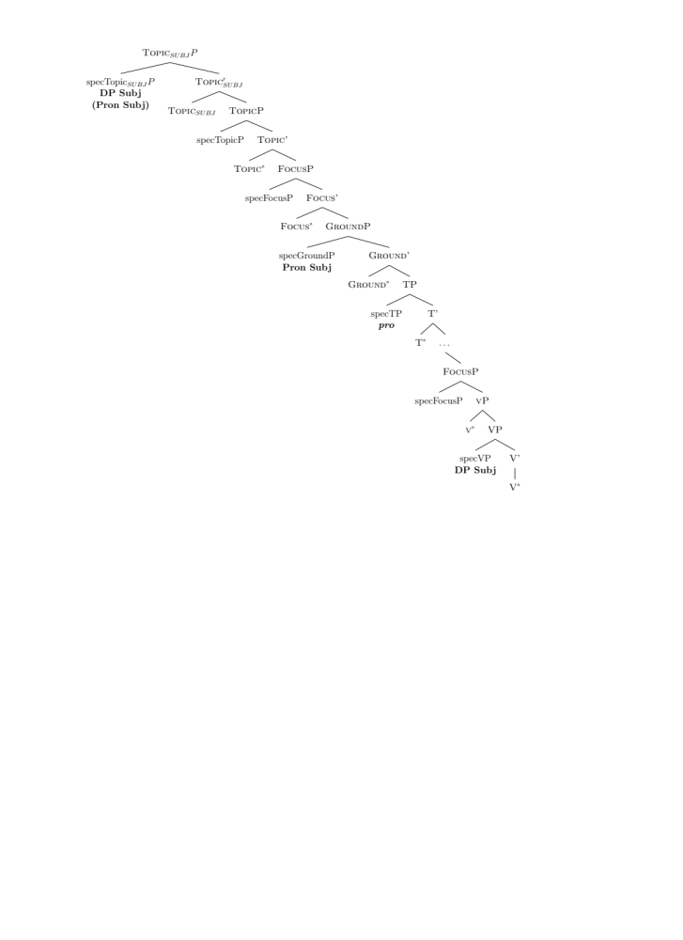

Slide 26
What happens in embedded clauses?
In embedded clauses both GroundP subjects (pronominal) and TopicP subjects (DPs) are preverbal.
This is so, because the inflected verb remains lower in the IP field.
So, no distinction emerges if we only consider preverbal subjects.
The distinction is only visible if we consider postverbal subjects in main and embedded clauses, i.e. if we cross different factors.
Only DP subjects can be postverbal in embedded clauses, as pronouns always have to move to Ground.

Slide 27
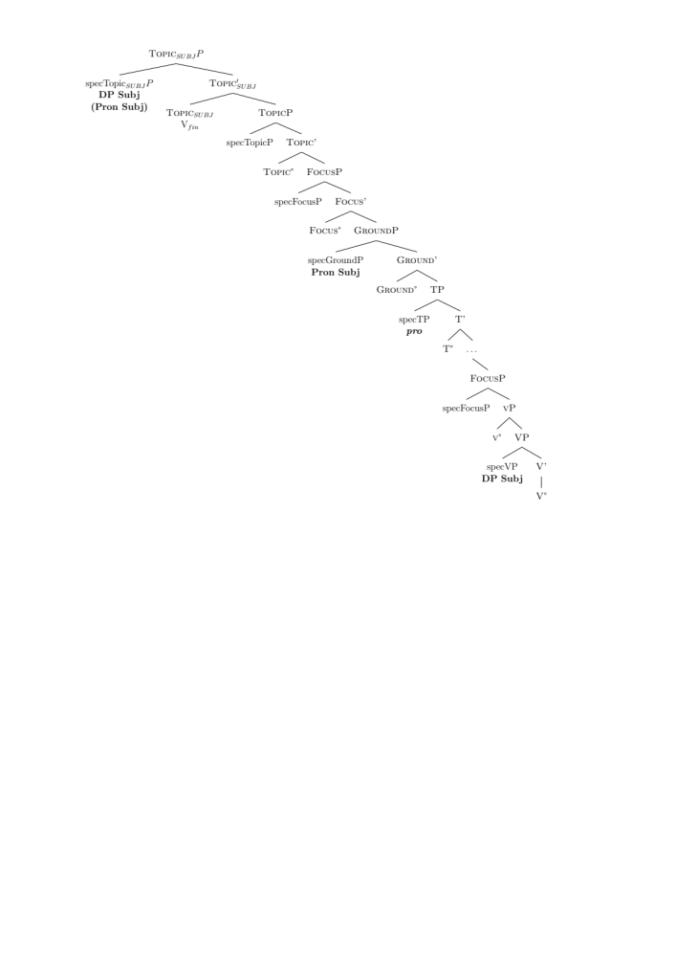
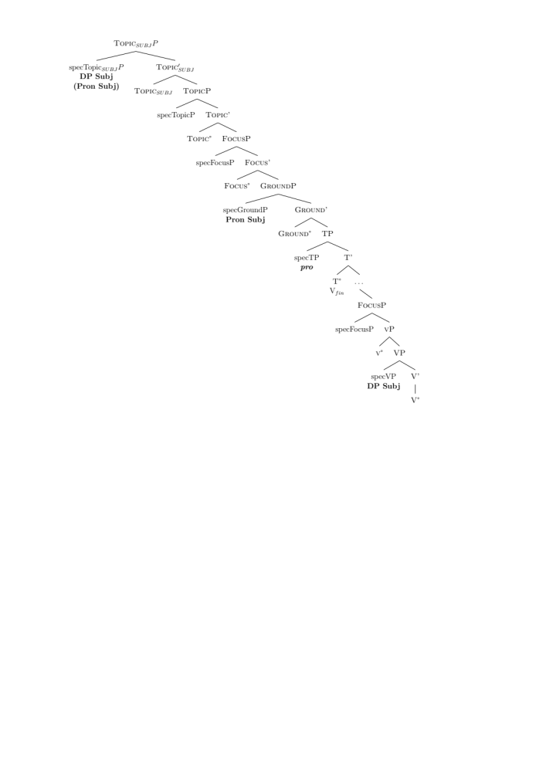
Main clause
Embedded clause

Slide 28
Further consequences I: the rise of subject clitics
When the V2 property starts to vacillate and the inflected verb is moved progressively to lower positions, subject pronouns are reanalyzed as clitics in SpecTP.
They start occurring after negation, being repeated in coordinations and have the typical properties of modern subject clitics.
Ven
No ti vien.
neg you come
‘you don’t come’
Ti magni e ti bevi tuto el dí
you eat and you drink all the day
‘You eat and drink all day’
OVen
El no vouse star content […]
He not wanted stay happy
‘He wasn‘t satisfied […]’
E he‘ respos e dis ch‘ […]
And I answered and said that
‘And I answered and said that […]’

Slide 29
Where are clitics?
Subject clitics can either be in Ground or in SpecT
In the modern varieties, they are in SpecT in declaratives
When a wh-item activates the left periphery of the clause, the GroundP is also available, then you have the following possibilities:
The clitic moves from SpecT to GroundP (as for instance in Friulian)
There is a biforcation in the system and you get two morphologically distinct subject clitic series (as for instance in Veneto)
If proclitics and enclitics are identical in terms of number and morphological form, then you have the first possibility.
If proclitics and enclitics have different forms, then you have the second possibility.

Slide 30
Example of a double system
Proclitics
1 2 3 4 5 6
- te el/la - - +i/le
Enclitics
1 2 3 4 5 6
I tu lo/la i - li/le
Te vien `you come´
Vien-tu?

Slide 31
Subject clitics and residual V2
The pro drop quality is lost for the persons where you have subject clitics: when they exist, they are obligatory.
*(Ti) vien.
You come
‘You come’
Subject clitics can still invert in the residual cases of V2 (interrogatives), be preverbal in regular declaratives and can double DP subjects, which still do not land in SpecTP even in modern Venetian but in their own dedicated position.

Slide 32
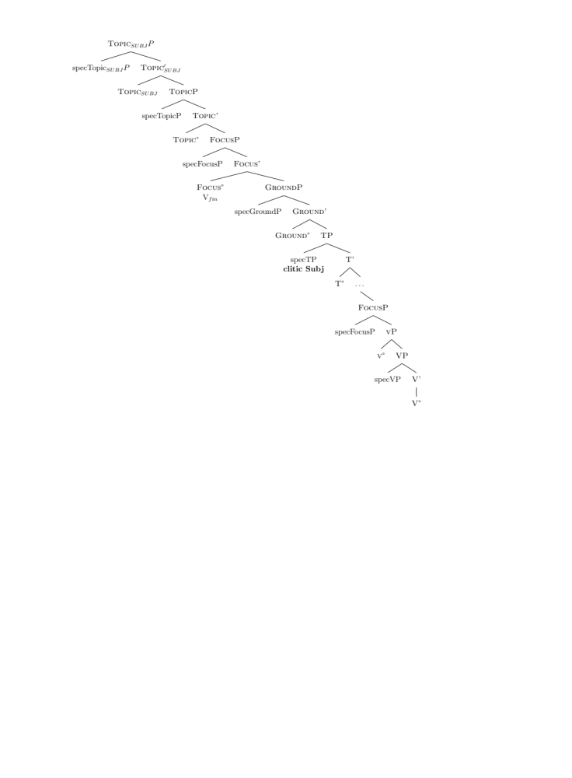
Residual V2 with interrogatives in Modern Friulian:
inversion with the subject clitic.

Slide 33
Residual V2 with interrogatives in Modern Venetian:
inversion with the subject clitic.
clitic Subj

Slide 34
Further consequences II:
Clitics as Ground elements
This also opens up a new scenario to understand what clitics are:
They are not defective in any structural sense, they do not lack Focus or Topic or other positions.
They are obligatorily marked for Ground, hence they target a specialized position in the clause.
They cannot be focussed or topicalized because they are [+ground].

Slide 35
Further consequences III: the relation to NegP
This is expected if Zanuttini´s (1997) original hypothesis about a high NegP in preverbal negation Romance languages is right:
SpecT (the position of the inflected verb) is lower than NegP
DP, QP and wh-subjects are higher than NegP
SpecT clitics are lower than NegP

Slide 36
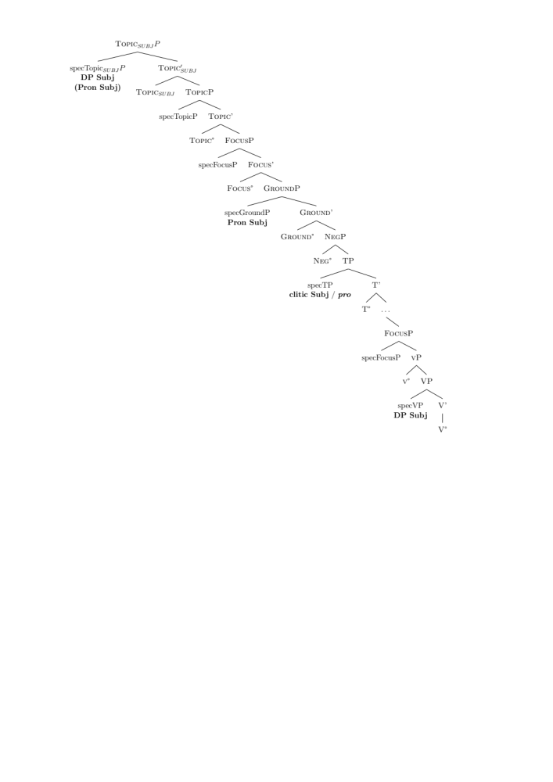

Slide 37
DPs also change
The position of DP subjects also changes:
in OVen it is a very high position due to the V2 property. There is independent evidence that OVen is a high-V2 language in the V2 typology proposed by Poletto (2002) and Wolfe (2015).
In modern non-V2 Romance, the subject position is not the one related to V2 but the one dedicated to definite subjects, lower than TopicP.
As for Focus, there are different classes of speakers. For some speakers preverbal DP subjects occur lower than Focus, for others you need subject inversion in vP if you Focus another XP, which is a residue of V2 → work in progress

Slide 38
General view on subjects
What we used to call AgrS is a set of different projections.
They are not semantically empty, they encode the interpretation of the subject
We have argued for a distinction between pronominal and DP subjects,
as well as for a distinction between DP subjects and quantifiers.
If you add that wh-subjects have their own position then you start having a more refined typology of subject positions.

Slide 39
DP, Q, WH Subjects

Slide 40
Towards a cartography of subjects
We have found that the data about Veneto dialects and old Venetian can only be explained by a cartography of subject positions.
Once we assume it we can explain:
The asymmetry between DPs and QPs in agreement patterns in the modern dialects.
The asymmetry between pronouns and DPs in Old Venetian.
The position of NegP (and other adverbs, e.g. temporal).
The rise of subject clitics.

Slide 41
References
Barbosa, Pilar. 1995. Null Subjects. PhD Thesis. MIT
Beghelli, Filippo, Stowell, Tim. 1997. Distributivity and Negation: The Syntax of Each and Every . In A. Szabolcsi (ed.), Ways of Scope Taking, 71-107. Dordrecht: Springer.
Benincà, Paola & Guglielmo Cinque. 1985. Lexical Subjects in Italian and the Pro- drop Parameter. Paper presented at the Comparative Generative Grammar Fiesta, Salzburg, August 1985.
Calabrese, Andrea. 1986. "The Interaction of Phonological Rules and Filters in Salentino," North East Linguistics Society 17 (1), Article 7.
Feldhausen, Ingo. 2016. “Inter-speaker Variation, Optimality Theory and the Prosody of Clitic Left-Dislocations in Spanish“. Probus 28(2): 293-334.
Giupponi, Elena. 1988. Pro-Drop-Parameter und Restrukturierung im Trentino. Diplomarbeit zur Erlangung des Magistergrades, Univ. of Vienna.

Slide 42
Thank you for your attention

Slide 43
In Lio Mazor, subjects in subordinates are nearly categorically preverbal (barely 2% of postverbal subjects).
→ The order is almost always SV.
Contrast with main clauses, where ≅20% of subjects are post-V.
Since inverted subjects only occur in main clauses, these are instances of Germanic subject inversion, i.e. the subject should be in SpecT and not in SpecvP.
Lio Mazor (1311) | Pre-V subject | Post-V subject | Tot
Main | 80,2% (405) | 19,8% (100) | 505
Subordinates | 98,1% (203) | 1,9% (4) | 207

Slide 44
Postverbal subjects
The few cases of postverbal subjects found in embedded clauses are only with unaccusative or passive verbs
INSERT TWO GRAPHICS

Slide 45


Slide 46
Main clause
Embedded clause

