Slide 1
LANGUAGE CONTACT AND DISCOURSE MARKERS. A CASE STUDY ON the ROMANIAN VARIETY SPOKEN IN MOLDOVA
Valentina Cojocaru
University of Bucharest
Romanian Academy, Institute of Linguistics
RoLinC
21.03.2023

Slide 2
introduction
Aims
to outline the particularities of the Romanian variety spoken in Moldova at the level of discourse markers (DMs) in the context of language contact and bilingualism
to see whether Russian DMs are pragmatic borrowings or instances of code-switching phenomenon
to answer the question “Why Romanian speakers from Moldova (bilingual or monolingual) choose borrowed DMs over their Romanian counterparts?”
to give an overview about old Romanian features that were preserved in the Romanian variety spoken on the left side of the Prut river

Slide 3
introduction
On sociolinguistic background
On DMs
On language contact and linguistic interferences at the level of DMs
Analysing data:
      pragmatic borrowings (poliubomu)
      loan translations / linguistic calques (până când, dacă ceva, nu cum)
      “local” DMs (psinică, mătincă, de-amu)
Conclusions

Slide 4
Sociolinguistic background
When two languages are in contact due to linguistic and extralinguistic factors (geographical distribution of the languages, historical background, migration from one country to another, political and economic advance or cultural prestige, etc., see Thomason 2001: 464), several deviations from the norm of either language may occur.
These obvious deviations, also known as linguistic interferences in a bilingual setting, include code-switching, borrowing of lexical and syntactic items, language transfer, linguistic convergence, etc. (Weinreich 1974, Poplack 1980, 2004).

Slide 5
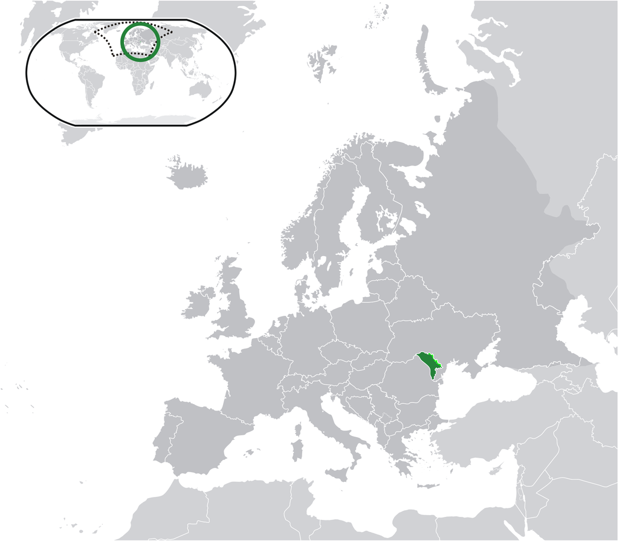
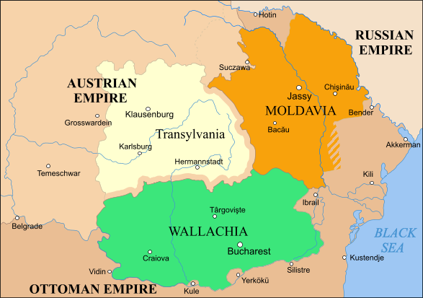
Sociolinguistic background

Slide 6
Sociolinguistic background
1812 Bessarabia is ceded to Russian Empire
1818 Russian becomes official language
1867 Russian is replacing Romanian in administration, education, and churches
1873 Romanian is forbidden in religious services
1918 Bessarabia is reunited with Romania
1944 Annexation to Soviet Union
1991 The independence of Republic of Moldova

Slide 7
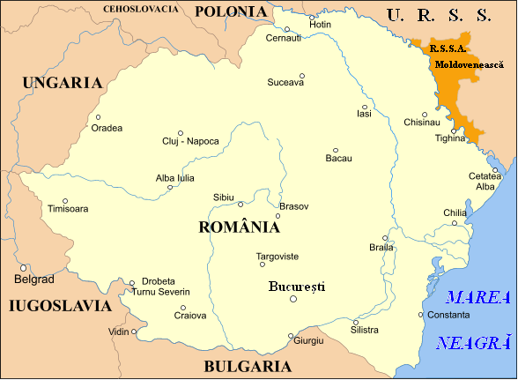
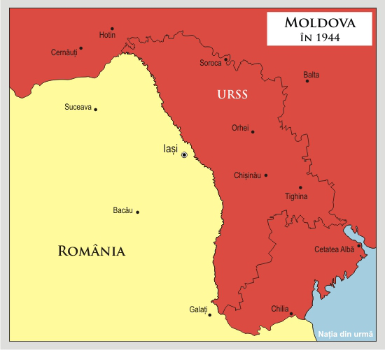
Sociolinguistic background

Slide 8
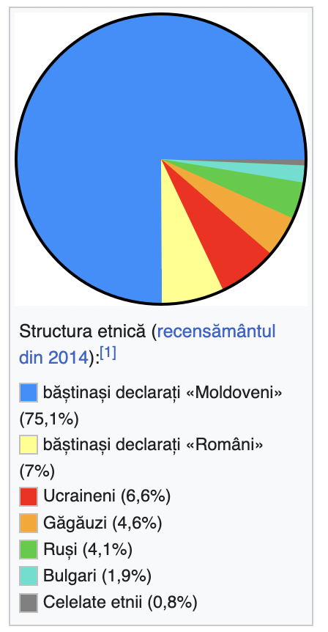
Sociolinguistic background
3rd generation of asymmetric and unilateral bilingualism
Russian as lingua franca within post-Soviet countries, in higher education, medicine, science, technology, business, and diplomatic relations.
Russian is not used only as means of intercultural communication (where speakers with different native languages are involved) but also as discourse strategies by non-native interactants inside a monolingual community.
Romanian speakers may commute between languages even if not all members are fluent in the second language.

Slide 9
Sociolinguistic background
Romanian (officially recognized as Moldovan language) is spoken by the majority of the population, however it continues to lose ground in front of Russian, given that, consciously or unconsciously, bilingual speakers still perceive it as a prestigious language.
Romanian spoken in Moldova functions under abnormal conditions (Condrea 2001, Berejan 2007, Ciobanu 2009 et al.) - > corruption of language
Massive borrowings into various areas of vocabulary, and the introduction of Russian elements into phonology, morphology, syntax and pragmatics

Slide 10
Sociolinguistic background
Language contact (Weinreich 1953, Matras 2006, Poplack 2004: 589 and others)
Two or more languages are in contact if they are used alternatively by the same persons.
The practice of alternatively using two languages will be called bilingualism and the persons involved bilinguals.
Those instances of deviations from the norms of either language which occur in the speech of bilinguals will be referred to as interference phenomena.
The interference phenomena is a linguistic manifestation of language contact and mixing, which variously include code-switching, borrowing on the lexical and syntactic levels, language transfer, linguistic convergence, etc.

Slide 11
(1) A: da’ îţi spun condiţioneru, pahodu, îl folosăşti numa: când îi damu căldură afară şî te înăduş da’ aşa noi nu pre l-am folosât.
C: da’ precis îi aşa? precis îţi scade banca?
B: asta deamu depinde şi di cum i-am zis şi eu lui, de evaluator. dacă vine aşela şî şeri, dacî scadi pi an, că-i din şaizăştrii … caroci, banca îţi dă numai cât îţi evaluează aşela casa
A: da, ciuvac, da’ vezi că poa’ să-ţi evalueze normal că el îi la stradă principală el je nu-i vârât în ...
B: şi asta-i drept
A: îţi dai sama casa asta tăt timpu a sî şie, adică oricum casa la stradă, mai ales la strada principală (xxx) poliubomu tre să șie normal … evaluatoru, înţăleji, cum o spus aşela că ii poliubomu îs cointeresaţi cât mai multă capustă să-ţi dăi că la dânşii procentu îi mai mari
B: evaluatoru’ vini şî sî uitî... Știi care e pricolu cu evaluatoru? În caz că tu nu plăteşti sî poată banca să-ş scoată banii din asta, ştii?!
A: păi el sî gândeşti tipaa
A: Yeah, I am telling you, the air conditioner, DM, you use it only when DM it’s hot outside and you are suffocating, otherwise we haven’t been using it too much / C: Yeah, are you sure it is like that? Are you sure the bank decreases [the amount]? / B: This DM depends, as I was telling him, on the evaluator. If he comes and asks, if he decreases because of the year, because if it is from ’63, DM, the bank gives[you money] only if he evaluates the house / A: Yeah, man, but DM he [also] can make a positive evaluation, because it is located on a main street, it DM is not located in some… B: True / A: You understand that this house will always be, I mean, a house located on a main street, especial on a main street (xxx) Anyway, it must be fine … the evaluator, you know, how he said, DM is interested to give you as much money as possible as the commission is bigger / B: The evaluator comes, sees.. You know what is the thing with the evaluator? In case you cannot pay [he must assure] that the bank can recover its money, you know / A: well, He thinks like…

Slide 12
Discourse markers
DMs, what are they?
(Schiffrin 1987; Schourup 1985, 1999; Blakemore 1987, 2002; Bazzanella1990; Fraser 1988, 1990, 1996; Jucker & Ziv 1998; Aijmer 1997, 2002, 2011, 2013, Fischer 2006, Heine et al. 2011)
DMs constitute a dynamic and heterogeneous functional category that includes
            adverbs (now, actually, anyway)
            coordinating and subordinating conjunctions (and, but, because)
            interjections (oh, gosh, boy)
            verbs (say, look, see),
            clauses (you see, I mean, you know)

Slide 13
Discourse markers
DMs have been often marginalized due to the difficulty to place within a traditional word class since they are semantically opaque, having little or no propositional meaning.
Syntactically, they are optional, occurring outside the syntactic structure or being loosely attached to it.
They are one of the most perceptually salient features of oral style where they appear with high frequency.
They are multifunctional, simultaneously operating on several linguistic levels.

Slide 14
Discourse markers
The most salient function is textual organization. It concerns general functions like commenting or elaborating on the preceding discourse, drawing attention to what follows, expressing a contrast between the preceding and the following discourse, highlighting specific points, etc. (Heine et al. 2011: 8)
DMs are responsible for social cohesion, signalling the relationship between the interlocutors, and personal stance, where markers indicate the speaker’s stance toward the discourse, the interlocutor, the context of interaction (Ghezzi 2014: 13–14).

Slide 15
Discourse markers & language contact
Recent studies (Maschler 2000, de Rooij 2000, Goss and Salmons 2000, Matras 2000, 2009 Torres and Potowski 2008, Andersen 2014) have established a widespread consensus that discourse markers occupy a position at the very top of the borrowability hierarchy in the context of bilingualism.
Heinne et al. (2021: 212): DMs are deeply entrenched in the socio-cultural environment and the discourse organization of a language therefore they can be affected by language contact more than many other kinds of linguistic expressions

Slide 16
Linguistic Interferences & DMs
DMs have a higher degree of borrowability due to their features.
The concepts used to describe the DMs transfer from one language to another vary among:
    code-switching (Maschler 1994, 2000, 2009; de Rooij 2000)
    tag-switching (Poplack 1980; Bullock & Toribio 2009)
    emblematic (code) switching (Goss & Salmons 2000)
    borrowing (Torres & Potowski 2008; Matras 1998, 2000)
    pragmatic borrowing (Andersen 2014)

Slide 17
Code-switching (Maschler 1994, 2000; Matras 2000; de Rooij 2000; Goss & Salmons (2000) | Lexical borrowing (loanwords) (Torres & Potowski 2008) | Pragmatic borrowing (Andersen 2014)
the ability of bilinguals to alternate effortlessly between their two languages code-switching refers to contact-induced synchronic variation in the language of bilingually competent speakers intra-sentential CS inter-sentential / extra-sentential CS emblematic CS (tags, interjections, idiomatic expressions) (Poplack 1980: 614) | are assimilated morphologically, syntactically, and often, phonologically in the recipient language; tend to be recurrent in the speech of the individual and widespread across the community; are available to monolingual speakers of the recipient language. | concern the incorporation of pragmatic and discourse features of a SL into a RL; carry signals about speaker attitudes, the speech act performed, discourse structure, information state, politeness, etc.

Slide 18
DAta
Corpus
Chat conversations
Oral conversation recorded and transcribed
Comments from social media platforms
Published corpus (see Bochmann, Dumbravă (eds) 2002)

Slide 19
data
Functions | DMs | cf. Ru. | Engl.
Positive evaluation | prikolina, klasna, kruta, narmalina | прикольно, классно, круто, нормально | „funny, cool, great” „properly, smoothly”
Negative evaluation | ujas (cu var. ujasna), kapeț | ужас, ужасно капец | „horror, terrible”
epistemic stance | canecina, iasna samo saboi | конечно, ясно само собой | „of course”, „obviously” „self evident”
Incertitude | pahodu, vrode, pamoemu | походу, вроде, помеому | „it seems”, „in my opinion”
Evidentiality | tipa | типа | „like”

Slide 20
Data
Functions | DMs | cf. Ru. | Engl.
Summarizing a conversation | caroce | кароче | „shortly”
Ending a conversation | ladna, harașo, vsio | ладно, хорошо, все | „alright”, „ok”, „fine”, „that’s it”
Changing the topic | cstati | кстати | „by the way”
Justification, excuse | prosta | проста | „just”, „simply”
Reinforcement | tembolee, vopșe | тем более, вообще | „especially”, „absolutely, totally”
Contrast | zato | зато | „however, on the other hand”
Concession | vsioravno, paliubomu | всё равно, по любому | „anyway”

Slide 21
DAta
Polyubomu
Contrastive [‘nonetheless’]
(2) E interesant, dar cam greu, dar poliubomu m-am jucat!
‘It’s interesting, but it is kind of difficult, but I played anyway.’
(3) [Filmul e] regizat bine dar se cunoaşte poliubomu că joacă aiurea :D
‘The movie was directed well, but it is obvious anyway that they act badly.’
(4) Yevro, po lyubomu, opustitsya, nado prosto zhdat' poka Amerika vladeyet resursami.
‘Euro will fall anyway. We need just to wait until America will own the resources.’

Slide 22
DAta
Additive [‘also’]
(5) Nu lucrează tv-ul, cu toate că-i nou ... imagine fără sound… am să-l cadonez lui bunelu că el poliubomu nu aude.
“The TV is not working, although it is new… picture without sound. I’ll give it to my grandfather. He is deaf anyway.”
(6) A: Tatăl vine să-l ia pe fecior de la grădiniţă. Educatoarea întreabă: Care este a dumnevoastra? -Da ne vajna [nu contează], poliubomu mâine îl aduc înapoi!
“A: Father comes to take his son from kindergarten. The teacher asks him: ‘who is your son?’ ‘Doesn’t matter. I’ll bring him back tomorrow anyway’.”
(7) Reshil tozhe chego-nabud' skreativit’. Nichego khoroshego i original'nogo v golovu ne prishlo, krome etogo, reshil dazhe na konkurs ne vystavlyat', potomu chto polyubomu ne pob'yet
‘I also decided to create something new. Nothing good and original came to my mind, except for this, I decided not to even exhibit at the competition, because anyway nothing will win.

Slide 23
DAta
Epistemic [no doubt]
(8) A: Cum crezi, acordarea cetățeniei române moldovenilor va contribui la unirea Moldovei cu România?
B: Polyubomu fără referendum n-o să facă nimika.
“A: How do you think, giving Romanian citizenship to Moldavians will lead to unification of Moldova and Romania?
B: Without referendum, nothing will happen, anyway.”
(9) Rossiyu po lyubomu ne Vostok. Potomu chto elementarno zapadnaya kul'tura, ona v Rossii davnym-davno i polnost'yu i ni v koyem sluchaye ne Indiya tam ne Pakistan, ne Vostok, ne musul'manstvo.
“Russia is not East, anyway. Because the basic western culture has been in Russia for long time ago and by no mean there is no India, no Pakistan, no East, no Islam”

Slide 24
DAta
Resultative [in consequence]
(10) Da ciuvak, da’ poate să-ţi evalueze normal că e la stradă principală [...] Îţi dai sama # casa asta tăt timpu o să şie. Adică # oricum, casă la stradă, mai ales la stradă principală # poliubomu tre să șie normal[...] ei poliubomu îs cointeresaţi cât mai multă capustă să-ţi dea că la dânşii procentu îi mai mare.
‘Well, man, yes, but he can also estimate a good price because it is located on a main street [...]. Do you understand that this house will always be there. I mean, it is a house on a main street, anyway. It has to be ok, anyway[...]. They are interested to give you money as more as possible because of the commission, anyway.’
(11) Vo vsyakom sluchaye, u nas prezidentskikh sroka dva, to yest' po lyubomu kogo-to drugogo pridotsya vybirat.
“Anyway, we have two presidential terms. I mean we have to elect someone else, anyway.”

Slide 25
DAta
LOAN TRANSALTIONS / LINGUISTIC CALQUES
până când, până ce – calque after Ru. conj./adv. пока (что) [poka (što)] (Engl. ‘for now’)
(12) Te deranjează muzica? Până când, nu.
‘Does the music bother you? Not for now’
(13) Biosept cumpără până ce 5 cutii.
‘For now, by 5 packeges of biosept’
dacă ceva – calque after Ru. если что [ésli što] (Engl. ‘if anything happen’, ‘if needed’)
(14) Se poate de cumpărat. V cred că o să vină peste vreo 2 săptămâni acasă. Daca ceva îi dau ei să-ți aducă.
‘I can buy it. I think V will come home after 2 weeks. If needed I will give it to her to bring it to you’

Slide 26
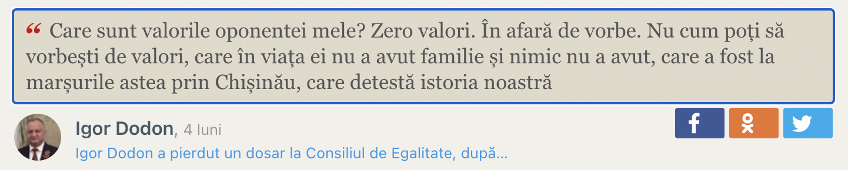
Data
nu cum – calque after Ru. ну как [nu kak] (one element is kept as in source language)
It marks interrogative sentences meaning „how are things going?”
It may mark an answer „how it can be!?”
It marks indignation, frustration „how is that possible?!”
(15)
‘What are the values of my oponent? Zero values. Except words. How it is possible to speak about values when she never had a family and nothing else, when she attended the marchings in Chișinău, when she is detesting our history’

Slide 27
data
“Local” DMs
ÎNDEOBȘTE
Engl. „generally speaking”
(16) Automobilu se află în stare bună... A fost adus în februarie 2018... Este al meu personal... Îl vind ca am nevoie de bani. NU SCHIMB!!! Este foarte econom... Îndeobște una din cele mai bune automobile la asa pret...
‘The car is in good condition. It was brought in February 2018. It is my personal car. I am selling it because I need money. No exchange! It is very economical. Generally speaking it is one of the best cars at this price.’
(17) Îndeobște, I feel happy. Chiar sunt și momente cînd te simți fericit/ă și nu știi de ce?! Surprinzător, dar sunt.
‘Generally speaking, I feel happy. There really are moments when you feel happy and you don't know why?! Surprisingly, they are.’

Slide 28
data
ÎNDEOBȘTE – reinforcement marker
Engl. „especially”
(18) Situația e foarte proastă la noi, îndeobște la Bariera Orhei, drumul ăsta nu se face curățenie niciodată.
‘The situation is very bad here, especially at Bariera Orhei, this road is never cleaned.’
(19) El dacă îl "trevojești" olecuțică și la trezie sare, dar la beție îndeobște.
‘If you "trouble" him a litle, he gets angry when he is not drunk, but especially [he gets very angry] when he is drunk.
Engl. „at all”
(20) La mine toți preoții din raion au slujit afară sau îndeobște n-au slujit cât a fost starea de urgență.
‘All the priests from my district did the ceremony outdoors or, did not serve at all during the state of emergency.’
(21) Nu există sănătate pe lume îndeobşte.
‘There is no health in the world at all’

Slide 29
data
PSINICĂ - evidential marker ‘it seems that’
(< pe + semne + că, trough reduction)
on signs that
(22) El a pălit-o psinică cu capul de perete. Era de sânge peretele, a spus mama victimei.
‘It seems that he slammed her head against the wall. There was blood on the wall, said the victim's mother’
(23) Toți doreau să trăiască-n Chișinău și să vadă Moskowa și Italia (psinică, visele devin realitate)
‘They all wanted to live in Chisinau and see Moskow and Italy (it seems that dreams come true)’
(24) Psinică numai Daria știe să iasă frumos în poze.
‘It seems that only Daria knows how to beautifully pose’
(25) Psinica tinara astai e nepoata lui Putin ca alta explicatie nu am.
‘It seems that, this young woman is Putin's niece, I have no other explanation’

Slide 30
data
MĂTINCĂ - epistemic marker of opinion ‘I think’
(< mă + tem + că)
I am afraid that
(26) A: noroc. tu când te pornești înapoi spre București
B: Saliut, cred că Marți seara sau miercuri pe la amiază
A: mmm clar. Mătincă o să meargă cu tine sora lu’ S.
‘A: hi! When do you return to București? B: Hi. I think Tuesday or Wednesday evening A: mmm, I see. I think the S’ sister will go with you’
(27) A: filme chinezăști îți plac ?:D
B: ia dă să văd , și-ți spun ... :D dacă mi-ar plăcea ți-oi mulțumi, dacă nu ... tot :P
A: da nu mai țin minte cum se numeau, am văzut vreo 3
B: eee iaca na
A: da mătincă le-ai vazut
‘Do you like Chinese movies? Let me see and I’ll let you know. If I like them, I would thank you, if not, as well. A: But I don’t remember their titles, I have seen around 3. B: no! A: yeah. But I think you have seen them already.

Slide 31
data
MĂTINCĂ - marker of intensification (‘It seems’)
-an intention
(28) A: ladna [bine], fug eu mătincă la culcare, că așa ni-i sommmmn.
‘Al right, I am running MD to bed, I am so sleepy’
-a reproach
(29) Tu mătincă cartea de gramatică n-ai văzut-o niciodată.
‘You MD have never seen the grammar book’
-an irony
(30) [i]eri aţi spus cod galben la vânt... 15-20 m/s, doar că erau vreo 4, iar azi îmi spuneţi cod galben de ploi, lapoviţă etc. Minciuni! O să vedem... matincă o să bureze oleacă
‘yesterday you said code yellow for wind, 15-20 m/s, only it was about 4, and today you tell me code yellow for rain, sleet, etc. Lies! We'll see. I think/It seems it will drizzle a little ’

Slide 32
data
DE-AMU (also deamu, deam) - mitigation maker
attenuates a regret
(31) A: I-ai spus că te duși și tu la Chișînău?
B: N-am apucat să-i spun.
A: Spune-i! Poate n-a plecat încă.
B: Deamu…
‘A: Have you told him that you are going to Chișinău?/ B: No, I had no chance to tell him/ A: Tell him! Maybe he has not left yet / B: ‘Well [it is too late]’’
attenuates a request:
(32) A: Eu ți-am făcut transfer de 400 de lei. Tare sper să fi făcut corect.
B: Pare bine.
A. Deam mă anunți oricum.
‘A: I have transfered you 400 lei. I really hope to have done it correctly’ B: It seems ok. A: DM let me know anyway'

Slide 33
data
DE-AMU (also deamu, deam) - mitigation maker
attenuates a refusal
(33) Deamu mâine o să instalăm altu’ și o să încercăm.
‘DM [=tonight is too late]Tomorrow we’ll install another one and we’ll try it’
a change of topic
(34) Aha, de-amu di-mult iești în Bălț?
‘mhm, so, you’ve been in Bălți for a long time’
marker of concession
(35) A: Ce-ai vrea să fie, fată sau băiat?
B: Deam ce-o fi.
‘A: What would you like it to be, a girl or a boy? [DM – it doesn’t matter]

Slide 34
Discussion
What motivates language change?
The first theoretical framework was drawn in 1987 by Verschueren, who claims that pragmatics should consider not only the use of language in micro-situations (i.e. among individuals in a society), but should also relate to the macro level of language, where interferences take place, and to the speaker’s adaptation to changes regarding the sociocultural circumstances that create a new distribution in their verbal resources (Argente & Payrató 1991: 465).
The pragmatic dimension in studies on language contact plays a significant role in understanding why certain types of changes occur. The main triggers of language change in contact situations are expressiveness, functionality, explicitness, economy of resources in the processes of language production and understanding (Argente & Payrató 1991: 469).

Slide 35
Discussion
  The strategic exploitation of the contrast between two systems.
  Maschler (1994): DMs are often highlighted by a language switch: the discourse they frame takes place mostly in one language, while the framing itself takes place in another.
  De Rooij (2000): borrowed markers contrast with their linguistic environment and, hence, are more salient than native markers.
  Matras (2000) proposes that motivation for switching at DMs is a cognitive process, rather than strategic, based on the nonseparation of the systems.
  Matras suggests the concept of a “pragmatically dominant language”—the language towards which a speaker directs maximum mental effort at a given instance of linguistic interaction.
  Pragmatic borrowings and emblematic switches are motivated in those communities where speakers identify themselves with dominant language and culture.
  Specific DMs have assumed emblematic functions as signals of group identity (see also Heine et al. 2021)

Slide 36
conclusions
The linguistic interferences between Russian and Romanian are also reflected at the level of discourse markers through:
      pragmatic loans (or pragmatic borrowings)
      Partial or total loan translations (linguistic calque)
      the preservation and spread in use of some Romanian constructions with a regional and outdated character in relation to the standard variety of the Romanian language
DMs are susceptible to borrowing because they are peripheral, optional, multifunctional, oral etc.
The fact that in a lot of bilingual communities code-switching at DM level and pragmatic borrowings are very common suggests that DMs are perceived as a distinct and unified category.
Code-switching might be explained in terms of a conversational strategy that aims at highlighting the boundaries of conversational units.
Pragmatic borrowings involve a cognitive process of nonseparation between systems.

Slide 37
references
Aijmer, Karin & Anne-Marie Simon-Vandenbenbergen, 2006, Pragmatic Markers in Contrast, Amsterdam, Elsevier.
Andersen, Gisle, 2014, “Pragmatic borrowing” in Journal of Pragmatics, nr. 67, p. 17-33.
Bochmann, K., V. Dumbravă (eds) (2002). Limba română vorbită în Moldova istorică, vol. I‒II. Leipzig: Leipziger Universitätsverlag.
Brinton, Laurel, 1996, Pragmatic Markers in English: Grammaticalization and Discourse Functions, Berlin, Mouton de Gruyter.
Bullok, Barbara E., Toribio, Almeida J., 2009, The Cambridge Handbook of Linguistic Code-switching, Cambridge University Press.
Costea, Ș. (2018). “Verb movement in Moldovan Daco-Romanian: Romance heritage or Russian influence?”. In V. Cojocaru, M. Naidinoaia-Tăbăcitu, A. Nicolae, R. Zafiu (eds) Variație în română și în limbile romanice. Bucharest: Editura Universității din București, 47‒57.
De Rooij, Vincent A., 2000, „French discourse markers in Shaba Swahili conversations” în International Journal of Bilingualism, vol. 4, nr. 4, p. 447-467.
Diewald, G. (2011). “Pragmaticalization (defined) as grammaticalization of discourse functions”, 49 (2): 365–390
Ferrara, Kathleen W., 1997, “Form and function of the discourse marker anyway: implications for Linguisticsdiscourse analysis” in Linguistics, 35, vol. 2, pp. 343-378.
Goss, Emily L. & Salmons, Joseph C., 2000, „The evolution of a Bilingual Discourse Marking System: Modal particles and English markers in German-American dialects” în International Journal of Bilingualism, vol. 4, nr. 4, p. 469-484.
Gumperz, John, 1982, Discourse strategies, Cambridge University Press.
Heine, Bernd, Gunther Kaltenböck, Tania Kuteva, Haiping Long, 2021, The Rise of Discourse Markers, Cambridge University Press.
Jucker, Andreas & Yael Ziv, 1998, Discourse Markers: Description and Theory, Amsterdam/Philadelphia, John Benjamins.

Slide 38
references
Maschler, Yale, 2000, „What can bilingual conversation tell us about discourse markers?: Introduction” in International Journal of Bilingualism, vol. 4, nr. 4, p. 437-445.
Maschler, Yale, 2000, „Toward fused lects: Discourse markers in Hebrew-English bilingual conversation twelve years later” in Iternational Journal of Bilingualism, vol. 4, nr. 4, p. 529-561
Matras, Yaron, 2000, „Fusion and the cognitive basis for bilingual discourse markers” în International Journal of Bilingualism, vol. 4, nr. 4, p. 505-528.
Poplack, Shana ,1980, „Sometimes I’ll start a sentence in English y terminó en español: Toward a typology of code-switching” în Linguistics 18, p. 581–618.
Romaine, Suzanne, 2004, “Language-Contact Studies” în Ulrich Ammon et al, Sociolinguistics: An International Handbook of the Science of Language and Society, vol. 1, Berlin/New York, Walter de Gruyter, p. 49-58.
Sankoff, Gillian, 2008, „Linguistic Outcomes of Language Contact” in The Handbook of Language Variation and Change, Blackwell Publishing, p. 480-502.
Schourup, Laurence, 1999, “Discourse Markers”, in Lingua, nr. 107, p. 227-265.
Schiffrin, Deborah, 1988, Discourse Markers, Cambridge Univerity Press
Thomason, S. G., 2001, „Contact languages” în L. Mesthrie (Ed.), Concise Encyclopedia of Sociolinguistics, Amsterdam/New York, Elsevier.
Torres, Lourdes & Potowski, Kim, 2008, „A comparative study of bilingual discourse markers in Chicago Mexican, Puerto Rican, and MexiRican Spanish” în Iternational Journal of Bilingualism, vol. 12, nr. 4, p. 263-279.
Weinreich, U., 1974, Languages in contact. Findings and Problems, The Hauge, Mouton.

