Slide 1
Analytic marking of obliques in Romanian: the case of lu(i) and li…
Oana Uță Bărbulescu
University of Bucharest, University of Oxford, Institute for South-East European Studies,
oana.uta@ling-phil.ox.ac.uk.

Slide 2
Prenominal marking is – if we were to consider only the data from grammars – a simple and marginal aspect of Daco-Romance morphosyntax. Simply put, a kind of Cinderella of morphosyntax.
The rules governing the selection are – according to the grammars and the main descriptive works (Sandfeld&Olsen, Jordan, GLR, GALR, etc.) – very simple, the categories of names showing this mark being:
all masculine anthroponyms, plus feminine ones ending in a consonant or ending in a vowel other than -a
all masculine anthroponyms, plus feminine ones ending in a consonant or ending in a vowel other than -a
lui Ion lui Matei lui Radu
lui John lui Matthew lui Radu = to John/John’s, to Matthew/Matthew’s, to Radu/Radu’s
lui Carmen lui Jeni_{F}
lui Carmen_{f} lui Jeni_{f}
2) nouns "resembling proper names" (GALR: 84)
a) months of the year
sfârșitul lui iunie, lui mai, lui august
end.the lui June lui May lui August = the end of June, May, August
b) years
sfârșitul lui 1990
end.the lui 1990 = the end of the year 1990
c) occasional metalinguistic uses of prepositions, conjunctions, and other invariant words as nominals
absența lui și
absence.the lui și = the absence of the conjunction și
If everything is so clear and simple, why would there be a need for a presentation on this prenominal marking?

Slide 3
This apparent stability of prenominal marking seems to be contradicted by the grammars themselves, insofar as even they admit that there was more variation in diachrony, but also at the diastratic, diaphasic level.
For example, SLR (1936: 68-69) states that: „Les noms de famille en -u(l) employés tout seuls peuvent former le génitif de façon ordinaire: băetul Mălăerului B-V Lu. 167… On trouve aussi les deux procédés avec les noms masculins en -a: … Ionu Bodii Ag. Int. 5 – lui Bodea … ”
While Jordan 1948 [1943]: 82 states that: „Numai cele terminate în -a pot fi, din cauza finalei, asimilate cu numele apelative (cf. Duminica Tomei, Nică a lui Ştefan a Petrei, etc.), deşi chiar la ele predomină antepunerea articolului (lui Toma, a lui Petrea, etc.). Cu scopuri stilistice, şi celelalte nume masculine primesc articolul la sfârşit (conspiraţia Dărmănescului, vitejia Radului, etc.), ca în limba veche şi, pe alocuri, în cea populară actuală” (sublinierea mea)/ Only those ending in -a can, because of their ending, be assimilated to appellative nouns (cf. Duminica Tomei, Nică a lui Ştefan a Petrai, etc.), although even with them the prenominal position of the article predominates (lui Toma, lui Petrea, etc. .). For stylistic purposes, the other masculine nouns take the postnominal article (Dărmănescu’s conspiracy, Radu’s valor, etc.), as in the old language and, in some places, in current popular language (my emphasis).
And GLR 1963: 88 mentions that: „Cele terminate în -(e)a se declină fie la fel cu celelalte, fie, mai rar (în vorbirea populară), după modelul numelor proprii feminine, din cauza terminaţiei identice cu a acestora: Toma – al Tomei (obișnuit lui Toma) – Tomo, Oprea – al Oprei (obișnuit lui Oprea ) – Opreo”./ Those ending in -(e)a decline either like the other masculine nouns, or, more rarely (in popular language), according to the declension of feminine proper names, because of their identical ending: Toma – Tomei (usual marking lui Toma) – Tomo, Oprea – Opreei (usual marking lui Oprea) – Opreo (my emphasis).
Thus, fundamental descriptive works and grammars – despite treating prenominal marking as a marginal aspect of morphosyntax – admit that there is variation in diachrony as well as at the diatopic, diastratic level etc. The notion that the norms of a literary language are “fixed” is somewhat relative (despite all the importance and stability of the norm, it changes over time).

Slide 4
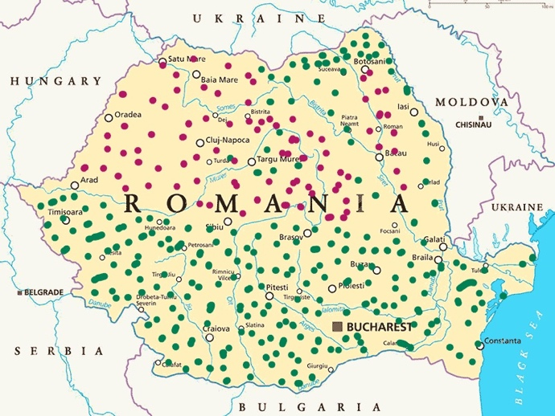
Linguistic atlases show a clear isogloss for lui and lu, which has contributed to some extent to the marginalization of prenominal marking.
The green area represents the lu area, while the red area represents the lui area. According to ALR II s.n. vol. 6, the lui area comprises north-western, central and eastern Transylvania and central Moldavia, while the lu area comprises Muntenia, Banat-Hunedoara, south-eastern Transylvania, northern and southern Moldavia, some isolated points in north-eastern and central Transylvania.

Slide 5
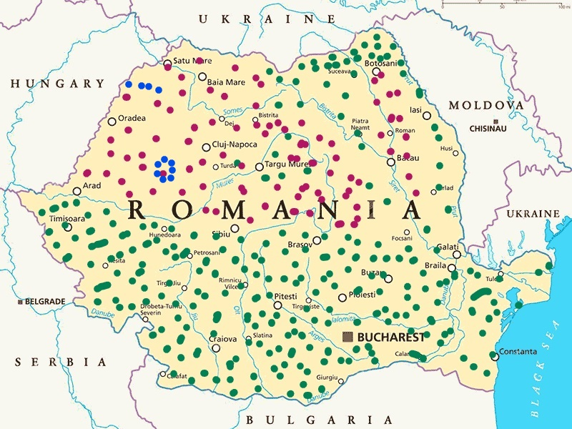
Yet…
Data from dialect text collections as well as from ALR II s.n. show that the situation is rather more complicated, because there is one more marker, li:
The blue dots indicate a discontinuous area, in the south of Bihor and in the Apuseni Mountains (more precisely in Țara Moților) where the li marker is attested.
So the situation is a bit more complicated. And not only for masculine anthroponyms oblique forms…

Slide 6
In order to understand the asymmetrical way in which anthroponyms and their morphosyntactic behaviour are attested in the 16th century, we need to take into consideration data from the so-called Slavo-Romanian and Latin documents written in the 14th and 15th centuries. These facts are usually not taken into account in the histories and grammars of the Romanian language.
In the 16th century, some anthroponyms are attested with oblique forms with suffixed -lui, while others are not. How can this asymmetry be explained?
The first thing to note is that the anthroponyms have diverse origins and this has influenced their morphosyntactic behaviour. Next, their morphophonological characteristics have influenced this behaviour. In other cases, it is about - most likely – an idiosyncratic behaviour. In the 14th and 15th century Slavo-Romanian documents, there are several categories of masculine anthroponyms that bear the definite article or have an ending assimilated to the definite article:
1) Secular anthroponyms of Latin origin, derived from nicknames that come from adjectives or nouns: (Albul 1389, Barbul 1389-1400, Crețul 1482, Fătul 1469, Lupul 1490, Micul 1415, Negrul 1476, Orbul 1495, Păunul 1483, Puiul 1453, Rătundul 1476, Tatul 1432-1440, Taurul 1475 etc.);
2) Secular anthroponyms of Slavonic origin, also derived from nicknames, originally participial adjectives (Pârlitul 1478), or adjectives (Dragul 1469) (and pârli, and drag were already borrowed from Slavonic) or nouns (Bobul 1447);
3) Masculine anthroponyms with adjectival form - derived with the suffixes -escu and -(e)anu; the former derives patronyms (the derivation with -escu means 'son of ...'), whereas those in -eanu (or -anu under certain phonological circumdstances) are derived from toponyms, in particular, the birthplace of the bearer of the name): Bârseanul 1429 (< Bârsa), Făgărășanul 1488 (< Făgăraş), Izvoranul 1496 (< Izvor or Izvoară, most probably the name of a village) etc.

Slide 7
4) Anthroponymic names formed from Slavonic names or truncated from so-called bithematic names (actually Slavonic compounds), which were originally common names, but also from quantifiers: Bratul 1431-1436 < Brato < Bratomir, Bratoslav, Brativoj, Dragobrat < vsl. *bratrŭ *bratŭ „frate”=brother; Dobrul 1486 < Dobromir, Dobroslav < vsl. *dobrŭ „bun”=good, Pârvul 1482 < vsl. *prŭvŭ „primul”=first, Radul începând din documentele din secolul al XIV-lea < Radomir, Radoslav < vsl. *rаdŭ „vesel”=glad, merry, Vâlcul 1389-1400 < vsl. *vlŭkŭ „lup”=wolf, etc.
In the nouns in 1) and 2), the form with the article is motivated, especially in nouns derived from adjectives, because it represents the nominalization of the feature considered the most salient for the referent. All these names appear with the postnominal article, because – originally - they could attach it postnominally. All these nouns have oblique forms in -lui, as expected, and they retain these oblique forms throughout the old period.
It is obvious that the anthroponyms under 3) were assimilated to the adjectives ending in -esc and -ean, so the mechanism that led to the suffixation of article is the same as in types 1) and 2). The aspect of names under 4) can also be explained by the same mechanisms, especially for anthroponyms coming from adjectives or from names whose Latin counterparts had the same treatment in the onomastic system (see the pair Lupul – Vâlcul etc.).
A word about the anthroponym Radu(l). In Romanian a form ending in -o was definitely borrowed, because the -u ending in this name is perfectly stable and absolutely independent of the viability of the -u in the phonetic type bunu.

Slide 8
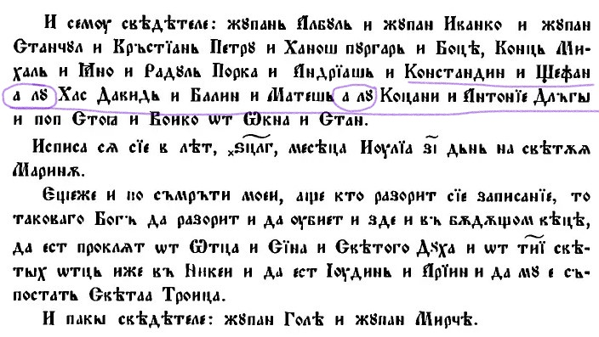
But in the 15th century Slavic-Romanian documents the prenominal lu/ lui is also attested:
The prenominal lu is attested in a document from Wallachia dated to 1425 (and not from 1421... as stated in Mareș, Gheție) in which Petriman's witnesses are mentioned when he donates his fortune to the Holy Trinity church, Cozia monastery.
The document from 1425 is the more important because it is a private document, which was not drawn up in the royal chancellery. The scribe faithfully reproduced (at somebody’s dictation?) the names of the witnesses.
The witnesses are:
Constandin și Ștefan a lu Has David și Balin
Constantin and Ștefan a lu Has David and Balin
și Mateș a lu Coțani
and Mateș a lu Coțani

Slide 9
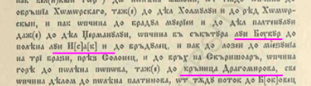
The prenominal lui is attested in a document written in the royal chancellery of Moldavia in 1491 and appears in the structure of some toponyms:
The toponyms are:
Săcătura lui Bucur
Place.in.a.forest.used.as.pasture lui Bucur
Poiana lui Isac
glade.the lui Isac
(compare to the Slavonic morphology in fântâna lui Dragomir).

Slide 10
The situation in documents written in Wallachia, Moldavia and Transylvania in the 16th century is quite uniform, being characterized primarily by the preservation of the aspects mentioned under 1-4) (see forms of the type Arbănașului, Sârbului, Bălosului - all nicknames, derived from ethnic names arbănaș = Albanian, sârb = Serbian or adjectives bălos = slabbering and of the type Radului), but at the same time reflecting interferences between the type with the postnominal - lui and the prenominal lui/lu.
The features are as follows:
1) the limited distribution of the prenominal lui/lui markers with the names mentioned under 1-4). This marker is marginally used with names that originate in nicknames. Its use with these names is still in its early stages and its generalization (lui Arbănaș, lu Murgu, etc.) is – contrary to the most widespread opinion – very late (it had not happened at the end of the Old Romanian period);
2) some anthroponyms have a wide range of derivatives (some of them with a very opaque structure); for example, Ion becomes (probably in some syntact contexts, most likely after the prenominal lui, with which it combines extremely frequently), Onu (the form without the palatal vowel occurs with final -u much more often than the primary form). A variant of Ion is Ian – due to Greek and possibly Polish influence (in Wallachia and Moldavia), but also Hungarian (in Transylvania); from Ian, by adding the Slavic (diminutive-hypocoristic) suffix -cu/ -co (< sl. -ko), the result is Iancu. Another suffixed form of Ion, Ionacu (< Ion + ac(u)), leads, by truncation, to Nacu. Interestingly, Ion does not appear in Slavo-Romanian documents, nor in Latin documents, nor, later, in Romanian documents with an oblique form in -lui; on the other hand, all the names "derived" from it (either internal creations or modified under the influence of onomastic correspondents from other languages, as in the case of the form Ian) occur extremely frequently with the the postnominal -lui: Iancului, Nacului, Onului. The cause of this differential treatment is undoubtedly to be found in the phonetic structure of the "derivatives", which are forms with a stable -u (see also below);
3) Vladului, the oblique form of Vlad (of Slavonic origin) ("cut" from Vladislav, Vladimir) which belongs to a different phonetic type from Radu, is also a form of interference.

Slide 11
Anthroponyms in -a, -(e)a or - (j)a – regardless of whether the final segment contains the suffixed article or an anthroponymic suffix assimilated to the article – are attested with oblique forms that follow the inflexion of common feminine names:
Stoii, Cârstei, Dimei, Dumei, Ierimiii/ Ierimiei, Manii, Nedei, Niculei, Oprei, Oancei, Predei, Puii, Bodii, Gonței (in Wallachia) and Teahni, Giurjii, Făti, Givei, Manei, Popoții (in Moldavia).
Oblique forms with the prenominal lui/ lu are attested, but they remain – throughout the entire period of old Romanian – marginal (see, for example, lui Giva in Petru Șchiopul documents, who had learned Romanian late and did not master it very well, and lu Baștea in a document from Wallachia).
The formal criterion also controls the morphosyntactic behaviour of masculine anthroponyms ending in - ca/ -că, -ga/ -gă, which have oblique forms such as Bangicăi, Potârcăi, Buscăi (as in the old form poruncăi) or Baschii (as in maichii), like the feminine anthroponyms or common nouns ending in -ca/ -că, -ga/ -gă.

Slide 12
Original (i.e., non-translated) documents from the 16th century contain several attestations of common nouns having oblique forms with the prenominal lui/ lu. These include lu voievod (to/of Voivode) and lu(i) crai (to/of king) – both refer to titles and indicate high-ranking persons in the medieval political-administrative structure. The oblique forms with postnominal -lui prevail. Vodă, on the other hand – also a title – behaves as a singulare tantum and presents exclusively forms with the prenominal lui/ lu (it behaves differently, however, when used as an anthroponym, having the oblique form Vodei/ Vodii). In documents from Wallachia, the prenominal lu + voievod / crai does not appear in official documents (these are brief notes/records on inventories, etc.). It is not excluded that this extension of the use of the prenominal lui/ lu is due to the reduction of structures such as lu/ lui + proper name + title (very well attested at the time): lu/ lui Mihai voievod, lu Jigmon craiu > lui/ lu voievod, lui/ lu crai, etc.
In the case of a complex group, modifier + proper name + title, in which the article attaches to the modifier, lui may appear as a marker to the whole group:
să creadză aceii mărtorii
să believe.conj.3 that.oblique testimony.oblique
a lui putenciosul Pătru-vodă
a lui powerful.def. Pătru-king
So that they believe in that testimony of Pătru-vodă

Slide 13
Thus, according to the data from the original documents (Slavo-Romanian, Latin, and Romanian), the oblique forms of masculine anthroponyms are only partly due to their phonological form. There is no free variation between the forms suffixed with -lui and those with prenominal lui/lu, much less a generalisation of the lui/ lu mark to masculine anthroponyms.
There are specialised types, but it is sometimes very difficult to decide what determines their form:
- clearly not the presence/absence of the final -u, because names with a stable final -u (Pătru) or a very resistant final -u (Mihaiu) are not compatible or have lost their compatibility with the postnominal article, while other names with a stable -u (Radu, Staicu, Danciu, Iancu) frequently appear with an postnominal article. The difference between the first category and the second consists in their etymology (?), but it is curious that it is precisely the oldest names (Pătru) that do not admit suffixation, while the Slavonic loanwords do (in principle, it would be expected to be the other way around);
-nouns that end in vowels are also differentiated; for example, names ending in -a of various origins (derived in Romanian: Florea; of Slavonic origin: Preda, Stoica, Mihalcea, Manea; or Biblical names: Zaharia, Ieremia) admit suffixation. Names ending in -ă of various origins (inherited: Nicoară; created in Romanian: Frățilă; of Slavonic origin: Stănilă) do not admit suffixation. Neither do those in -ie (Grigorie, Vasilie, Teodosie), although they could be assimilated to feminine -́ie / -́ia (Eudoxia etc.). The differences that arise here are related to the variants of adaptation: Arie admits the postposition, but this is because it has a variant in -ia (Aria).

Slide 14
The 16th century translations do not show a situation much different from that in the original documents. At least, at first glance.
Translations from the 16th century show that the area where lu is widely used is Banat-Hunedoara. Texts from this area were copied in Moldavia, so an influx of forms from this area cannot be excluded for Moldavia.
Given the geographical origin of the translators of the Palia de la Orăștie, the language of the text, which is very uniform, reflects the dialect spoken at the end of the 16th century in the Banat-Hunedoara area. Even in the case of Paliei of Orăștie, the distribution of the prenominal lui and lu may be slightly different, in the sense that lu is preferred in the second part of the text.
The text of Paliei of Orăștie provides clues to a possible acceptance hierarchy of of prenominal marking in masculine anthroponyms ending in -a:
ficiorii lui Raima
sons.the lui Raima
PO G 10: 7 = the sons of Raamah
feciorii lui Deda
sons.the lui Deda
PO G 25: 3 = the sons of Dedan
But even in the case of these anthroponyms, a difference in treatment can be observed according to their frequency, Raima, Deda have few occurrences and are not frequently attested, so they are the first affected by the extension of prenominal marking. While Iuda, Anania, Eremia - which have more attestations, show postnominal marking and, less frequently, prenominal marking:

Slide 15
Spuseră Iudăei
tell.ps.3pl Iudă.oblique PO G 38: 24 = they told Judah
Feciorii Iudeei
Sons.the Iude.oblique.oblique PO G 46: 12 = The sons of Judah G 46: 12
Haliva, fata Ananiei (=Oholibamah, the daughter of Anah) PO G 36: 2
carea fata Ananiei şi muiarea lu Isav era (= which was the daughter of Anah and wife of Esau) PO G 36: 18
Compared to
den sămânța lu Iuda,
from seed.the lu Iuda PO E 38: 22 = of the tribe of Judah
or to double/multiple marking:
Cartea a lu Eremiei prorocul
book.the a lu Eremia.oblique prophet.def PO 3 = the book of the prophet Jeremiah

Slide 16
The rhotacized Psalters , as well as those of Coresi, present masculine anthroponyms in -a mostly with postnominal marking and – much more rarely – with prenominal marking:
 | PH 1500-1510 | CP 1570, 1577 + 1589 | PS 1573-1578
Isaia | - | Rugăciunea Isaiei, 299^{v} CP₁ – 0 | Isaiei 323/10; 31
Iuda | alease genruchiulu Iudeei, 67^{r} | alease genuchiul Iudei, 152^{v} CP₂ ruda Iudei, 152^{v} | Iudeei 162/12
Zaharia | - | Prorociia Zahariei 311^{r} | Zahariei 523 lu Zaharia 471 lui Zaharia 473

Slide 17
Titles and ... titles
The original documents contain few examples in which titles with regular inflection may occur – very rarely – with prenominal marking (see the case of voievod and crai). The translations show a slightly different situation, in that there are some very stable patterns, as is the case for Faraon (=Pharaoh) and Chesar(iu) (=Cesar), while others normally show postnominal marking and quite casually prenominal marking.
Throughout the ancient era, Faraon and Chesar(iu) are treated as anthroponyms. This is how the situation is presented in the Bratul Codex, Coresi’s translation of Acts of Apostles and the Voroneț Codex:
Nu te teame Pavle, lu Chesaru ţi se cade nainte-i se stai 250 | Nu te teame, Pavel, înaintea lu Chesar cade-ţi-se a sta | Nu te teame Pavle, că înraintia lu Chiesariu ţi se cade se stai 45^{r}:11 | 27:24 Ne timeas Paule, Cæsari te oportet assistere Μὴ φοβοῦ, Παῦλε· Καίσαρί σε δεῖ παραστῆναι Do not be afraid, Paul, you must stand trial before Caesar
ziceri ale lu Chesaru 182 | împrotivă zisei lu Chesar |  | 17:7 contra decreta Cæsaris πάντες ἀπέναντι τῶν δογμάτων Καίσαρος against the decrees of Caesar
 |  | în giudecarea lu Chiesariu sântu stându 34^{r}: 3-4 | 25: 10 Ad tribunal Cæsaris sto/ ἐπὶ τοῦ βήματος Καίσαρος εἰμι I am standing before Caesar’s tribunal

Slide 18
naintea lu Faraon 67 | naintea lu Faraon |  | 7:10 in conspectu Pharaonis ἐναντίον Φαραὼ before Pharaoh
aiave fu lu Faraon neamul lu Iosif 68 | aiave fu lu Faraon ruda lu Iosif |  | 7:13 manifestatum est Pharaoni ἐγένετο τῷ Φαραὼ Joseph’s family became known to Pharaoh
fata lu Faraon 70 | fata lu Faraon |  | 7:21 filia Pharaonis ἡ θυγάτηρ Φαραὼ Pharaoh's daughter

Slide 19
The titles themselves appear with the prenominal markers in 2 instances:
when the voievod presents a form ending in -ă, for which it is difficult to determine whether it is due to Slavonic influence (sl. vojevoda) or whether it was influenced by the noun vodă; but also the form without -ă
sutaşul deade legaţii lu voivodă CB 260 | sutaşul deade legaţii lu voivodă CPr | sutaşul pridădi fuglii lu voivod CV | 28:16 permissum est Paulo manere sibimet cum custodiente se milite ὁ ἑκατόνταρχος παρέδωκεν τοὺς δεσμίους τῷ στρατοπεδάρχῃ the centurion delivered the prisoners to the captain of the guard
b) other titles (ending in a consonant) may have a prenominal mark:
in Voroneț Codex, ghiemon and împărat
29^{r} 4-5: spuseră lu ghiemonu (Ap. 24: 1)/ ἐνεφάνισαν τῷ ἡγεμόνιἐνεφάνισαν τῷ ἡγεμόνι/ adierunt præsidem/ they reported to the governor
30^{r} 8-9: măhăi lu ghiemonu (Ap. 24: 10)/ νεύσαντος αὐτῷ τοῦ ἡγεμόνος λέγειν/ Respondit … (annuente sibi præside dicere)/ he nodded to the governor
28^{v} 5-6: deaderă carrtea lui ghiemonu (Ap. 23: 33)/ ἀναδόντες τὴν ἐπιστολὴν τῷ ἡγεμόνι/ tradidissent epistolam præsidi/ they delivered the letter to the governor
74^{v} 1-2: supunreți-vă … seva lu împăratu, … seva giudeațelor (I Petru 2: 13-14: Subjecti igitur estote…: sive regi, sive ducibus/Ὑποτάγητε …· εἴτε βασιλεῖ ὡς ὑπερέχοντι, εἴτε ἡγεμόσιν/ Submit yourselves: whether to the emperor … or to governors)
spuse împăratului CB 235 | spuse împăratului CPr | deaci Fistu spuse lu împăratu CV 34^{v}:9-10 | 25:14 Festus regi indicavit τῷ βασιλεῖ ἀνέθετο Festus said to the emperor

Slide 20
In the case of titles – apart from their semantic configuration, which refers to the uniqueness of the referent – one can observe the acceptance hierarchy of prenominal marking according to the origin, frequency and morphophonological aspect of the title:
(a) if a title has a lower frequency or is a more recent borrowing, then it is more likely to receive the lui/ lu mark than a title that is already fixed in the language and exhibits regular inflexion;
b) if a title is modified under the influence of the invariable vodă, then it will receive the prenominal mark.
On the other hand, there is a slight extension of prenominal marking with titles, but this remains a rather marginal achievement in the 16th century (the exception is the prenominal marking in the case of vodă, which is stable and widespread). As in the few cases attested in documents, in translations titles may also appear with the lui/lu mark without being accompanied by an anthroponym.

Slide 21
Did the extension of the prenominal marking to the feminine anthroponyms occur in the 16th century?
The extension of the lui/lu to the feminine anthroponyms markers is considered to be a phenomenon occurring in the 16th century (Diaconescu 1970: 225-228, Stan 2013: 30, SOR 2016: 294, etc.). Placing this extension in the 16th century raises two issues:
1) how could this mark extend to the feminine anthroponyms when it was not yet generalized to the masculine anthroponyms?
2) how could this marker extend directly to feminine nouns ending in -a, when masculine nouns in -a, - ḙa, ­-ja still have forms that follow the declension of feminine nouns? In their case, the formal criterion was decisive.
Are these forms attested in the 16th century diagnostic for the extension of the prenominal marking to feminine, do they provide evidence that the extension happened in the 16th century?
First there is the case of the Gospel from Sibiu in 1551-1555 (the oblique form is listed in the glossary of the 1971 edition). Here is the problematic fragment (48^{r}):

Slide 22
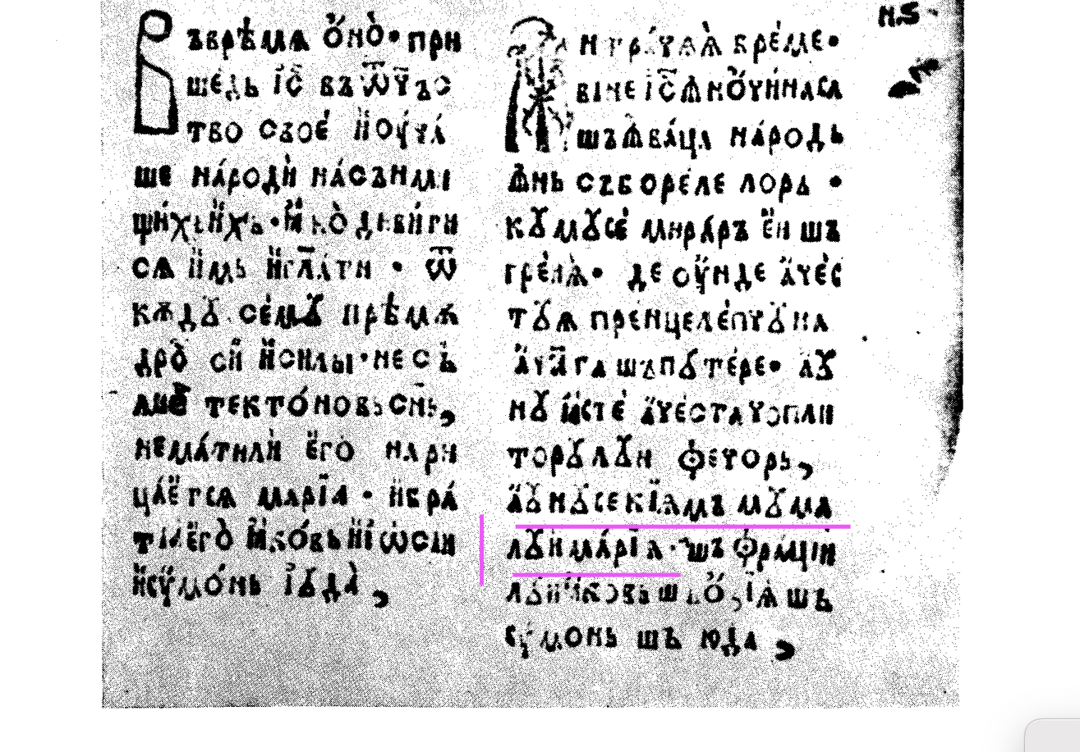
au nu iaste acesta cioplitorului fecior, au nu se cheamă muma lui Maria?
Isn't this the carpenter's son, isn't his mother's name Mary?
In this case lui is the complement of muma and not the oblique form with lui prenominal of the anthroponym Maria.

Slide 23
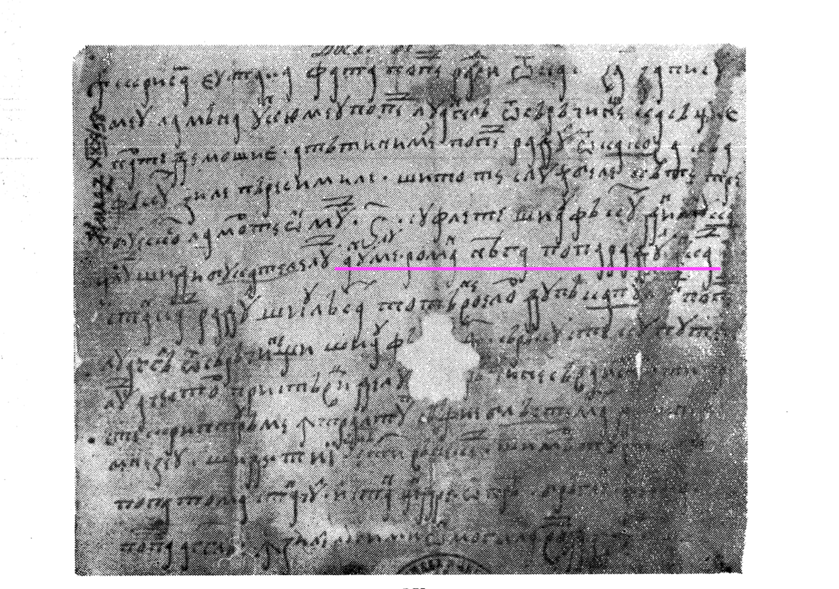
Another example is from an inventory compiled in Wallachia in 1599-1600:
???a lu mueriĭ lu Apafi XXVIII 1599-1600
The original is in an unidentified collection in the Vienna Archives, and the transcription was made according to Iorga's interpretation. In this case, the interpretation is based solely on Iorga's segmentation, but in the absence of the original, we should be circumspect.
Another example is from a 1600 document, also from Wallachia. In this case it is an enumeration of the beneficiaries of a donation:
anume lu Roman, Neaga, popa Radul, Ancai, Stancai (DIR LV 1600-1602)
namely lu Radu Neaga priest.the Radu.the Anca.oblique?Stanca.oblique?
As can be seen, lu seems to have been added later (a superscript lu). The oblique forms Ancai, Stancai – but why not Anca i Stanca i Radul? – also seem problematic. Since the document poses so many problems, I think it would be more correct not to establish the chronological limit of the extension of the marker lui/ lu to feminine based on it. It is obvious that the prenominal and postnominal markers (if we interpret Ancai, Stancai as oblique forms) are added later (initially it was just a simple enumeration).

Slide 24
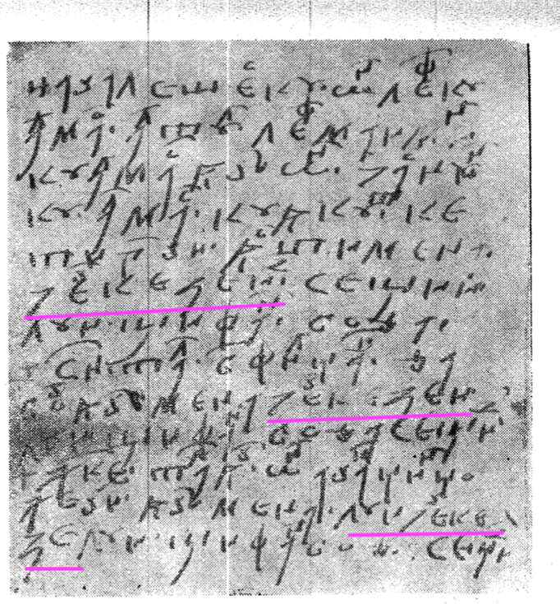
Another example comes from the inventory of the estate of Ștefan vodă, written by his father, Petru Șchiopul, in which a feminine anthroponym derived from an ethnic name (Cercheza) is accompanied by lui marker:
The fragment contains both suffixed oblique forms and forms with lui prenominal: mena Čerchezeii... lui Știfan voda; ... mena Čerchezei… lui Știfan voda, ... mena lui Čercheze, lui Știfan voda. In this case, the document is written by a person who does not master the Romanian language, and the alternation of suffixed oblique forms and those with lui prenominal seems to have led to the reprise of lui mark to the feminine anthroponym (which is adapted with an atypical ending anyway in the writing of Petru Șchiopul).

Slide 25
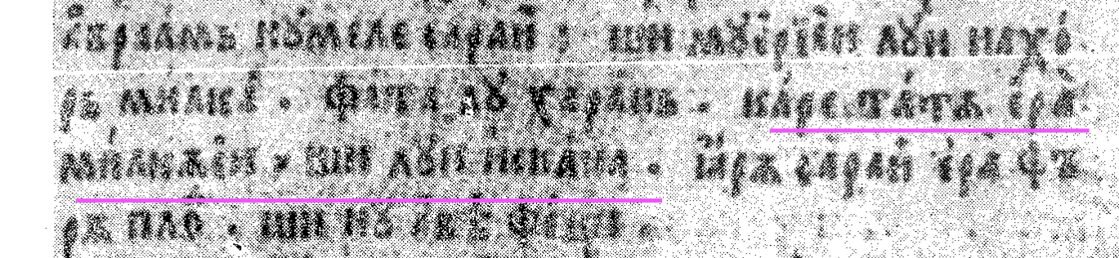
Perhaps the most interesting case is an example in the Palia de la Orăștie (1582), where lui appears before an ... enigmatic form ending in -a:
fata lu Haran, care tată era Milcăei și lui Iscana
daughter.the lu Haran which father was Milca.oblique and lui Iscana
PO G 11: 29 = the daughter of Haran, the father of both Milkah and Iskah
In the Hungarian original – which is the basis of the Romanian translation:
ki attaya vala Milcanac es Iscanac (PO 42).
Both forms in the Hungarian original are suffixed to express possession, but unlike the first form, which appeared earlier in the text, and which is adapted in the Romanian Milca, the second form is attested only in this context. As a result, the translator adapts it by keeping part of the suffix in the original and does not recognise its gender. The mere presence of the final –a is not evidence of the feminine gender. For Palia's translator, Iscana (instead of Isca) may as well be a masculine anthroponym.

Slide 26
Lost in translation...
I would like to bring to your attention the following fragment from the Voroneț Codex:
carele iaste omul cela ce nu şti[e] cetatia efeseiasca, spre despusu fiindu mariei Arrtemide şi lu Diopetu (6^{r}-6^{v})
Diopet looks like a masculine anthroponym, doesn't it?
Mystery deepens: here are the correspondences in the Codex Bratul and in Coresi's version:
carele amu iaste omul cel ce nu ştie efeseasca cetate spre despus fiindu marelui Artemidea şi Deopetului 210 | cine iaste om ce nu ştie a Efesului cetate spre despus fiind atîta mare şi Artemidea şi Diopetovi | carele iaste omul cela ce nu şti[e] cetatia efeseiasca, spre despusu fiindu mariei Arrtemide şi lu Diopetu (6^{r}-6^{v})
And yet who is this Diopet and why does this Diopet preserve in Coresi's version the Slavonic form?

Slide 27
The translator of the text on which the Voroneț Codex is based, interpreted an adjective as an anthroponym. In Greek, διοπετής (from Διός of Zeus and πέτω for πίπτω) means fallen from Zeus, i. e. from heaven and refers to an image of the Ephesian Artemis which was supposed to have fallen from heaven, in Slavonic, Диопетовъ is a possessive adjective, with the suffix -ov. Neither the Greek nor the Slavonic versions were of much help to the translators, who either turned the original form into an anthroponym or preserved as such. Somewhat later, in the translation of the New Testament de la Belgrad (1648), the mysterious Diopet is translated correctly (the Latin version most likely helped):
cine iaste om carele n-ară şti pre oraşul Efesului că cinsteaşte pre mare dumnezeiasa Diana, şi chipului de la Iupiter pogorît? = Men of Ephesus, who is there who does not know that the city of the Ephesians is temple keeper of the great Artemis, and of the sacred image that fell from the sky?
But the clarification was short-lived, because in the 1688 translation of the Bible, Diopet comes back in force:
Bărbați efeseni, dară care iaste omul acela care nu știe cetatea a efesenilor că e purtătoare de grija besericii Artimidei, dumnezoaiei cei mari, și a lui Diopetus? (BB 1688)

Slide 28
Further extensions
In the 17th and 18th centuries the extension of prenominal marking both within and outside of masculine anthroponymic configurations continues.
In the case of masculine anthroponymic configurations, the most stable postnominally marked patterns also admit prenominal marking – still no free variation of the two markings:
anthroponyms derived from nicknames:
DIR.A. 1621 Drăguța, fămeia lui Ursu
Drăguța woman.the lui Ursu = Drăguța, Ursu’s wife
cu fata Drăguții și a lui Ursu
with daughter.the Drăguța.oblique and a lui Ursu
= with the daughter of Drăguța and Ursu
But also:
sura Ursului
sister.the Ursu.lui = Ursu’s sister
DIR.A. 1623 partea unchilui nostru, lui Făt[u]
part.the uncle.the.oblique our lui Fătu = the part of land of our uncle, Fătu
But also:
partea Fătului
part.the Fătu.oblique = Fătu’s part
b) anthroponyms of Slavonic origin belonging to the series Stanciu(l), Nanu(l), etc.
DRH.B.before 1631 feciur lu Stanciu şi feciurii lu Nan
son lu Stanciu and sons.the lu Nan
c) anthroponyms ending in -a, -ja, - ḙa:

Slide 29
In this category, two situations can be distinguished, older anthroponyms such as Toma, Eremia, Zaharia etc. are more resistant to prenominal marking, while newer borrowings ending in -a, -ja or - ḙa are more willing to accept prenominal marking:
DIR.A. 1623 denaintea Tomei … şi denaintea lui Irimiia
before Toma.oblique and before lui Irimia
NT.1648 16^{r} sămnul lui Iona prorocul
sign.the lui Iona prophet.the
But also:
21^{v} fiiul Ionei
son.the Iona.oblique
DVS. 1682-1686 lui Ieremiia 106^{v}
DPar. I 7^{r}: casa lui Iúda şi casa lui Izrail, I 7^{r}, I 7^{v}: casii lui Iúda
II 1r: prorociia lui Isaíia, II 3^{v}, II 6^{r}, dar Isaíei: III 87^{v}, IV 1^{r}, IV 8a^{v}
BB.1688 fiii lui Iuda – Jud. 1: 9
But the forms frequently used are Iudei/Iudii
lui Zaharia – Esdra 8: 16
But the form frequently used is Zahariei
Less resistant are:
BB.1688 Şi muri Aran înaintea lui Thara_{M}, tatăl lui – G 11: 28/ And Haran died before his father Terah
Olivema, fata lui Ana_{M} – G 36: 2/ the daughter of Anah
feciorul lui Zara_{M} – G 36: 33/ the son of Zerah
feciorii lui Varia_{M} – G 46: 17/ the sons of Beriah
feciorii lui Vala_{M} G 46: 22/ the sons of Bela
feciorul … al lui Risa_{M}, … al lui Mattha_{M}, … al lui Melea_{M}, … al lui Mattatha_{M}, … al Iui Thara_{M}, … al lui Sala_{M} – Luca 3: 26-35/ the son of Rhesa, of Matthat, of Melea, of Mattatha, of Terah, of Shelah…

Slide 30
A metatextual extension...
In the 1683 translation of his Paremiar (=The Book of Parables), Dosoftei uses the proclitic marking to introduce an interpretation of an earlier fragment, which he forgot to insert into the text where it should have been. This usage is altogether peculiar, but it shows that lui is turning into something other than it originally was:
III Tâlcul acesta-i lui
ce-am uitat:
(Precum binevru de sine învoit = as he pleased according to his will).
A further extension
As a rule, grammars show that prenominal marking has also extended to nouns belonging to kinship terms group. But how did this extension happen and who were ... the usual suspects?
The grammars give as examples constructions such as:
Lui tata
Lui mama
Or the infamous example from the old Romanian period:
Și dzâsă lui maică-sa (DPar. 1683 III 16^{v})
This extension is too good to be true…

Slide 31
First, the example taken from Dosoftei ... contains no prenominal marking. Here is the whole context:
Și dzâsă Iacov cătră Răveca, maică-sa: …
And said Jacob to Rebecca, mother.his
Și dzâsă lui maică-sa:… (DPar. 1683 III 16^{v})
And said to him mother.his
The context shows that the analytic construction (a verbum declarandi + cătră) occurs simultaneously with the inflexional one (a verbum declarandi + Dative). Lui is the indirect object and not the prenominal mark of the noun.
And yet…
in Old Romanian there is this extension of the prenominal marking to nouns belonging to the kinship terms group. At the end of the old Romanian period this construction is attested:
i-a venit cliironomie de la casa
cl.dat-aux.perf.3sg come.pple inheritance from house.def
lui unchiu-său Văcărescu (AJ. 1780. Doc. 845)
lui uncle-his Văcărescu
= he inherited it from his uncle’s family Văcărescu
Thus, the prenominal marking also appeared on masculine nouns of the special group of kinship terms when these nouns were suffixed with the possessive, because in this suffixed form they had a special morphological behaviour, i.e. they were invariable (in old Romanian there are attested constructions such as casa unchiu-său, where the noun has no case marks).

Slide 32
The ratio of lui vs lu
In the printed works of the second half of the 17th century in Wallachia, lui begins to be preferred, the phenomenon does not affect, for example, documents of the same century (in documents from Wallachia, lu is a clear majority). For example, in the Bible printed in Bucharest in 1688, lui appears overwhelmingly, while lu is a marginal form. One might argue that this text has a special status because it is based on a translation of the Old Testament made by a Moldovan (Nicolae Milescu?). What about the New Testament? The New Testament was not translated by Nicolae Milescu. The manuscripts from Wallachia still show a ratio in which lu is preferred. Chancellery documents from the 18th century also seem to prefer lui form.
This preference for lui from the late 17th century onwards in areas where lu is preferred in spoeken register is confirmed by the recommendations made in the grammars of the period.

Slide 33
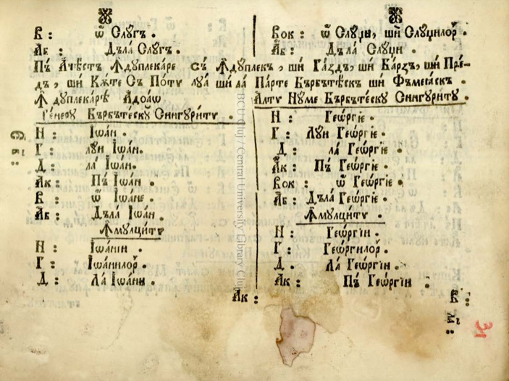
Dimitrie Eustatievici Brașoveanul 1757 – southern Transylvania
35v: Este ceea ce pre numele numai cele osebite bărbăteşti pleacă, cele ce sînt lipsite de numărul cel înmulţitor. Num. un. N. Daniil, Gheorghie. Năs. A lui Daniil, a lui Gheorghie. D. lui Daniil, lui Gheorghie. P. pre Daniil, pre Gheorghie. C.o, Daniile, o, Gheorghie. L. de la Daniil, de la Gheorghie. Înmul. Să lipseşte.
S. Micu, Gh. Șincai 1780 - Transylvania
14-15: Dativus singularis: Lui nominibus propriis & voci Dieu semper praeponitur. v.g. lui Antonie, lui Dieu.
Ianache Văcărescu 1787 - Wallachia

Slide 34
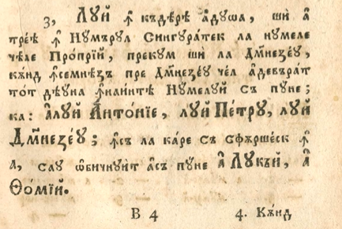
Radu Tempea 1797 – southern Transylvania

Slide 35
Interim findings
Lui/ lu has in the 16th century (and as far as I can tell from Slavonic and Latin documents of the 14th and 16th centuries) a distribution limited to masculine proper names, but not to all masculine anthroponyms, in the singular. The selection of lui/ lu is therefore restricted by gender and number. From the second half of the 16th century onwards, it extends to titles and honorific structures, at first when these were part of complex, classifying constructions (with titles, honorifics of various kinds) with proper names and then even without proper names:
am dat … lui jupuni Anton (DIR.LXXXVI.1593)
aux.perf.1sg give.pple lui master Anton
= I gave it to master Anton
Spuse Hristos lu ievanghelistu Ioan (CS.V.1590-1602 51^{v})
Say.ps.3sg Christ lu evangelist Ioan
= Christ said to St. John the Evangelist
In the 18th century, it appears with kinship terms when they were suffixed with the possessive (but the absence from the documents does not exclude the possibility that prenominal marking existed in the spoken language).
In the case of anthroponyms, those ending in -a, -ja, - ḙa begin to receive the prenominal marking, but there is a hard core that will retain the postnominal marking until later (the postnominal marking is preserved in fixed expressions, such as Duminica Tomei or in toponyms, Poiana Gruii).
Whatever the status of this marker, towards the end of the 17th century it begins to transform since it accepts to appear in structures with metatextual value.

Slide 36
The eternal feminine draws us on high… or not…
Feminine anthroponyms also pose a number of problems. I will not deal with all these problems, but exclusively with prenominal marking.
If the feminine wasn't marked with lui, then what was their marker?
Palia de la Orăștie (1582) provides the answer:
muieriei tale, ii Sara, fi-va fecior PO.1582.G 18: 10/ your wife, Sarah, will have a son
spuseră ... ii Tamar PO.1582.G 38: 13/ they told Tamar
And a document from Maramureș dated to 1593:
lui Tămaş şi fetei ii Marie DIR.CXIII.1593
lui Tămaș and daughter.oblique ii Marie
= to Tămaș and his daughter, Mary
Right from the first attestations, it is observed that the feminine mark ii is combined with a name in –a, and with an anthroponym ending in a consonant. It would have been expected to combine exclusively with names ending in a consonant and those ending in a vowel other than -a (see Marie). Most likely, it is because in the Bible, Sara actually has two names, Sarai and Sara (=Sarah). However, ii Sara occurs in the context of Sarai /Sarai era fără plod PO.1582.G 11: 30 Sarai was childless, and the postnominal marking Sarei corresponds to the non-oblique form Sara. Incidentally, Tamar also has an -a variant and the marking for that variant is, as expected, postnominal: Tamareei PO.1582.G38.

Slide 37
As a rule, prenominal marking in feminine is considered to be a marginal phenomenon, without diatopic spread, without viability in diachrony (Gheție, Mareș). Documents say otherwise...
In the 17th century, prenominal marking is well attested in documents from Moldovia and in translations from the same area.
APPENDIX_2
In all these documents, the prenominal marking appears mostly with marital names, derived with the motional suffix -easă or -oaie. In addition, it has shifted from ei form to ii and then to îi, most likely by the same mechanism that led to the prosthesis in the pronominal clitic forms.

Slide 38
A further extension
In the 18th century ii is attested in the southern area, at Corbea, with mythological names, all ending in a consonant:
Cupido,-idinis, g.m. fiiuleţul lui Mars şi al ii Venus = the son of Mars and Venus
lyncurium, g.n. o piiatră scumpă din pieptul ii Lynx = a precious stone from the chest of Lynx
Ninive, g.n. oraş haldeienesc foarte mare, pre care Ninus, bărbatul ii Semirasis l-au zidit = Ninus, the husband of Semirasis
Palladium, g.n. idol ii Pallas = image of Pallas
venereus,-a-um lucrul ii Venus
The attestations in Corbea's dictionary do, however, indicate another phenomenon, namely that ii can occur with masculine:
Praessul,-is, g.m. ... cap dintre popii ii Mars pre carii i-au chiemat saliuseani = the leader of the Salii, priests of Mars
Which would imply that the parameters that controlled the selection of ii were no longer motivated or transparent; it is sufficient for an anthroponym to end in a consonant and it will receive an available prenominal marker.
A confirmation comes from a translation of the second half of the 17th century. I am talking about the ms. 45 (containing the Old Testament translation attributed to Nicolae Milescu). In the translation appear lui Madiam (Num. 31: 7) and ii Madiam (Num. 31: 3), lui Moav (Jer. 48: 16) and ii Moav. Milescu is influenced by the Greek original and therefore uses the feminine form (Madiam). At other times, Milescu tries to make a distinction between the city and the name of the king, ii Eglon (Jos. 10: 37) – the city versus lui Eglon (Jud. 3: 15) – the king.

Slide 39
We return to the prenominal mark of lui + feminine anthroponyms…
If the so-called 16th century attestations are problematic, when is lui/lu marking with the feminine anthroponyms attested?
In the late 17th century, more precisely. In ms. 45 and in the Bucharest Bible, among others, some configurations with lui + feminine anthroponym in -a are attested. But these anthroponyms are not among the common ones, they were new in Romanian onomastics.
Ms. 45 tatăl lui Melha și tatăl lui Iesha (la fel în BB. 1688 G 11: 29). În ms. 45 alături de lui Melha este înregistrată ii Melhas G 24: 15, iar în BB. 1688 Melhăi.
In the 18th century, lui is very well attested with feminine anthroponyms ending in a consonant. Corbea's dictionary of the early 18th century contains several occurrences of the prenominal mark + anthroponym ending in a consonant or in a vowel other than -a:

Slide 40
Actasta, g.f. fata lui Thetis, dumnezăoaiea mărei
Amycla, g.f. una dintre featele lui Niobes [sic!]
Anadyomene de la Apeles scrisul chip al lui Venus
Anna, g.f. fata lui Belus, sora lui Dido
aphrodisia, g.f. veseliia trupului, jârtva lui Venus
archigallus, g.m. popa cel mare a lui Ţibeles
Berecynthia, g.f. dumnezăoaia lui Ţibel [sic!]
Brimo g.f. numele lui Hecates
Caprotina, g.f. polecră a lui Iunonie
Charaxus, g.m. un mitilean, fratele lui Safus
Eetion, g.m. tatăl lui Andromah
Erucina,-as, g.f. numele lui Venus de pă muntele Erix
Galanthis, g.f. slujnica lui Alţemene
Hebe, g.f. fata lui Iuno, muiarea lui Hercules
Icarius, g.m. tatăl lui Penelopes [sic!]
Juventa vreamea tinereaţelor de la doaozăci şi unul de ani până la doaozeci şi opt; iarăş: dumnezăiţa tinereaţelor, fata lui Iuno, muiarea lui Hercules
Pygmalion, g.m. fiiul împăratului Belus tirrinseanul, ruda lui Dido
Sigalion, g.m. chip de idol au fost în biseareca lui Isis şi Serapis
Thoa, g.f. dumnezăiţă de mare, fata lui Thetis

Slide 41
As the onomastic inventory widens, several tendencies emerge: adaptation to feminine patterns already existing in the language with postnominal marking – Didei, Thetisei, Țeresei, Venusei, etc., or prenominal marking with ii: ii Venus, ii Pallas etc. On the other hand, at least in the southern area the mark ii is in regression and is gradually replaced by lui, which ceases to be sensitive to gender.

Slide 42
At the end of the 18th century and the beginning of the next century, the prenominal and postnominal marking occurs in classes of anthroponyms as follows:
Wallachia – Iorga, Weigand, Teodorescu | Moldova – Furnică, Sava, Weigand, Vârnav | Transylvania – Șincai, Mândrescu
Iordache feciorul Radului (IH, a. 1806: 346) | mama Dinului (FD, a. 1830: 362) | muierea Creţulescului (ŞO: CXXX)
paşte calu Iorgului (WW: 305) | ginere Hâncului (SL, a. 1812: 270) | De doru Ionului, io Ionu Iancului (MLP: 51, 181), but grădina lui Ion (id.: 59).
să trag Marcului palma, | calu Iancului (WM: 206, pct. 558)
fagul Miului (TPP, II: 72, 214) | Măriuca Săvucului (I. Creangă)
Zise Ileana Fătului Frumos (IL: 45) | fiul Brăescului (VI: 23)
Postnominal marking – anthroponyms ending in -u or in consonant

Slide 43
Wallachia – Documente, Candrea, Densusianu, Sperantia | Moldova – Candrea, Densusianu, Sperantia | Transylvania – Weigand, Țiplea, Pușcariu
la mâna chir Toncii (DIB, a. 1794: 169) |  | Pinti, but hora lui Pintea (WST: 32)
mahalaua Manii brutarul (DIB., a. 1828: 251) |  | Drăguş ursu Pintii, but ursu al Pintii (ŢM: 28, 41)
în anii Cuzii (GN, I: 136) | iera înaintea Cuzii (GN, I: 429); | fereastra Gruii (PŢO: 186, pct. 243)
Postnominal marking – anthroponyms in -a, -ja, - ḙa

Slide 44
At the dialectal level, one may note the preservation of the postnominal marking and even its extension to anthroponyms that did not occur with this marking in the texts from old Romanian (the Ionului pattern etc.).
As for the prenominal marking, lui was noted in Bihor (cf. WST: 32), in the south-west of Transylvania (PH: 127), in Muntenia, especially in the Subcarpathian area (GN, I: 96, 104), in Oltenia (GN, I: 148) and in Moldova (WM: 184, 196, 205; GN, I: 423, 523, 530, 547–549). Lu is more frequent than lui, being attested throughout the Daco-Romanian territory.

Slide 45
Banat – Weigand | Transylvania – Weigand, Popovici, Candrea | Maramureș – Weigand | Moldova – Candrea, Densusianu, Sperantia, and Weigand | Wallachia – Candrea, Densusianu, Sperantia, and Weigand
lu Petru | Ana lu Rodean (WK: 316, pct. 120) | hora lu Pintea, but Pinti, popi, tati (WST: 32) | spuni lu Ilii (Şez., III, 1894: 5; cf. WM: 184) | Arvaţii lu Tudor
 | banii lu Ianăş (PH: 147) |  |  | cheia lu Zdrelea (WW: 296, pct. 410)
 |  |  |  | fata lu boier Ispas
 | lu Mihăilaş (CO: 17) |  |  | Şuşaua lu Domnu de rouă
lu popa |  |  | Fata lu Sfântu Soare
lu ţâgan |  |  | lu tatu-su (GN, I: 505, 520, 542) | tata lu tetea
lu Maria | lu Maria (id.: 292; cf. WST: 329)
lu mama | a lu mama (PH: 127)
lu ăla |  |  |  | mama lu ăla

Slide 46
In almost all the surveyed areas, the prenominal marking occurs not only in anthroponyms (including those in -a, -ea, see lu Zdrelea), in groups with a modifier and a personified common name, in combinations with titles and honorifics, but it also extends to names from the kinship group, even then both suffixed with the possessive and without the possessive, and to pronouns (which have oblique forms morphologically marked). Towards the end of the 19th century, in the southern dialects (Banat, Muntenia), the masculine proclitic article is frequently attested for nouns from the kinship group suffixed with the possessive: vorbile lu ta-so (GN, I: 253, 260; WM: 184; WB: 279 etc.).

Slide 47
Forms with postnominal and prenominal marking
In Old Romanian, especially after the second half of the 17th century, forms with postnominal marking in the group of anthroponyms in -a, -ja, - ḙa are attested:
Doamna lui Ieremiei vodă CLM 1700-1750 178r
ginerii lui Ieremiei vodă CLM 1700-1750 178v
casa lui Ieremiei vodă CLM 1700-1750 179r
but in all these examples the second constituent vodă is invariable.
In the 19th century, at the dialectal level, forms with postnominal and prenominal marking are attested, even when all constituents have postnominal markings:
a spus lu solului ăluia (GN, I: 34)
aux.perf.3sg say.pple LU envoy.OBLIQUE that.OBLIQUE

Slide 48
As we approach the conclusions, a new form occurs…
The proclitic mark li is attested in Bihor and Ţara Moților, both for masculine anthroponyms
casa li Mihai, casa li Iancu,
and for the feminine ones
casa li Marie (WK: 292; WST: 32–33)
And not only li, but also a li (ali?)
For masculine proper names, Weigand indicates the marker a li in the Apuseni Mountains, the same marker being attested in the northwest of Oltenia in the civil status register from 1886:
Munții Apuseni Weigand, Papahagi | Nord-vestul Olteniei
Savina a li Bodă | Vasili a li Cucu (Radu Sp. Popescu, 1980: 74)
Ioan a li Pătru
Gheorghe a li Lip

Slide 49
A different AL…
N. Drăganu (1928: 312–314) found it in Zagra (Bistrița-Năsăud), in a register that includes the names of those born and baptized between 1784 and 1827. For the period 1802–1816, 74 masculine proper names preceded by the prenominal mark al are cited.
Sometimes, al extended from masculine proper names to feminine (first) names.
Al coexists with the marks (a) lui, (a) lu or a
Nastasia a lui Mic Dumitru / Savina a lu Niculai Cucu / Luca lui Mani Lupul / Iacob a Simii.
Al was attested, towards the end of the 18th century and in the first half of the 19th century, also in the Subcarpathian area of Muntenia.
Bistrița-Năsăud – Drăganu | Bistrița-Năsăud – Drăganu | towards the end of the 18th century and in the first half of the 19th century, in the Subcarpathian area of Muntenia
Lupul al Neamţ Andrei (1802) | Grăpina al Safta Bușcoi (1807) | Dumitraşcu al Florică (IH, a. 1735: 123)
Gripina al Toader Sb[r]eha (1803) |  | fată al Ioniţă Bratul (IDT, a. 1842: 57).
Luca al Drăgan Urs (1806)
Ana al Ilie Sima Pop Andre[i] (1808)
Mihail al Ioan Zbreha (a. 1816)

Slide 50
But is this al the so-called prepositional determiner al? If it were, this functional proclitic would be expected to agree in gender and number with the possessee. However, this agreement is violated in fată al Ioniță Bratul. In this case, we must assume that al has become invariant, but a is also invariant. And how can we explain the occurrence of this mark precisely in the areas where a is invariable?
A possible solution...
Drăganu (1928: 312–314) notes a prenominal mark ai which occurs in feminine proper names in the dialect of Zagra (Bistriţa-Năsăud). In exactly the same area where al occurs in male first names. The same form is attested in Maramureș.
Bistrița-Năsăud – Drăganu | Maramureș - Papahagi
Agata ai Tinie Cucu (1813) | Anuţa ai Parasca (Ieud şi Burnar)
Ştefan ai Mărie Năsăudean (1819) | Ion ai Mari (Săcel)
Măria ai Nastasie Buşcoi (1827)
When both parents of the newborn are mentioned, both first names - the father's and the mother's - have prenominal marks, maintaining the gender distinction:
Susana a lui / al Tănase Drăgan şi ai Marie soaţa sa (a. 1819).
That could indicate a different evolution for this al. Therefore, a(l) lui > a lu > al…

Slide 51
The 20th century: lui vs lu
Lui, which established itself in the literary language, is well attested in many areas of Transylvania (except the south-west part), in Maramureş, Crişana, Oaş, Moldova (except in the north-west part and the southern extremity) and altogether sporadically in Oltenia and Muntenia.
Lu is well attested in the southern area of Daco-Romania: southern Transylvania, Oltenia, Muntenia and Dobrogea, to which Banat – Hunedoara may be added.
The only form attested in Daco-Romanian dialects spoken outside the borders is lu (cf. Marin, Mărgărit, Neagoe 1998: 95; Marin, Mărgărit 2005: LXXVIII; Neagoe, Mărgărit 2006: LXXXVI; Marcović 1969: 189).
The coexistence of the prenominal and postnominal markings is also attested at the level of the current dialects.
E. Petrovici (1988: 373, point 399) notes the prenominal lui, alternating with lu: Gheorghe a lui Miron / Ştefan a lu Truţă, and S. Pop records the coexistence of the prenominal marking lui / lu with the postnominal one, both in anthroponyms and in toponyms: Florica lui Gurzău / Mărie Huţului (pt. 30); Părău lu Moiseni / Părău Copăşisului (pt. 87); Cotu Purcariului / Cotu lu BouRoş (pt. 476). Masculine anthroponyms (as well as toponyms containing an anthroponym) preserve, just like in the old language (Diaconescu 1970: 224), the prenominal marking in the west, north and centre of Transylvania: Mitru Cucului (Petrovici 1929: 580); Mitu Morganului (Şandru, Brânzeu 1931–1932: 320); Vremea Iancului (Şandru 1934: 235); Ion Dumitrului (ALR II, s.n., VI, h. 1597); Ionu lu Ionu Tincului (Roşca 1978: 325); Poiana Ştefului (R. Sp. Popescu 1970: 385), as well as in some Moldavian dialects (Turculeţ 1984: 365). In the same area, the two markings coexist: Iona Tincului / Constantin lu Pătru (Roşca 1978: 326).
In the north-west of Transylvania, but also in isolated points in the centre of Transylvania, masculine proper names ending in -a, -ja, - ḙa preserve the postnominal marking Petrea Danii (Petrovici 1929: 581), Petru Costii (ALR II, s.n., VI, h. 1598) etc.

Slide 52
In Banat lu is distributed as follows:
BANAT – Șandru 1937, Tratat, ALR, ALRM, Cohuț&Vulpe
'tata lu bə'jatu 'əla/ 'ne̯amurile 'feti, 'ne̯amurile lu bə'jat | də 'apə de po'manə lu 'mortsi 'karei̯ 'are | 'kreʃte 'pəru lu 'jele | la 'kapətu lu krump
pre'tɕini lu bə'jat | lu kələ'tor^{j} | ɨmi 'plaɕe de 'fata lu dumn^{j}a'vo̯astrə | re'kolta lu grɨu̯
din 'partɕe̯a lu... 'tɨnəru |  |  | ku 'brusturile lu 'varzə
'fratɕili lu... 'tɨnər |  |  | lu 'pomu 'əla
'fata a lu un vi'ɕin |  |  | 'pana lu ku'koʃ
dau̯ lu mu'jere̯a lu 'ui̯kə-so |  |  | a lu prə'jɨnə
'jo̯akə... 'tata lu 'fatə ku e̯a, 'mama lu 'fatə
pre'tɕini lu 'fatə
ɨn urma lu 'fatə
'vadra lu 'baba
'marʃu lu mi'rjasa
o'grada lu vi'ɕina
'omu lu 'do̯amna

Slide 53
According to ALR. Synthesis, vol. IV, the forms marked by lu are used with inanimate feminine nouns and show two patterns:
1) articulated noun + lu + definite noun + modifier: 'uʃa lu 'kasa ku kwoʃ
2) articulated noun + lu + unarticulated noun: 'uʃa lu 'kasə, 'uʃa lu 'tindë, 'uʃa lu kui̯nə.
Banat is the area where the expansion of the lu mark is the most advanced.
In addition, lu has also expanded to the plural (see lu călători și lu morții care-i are). Subsequent research showed that the expansion also occurs in the Romanian dialects spoken in Hungary, but also in those of the Republic of Moldova (Marin, Mărgărit, Neagoe 1998: 95; Marin, Mărgărit 2005: LXXVIII).

Slide 54
In Crișana lu is distributed as follows:
CRIȘANA – Tratat, ALR, Teaha
Ji'wonu lui̯ Dumn^{j}itru | Ji'wənu li Ianku | Ji'wənu lu 'Janku | Mə'rija lu I'ljana | Ji'wənu 'Petri
 | Kostə li Petri | 'Pətru lu 'Koste
 | A li Nistor Petri
 | Ji'wənu li 'Janku
 | 'Pətru li Ji'wən

Slide 55
In Crișana, lu is well attested and extends to the plural:
holdele lu ceia harnici Br I
An observation related to the role of the school and the pressure of the literary language is provided at the beginning of the 20th century by Şandru, who shows that „Lui (et non lu) caractérise le parler des personnes qui ont fréquenté lʼécole”.
In the 6th decade of the past century, when Teofil Teaha carried out his investigations in the south of Bihor, more precisely in the valley of Crișul Negru, lu and li were noted in the following configurations:
- masculine anthroponyms
Ionu lu Mihai, Br I | Blagu li Macavei C I
Florea lu Mitru B III | Mircea li Iancu Ursului C I
Saveta lu Șimon B II | Florea li Adam C I
feminine anthroponyms
Maria lu Ileană Br I | Floricuța li Marie C I
Florica lu Saveta B II
oala lu Floare B II

Slide 56
- with kinship terms, both masculine and feminine: lu for both, li for masculine
Socru lu fecioru meu B II | Cumnatu li frate-meu Br I
Casa lu muierea cea harnică B II
Zestrea lu soră-mea B II
- with indefinite
fata li cutare și cutare
Further dialectal research has highlighted the extension of the li mark to the feminine:
tata li moașa (Neagoe, Apuseni).

Slide 57
Maramureș, northern and central Transylvania – Petrovici, Șandru, ALR II, s.n., VI, h. 1597, Roșca, Radu Sp. Popescu | Maramureș, northern and central Transylvania – Roșca
'Mitru 'Kukului̯ | Konstan'tin lu 'Pətru
'Mitu Mo'ganului̯
Ji'won Du'mitrului̯
Ji'wonu lu Ji'wonu 'Tinkului̯
Po'jana 'ʃtefului̯
In this area, too, the extension of the prenominal marking to animate – human nouns is attested:
lu 'kalu (Șandru, Brânzeu, Jina)
lu ber'bek (Șandru, Lăpuș)
lu 'vakə (Șandru, Lăpuș)
lu gə'jinə (Șandru, Năsăud)
Lu is attested with personal, demonstrative, indefinite or relative pronouns, even if they have oblique forms morphologically marked:
ne'vasta lu hələ'lant (Şandru 1935: 132);
dai̯ lu fije'kare (id.).

Slide 58
AL – is back and more extensive than was originally thought
Further research widens the area where al is used. It is attested in Crișana
Al Somoș (Petrovici, Bihor)
and in northern Bucovina, Transnistria and southern Bessarabia: Adam al Pavăl, Niculai al Dionis, Tanase al Radu (Marin, Mărgărit, Neagoe 1998: 95).
And it's not only al, but also a li/ ali…
A li is attested in the Apuseni Mountains, in the area of Cluj, Târnava Mare, Alba and Hunedoara, as well as in the Hungarian dialects: a li Todor, Bota Ştefan a li Ion, a li Gheorghi Liii; Iacob Marie a li Iacob Ioan, a li Pitoc (S. Pop, pct. 93, 100, 103, 156, 273, 283; Marin, Mărgărit, 2005: LXXVIII).
In the Apuseni Mountains, in Ţara Moţilor, it also appears in names from the kinship group
a li frate (Marin, Mărgărit 2005: LXXVIII).
it extended to the feminine:
păru a li Rafilă (Papahagi 1925b: 52)
and to pronouns:
a li astúia (Neagoe, Apuseni).

Slide 59
The feminine returns...
Prenominal marking is attested in the Crișana-Maramureș area:
-i Florică (Papahagi 136), Mana i Surae (p. 138), Dealu i Beresî,
- în Bistriţa-Năsăud: Ionu îi Ane; Fântâna îi Mărine, Valea îi Cuboaie (Lacea 1923: 799);
- in the north to the south as well as the north of Tisa:
Alexa-i Pălăguţî, Faţa-i Dumbrăviţî (Roşca 1978: 324)
The use in private letters from the end of the 20th century shows the viability of this mark in dialectal onomastics: lui Dumitru lui Ion i Aniţă, but also outside these onomastic patterns: ii Marie ii poftim voie (Neagoe 1987: 314).
But also
- in north-western Transylvania: Ionu i Mărie, Dumitru i Ană (Iancu 1983: 41–42);
- the west of Oltenia: Dâlma ii Dragole, (toponyms formed with the feminine first name Dragolea) (R. Sp. Popescu 1980: 74).
There is no shortage of double-marked constructions either:
Ionu-i Floarii (Roşca 1978: 326);
Dumn^{j}itru ɨi̯ An^{j}i (ALR II, s.n., VI, h. 1601, pct. 272; h. 1603, pct. 325; Petrovici 1988: 158, pct. 272);

Slide 60
Daco-Romance varieties
A few words now about the other Daco-Romance varieties. In fact, I will attempt to answer two questions:
1) if there is prenominal marking in these varieties;
2) to what extent the patterns in these varieties are similar to, or different from, those in Daco-Romanian.

Slide 61
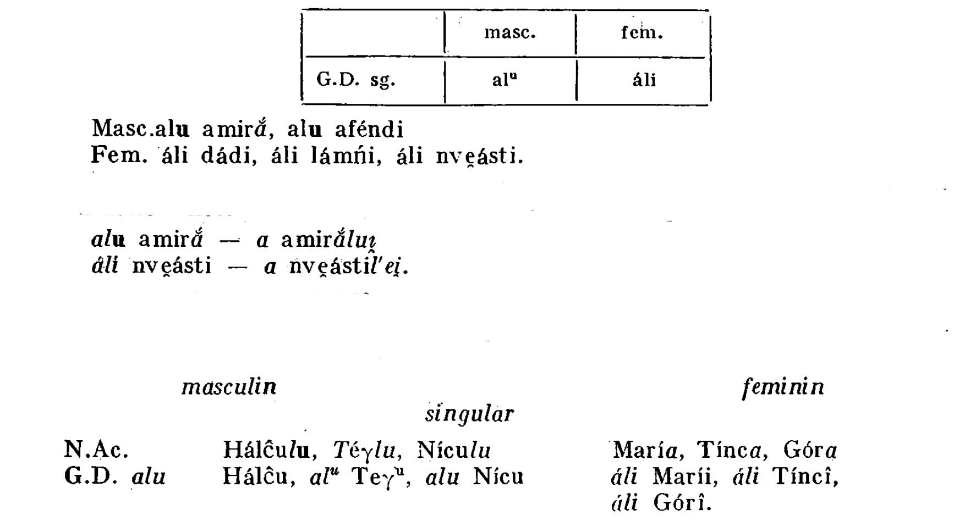
Again, there are some inconsistencies between what the monographs on these varieties say and the actual texts.
For Aromanian, for example, in the monographs (Tratat, Nevaci, Saramandu, etc.) it is shown that the proclitic marking occurs in personal names, after which – en passant - the names of animals, plants and personified objects are also mentioned. The assessment personified objects is problematic: are they personified because they accept prenominal marking? But if they have postnominal marking, are they un-personified?
Broadly speaking, the prenominal marking is as follows:

Slide 62
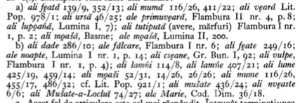
Very broadly speaking, since the data from Capidan are a little more nuanced, not so much for the masculine, where they indicate only anthroponyms, honorifics, professional names and nouns from the kinship group:
al 'domnu
al 'frate
al 'lala
al/alu a'miră (Capidan 386)
For the feminine, Capidan indicates several strategies
Type 1 – with prenominal marking
- either with simple marking (a)
ali 'fɛtə
- or with double marking (b)
ali 'fɛte (where the oblique form is also morphologically marked)

Slide 63
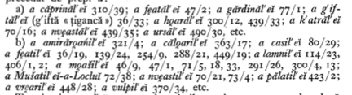
Type 2 – with postnominal marking
- either with no marking in nouns (a)
a 'fɛtəʎei̯
- or with double marking in nouns (b)
a 'fɛteʎei̯ (where the oblique form is also morphologically marked)

Slide 64
In the 18th century, type 2b is the most widespread:
a 'kasiʎi, a mu'ʎeriʎi etc. (Dim. Code)
According to Capidan's research, there is also a ranking of forms by frequency
ali 'fɛte > a 'fɛteʎei̯ > ali 'fɛtə > a 'fɛtəʎei̯.
Be that as it may, in Aromanian the prenominal marking is sensitive to gender and number (it seems to be used only in the singular). However, extensions exist compared to the situation presented by Capidan, since this prenominal marking is no longer exclusively found in anthroponyms and animate + human, but is also used in animate – human nouns.

Slide 65
In Istro-Romanian, according to the monographs, prenominal marking is realised by (a) lu (for masculine) and (a) le (for feminine), along with postnominal marking (at least that is the case in the northern variety).
'omului̯ vs (a) lu 'omu
mu'lereʎei̯ vs (a) le mu'ʎɒre
av spus le mu'ʎɒre (Ko)
'kɒsa le 'mɒje (Ko)
'kɒsa le 'ʒenske (Ko)
zis a le 'sore (Ko)
ar'mɒru le 'fiʎe lu 'grofu (Mo)
'strineʎei̯ / le 'strine (Fi 515 J)
'roba le 'mɒje (ALR II, s.n.)
And yet...
In the southern variety of Istro-Romanian, we note that lu is selected for masculine and feminine nouns, in both singular and plural, irrespective of whether they are animate or not. That means that the various gender and number conditionings occur only in the more conservative northern variety.
lu omu, lu bovu, lu mu'ʎɒre etc.
lu 'frɒtele ʃi lu 'sore 'libri (Fi 492 S)
ko'rona lu tse'sɒru (Pi)
ko'rista lu fa'milije (Da)
'korta lu 'porku (Da)
n a kre'zut lu 'listurle (Pu)
lu 'kɒprele lui̯ (Fi 1418 M)

Slide 66
In Megleno-Romanian, there are two prenominal marks: lu and əl, əṷ, but they are specialised for the genitive case.
Lu is selected:
in anthroponyms:
'Piti lu 'Tsapu (AT)
'Djuniʃ lu 'Stavri lu Papa'tsafa (AT)
in animate (+ human) nouns
a 'po̯arta lu ampi'ratu (Pap)
lu ampi'ratu 'iʎə (Cap²)
la t̠ʃi'flik^{j}u lu 'begu (D.ms)
lu 'popa 'kasə (Pap)
But lu extended to animate – human and to inanimate nouns:
'ko̯ada lu 'kalu lu fi't̠ʃor (Cap²)
t̠ʃə'nuʃa lu 'meru (Can)
kəl'ko̯aɲu lu ti'kuʃu (D.ms)
'zidu lu 'kasa (D.ms)
it extended to the feminine (see zidu lu kasa), but also to the plural:
bu'naru lu 'zmejiʎ (Can)
The double-marked constructions are very well attested, especially in Lumniță/ Skra:
lu əmpi'ratului̯ 'kasa (MP)
'kasa lu 'tinirului̯ (MP)
'mjerdzirḙa lu 'tsista 'kalului̯ (Kats)
and in the plural:
'tat su lu fi't̠ʃurilwər (MP)

Slide 67
Based on his own investigations, P. Atanasov argues that the use of the article əl is specific to the speech of the village of Uma, whilst its variant əṷ is specific to the speech of Ţârnareca, where l is pronounced as a velar consonant, similar to a vowel (Atanasov 2002: 213). Al is insensitive to gender and number, it has extended to animate – human and to inanimate nouns; therefore, like lu, it has generalized:
əl ampi'ratu 'fɛtə (Cap²)
lə'trarḙa əl 'kənli (Kats)
ku 'tsela zə'bit əl 'rapi (DP)
It may also occur – like lu – in multiple-marked structures:
əṷ 'tsarlui fi't̠ʃor

Slide 68
What is the origin of these markers? The discussion on their origin is a never ending story in Romanian linguistics. Three hypotheses have been formulated since the 19th century:
- lu is the original form, and lui is a later innovation (Hasdeu 1879, Meyer-Lubke 1930, Rosetti 1964, Rosetti 1986, Coteanu 1969, Ruxăndoiu 2018); lui is explained as lu+i (where i is an oblique mark) or by analogy with acestui, acelui, etc.
- lui is the original form, and lu is a later innovation; in fact, lu occurs in some specific syntactic contexts (lui Ion, lui Ilie) (Bacmeister 1897, Găzdaru, 1929, Densusianu 1938, Dimitrescu 1974, etc.)
- the hypothesis that runs with the hare and hunt with the hounds ... lu and lui are both inherited from Latin, lu from illo and lui from illui (Pușcariu 1921).
Ei, ii, too, did not escape controversies. The origin of the feminine markers was explained:
- either as an old phenomenon (Philippide, Densusianu 1938);
- either as a recent phenomenon (Coteanu 1969).

Slide 69
The documents show that lu and lui are both attested in the 15th century, lu in Wallachia and lui in Moldova. There is no compelling evidence to assume that lu and lui have different origins. Is lu inherited from illo? This is controversial for the following reasons:
1) unstressed -u and -o evolved to u in Romanian, therefore illo and the nominative – accusative *illu (<illum) would have had the same outcome; why is lu only used for the oblique case?
2) the -ui ending appears as an oblique mark for the m.sg. on all determiners and pronouns (acestui, acelui, lui, etc.), including in the Daco-Romance varieties that use the form lu.
And NO, in old Romanian lu is not a high-frequency form, and lui a low-frequency form. The ratio between these markers does not favour lu.

Slide 70
The existence of a correlation between prenominal lu and lui and postnominal -lui can be demonstrated by two phenomena:
1) the change in the distribution of lu and lui in the printed texts from Wallachia in the 18th century (the prenominal mark lu was constantly changed into lui) Is it because lu formally diverged from the postnominal -lui?
2) co-occurrence of the prenominal and postnominal marker in the same sequence, with the same name, etc.
The form lu can be explained as a reduction of a frequently used functional word in an unstressed position (initially, some specific contexts are relevant for the possible influence of the phonological context on the loss of the glide before a noun with an initial (high) palatal vowel).
The very existence of the marker li must be attributed to changes that occured in the post-nominal position. For example, in northern Crișana, the postnominal -li appears exclusively with the nouns ending in a consonant, in (semi)vocalic -u, and semivocalic -i,
so for cal horse, codru forest, leu lion, pui chicken, the oblique forms are:
'kalului̯ > 'kaluli, 'pujului̯ > 'pujuli,
whereas for câine dog:
'kɨnelui̯

Slide 71
The fact that exactly in the area where this phenomenon occurs also the prenominal li occurs proves (once again) that there is a correlation between postnominal and prenominal markers. On the other hand, the oblique postnominal -lu is attested in northern Moldova (including Bukovina, Bessarabia, and Transnistrian dialects). In the same locality, the postnominal marking with -lu or -lui and the prenominal marking with lu coexist in toponyms: Vadu Horoniculu / Vadu Horonicului / Dealu lu Precup (Pușcariu 1974: 450).
Due to the analogical pressure of the masculine markers, some feminine markers changed their form. This is why in Daco-Romance varieties such as Aromanian or Istroromanian (especially, the northern variety), the prenominal feminin marker is le/ li and not ʎe or ʎi with a palatal lateral. It was the masculine form that led to the replacement of the palatal. In Istroromanian, the final glide is lost in both markers (lu and le), and that can be explained as the result of analogy, or as the result of phonological reduction of functional words.

Slide 72
The ‘animate’ feature is a very important feature in traditional grammars. It has been discussed for a long time (Racoviță 1938, Graur 1945, Iordan, Guțu Romalo, Niculescu 1967, Avram 1997, GALR, etc.). In fact, the main grammars are talking about a sensitivity of the Romanian for marking animacy. The grammars mention, every single time, that the ‘animate’ feature controls phenomena such as prenominal marking in Romanian. The data from the old Romanian shows that this trait should be taken cum grano salis. Is it a split ... in animacy? How is it that some masculine anthroponyms admit prenominal marking and others are attested with postnominal marking? Do they have less ... animacy? And do the feminine anthroponyms occupy a lower position in the animacy scale? I don't even want to take that into consideration...
The data show that ‘animate’ feature should not be assign an absolute value, since, for example, morphophonological features are as important as semantic feature. Or, even more important...
And sometimes it depends on which register we have in mind. Literary language can be an example, but even here the norms were established at a later date. Compared to the standard literary language, colloquial registers of the spoken language and Daco-Romanian varieties show a (somehow) reduced sensitivity to animacy, as the prenominal marking has extended to the inanimate nouns. Likewise in some Daco-Romance varieties.

Slide 73
And now the sixty-four-thousand-dollar question. What is the status of lui, lu, li etc.?
Are they preproprial articles?
One hypothesis is that lui, lu etc. are articles, this (traditional? modern?) interpretation reflects their origin (GLR 1963: 104‐105, Giurgea 2013). Lui could be considered a determiner, with the feature +oblique, which selects proper nouns without Case inflexion. The hypothesis is supported by the fact that even in colloquial register the oblique forms of kinship nouns accept this marker: lu' mama, lu' sor‐ta, lu' băiatu'. The determiner status is suggested by its restrictions to singular nouns, which indicates that it bears singular number.
This article is used in the oblique case because proper nouns do not have oblique case forms, and genitive and dative select DPs marked +oblique. Moreover, feminine proper nouns with case inflexion exhibit, in the standard register of the literary language, forms that bear the postnominal article. For the forms with no determiner, it can be assumed that it simply remains empty (see a different intepretation in Longobardi 1994). The proprial article is not unique to Romanian, it can be found, among many other languages, in Tagalog (Campbell 1991: 1587), Māori (Harlow 2001: 28-29), Catalan (Coromina i Pou 2001), Icelandic (Sigurðsson 2006; Wood 2009), and certain dialects of Norwegian and Swedish (Delsing 1993, Delsing 2003, Johannessen and Garbacz 2014 etc.).

Slide 74

The proprial article is highly selective with its complements, occurring grammatically with names to the exclusion of other nouns. This may suggest that the proprial article is a special determiner, whose limited distribution reflects a function important to the semantics of names specifically (Muñoz 2019). Muñoz suggests that this element is distinct from the definite article, and its semantic role is to take a name-bearing predicate into a rigidly referential expression. Thus for example in Romanian, lui/lu selects for an NP to yield a DP consisting of the name and the article, as on the following highly simplified representation of the referential name lui Ion:
lui Ion

Slide 75
In various Daco-Romanian and Daco-Romance varieties lui, lu are no longer restricted to singular, they are no longer sensitive to gender and animacy, they can combine with plural forms, feminine nouns, and inanimate nouns. This might suggest that – whatever their status in old Romanian – they are now closer to case markers, because case markers are not sensitive to number. The fact that they can also be used with feminine shows that they lost their φ-features. The data from Daco-Romanian and Daco-Romance varieties should not be ignored. The grammaticalization process keeps repeating in Daco-Romanian varieties (with lui/lu, li etc.), but also in Daco-Romance varieties (although it is not generalized in all these varieties).
Since proper nouns are, due to their referential meaning, DPs (perhaps as an instance of N-movement to D, as Longobardi 1994 proposed for Romance languages), and lui/lu is clearly an independent morpheme, one might conclude that lui has been from the beginning a case marker (GALR, GOR, SOR treat it as a case marker). Lui can be preceded by al, which may be interpreted either as a fact that al takes a complement or as a possibility that al is not a K head. Whatever the interpretation of al, we must bear in mind that there is a second AL and it might be possible that in certain areas the fusion between a (<AD) and the descendants of ILLE did not happen (not a(l) lu(i) > al(u), but a lu(i)> al(u)).

