Slide 1



RoLinC (Romance Linguistics Circle)
Universities of Cambridge and Newcastle
May 17th 2022
REDUPLICATION IN NORTHEASTERN CALABRESE
Giusy Truncellito (Università per Stranieri di Siena)
g.truncellito@studenti.unistrasi.it

Slide 2

Reduplication
Reduplication in Italian
Reduplication in southern Italian dialects
Different types of reduplication in the variety of Canna

Slide 3
REDUPLICATION

Slide 4
REDUPLICATION
«Reduplication – i.e. the repetition of a word or a part of it – widespread phenomenon among the world's languages. It is a strategy that natural languages resort to in order to convey a wide and varied range of information on a syntactic and/or semantic level» (Sgarioto, 2005: 36)
total (repetition of the whole word)
Reduplication
partial (repetition of a part of the word)
Reduplication is used to convey different types of information, and varies from language to language. These include: number (plural), aspectual values, alterations of the noun (diminutives and augmentatives).
«Nothing is more natural than the prevalence of reduplication, in other words, the repetition of all or part of the radical element. The process is generally employed […] to indicate such concepts as distribution, plurality, repetition, customary activity, increase of size, added intensity, continuance» (Sapir, 1921: 79)

Slide 5
SOME EXAMPLE OF REDUPLICATION

Slide 6
SOME EXAPLES OF REDUPLICATION
BRASILIAN PORTUGUESE
rói-rói (lit. nibble nibble) ‘to nibble for a long time’
corre-corre (lit. run run) ‘hustle and bustle’
ROMANIAN
Încet încet (lit. speak speak) ‘to speak very lowly’
albă albă (lit. white white) ‘very pale’
ENGLISH (Sapir, 2007: 77):
goody-goody
to pooh-pooh
TURKISH (Müller, 2003)
gel-gel (lit. come come) ‘attraction’
çek-çek (lit. push push) ‘rickshaw’
INDONESIAN (Forza: 2011, 8)
buku ‘book’
buku buku ‘books’
PERSIAN (Khanjan & Batool, 2010: 175):
Bepær-bepær (lit. jump jump) ‘jumping repeatedly’
boxor-boxor (lit. eat eat) ‘eat too much’
BIKOL (austronesian language; Mattes, 2014: 72)
samod ‘cry’
samod samod ‘cry a little bit’

Slide 7
REDUPLICATION
IN STANDARD ITALIAN

Slide 8
REDUPLICATION IN ITALIAN
It is a morphological phenomenon which involves various parts of speech (adjectives, adverbs, nouns, verbs) and mostly acts as an intensifier of the meaning of the repeated unit (De Santis, 2014).
Rohlfs (1968: 87) showed that it is possible to find reduplicated adjectives «a mo’ d’intensificazione» even in Latin inscriptions:
  malus malus ‘pessimus’
  bene bene ‘optime’

Slide 9
REDUPLICATION IN ITALIAN
STANDARD ITALIAN:
durative function, widely spread in fairy tales (De Santis, 2014):
    cammina, cammina… ‘after a long walk’
to express urgency, annoyance, astonishment, etc. (De Santis, 2014):
    Senti, senti! ‘hear hear!’
    Guarda, guarda! ‘look look!’
it can bring «a change of the grammatical meanings of the new compound» (Forza, 2011: 13):
    lecca ‘lick’ lecca lecca ‘lollipop’
In Italian, the formation of action nouns through verb reduplication (in a form homophonous to the singular imperative) has been productive since the 14th century and is still productive today: tira tira ‘pull pull’, serra serra ‘lock lock’, mangia mangia ‘eat eat’, scappa scappa ‘run run’, parla parla ‘talk talk’, etc. (Thornton, 2010).
Notes:
Aggiungere meaning of the reduplicated forms

Slide 10
REDUPLICATION
IN THE DIALECTS OF ITALY

Slide 11
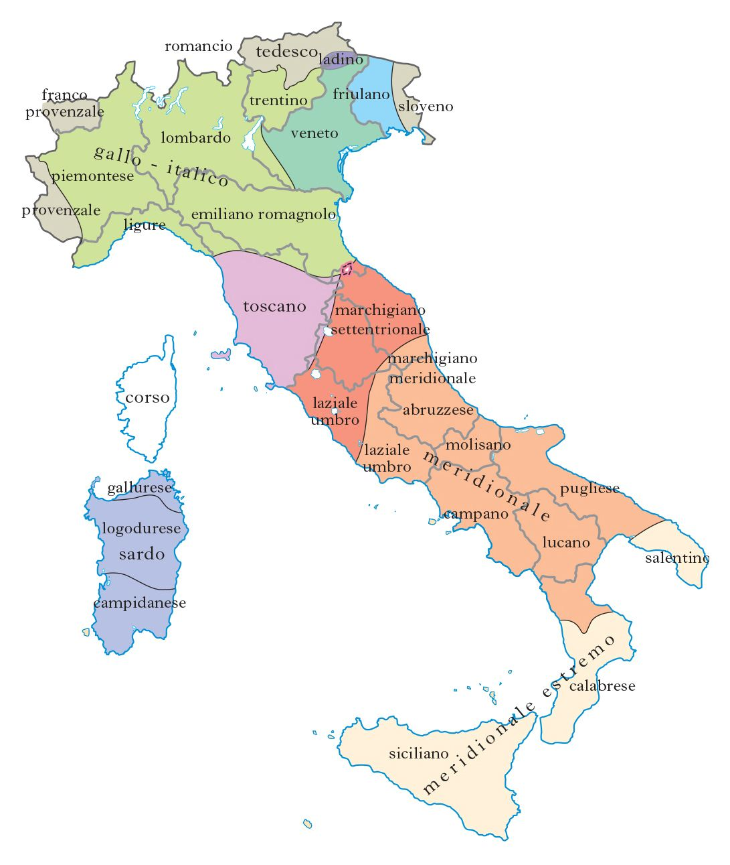
THE DIALECTS OF ITALY
northern dialects (gallo-italici, veneto)
friulan dialects
tuscan
central southern dialects (area mediana e area meridionale)
extreme southern dialects
sardinian dialects

Slide 12
REDUPLICATION IN THE DIALECTS OF ITALY
ABRUZZESE (Passino, 2017: 242-243):
    collə ‘hill’ > collacollə ‘hill after hill’
    spennə ‘spend’ > spinnaspinnə ‘spend-spend’
    lεmmə ‘slow’ > lεmməlεmmə ‘slowly’
    APULO BARESE (D’Onghia, 2019: 317-318):
    A gɔnnə, mə lɔ taggjεtə prećisa prećisə ‘she cut my skirt precisely’
    Na lunə bbjanga bbjangə ‘a very white moon’
    makkjə makkjə ‘full of stains’
    costa costə ‘along the coast’

Slide 13

REDUPLICATION IN THE DIALECTS OF ITALY
    SOUTHERN CALABRESE (Idone, 2020):
        kuɟɟɪ́ʊmʊ bbrɪttʃʊ ʃʊmari ʃʊmari ɛ ʊ vɪndɪ́ʊmʊ ‘we used to collect gravel along the river and sell it’
        ʂɽɪkaʊ a mákɪna mʊrʊ mʊrʊ ‘he crawled the car all along the wall’
        SICILIAN (Sgarioto, 2005):
    caminava riva riva ‘he/she was walking along the edge’
    tagghiau u pisci pizzuddi pizzuddi ‘he/she cut the fish into pieces’

Slide 14
REDUPLICATION
IN THE DIALECT OF CANNA (CS)

Slide 15
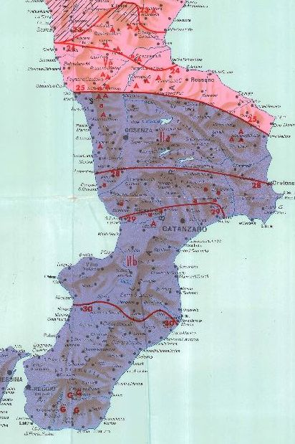
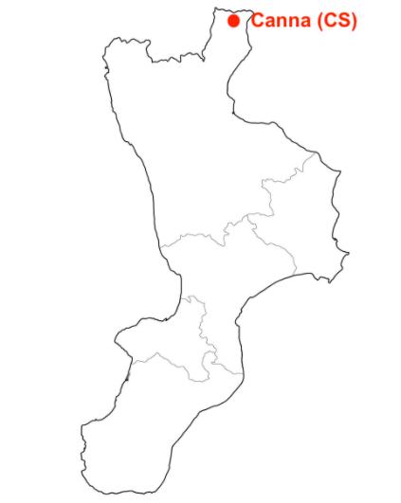
CALABRIA
«Dal punto di vista idiomatico la Calabria appartiene a quelle regioni d’Italia che offrono i più forti contrasti. Essa è dunque per gli studi linguistici una delle terre più interessanti» (Rohlfs, 1950: 997).

Slide 16
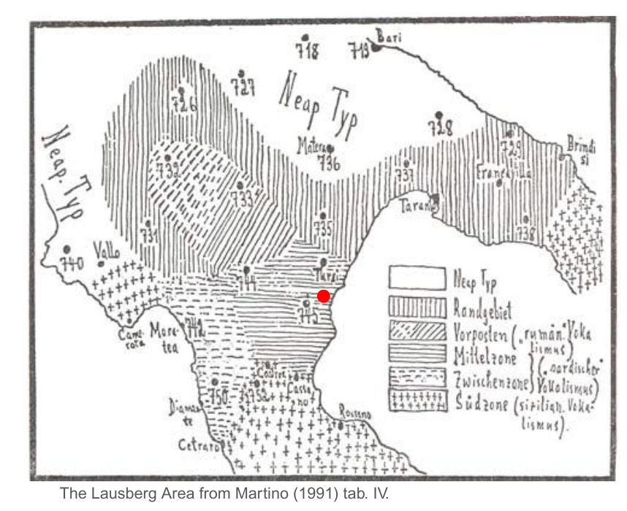
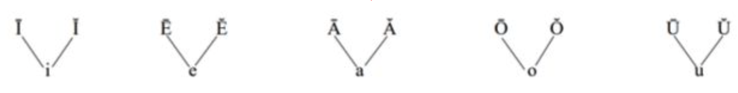
LAUSBERG AREA
(Lausberg, 1939)
Southern Lucania and Northern Calabria
high degree of archaism: this area has long been affected by a condition of both geographical and cultural isolation (Martino, 1991: 11)
considered one of the most conservative areas of the Romània
influenced in the north by Neapolitan and in the south by Sicilian-type dialects
Mittelzone o “central zone”: «"Sardinian" vocalism (preservation of timbre and convergence of long vowels with short homotopic ones)

Slide 17
REDUPLICATION IN CANNESE

Slide 18
Three types of reduplication:
adjectives / adverbs
nouns
verbs

Slide 19
ADJECTIVAL AND VERBAL REDUPLICATION

Slide 20
ADJECTIVAL REDUPLICATION
In many varieties, there is (almost) no trace of the derivational suffixes -issimo and -mente, which form superlatives and adverbs of manner.
ADJECTIVAL REDUPLICATION
Expresses the superlative degree
Intensification and expressive reinforcement functions (Rohlfs, 1968; Floričić, 2012)
A clear separation between the superlative degree and expressive reinforcement is very difficult
ADJ+ADJ = SUP. DEG.
(1)
a. | stu | kafɛ́ | jɛ́ | llíndə líndə
 | this | coffee | be.3SG | weak.M weak.M
‘this coffee is very diluted’
c. | εj | fattə | káudə káudə
 | have.AUX.2SG | do.PPT | hot.M hot.M
‘you’ve become very hot’
b. | εj | fattə | jáŋga jáŋgə
 | have.AUX.2SG | do. PPT | white.F white.F
‘you’ve become very pale’
d. | εj | fattə | káuda káudə
 | have.AUX.2SG | do.PPT | hot.F hot.F
‘you’ve become very hot’

Slide 21
ADJECTIVAL AND ADVERBIAL REDUPLICATION
Formation of manner adverbs (-mente) or intensified adjectives (D’Onghia 2019; Passino, 2017: 243)
ADJ+ADJ= ADV
(2)
a. | dətʃíllə | cárə | cárə
 | say.IMP.2SG+CL | clear.ADJ | clear.ADJ
‘say it (really) clearly’ it. ‘dillo chiaramente’ | ‘mia mamma cucina bene’
ADV+ADV= ADV
b. | ej | a | í | cɛ́nə | cɛ́nə | k | a | mákənə
 | have.IMP.2SG | PREP | go.INF | slowly.ADV | slowly.ADV | with | the | car
‘you should drive your car (really) slowly’ it. ‘dovresti guidare molto lentamente’ | ‘devi andare lentamente con la macchina’

Slide 22
ADJECTIVAL AND ADVERBIAL REDUPLICATION
In some cases, reduplication is not necessary:
(3)
a. | stu | kafɛ́ | jɛ́ | llíndə líndə
 | this | coffee | be.3SG | weak
‘this coffee is very diluted’
b. | ej | a | í | cɛ́nə | cɛ́nə | k | a | mákənə
 | have.IMP.2SG | PREP | go.INF | slowly.ADV |  | with | the | car
‘you should drive your car very slowly’ | ‘devi andare lentamente con la macchina’
The sentences are grammatical, even though there is either no superlative degree or expressive reinforcement.

Slide 23
ADJECTIVAL AND ADVERBIAL REDUPLICATION
In some cases, reduplication is obligatory:
(4)
a. | *εj | fattə | káudə káudə
 | have.AUX.2SG | do.PPT | hot.ADJ
‘you’ve become very hot’
b. | *εj | fattə | jáŋgə jáŋgə
 | have.AUX.2SG | do. PPT | white.F
‘you’ve become very pale’
(5)
a. | *dətʃíllə | cárə | cárə
 | say.IMP.2SG+CL | clear.ADJ
‘*say it clearly’ | ‘mia mamma cucina bene’
The sentences are ungrammatical.

Slide 24
NOMINAL
REDUPLICATION

Slide 25
NOMINAL REDUPLICATION
This phenomenon has been observed for most southern and extreme southern dialects (Sgarioto 2005, Passino, 2017 D’Onghia 2019, Idone 2020, Barotto-Mattiola 2020): Cannese does not behave differently.
According to Rohlfs, «[…] diffuse, e d’uso non circoscritto a particolari concetti, son tali locuzioni nel Meridione» e «quanto più si procede verso mezzogiorno, tanto più frequente si fa quest’uso» (Rohlfs 1968, § 441: 90).

Slide 26
NOMINAL REDUPLICATION
Telmon e Maiden (in Maiden and Parry, 1997: 122): «extensive use is made of reduplication of nouns to form particular types of adverbial phrases, usually with emphatic, distributive or repetitive meaning».
Haspelmath (1995: 378) underlines the distributive function of reduplication: «an exceedingly common way to form distributive expressions across languages» (cfr. anche Sgarioto 2005, Passino 2017, D’Onghia 2019, Idone 2020, Barotto-Mattiola 2020).
The repetition of nominal elements corresponds to a PP with adverbial value in standard Italian.

Slide 27
NOMINAL REDUPLICATION
Nominal Reduplication Constructions (NRC) may occur after certain types of verbs (cfr. Sgarioto, 2005: 39-40):
  atelic motion verbs (andare ‘go’, camminare ‘walk’, correre ‘run’)
  transitive motion verbs (portare ‘bring’, cercare ’look for’)
  stative and resultative verbs (essere ‘be’, ridurre ‘reduce’, tagiliare ‘cut’, rompere ‘break’)

Slide 28
NOMINAL REDUPLICATION
Reduplication after motion verbs (andare ‘go’, camminare ‘walk’, passare ‘pass’ etc.) refers to the path along which a movement is made:
(6)
a. | sə | nn | έ | ɟɟʊ́tə | ​​kɔ́sta | kɔ́stə
 | CL | CL | have.AUX.3SG | go.PPT | coast | coast
‘he/she left by passing along the coast’
b. | vatínnə | mʊ́rə | mʊ́rə
 | go.IMP.2SG+CL+CL | wall | wall
‘go away by passing along (close to) the wall’

Slide 29
NOMINAL REDUPLICATION
In some SIDs, «arɪ́pa arɪ́pə» has undergone grammaticalisation, becoming a preposition and, therefore, the head of a PP:
(7)
a. | εm | a | kamənɛ́ | arɪ́pa | arɪ́pə | a | víjə
 | have.PRS.1PL | to | walk.INF | edge | edge | the | street
‘we must walk along the edge of the street'
b. | passə | arɪ́pa | arɪ́pə | u | mʊ́rə
 | pass.IMP.2SG | edge | edge | the | wall
‘pass along the wall’
The same change happened in other dialects, e.g. in salentino: ripa ripa ti la casa ‘along the house’ (Castiglione-Chilà, 2021).

Slide 30
NOMINAL REDUPLICATION
Verbs which express change of state (es. farsi ‘become’, diventare ‘become’, ridurre ‘make, reduce’, rompere ‘break’, ecc.) – when used with redupliation take a distributive meaning:
(8)
a. | sta | má​ʎʎə | s | έ | ffáttə | bbʊ́kə bbʊ́kə
 | this | shirt | RIFL | have.AUX.3SG | do.PPT | holes holes
‘this shirt has become full of holes’
b. | έ | kumbənɛ́tə | u | telɛ́fənə | píttsə píttsə
 | have.AUX.3SG | combine.PPT | the | phone | pieces pieces
‘he/she smashed the phone into a thousand pieces’

Slide 31
NOMINAL
REDUPLICATION:
RESTRICTIONS

Slide 32
NOMINAL REDUPLICATION: RESTRICTIONS
Reduplication is the only strategy available to encode adverbial expressions.
Nominal Reduplication (NR) forms do not allow for the insertion of lexical material between the reduplicated elements. Some scholars consider these expressions to be crystallised, as a single lexeme (Castiglione-Chilà, 2021: 110):
(9)
a. | sta | má​ʎʎə | s | έ | ffáttə | bbʊ́kə bbʊ́kə
 | this | shirt | RIFL | have.AUX.3SG | do.PPT | holes holes
‘lit. ‘this shirt became holes holes’
b. | *sta | má​ʎʎə | s | έ | ffáttə | bbʊ́kə
 | this | shirt | RIFL | have.AUX.3SG | do.PPT | holes
‘lit. ‘this shirt became holes’

Slide 33
NOMINAL REDUPLICATION: RESTRICTIONS
Restrictions:
the interpolation of other elements between the reduplicated forms;
determiners, modifiers or complementizers;
word order (marked structures) inversions.
(10)
a. | *sta | má​ʎʎə | bbʊ́kə | s | έ | ffáttə | bbʊ́kə
 | this | shirt | holes | RIFL | have.AUX.3SG | do.PPT | holes
lit. ‘*this shirt holes became holes’
b. | *sta | má​ʎʎə | s | έ | ffáttə | bbʊ́kə gránnə | bbʊ́kə gránnə
 | this | shirt | RIFL | have.AUX.3SG | do.PPT | holes big | holes big
lit. ‘*this shirt became big holes big holes’
c. | bbʊ́kə | bbʊ́kə | sta | má​ʎʎə | s | έ | ffáttə
 | holes | holes | this | shirt | RIFL | have.AUX.3SG | do.PPT
lit. ‘*holes holes became this shirt’

Slide 34
VERBAL
REDUPLICATION

Slide 35
VERBAL REDUPLICATION
The most productive and systematic typology of reduplication in Cannese.
Gerund
Indicative forms to create ever free relatives
Imperative
  action nouns
  periphrasis with v. fare ‘do’
  partial reduplication

Slide 36
GERUND
REDUPLICATION

Slide 37
VERBAL REDUPLICATION: GERUND
The reduplication of the gerund conveys durativity of the action.
adverbial clause:
(11)
a. | ɛ́də | arrəvɛ́tə | candʒɛ́nnə candʒɛ́nnə
 | have.AUX.3SG | arrive.PPT | cry.GER cry.GER
‘He/she arrived while he/she was crying’
b. | kadɛ́nnə kadɛ́nnə | s | ɛ́ | rrəkɔ́tə | n | a | kɛ́sə
 | fall.GER fall.GER | RIFL | have.AUX.3SG | go back.PPT.F | in | the | house
‘although she kept falling, she managed to get home’

Slide 38
VERBAL REDUPLICATION: GERUND
The gerund can license a DO:
(12)
a. | ɛ́ddʒə | vístə | u | fílm | mandʒánnə mandʒánnə
 | have.AUX.1SG | watch.PPT | the | movie | eat.GER eat.GER
‘I watched the movie while I was eating’
b. | ɛ́ddʒə | vístə | u | fílm | mandʒánnə mandʒánnə | a | píttə
 | have.AUX.1SG | watch.PPT | the | movie | eat.GER eat.GER | the | pizza
‘I watched the movie while I was eating a pizza’

Slide 39
VERBAL REDUPLICATION: GERUND
Functional verb andare ‘go’ + reduplicated gerund:
(13)
a. | u | tímbə | vɛ́ | ccuvɛ́nnə cuvɛ́nnə
 | the | weather | go.PRS.3SG | rain.GER rain.GER
‘recently it has been raining a lot/continuously’
b. | i | súrə | vɛ́nə | arrubbánnə arrubbánnə
 | the | sisters | go.PRS.3PL | steal.GER steal.GER
‘his/her sisters are used to stealing’
In cases like these, the presence of the verb ‘andare’ is obligatory; it is a tense marker and it also gives information about the person, but it is semantically empty.
The lexical meaning is given by the gerund.

Slide 40
VERBAL REDUPLICATION: GERUND
The sentence does is ungrammatical if the gerund is dropped:
(14)
a. | u | tímbə | vɛ́ | ccuvɛ́nnə cuvɛ́nnə
 | the | weather | go.PRS.3SG | rain.GER rain.GER
‘recently it has been raining a lot/continuously’
b. | *u | tímbə | vɛ́
 | the | weather | go.PRS.3SG
‘*the weather goes’

Slide 41
VERBAL REDUPLICATION: GERUND
Actually, the sentences work if only the second element is removed, but there is a light change in the meaning of the sentence:
(15)
a. | u | tímbə | vɛ́ | ccuvɛ́nnə
 | the | weather | go.PRS.3SG | rain.GER
‘it’s been raining often (frequency)’
b. | u | tímbə | vɛ́ | ccuvɛ́nnə cuvɛ́nnə
 | the | weather | go.PRS.3SG | rain.GER rain.GER
‘it’s been raining a lot/continuously (quantity)’

Slide 42
INDICATIVE
REDUPLICATION

Slide 43
VERBAL REDUPLICATION: INDICATIVE
Reduplication of indicative forms to express free relative clauses, in which the reduplicated verb performs the same function as relative pronouns/adverbs such as dovunque ‘wherever’, chiunque ‘whoever’ etc. (wh-ever clauses).
Several varieties of Calabria «avail themselves with the only structural strategy of reduplication to realize ever FRs [Free Relatives], being the morphological pronominal formation (almost) completely absent in their grammar» (Silvestri, 2019: 288-289)

Slide 44
VERBAL REDUPLICATION: INDICATIVE
(15)
a. | kə | ddíkə díkə | t | arráddʒəsə
 | what | say.1SG say.1SG | you.RIFL | get angry.2SG
‘whatever I say, you get angry’ | ‘qualunque cosa io dica, ti arrabbi’ (lit. ‘che dico dico, ti arrabbi’)
b. | addú | vɛ́ | vvɛ́ | sə | arrágədə | k | aŋgúnə
 | where | go.PRS.3SG go.PRS.3SG |  | RIFL | argue.3SG | with | someone
‘wherever he/she goes, he/she argues with someone’ | ‘qualunque cosa io dica, ti arrabbi’ (lit. ‘che dico dico, ti arrabbi’)
c. | kə | ɛ́ | stɛ́tə | ɛ́ | stɛ́tə | ll | ɛ́nə | rúttə | a | fənɛ́strə
 | who | have.AUX.3SG | be.PPT | have.AUX.3SG | be.PPT | CL | have.AUX | brake.PPT | the | window
‘whoever did it (regardless of who did it), the window is broken’

Slide 45
IMPERATIVE
REDUPLICATION:
PERIPHRASIS WITH FARE ‘DO’ + REDUPLICATED IMPERATIVE 2SG

Slide 46
VERBAL REDUPLICATION: PERIPHRASIS WITH FARE
How do we know these forms are morphologically imperatives?
These reduplicated verbs are morphologically classifiable as second person singular imperative forms since, unlike those of other moods and tenses that retain Latin endings, this one has only a [ə] :
Indicative - present tense:
sɔ́ngə ‘suono’
sɔ́nəsə ‘suoni’
sɔ́nədə ‘suona’
sunέmə ‘suoniamo’
sunátəsə ‘suonate’
sɔ́nənə ‘suonano’
Imperative:
-
sɔ́nə ‘suona’
-
sunέmə ‘suoniamo’
sunέtə ‘suoniamo’
-

Slide 47
VERBAL REDUPLICATION: PERIPHRASIS WITH FARE
Reduplicated imperative forms:
periphrasis (verb fare ‘do’) + reduplicated imperative forms (2SG)
not used to give order
durative meaning
(16)
a. | ɔ́jə | u | tímbə | ɛ́ | ffáttə | cɔ́va | cɔ́və
 | today | the | weather | have.AUX.3SG | do.PPT | rain.IMP.2SG | rain.IMP.2SG
‘today it rained a lot/for a long time'
presence of the linking vowel -a (Passino, 2014)

Slide 48
VERBAL REDUPLICATION: PERIPHRASIS WITH FARE
b. | kuddʒínə | míjə | faj | ppárla | párlə
 | cousin.M.SG | my.POSS | do.PRS.3SG | talk.IMP.2SG | talk.IMP.2SG
‘my cousin talks too much / all the time’
c. | enə | fáttə | ammúttʃa | ammúttʃə | ka | non | sə | vuínnə | fɛ́ | vídə
 | have.AUX.3PL | do.PPT | hide.IMP.2SG | hide.IMP.2SG | that | NEG | RIFL | want.IMPF.3PL | do.INF | see.INF
‘they kept trying to hide because they didn’t want to be seen’
d. | ɛ́ | ffáttə | kúrra | kúrrə | tándə | ka | pù | ɛ́ | kkadútə | ndɛ́rrə
 | have.AUX.3SG | do.PPT | run.IMP.2SG | run.IMP.2SG | so | that | then | have.AUX | cadere.P.PPT | on the ground
 | ‘he ran a lot / continuously, so much so that he fell to the ground’

Slide 49
VERBAL REDUPLICATION: PERIPHRASIS WITH FARE
e. | stέə fatʃέnnə | sɔ́na | sɔ́nə | n | u | kambaníllə | ma | nəʃʃúnə | grápədə | a | pɔ́rtə
 | do.PRS.PROG.1SG | ring.IMP.2SG | ring.IMP.2SG | to | the | doorbell | but | nobody | open.3SG | the | door
‘I am ringing the doorbell insistently, but no one opens the door’
f. | stέ ffatʃέnnə |  | cáma cámə |  | cáma cámə | cáma cámə
 | do.PRS.PROG.3SG |  | call.IMP.2SG call.IMP.2SG |  | call.IMP.2SG call.IMP.2SG | call.IMP.2SG call.IMP.2SG
 | non | tʃə | a | fáttsə | ccú
 | NEG | CL | CL | do.PRS.1SG | more
 | ‘he/she calls me continuously / insistently, I can't take it anymore’

Slide 50
IMPERATIVE
REDUPLICATION:
RESTRICTIONS

Slide 51
VERBAL REDUPLICATION: PERIPHRASIS WITH FARE
The previous sentences cannot be created without the second of the two imperatives:
(17)
a. | *stέə fatʃέnnə | sɔ́nə | n | u | kambaníllə
 | do.PRS.PROG.1SG | ring.IMP.2SG | to | the | doorbell
lit. ‘*I’m doing ring to the doorbell’
b. | *kudʤínə | míjə | fáidə | párlə
 | cousin | my | do.PRS.3SG | speak.IMP.2SG
lit. ‘*my cousin does speak’

Slide 52
VERBAL REDUPLICATION: PERIPHRASIS WITH FARE
It is not possible to interpone other elements between the two reduplicated forms, which must be contiguous:
(18)
a. | *stέə fatʃέnnə | sɔ́nə | sέmbə | sɔ́nə | n | u | kambaníllə
 | do.PRS.PROG.1SG | ring.IMP.2SG | always | ring.IMP.2SG | to | the | doorbell
lit. ‘*I am doing ring always ring to the doorbell’
b. | *stέə fatʃέnnə | sɔ́nə | u | kambaníllə | sɔ́nə
 | do.PRS.PROG.1SG | ring.IMP.2SG | the | doorbell | ring.IMP.2SG
lit. ‘*I am doing ring to the doorbell ring’
c. | *kuddʒínə | míjə | faj | ppárlə | assέj | párlə
 | cousin.M.SG | my | do.PRS.3SG | talk.IMP.2SG | a lot | talk.IMP.2SG
lit. ‘*my cousin does talk a lot talk’

Slide 53
VERBAL REDUPLICATION: PERIPHRASIS WITH FARE
The V₁ is always fare ‘do’ and it can only appear in the finite form:
  Indicative:
    fattsə párla párlə (lit. ‘I do talk talk’);
    ɛdʒə fáttə párla párlə (lit. ‘I did talk talk’);
    stέə fatʃέnnə párla párlə (lit. ‘I’m doing talk talk’).
  Subjunctive:
    s ijə fajέrə párla párlə… (lit. ‘if I did talk talk…’)
  Conditional:
    ijə fajerə párla párlə (lit. ‘I would do talk talk’)
  Imperative
    *Fai párla párlə! (lit. ‘Do talk talk!’)
    *Párla párlə! (*Talk talk!) Párlə! (Talk!)

Slide 54
IMPERATIVE
REDUPLICATION:
IS THE REDUPLICATED FORM
STILL A VERB?

Slide 55
VERBAL REDUPLICATION: PERIPHRASIS WITH FARE
The imperative, in this case, is not used to give orders, but to convey aspectual meanings such as durativity and/or modal meanings such as insistence, which are otherwise encoded by an AdvP.
But these verbs seem to have only some characteristics of the imperative:
they don’t admit the use of enclitics which are generally admitted by functionally full imperatives:
(19)
a. | *kudʤínə | míjə | faj | ppárləmə | párləmə
 | cousin.M.SG | my | do.PR.3SG | talk.IMP.2SG me.CL | talk.IMP.2S me.CL
lit. ‘*my cousin does talk to me talk to me’ | lit. ‘my cousin does talk to me – talk to me’
Apart from these constructs, imperatives admit the use of enclitics:
párləmə
talk.IMP.2SG+CL
‘talk to me’
gwárdətə
look.IMP.2SG+CL
‘look at yourself’
səndíllə
listen.IMP.2SG+CL
‘listen to him’

Slide 56
VERBAL REDUPLICATION: PERIPHRASIS WITH FARE
2. They cannot be combined with the negation ‘non’, which is only admitted before the V₁ fare ‘do’
(20)
a. | *ɔ́jə | u | tímbə | έ | ffáttə₁ | non | cɔ́və₂ | non | cɔ́və₂
 | today | the | weather | have.AUX.3SG | do.PPT | NEG | rain.IMP.2S | NEG | rain.IMP.2S
 | lit. ‘today the weather did not rain not rain’
b. | *ɔ́jə | u | tímbə | έ | ffáttə₁ | non | cɔ́va₂ | cɔ́və₂
 | today | the | weather | have.AUX.3SG | do.PPT | NEG | rain.IMP.2S | rain.IMP.2S
 | lit. ‘today the weather did not rain rain’
c. | ɔ́jə | u | tímbə | nonn | έ | ffáttə₁ | cɔ́va₂ | cɔ́və₂
 | today | the | weather | NEG | have.AUX.3SG | do.PPT | rain.IMP.2S | rain.IMP.2S
 | ‘today it did not rain’ or ’today it did not rain that much’

Slide 57
VERBAL REDUPLICATION: PERIPHRASIS WITH FARE
3. Adverbs are admitted, but only between V₁ and V₂ :
(21)
a. | ɔ́jə | u | tímbə | έ | ffáttə₁ | sέmbə | cɔ́va₂ | cɔ́və₂
 | today | the | weather | have.AUX.3SG | do.PPT | always | rain.IMP.2S | rain.IMP.2S
 | ‘today it didn’t stop raining’
b. | stέ fatʃέnnə₁ | ddʒá | sɔ́na₂ | sɔ́nə₂ | n | u | kambaníllə
 | do.PRS.PROG.1SG | already | ring.IMP.2SG | ring.IMP.2SG | to | the | doorbell
‘he/she is already ringing the bell insistently’

Slide 58
VERBAL REDUPLICATION: PERIPHRASIS WITH FARE
4. It is not possible to place these forms before V₁:
(22)
a. | *párla₂ | párlə₂ | fajdə₁ | kudʤínə | míjə
 | talk.IMP.2SG | talk.IMP.2SG | do.PRS.3SG | cousin.M.SG | my
 | lit. ‘*talk talk my cousin does’
5. Reduplicated elements cannot be placed after the DO:
b. | *stέə fatʃέnnə₁ | u | kambaníllə | sɔ́na₂ | sɔ́nə₂
 | do.PRS.PROG.1SG | the | doorbell | ring.IMP.2SG | ring.IMP.2SG
 | lit. ‘*I’m doing the doorbell ring ring’

Slide 59
VERBAL REDUPLICATION: PERIPHRASIS WITH FARE
We may consider the V₁ fare ‘do’ as a functional verb, since it conveys information about mood, tense and person; it also agrees with S.
But, the verb that licenses the arguments is the V₂ and it also imposes semantic restrictions on S and DO:
(23)
a. | kuddʒínə | míjə | faj | ppárla | párlə
 | cousin | my | do.PRS.3SG | talk.IMP.2SG | talk.IMP.2SG
‘my cousin is always talking’
b. | *a | sɛ́ddʒa | mɛ́j | faj | ppárla | párlə
 | the | chair | my | do.PRS.3SG | talk.IMP.2SG | talk.IMP.2SG
‘*my chair is always talking’
  The S must be [+animate] [+human].

Slide 60
VERBAL REDUPLICATION: PERIPHRASIS WITH FARE
(24)
a. | (ijə) | stέə fatʃέnnə | sɔ́na | sɔ́nə
 | I | do.PRS.PROG.1SG | ring.IMP.2SG | ring.IMP.2SG
‘I am ringing (the doorbell) insistently’
b. | a | svɛ́ʎʎə | fáj | ssɔ́na | sɔ́na
 | the | alarm | do.PRS.3SG | ring.IMP.2SG | ring.IMP.2SG
‘the alarm is ringing insistently’
c. | stέə fatʃέnnə | sɔ́na | sɔ́nə | a | cambɛ́nə
 | do.PRS.PROG.1SG | ring.IMP.2SG | ring.IMP.2SG | the | bell
‘I am ringing the bell insistently’
d. | *stέə fatʃέnnə | sɔ́na | sɔ́nə | u | waɲɲəníllə
 | do.PRS.PROG.1SG | ring.IMP.2SG | ring.IMP.2SG | the | child
‘*I am ringing the child insistently’
The DO must be [-animate].

Slide 61
VERBAL REDUPLICATION: PERIPHRASIS WITH FARE
(25)
a. | u | waɲɲəníllə | έ | ffáttə | kúrra | kúrrə
 | the | child | have.AUX.3SG | do.PPT | run.IMP.2SG | run.IMP.2SG
‘the child was always running’
b. | a | gáttə | έ | ffáttə | kúrra | kúrrə
 | the | cat | have.AUX.3SG | do.PPT | run.IMP.2SG | run.IMP.2SG
‘the cat was always running’
c. | *u | telέfənə | έ | ffáttə | kúrra | kúrrə
 | the | telephone | have.AUX.3SG | do.PPT | run.IMP.2SG | run.IMP.2SG
‘the telephone was always running’
The S must be [+animate].

Slide 62
IMPERATIVE
REDUPLICATION:
ACTION NOUNS

Slide 63
VERBAL REDUPLICATION: ACTION NOUNS
The reduplication of imperative forms can also produce action nouns (es. Italian fuggifuggi ‘escape-escape’, corricorri ‘run-run’; cfr. Thornton 2007) to convey a durative meaning.
In this case the nouns are the result of the lexicalisation of direct speech, used as «imperativo descrittivo» (Spitzer 1918).
V+V=N
párla párlə ‘talk talk’
sɔ́na sɔ́nə ‘play play / ring ring’
cɔ́va cɔ́və ‘rain rain’
fúma fúmə ‘smoke smoke’
sbútta sbúttə ‘push push’
sfútta sfúttə ‘annoy annoy’
cáma cámə ‘call call’
víva vívə ‘drink drink’
…
akkátta akkáttə ‘buy buy’
ammúttʃa ammúttʃə ‘hide hide’
arrɔ́bba arrɔ́bbə ‘steal steal’
…

Slide 64
VERBAL REDUPLICATION: ACTION NOUNS
Even though these elements are nouns, they don’t admit every kind of determiner, only demonstratives:
(26)
a. | sməttíllə | k | stu | sbútta | sbúttə
 | stop.IMP.2SG+CL+CL | with | this | push.IMP.2SG | push.IMP.2SG
 | lit. ‘stop with this pushing’
b. | stu | fúma | fúmə | non | m | pjátʃədə
 | this | smoke.IMP.2SG | smoke.IMP.2SG | NEG | CL | like.PRS.3SG
 | ‘I don't like that you smoke / keep smoking so much’

Slide 65
VERBAL REDUPLICATION: ACTION NOUNS
We can try to substitute the action noun with another noun:
(27)
a. | sməttíllə | k | stu | sbútta | sbúttə
 | stop.IMP.2SG+CL+CL | with | this | push.IMP.2SG | push.IMP.2SG
 | ‘stop with this pushing’
b. | sməttíllə | k | stu | telɛ́fənə
 | stop.IMP.2SG+CL+CL | with | this | phone
 | ‘stop using the phone’
(28)
a. | stu | fúma | fúmə | non | m | pjátʃədə
 | this | smoke.IMP.2SG | smoke.IMP.2SG | NEG | CL | like.PRS.3SG
 | ‘I don't like that you smoke / keep smoking so much’
b. | stu | ddʒɛlátə | non | m | pjátʃədə
 | this | gelato | NEG | CL | like.PRS.3SG
 | ‘I don't like this gelato’

Slide 66
PARTIAL
IMPERATIVE
REDUPLICATION

Slide 67
PARTIAL VERBAL REDUPLICATION
In Cannese, it is possible to find examples of partial reduplication with an expressive meaning:
  vída ví’ ‘see’
  gwarda gwà ‘look’
  sínda sí ‘hear’
  píʎʎa pí ‘take’
  pɔ́rta pɔ́ ‘bring’
  ŋɡáʃʃa ŋɡá
  dálla dá
  jíŋɡa jí ‘fill’

Slide 68
PARTIAL VERBAL REDUPLICATION
Often used in an ironic / sarcastic or expressive way :
(29)
a. | dállə | dá | vívə | n | átu | pɔ́kə
 | give.IMP.2SG | give.IMP.2SG | drink.IMP.2G | a | other | bit
 | ‘sure, great idea, keep drinking!’
b. | vída | ví | vέnə | kɔ́mə | i | páttʃə
 | see.IMP.2SG | see.IMP.2SG | go.PRS.3PL | like | the | crazy (people)
 |  | ‘look look, they drive like crazy!’

Slide 69
TO SUMMARIZE

Slide 70
CONCLUSIONS
Reduplication encodes different syntactic functions, conveying different semantic values depending on the type of reduplicated element.
ADJECTIVAL AND ADVERBIAL REDUPLICATION:
  expressive and emphatic meaning;
  superlative degree;
  formation of manner adverbs;
  reduplication is not always required.

Slide 71
CONCLUSIONS
NOMINAL REDUPLICATION
  atelic motion verbs, transitive motion verbs, stative and resultative verbs;
  creation of adverbial expressions which convey distributivity;
  reduplicated noun construction arɪ́pa arɪ́pə has undergone grammaticalization to become the head of a PP;
  crystallized: the interpolation of other elements is not allowed.

Slide 72
CONCLUSIONS
VERBAL REDUPLICATION
GERUND
  cdverbial clauses or lexical predicates
  licenses DOs
  slight change of meaning when reduplication is absent
INDICATIVE
  free relatives
  reduplication to fill a morphological gap

Slide 73
CONCLUSIONS
IMPERATIVE
  Periphrasis: fare ‘do’ + reduplicated imperative
    durative meaning
    reduplication is obligatory
    the imperative has lost some of its functions
  Action nouns
    demonstratives are the only determiners admitted in the construction
  Partial reduplication
    expressive meaning (ironic)

Slide 74
REFERENCES
Barotto A. - Mattiola S. (2020), Reduplicazione e ripetizione in tipologia: due strategie separate o espressione dello stesso fenomeno?, in CLUB Working Papers in linguistics, pp. 47-66.
Castiglione A. – Chilà A. (2021), Reduplicazioni nominali nell’estremo meridione d’Italia: il ruolo del greco a contatto col romanzo, in Appunti Romani di Filologia. Studi e comunicazioni di filologia, linguistica e letteratura greca e latina vol. XXIII, Pisa-Roma, Serra, pp.107-139.
De Santis, C. (2014), Cresci, cresci, cresci… La reduplicazione espressiva come strumento di espressione di relazioni trasfrastiche, in C. De Santis et al., Le relazioni logico-sintattiche, Roma, Aracne, pp. 181-207.
D’Onghia M. V. (2019), La formazione di avverbi tramite reduplicazione degli aggettivi nei dialetti pugliesi, in Aldinucci B. et. al., Parola. Una nozione unica per una ricerca multidisciplinare, Siena, Edizioni Università per Stranieri di Siena, pp. 313-322.
Floričić, F. (2012). On reduplicated “imperative compounds” in Sardinian. Lingue e linguaggio, 11(1), pp. 71-96.
Floris B. - Truncellito G. (forthcoming), La reduplicazione nel calabrese settentrionale e nel sardo arborense: uno studio contrastivo
Forza F. (2011), Doubling as a Sign of Morphology: A Typological Perspectve, in «Journal of Universal Language», pp. 7-44.
Haspelmath M. (1995), The converb as a cross-linguistically valid category, in Haspelmath M. - König E. (a cura di), Converbs in Cross-Linguistic Perspective, Berlin-New York, Mouton de Gruyter, pp. 57-95.
Idone A. (2020), Morfologia e sintassi dell’accordo in calabrese meridionale: il dialetto di Villa San Giovanni (RC), Tesi di dottorato, Università di Zurigo.
Khanjan A. - Batool A. (2010), A morphological doubling approach to full reduplication in Persian, in «SKY Journal of Linguistics» 23, 169-198.
Loporcaro M. (2009), Profilo linguistico dei dialetti italiani, Bari-Roma, Laterza

Slide 75
REFERENCES
Martino P. (1991), L’“Area Lausberg”. Isolamento e arcaicità, Roma, Dipartimento di studi glottoantropologici dell'Università di Roma La Sapienza.
Mattes V. (2014), Types of reduplication. A case study of Bikol, Berlino, Mouton de Gruyter.
Müller H. G. (2003), Morphophonologische Untersuchungen an Reduplikationen im Türkischen, Tesi di dottorato, Università di Tubinga.
Passino D. (2014), Introduzione di /a/ nei dialetti abruzzesi: fonologia, morfologia, sintassi o lessico?, in Pescarini D. e Passino D. (a cura di), «Quaderni di lavoro ASIt», 17, pp. 59-80.
Passino D. (2017), La composizione in abruzzese, in D’Alessandro et. al. (a cura di), Di tutti i colori. Studi linguistici per Maria Grossmann, Utrecht, Utrecht University Repository, pp. 231-246.
Rohlfs G. (1950), La varietà degli idiomi di Calabria, in Il Ponte, anno VI, n. 9-10, 997-1003.
Rohlfs G. (1968), Grammatica storica della lingua italiana e dei suoi dialetti. Morfologia, Torino, Einaudi.
Sapir E. (2007), Il linguaggio. Introduzione alla linguistica, Torino, Einaudi.
Sgarioto L. (2005), Caminari riva riva: su un fenomeno di reduplicazione nominale in siciliano, in «Quaderni di lavoro dell’ASIS», 5, pp. 36-49.
Silvestri G. (2019), Reduplication as a Strategy for -ever Free Relatives: Semantic and Syntactic Observation, in Manzoni M. R. - Savoia L. M., Quaderni di Linguistica e Studi Orientali. Working Papers in Linguistics and Oriental Studies n.5, Firenze, Firenze University Press, pp. 279-304.
Spitzer L. (1918), Über den Imperativ im Romanischen. In: Aufsatze zur romanischen Syntax und Stilistik, Halle, Niemeyer, pp. 181-231.
Telmon T. - Maiden M. (1997), Word structure and word formation, in Maiden M. - Parry M., The dialects of Italy, Londra-New York, Routledge, pp. 116-122.

