Slide 1


Temporality in Occitan and French Oral Narrative RoLinC, 7 June 2022 Janice Carruthers and Marianne Vergez-Couret Queen’s University Belfast/Université de Poitiers

Slide 2
Context ExpressioNarration: EU, Horizon 2020 Marie Skłodowska Curie project: 2016-2018 and ongoing Janice Carruthers (Queen’s, Belfast) and Marianne Vergez-Couret (Poitiers, formerly Queen’s) Project on temporality in oral narrative in Occitan, with a comparative dimension in French Temporality: tense usage and tense switching; temporal frames and connectives (Carruthers and Vergez-Couret 2021. Lingvisticae Investigationes 44.1, 1-36 – article on frames and connectives)

Slide 3
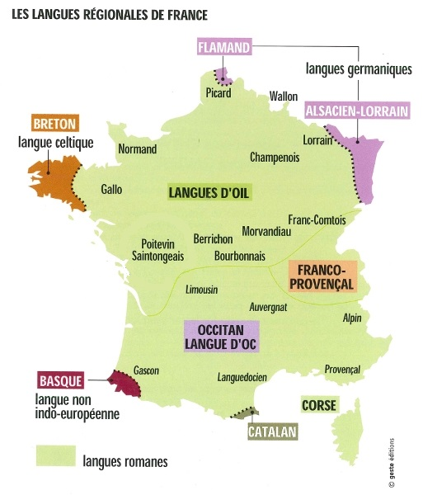
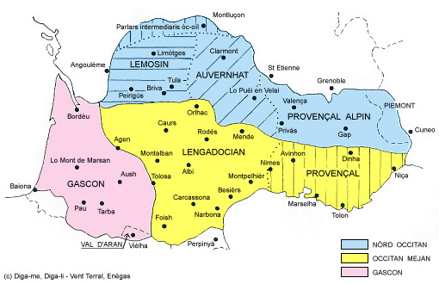
Occitan

Slide 4
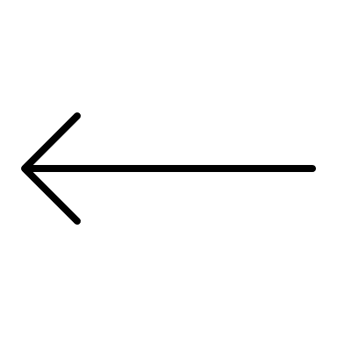
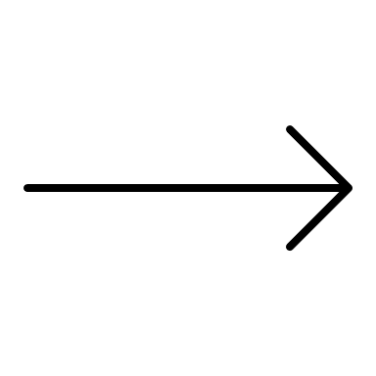
A scalar approach to orality Inadequacy of binary approaches: linguistics, folklore studies, anthropology…. Koch and Oesterreicher (2001) – channel, ‘conception’, comportement communicatif unknown interlocutor close/intimate interlocutor preparedness spontaneity public private Biber (1988)/Biber and Conrad (2009) – linguistic features, situational, dimensions oral literate narrative non-narrative procedural content-focused Finnegan (1988); Foley (2002) : composition, performance, transmission, dissemination

Slide 5
A scalar approach to orality (cont.) Research on tense switching in oral narrative in French: medieval, contemporary conversational, contemporary performed storytelling (Carruthers, 2005; Fleischman, 1990) Questions relating to context, performance factors and societal backdrop begun to be explored Minoritized language such as Occitan: sources, composition, transmission/dissemination, performance Plus: revitalization, language contact, diachronic and diatopic variation, language competency, story-type, individual style

Slide 6
The Corpus - OcOr https://zenodo.org/record/1451753# OWT (Occitan Written Traditional): oral sources, oral tradition, published texts by Bladé, Lalanne, Arnaudin based on fieldwork in community, storytellers born first half of 19th century, storytellers first language = Occitan, writers bilingual Occitan-French OOT (Occitan Oral Traditional): oral tradition, oral sources, recordings of stories recounted in community, storytellers born 1850-1925, bilingual Occitan/French? with Occitan first language OOC (Occitan Oral Contemporary): mixture of traditional and ‘new’ storytelling practice, oral and written sources, live performances for public, storytellers born second half of 20th century, all first language = French and educated through French - varying levels of bilingualism with Occitan PLUS.. FOC (French, Oral, Contemporary): French Oral Narrative Corpus (Carruthers 2013): ‘new’ storytellers, written sources, live performances for public, storytellers born second half of 20th century, all mother-tongue French https://frenchoralnarrative.qub.ac.uk

Slide 7
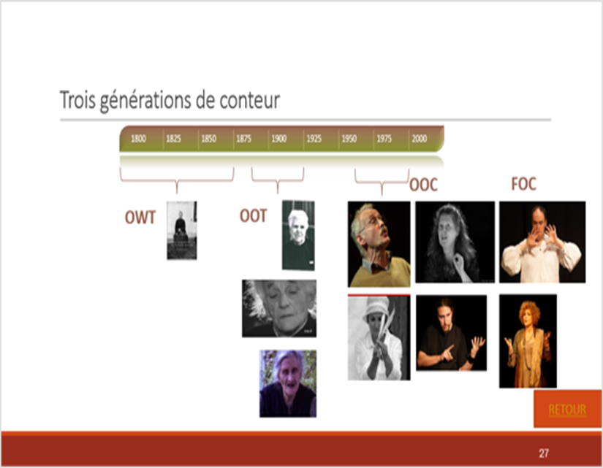
o

Slide 8
Carruthers, J. and Vergez-Couret, M. (2018). ‘Méthodologie pour la construction d’un corpus comparatif de narration orale. Objectifs, défis, solutions’, Corpus 18, online : https://journals.openedition.org/corpus/3490 J.
o
OWT + traditional – spontaneous + planning community performance, reading public oral sources Occitan first language (storytellers), Occitan/French bilingual (writers) speakers born early 19th c. | OOT + traditional + spontaneous – planning community performance oral sources Occitan first language – bilingual French? speakers born late-19th to early 20th c. | OOC +/– traditional + spontaneous + planning public performance written and oral sources French first language – varying levels of bilingualism speakers born mid 20th c. onwards | FOC – traditional + spontaneous + planning public performance written sources French first language speakers born mid 20th c. onwards

Slide 9
Tenses on the Narrative line in Occitan and French Narrative line and narrative clauses: l’homme y est allé/ il a pris la graine/ il l’a semée/ il a recouvert le tout de terre Different theoretical approaches… Passé simple/passat simple PS: which hasarriva/arribèt non-habitual, completed past-time events PRETERIT in both languages but in French, largely restricted to certain written forms; rare in oral medium Passé composé/passat compausat PC: est arrivé/ei arribat PRESENT PERFECTIVE in both languages; but also preterit function in most varieties of oral French and some varieties of written Frenchib Présent narratif/present narratiu PRN: arrive/arriba NARRATIVE PRESENT FUNCTION in both languages; marking completed non-habitual past events on the narrative line – can alternate with PS or PC in preterit function

Slide 10
In other words…. Major difference between the two languages: - PS ‘normal’ preterit marker in both written and spoken Occitan - PC ‘normal’ preterit marker in most varieties of spoken French BUT NOTE: widespread evidence in Gascon maritime that PC is replacing the PS as ‘normal’ marker of preterit TENSE SWITCHING BETWEEN PAST AND PRESENT IS STRONGLY ASSOCIATED WITH THE ORAL MEDIUM PRN be used in alternation with PS or PC to mark a completed past event on the narrative line (preterit function) in both languages. Research on French suggests tense-switching can have a range of discourse-pragmatic functions – PRN foregrounding particular events, PC or PS closing sections of the narrative, switching can structure the narrative into sub-sections, create turbulence at narrative peaks ….. (Fleischman 1990; Carruthers 2005).

Slide 11
Questions
What tenses are used on the narrative line in the four sub-corpora and how do the sub-corpora compare with each other? What is the dynamic between narrative tense usage and different degrees of orality, taking into account questions around written versus oral transmission, written versus oral sources, and performance context in terms of tradition and practice?
• To what extent is tense-switching found in the four sub-corpora and how, if at all, is this related to
different degrees of orality in terms of frequency, rate and function?
• To what extent do other factors play a role in the patterns attested, such as individual variation in
style, diatopic or diachronic variation, story-type, or language contact between French and Occitan?
Will discuss: major tenses found on the narrative line; the presence, frequency, rate and function of tense switching before drawing together any patterns attested in terms of degrees of orality and the role of complicating factors such as individual or diatopic variation, or language contact.

Slide 12
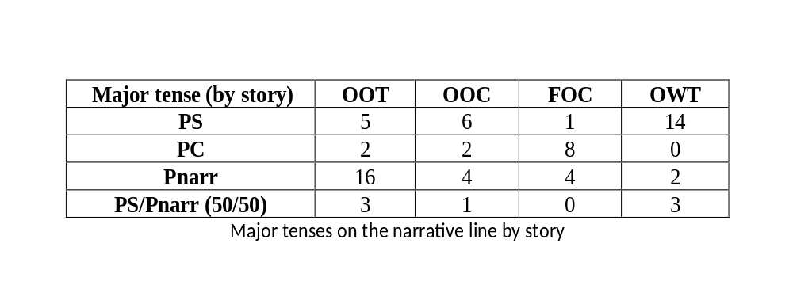
Findings: major tenses on the narrative line

Slide 13
Complicating factors
Use of PC as narrative tense in Occitan
  OOT: diatopic variation or language contact?
  OOC probably language contact (Pierre Vidal main narrative tense; Monique Burg occasional use)

Slide 14
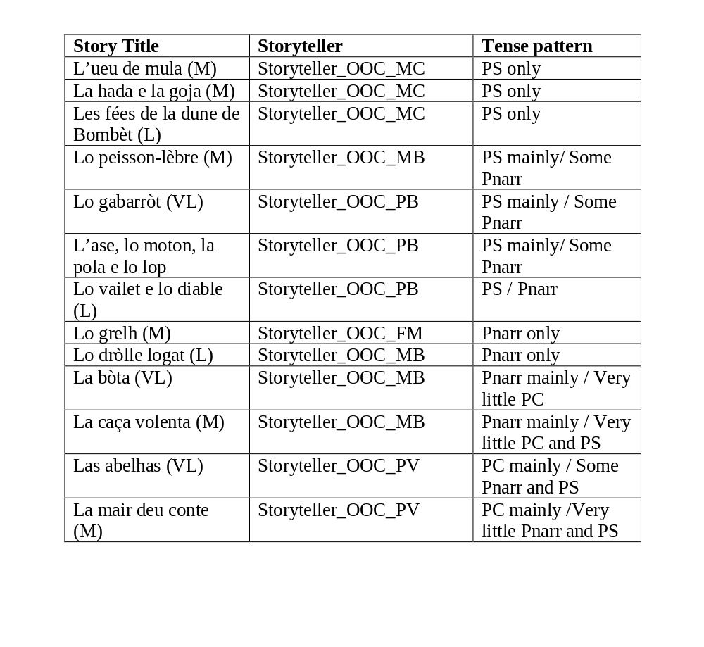
Individual storyteller variation: OOC

Slide 15
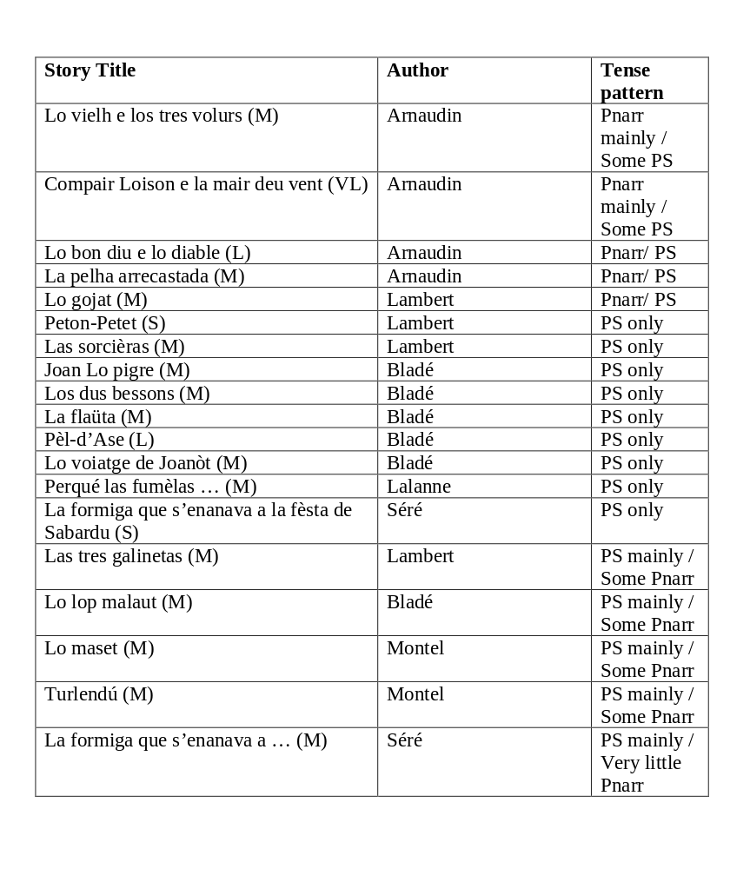
Individual writer variation: OWT

Slide 16
TENSE SWITCHING Functions attested are familiar: foregrounding particular events, turbulence at narrative peak, structuring the narrative, closure with the PS/PC One particular function characteristic of storytelling, particularly amongst those closest to the oral tradition, including the published texts in OWT: switching in parallel episodes

Slide 17
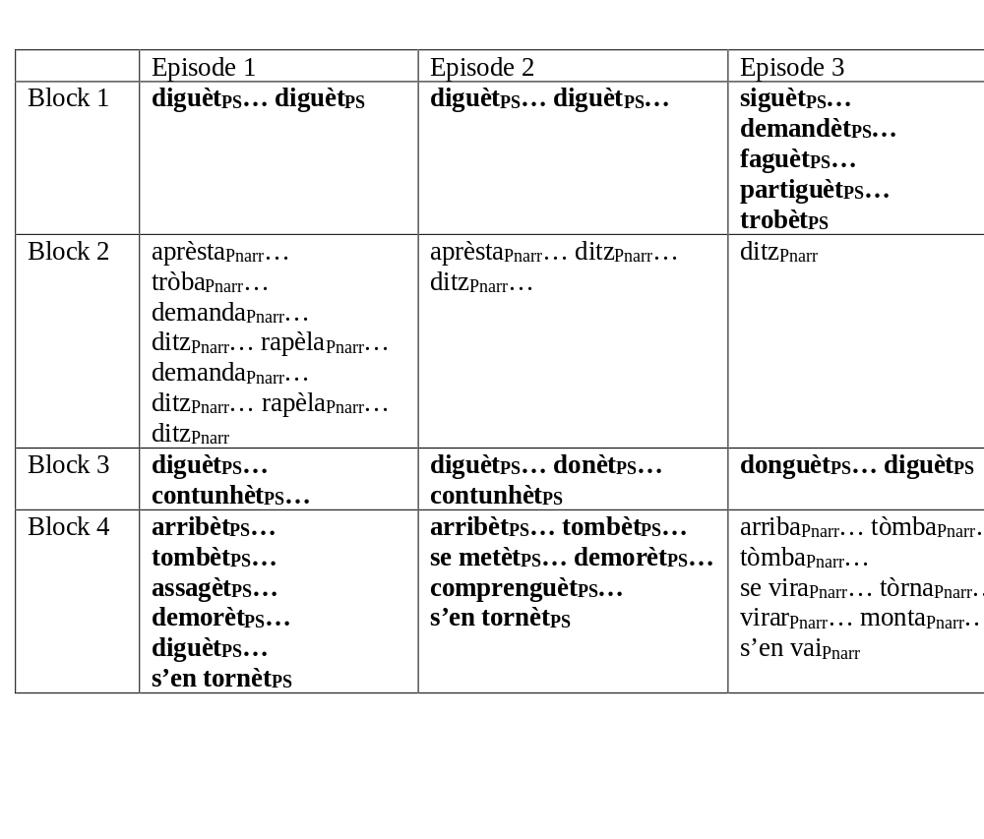
Lo gabarròt

Slide 18
TENSE SWITCHING
 | OOT | OOC | FOC | OWT
Percentage of narratives containing tense-switching (texts containing tense-switching/number of texts) | 88.5% (22/26) | 61.5% (8/13) | 61.5% (8/13) | 52.6% (10/19)
Average rate of tense-switching relative to number of narrative clauses containing verbs (narratives containing tense-shifting ONLY) | 1 switch per 4.1 clauses sustained switching throughout | 1 switch per 6.7 clauses short blocks | 1 switch per 9.7 clauses short blocks + some isolated switches | 1 switch per 3.6 clauses longer blocks + few isolated switches

Slide 19
Towards conclusions…. Oral transmission, sources, performance practice all relevant Degrees of orality transmission sources performance tradition + ORAL OOT ↔ OOC ↔ FOC ↔ OWT -ORAL + PRN as main narrative tense – + frequency of tense switching – + rate of tense switching – - temporal frames + + temporal connectives - Importance of oral vs written ‘transmission’ Complex patterns in OOC and FOC: sources, performance tradition Function of tense-switching in parallel episodes

Slide 20
Towards conclusions…. Importance of: language contact/levels of bilingualism individual preferences diatopic variation? Note no significant patterns with story type Further applications….

Slide 21
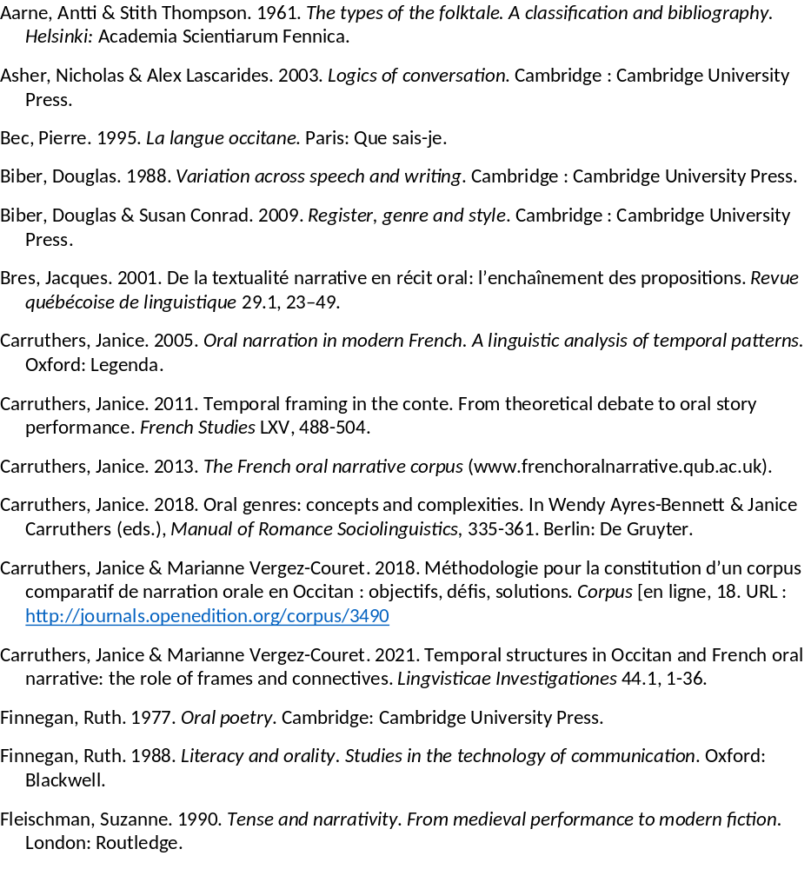

Slide 22
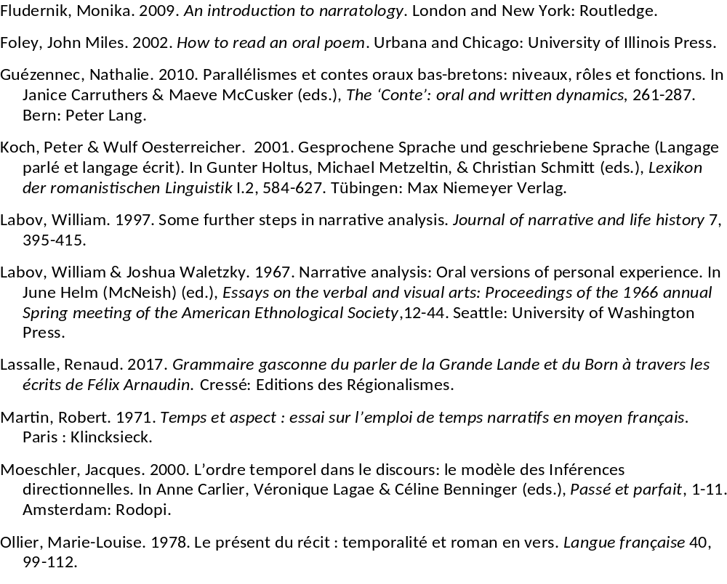

Slide 23
