Slide 1
The uniqueness of Dominican Spanish
and its importance for linguistic
research
Almeida Jacqueline Toribio, The University of Texas
Romance Linguistics Circle, Universities of Cambridge & Newcastle

Slide 2
My purpose today
Overview of observations on Dominican Spanish
  Examine the language forms and language practices of Dominicans in national and diasporic contexts
  Problematize notions of ethnic and racial identity that shape beliefs about language
  Motivate an integrated and interdisciplinary approach
Notes:
Research itinerary over thirty years

Slide 3
Observing language
Inspection of language unveils a wealth of information
  About language structure and variation
    Lexicon
    Phonology
    Morpho-syntax
  About language usage
    Norms or ‘codes’ of language behavior
    Ideologies
  About social structures
    Speakers
    Communities
    Societies
Notes:
Little attention to DS structure; though it contributes important insights in advancing/confronting linguistic-theoretical proposals

Slide 4
Outline of the presentation
The language situation in the Dominican Republic
  Thumbnail linguistic portrait
  Shaping language ideologies: “From Trujillo to the terremoto”
Language and identity among Dominicans in the U.S.
  Language loyalty: “La mancha (negra) del plátano”
  Framing language acts
New discourses
Notes:
Begin with thumbnail portrait for those with interests in language structure and variation

Slide 5
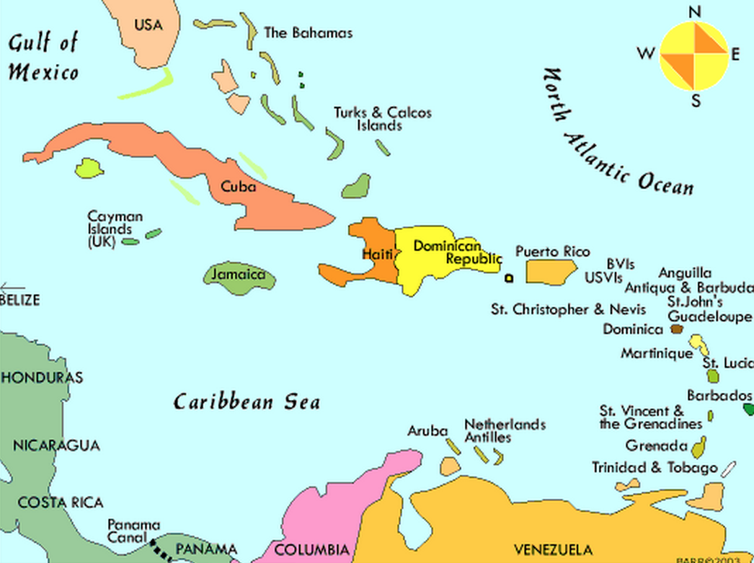
Dominican Spanish: Lexicon
Taino/Arawak indigenisms
  ají ‘pepper’ ; cabuya ‘twine’ ; guanábana ‘soursop fruit’
African contact
  cachimbo ‘pipe’; fucú ‘evil spirit’; mondongo ‘tripe stew’
Haitian Creole contact
  bonané ‘New Year’s gift’; galipote ‘werewolf’
English contact
  suera, grefrú, buldócer, parisear
Innovations, word play
  caballo/toro ‘skilled person’; jebo ‘hunk’; viejebo ‘sugar daddy’

Slide 6
Dominican Spanish: Morphosyntax
Subject-Verb word order
  Cuando tu papá llegue…
  ‘When your father arrives…’
  ¿Cuánto ese médico cobra? / ¿Cuánto es que ese médico cobra?
  ‘How much does that doctor charge?’
  Por aquí no hay donde un muchacho encontar un libro.
  ‘Around here there is nowhere for a kid to find a book.’

Slide 7
Dominican Spanish: Morphosyntax
Overt personal pronouns
  Uno no puede salir porque uno se puede encontrar en peligro.
  ‘You can’t go out because you might find yourself in danger.’
  Yo le dije así para yo poder ir con él.
  ‘I told him that so that I could go with him.’
  Hay unas muchachitas que están juntas conmigo que ellas viven pa’ fuera, entonces ellas vinieron a estudiar en la escuela del Pino, entonces ellas saben mucho inglés …yo no me acuerdo en el país que ellas vivían.
  ‘There are girls who are with me that they live abroad, then they came to study in the school in El Pino, so they know a lot of English.. I can’t remember what country they live in.’

Slide 8
Dominican Spanish: Morphosyntax
Overt referential, non-personal subject pronouns
  Pero yo no sé que le pasó a la camioneta porque ella tiene gasolina y ella estaba caminando bien.
  ‘But I don’t know what happened to the pick-up because it has gas and it was running fine.’
Overt impersonal subject pronoun ello (‘it/there’)
  Ello hay personas que lo aprenden bien.
  ‘There are people who learn it well.’
  Dicen que ello va a llover.
  ‘They say it will rain.’

Slide 9
Dominican Spanish: Morphosyntax
Focus constructions: no / sí ‘yes’ / ser ‘to be’
  No no voy para allá no.
  ‘I am NOT going there.’
  Tú lo ves así, pero ese viejito tiene dinero sí.
  ‘You see him like that, but that old man really HAS money.’
  Nosotras íbamos era para el río.
  ‘We were going to the river [not elsewhere].’
  Cristo murió fue crucificado.
  ‘Christ died crucified [not any other way].’

Slide 10
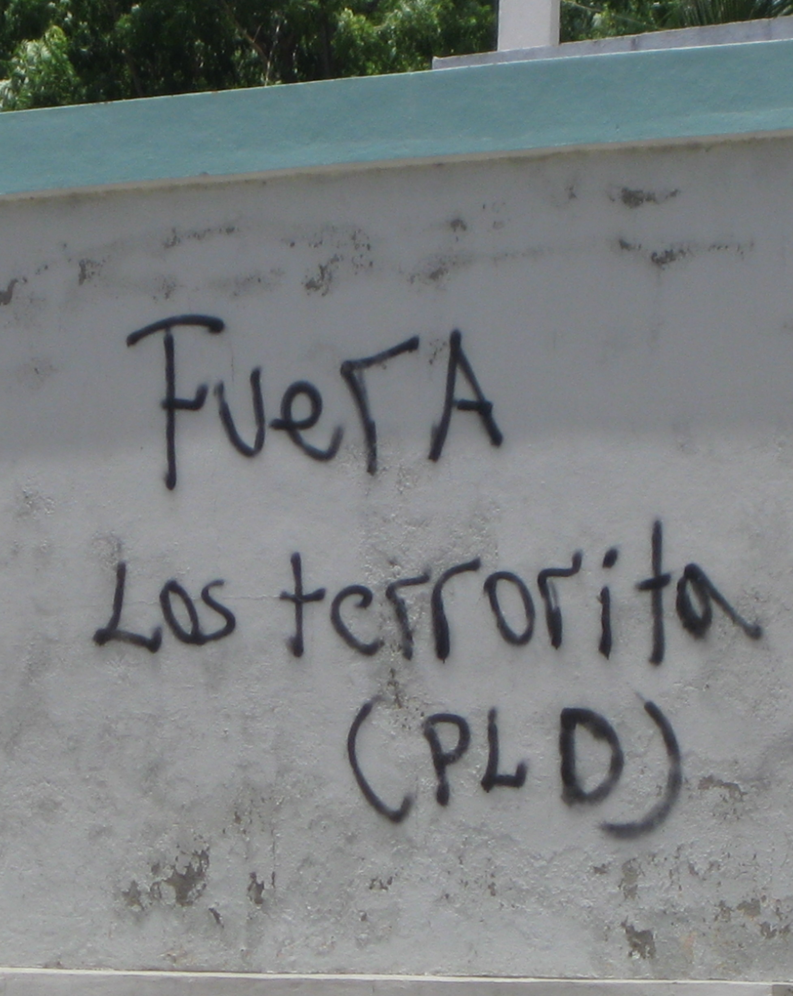
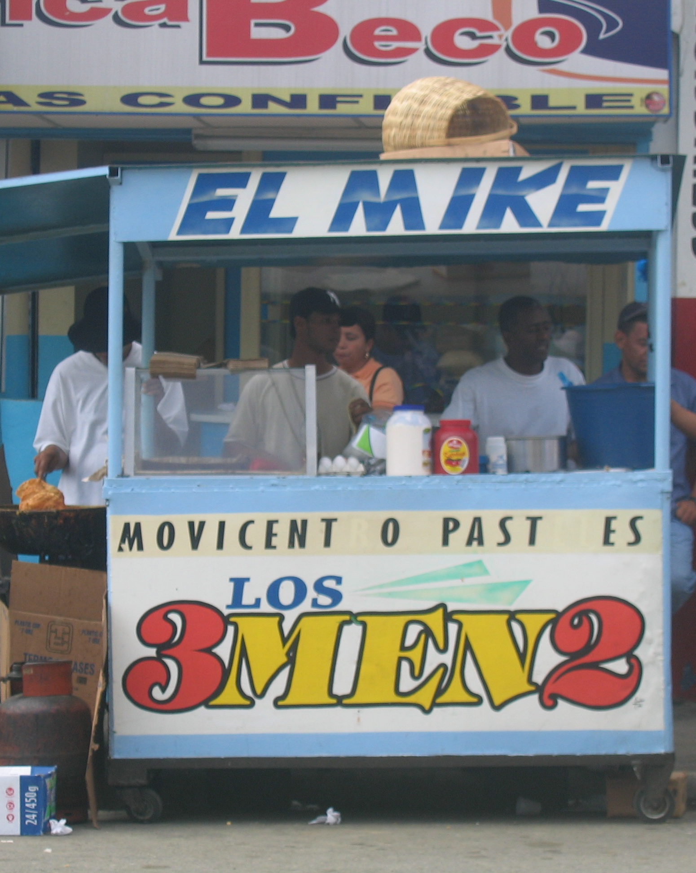
Dominican Spanish: Phonology
Syllable-final nasal: velarization, deletion
  Jua[ŋ] y María estudia[ŋ]
  Ju[ã] y María estudi[ã]
Etymological /s/: elision
  las casas ~ la casa
  estudias ~ estudia
  la- mujere- ‘the women’
  do- cafese ‘two coffees’
Non-etymological [s] insertion
  ¡Hola[s] Ja[s]queline!

Slide 11
Dominican Spanish: Phonology
Prosodic
  Pero ven acá …
  Sí …
  Listing intonation
Regional: segmental and prosodic
  Capital: lambdacism (hablan con la l ) mar → [mal]
  South: rotacism (hablan con la r ) mal → [maɾ]
  Cibao: vocalization (hablan con la i ) mal/mar →[ maj]
  Fronterizo ‘border’ intonation
Hypercorrection
  muy → [muɾ]/[mul]

Slide 12

Speech samples
Sí, porque ello hay haitianos buenos y ello hay haitianos que son, usted ve, cosa, pero ello hay haitianos que vienen aquí y uno los, los trata bien.
No … Yo quiero aprender sí. … Porque, porque yo he escuchado los muchachos hablar y a mí, yo quiero aprender también…
Mi mamá se llama Carmen Rosa; yo soy la más vieja, y mi hermano, mi hermana la que me sigue, tiene nueve años y se llama Verónica, uno se llama Andi y el otro Luis Ángel.
[el galipote] … estaba enamorado de mí. Y él me dijo a mí, desde que yo vivía en El Pino era eso. Yo siempre me gustaba bañarme de nochecita en el baño que quedaba fuera de la casa y me dice un día, dice, “Para allá voy, para allá voy yo esta noche a verte.” Bueno yo me quedé, digo, “Mire, usted está loco es, usted, qué usted es? Usted es un brujo?”
La familia mía es de a[s]quí mismo…de aquí … A mí, a mí[s] me gusta la agricultura.

Slide 13

Speech samples
Como no tenía burro[s], decidiose irse a pie[s], como hubiera llovido[s], y había mucho lodo[s]…
Había un viejo[s], llamado Lino, y había un gallo[s], llamado Quiquiriquí, y abajo de una mata[s], había un lobo
Ella [la comunidad] es grande, no tan grande[s]
Yo estudio lo que la profe me[s] pone en la escuela y lo hago

Slide 14
Sample elicitation tasks
Narrative re-telling
  El amigo Lino salió para su rancho con una fuerte lluvia. Cuando llegó no tenía cómo aluzar. Abrió la puerta, entró el relámpago, y arregló todo, y fue y se acostó. Y volvió y abrió la puerta y salió —¿así fue?— y salió su relámpago
  El Abuelo Lino quería ir al pueblo. No[s] tenía burro cuando eso. Se encontró en el camino con un compadre. Cortó un bastón, hablaron y hablaron, cuando se quisieron despegar ya[s] tenía raíz el palo y lo quería halar y se quedó pegado.
Experimental name game
  “Mi prima tiene un nombre muy especial: Metonís.
  ¿Cómo se llama mi prima?”

Slide 15
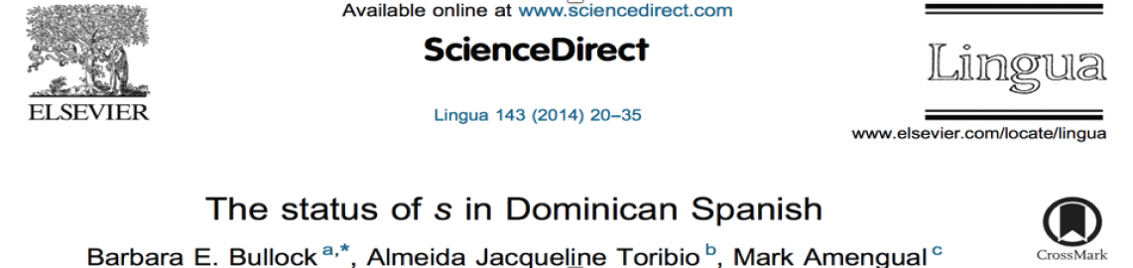
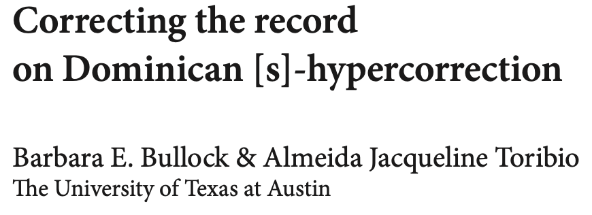
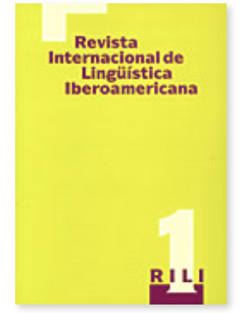
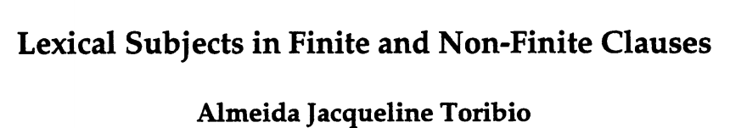
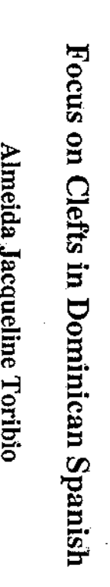
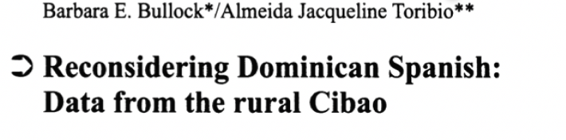

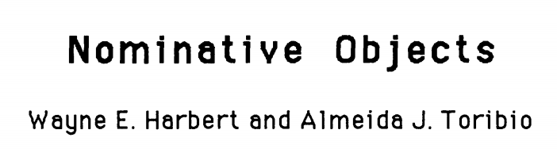
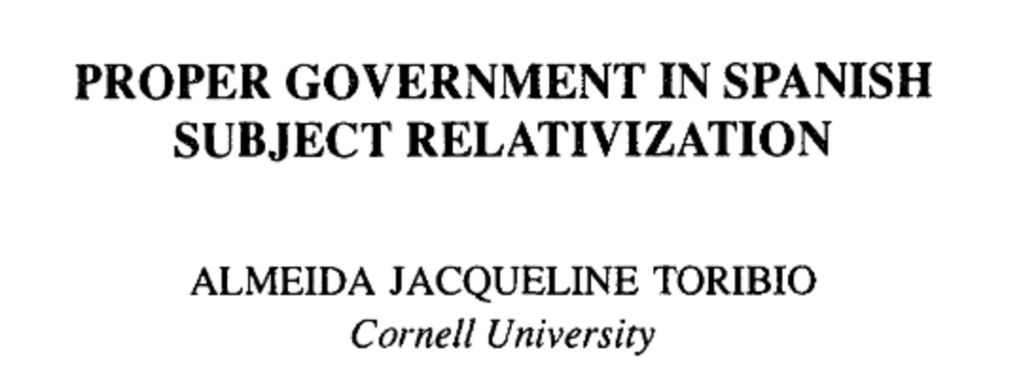
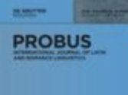
Minimalist ideas on parametric variation
Almeida Jacqueline Toribio
Notes:
Addressed many of these properties in individual and co-authored publications … on-going work

Slide 16
On-going research
Perception of etymological /s/ and non-etymological [s]
  Collaborators: Barbara Bullock, Ellis Davenport, Tom Leslie, Haleigh Wallace
Dominican Spanish as a non-pro-drop variety
  Collaborators: Joshua Frank, Amalia Merino
Notes:
Etymological [s] as effeminate; non-etymological [s] as uneducated (Toribio&Clemons); pro-drop as ‘formal’; But: Inquiry into language practices necessitates an inter-disciplinary approach that draws on methods and findings from multiple sub-disciplines, including demography, sociology, history, cultural anthropology, and social psychology…

Slide 17
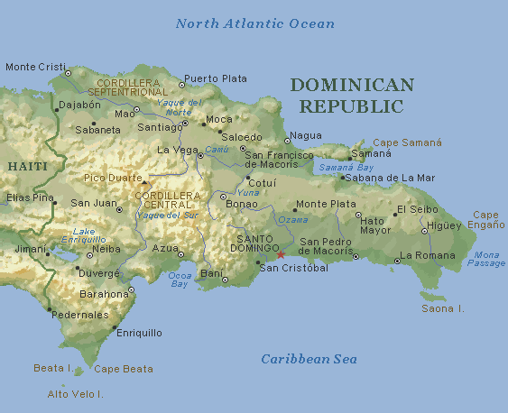
Historical context
The Trujillo dictatorship (1930-1961) forged a vision
Nation-building campaign was strongly felt in northern border
  Sparsely populated
  ‘Haitian’ population was 4 times
  that of the Dominican
  NB: ‘Haitian’ included Dominicans
  of Haitian ethnicity (ethnic Haitians)
  and persons of mixed ethnicity
Notes:
Dominicans self-identify as ‘European’ or mixed European+indigenous (Taíno) heritage; blanco, indio, mestizo, rubio, amiarillo, jabao, colorao, trigueño, grifo, moreno, mulato, canela … ‘Negro’ erased from racial vocabbulary; black = foreignness (Haitian)

Slide 18
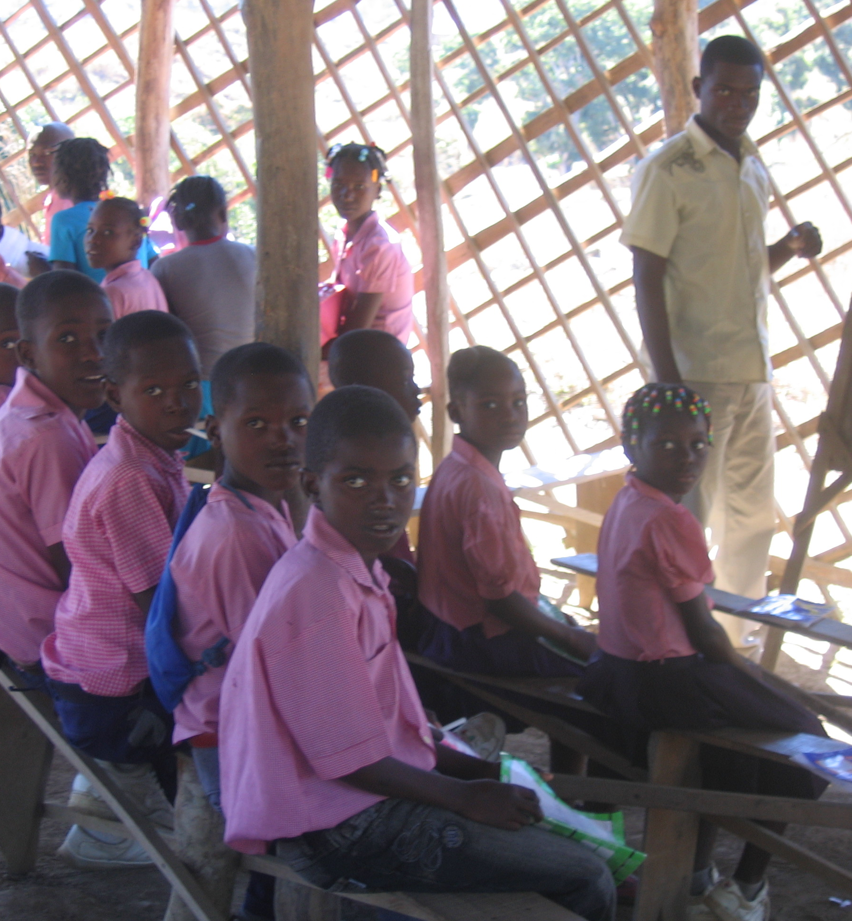
Nation-building and anti-haitianismo
Elites warned of haitianización of border and invasión pacífica
Haitians blamed for all Dominican ills and failings
Trujillo orders the Dominicanization of the border
  Educational and social reforms
  ‘White’ agricultural colonies
  Guard towers and border patrols
  Dominican monuments
  Massacre of Haitians (1937)

Slide 19
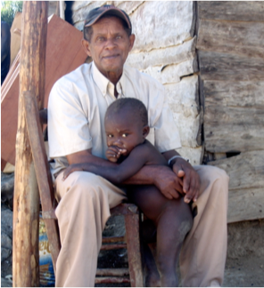
The contested border region
Present-day
Many ethnic Haitians
Daily contact with Haitians
Shared (contraband) economy
Shared beliefs and practices shunned by the elite
Shared daily plight
Shared language: SPANISH
Prior to 1937
Common currency: gourde
Intermarriage
Shared religious practices: voudou
Common schooling in
Dajabón or Ouanaminthe
Shared ‘contraband’ economy
Shared languages: Spanish AND Creole

Slide 20
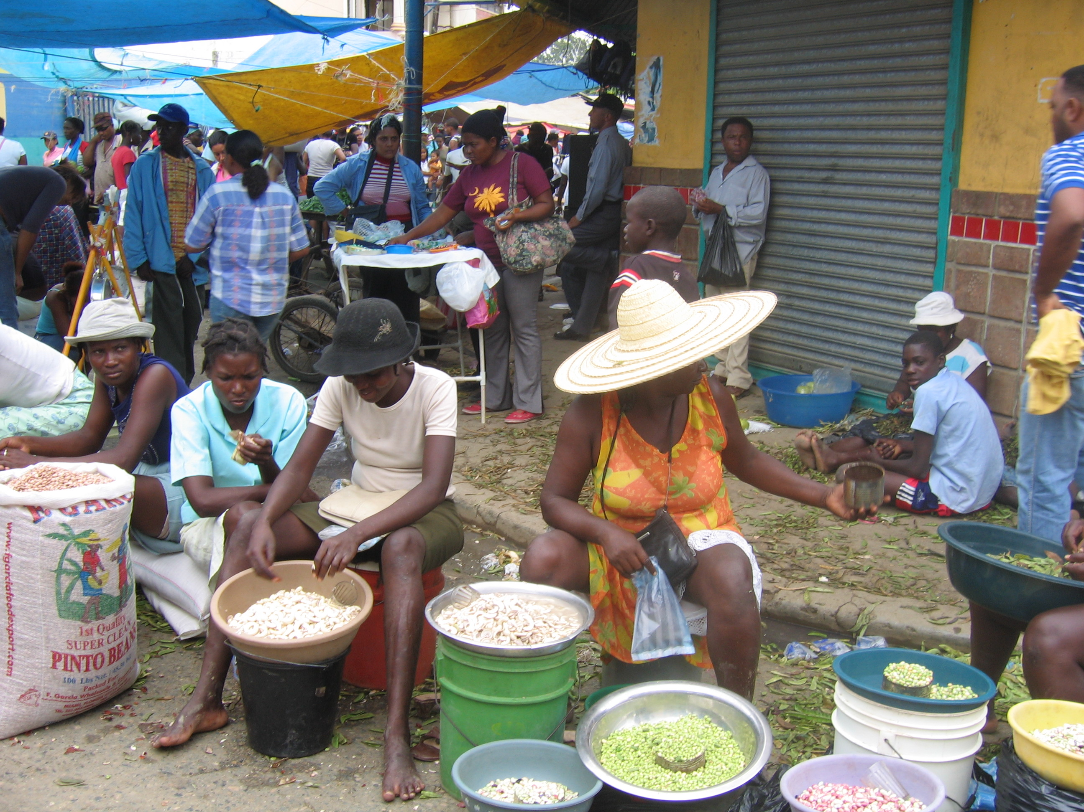
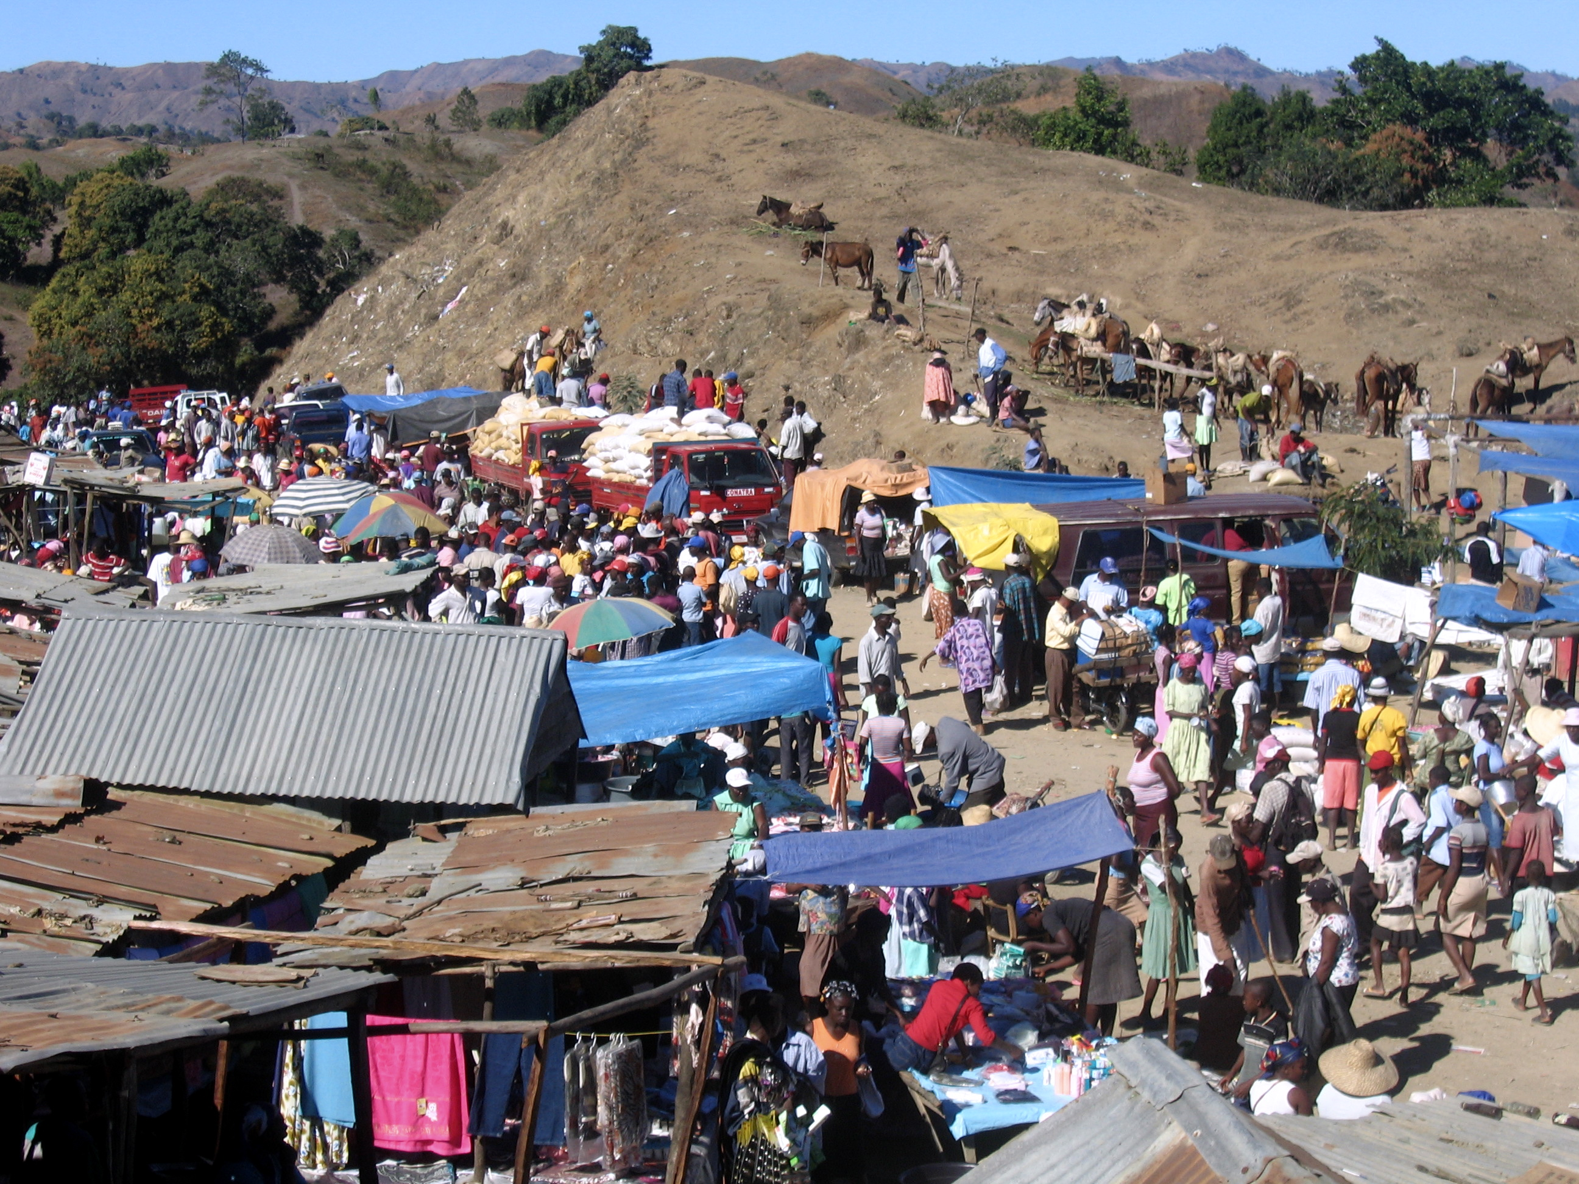
Shared economies

Slide 21
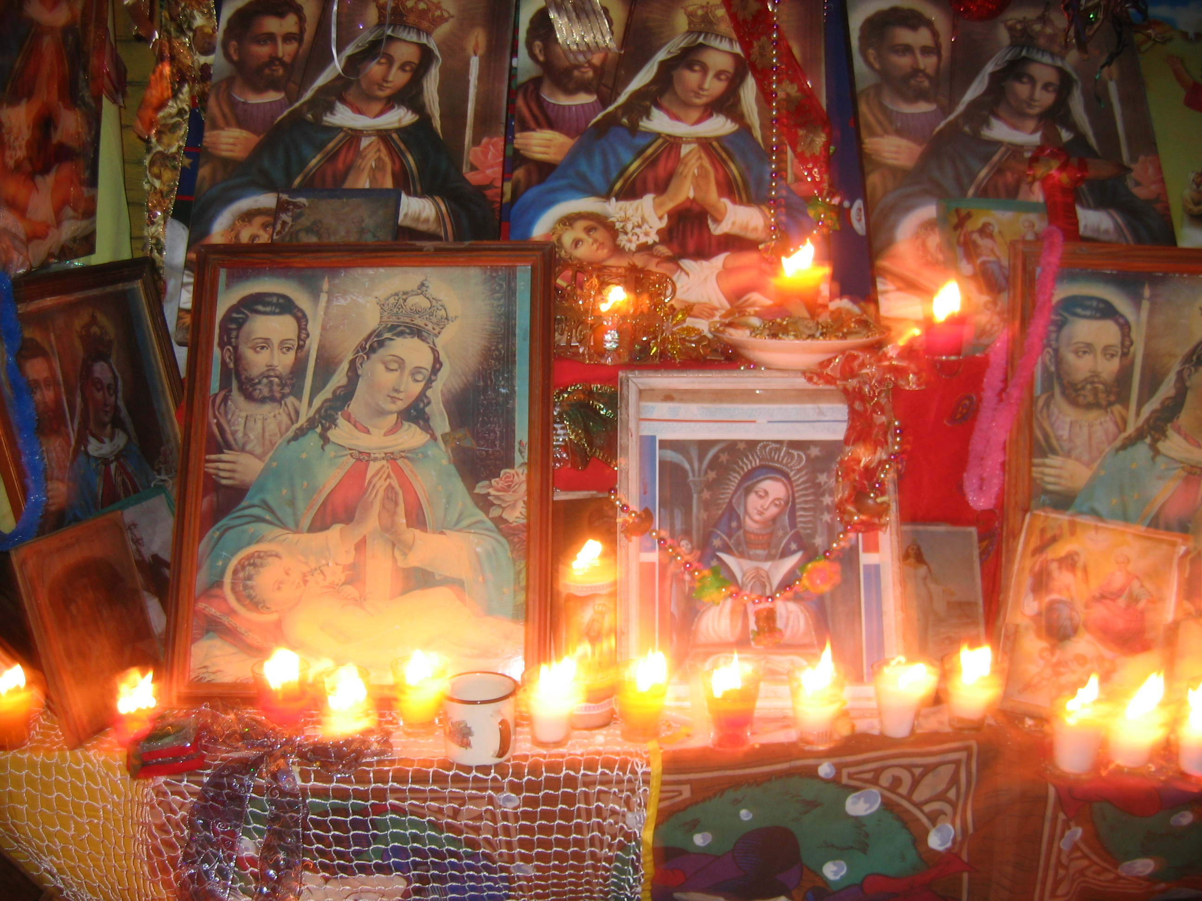
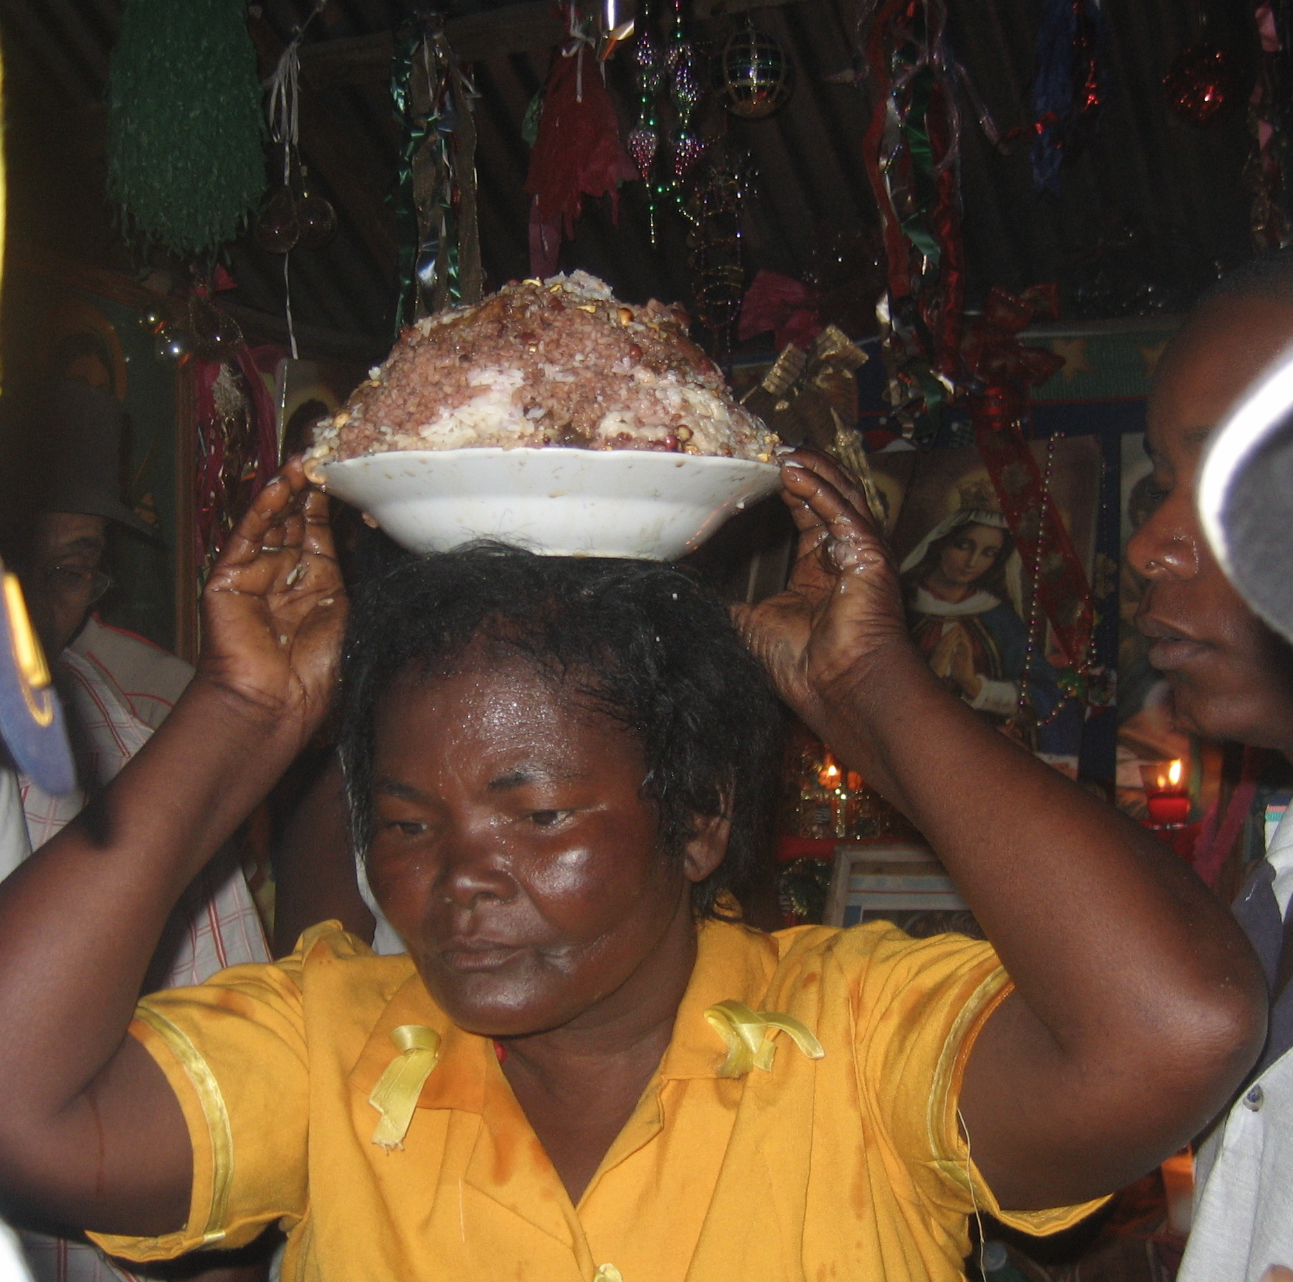
Shared customs

Slide 22
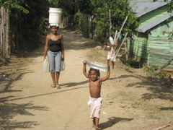
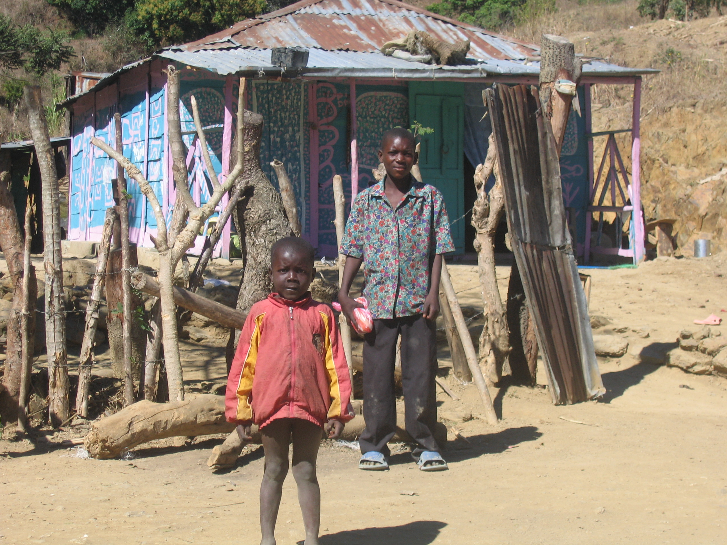
Shared plight

Slide 23
‘Erasing Creole’
‘Haitianized’ in reference to the border has changed
  Pre-1937: presence of Creole-speaking Haitians
  Today: descriptor for Spanish-speaking, rural poor
Residue of anti-Haitian rhetoric left enduring legacy on fronterizos
  Fear of being ‘haitianized’ through language

Slide 24
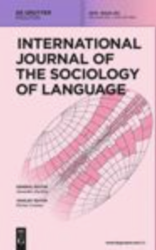
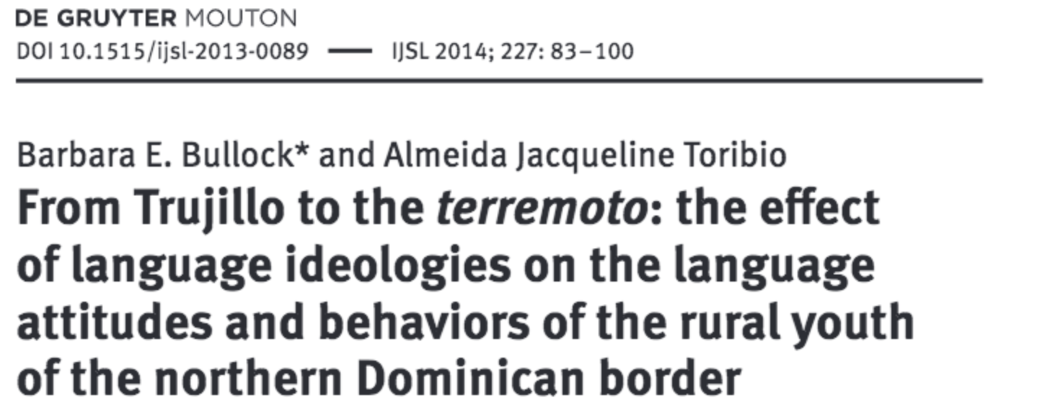
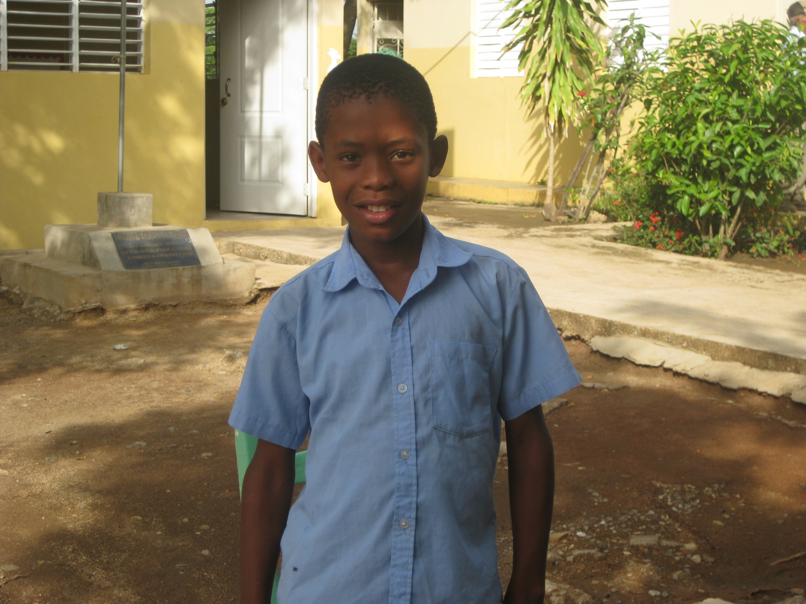
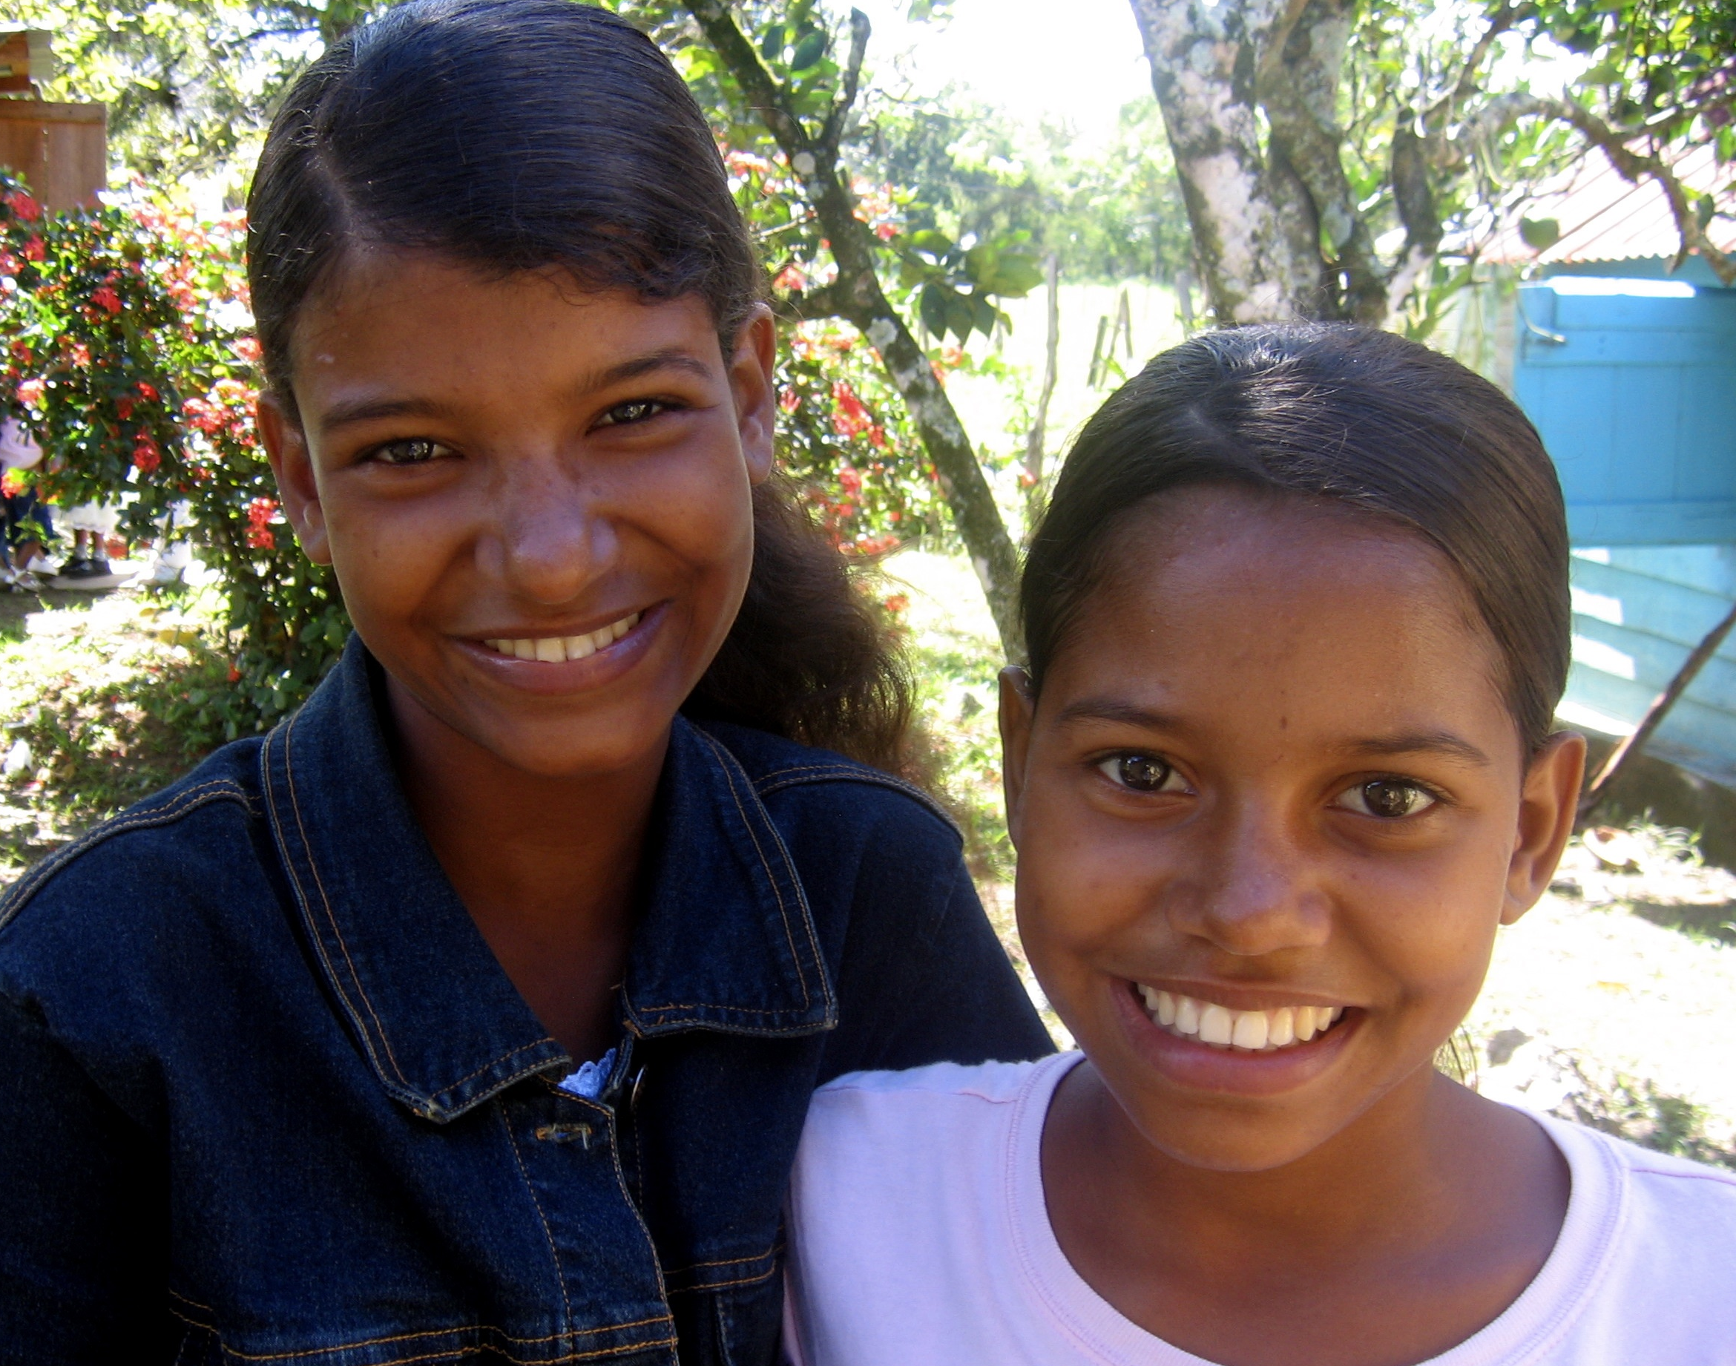
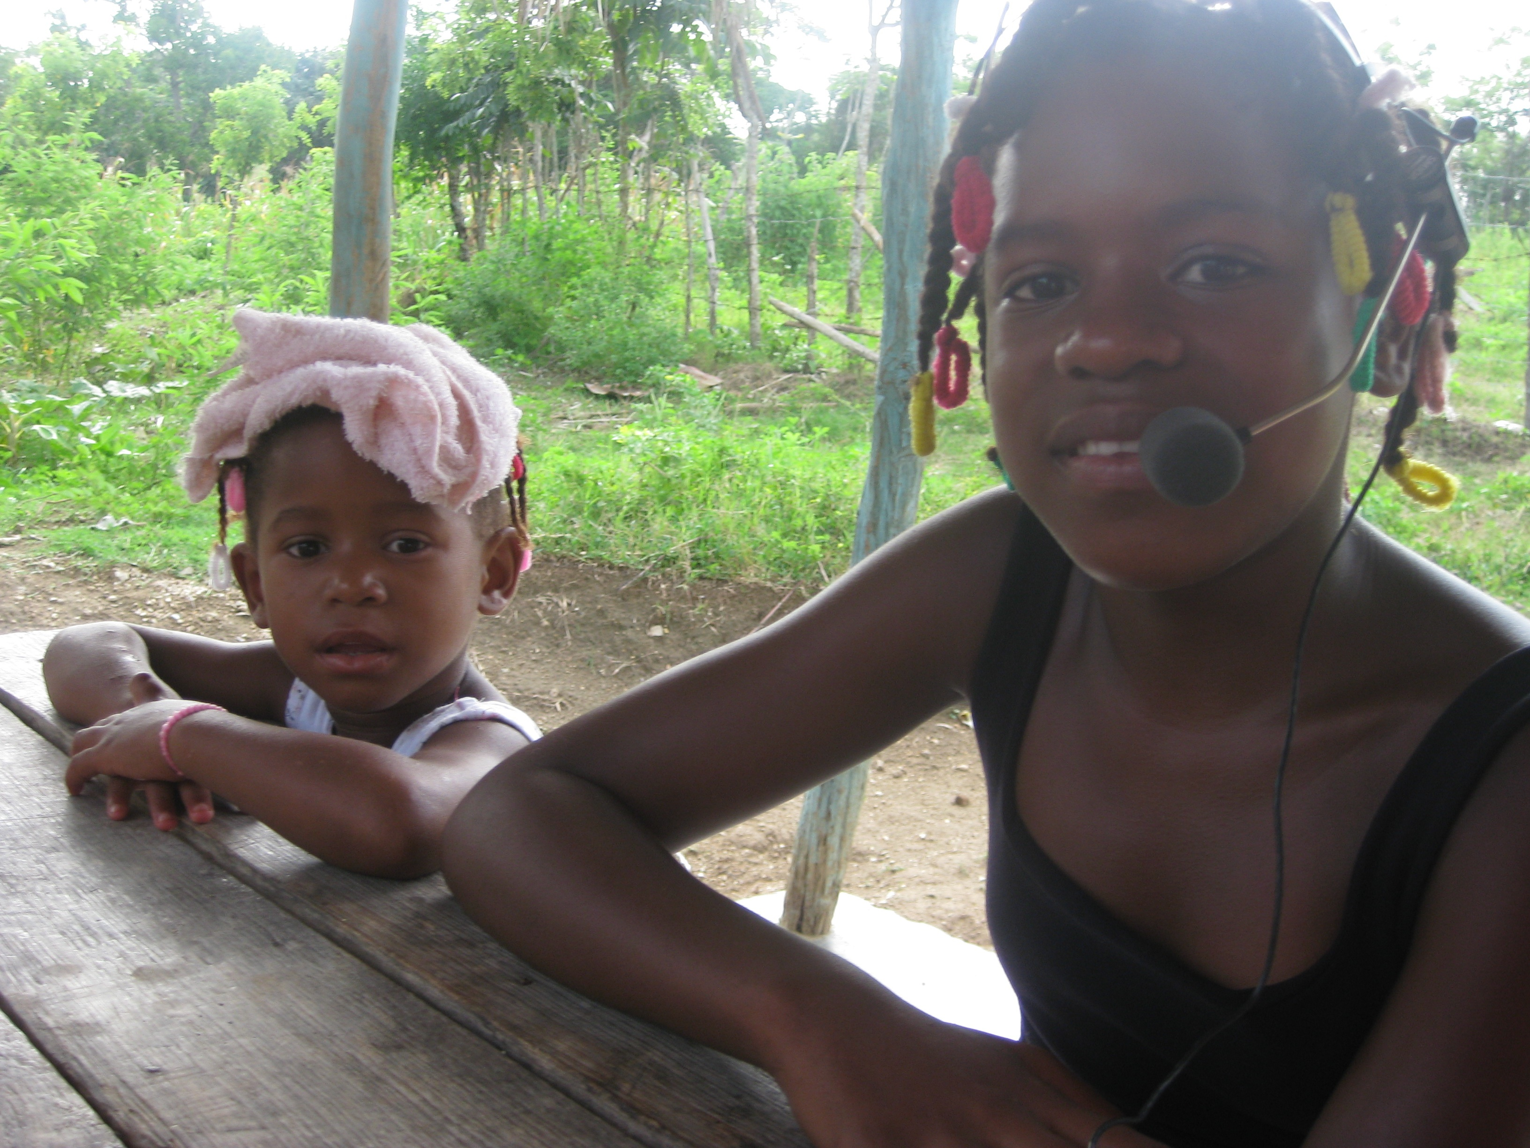
Participants: 90
  32 age 6-10 yrs.
    16 Male, 16 Female
    Grades 1-6
  58 age 11-19 yrs.
    Grades 4-11
    32 Male, 26 Female
Semi-structured interviews

Slide 25
Language attitudes: Children vs. Adolescents
No significant difference in attitudes towards English: Positive
  “So I can speak to Americans (f)” (M, age 9)
  “To be better prepared in life and also those who don’t know English or computers, are nobodies” (F, age 12)
Significant difference in attitudes towards Haitian Creole

Slide 26
Children’s responses
One third of children want to learn Haitian Creole
  “So I can speak with my little brothers, with my family” (F, age 10)
  “Because if one hears a Haitian speaking, you’d know what they are talking about” (M, age 10)
Majority do not want to learn Haitian Creole: ugly, gibberish, weird
  “I don’t like that language, no way” (M, age 10)
  “When they speak it’s a mixed up mess, you can’t understand them” (M, age 10)

Slide 27
Adolescents’ responses
More than half want to learn Creole
  “I’d like to learn more because if you work in a store you can understand them” (M, age 15)
  “They want to learn our language and we should learn theirs too” (F, age 14)
Rejection is based in notions of nationality and self-preservation
  “No, because they’ll take you off to Haiti” (M, age 11)
  “What if they make me speak Haitian and the police hold me as if I am Haitian…” (F, age 15)

Slide 28
Attitudes and behaviors
Adolescents report more positive attitudes about Haitian Creole
  More aware of instrumental value of Haitian Creole?
  Acquiescing?
Mismatch between attitudes and language learning behaviors
  Believe they can’t learn Creole
    Difficult language
    Dominicans lack motivation
    Dominicans lack special intelligence for language that Haitians possess

Slide 29
Legacy of ‘erasing of the Kreyol’
The likely cross-linguistic experiences for fronterizo youth remains contact with speakers of Haitian Creole (NOT English)
Burden of intercultural communication falls on Haitians
  Children reject Haitian Creole
  Adolescents claim inability to learn Creole: Dominicans lack language aptitude and Creole is especially difficult to learn (unlike English)
≠ ‘erasing of the Kreyol’
= erasing of Creole

Slide 30
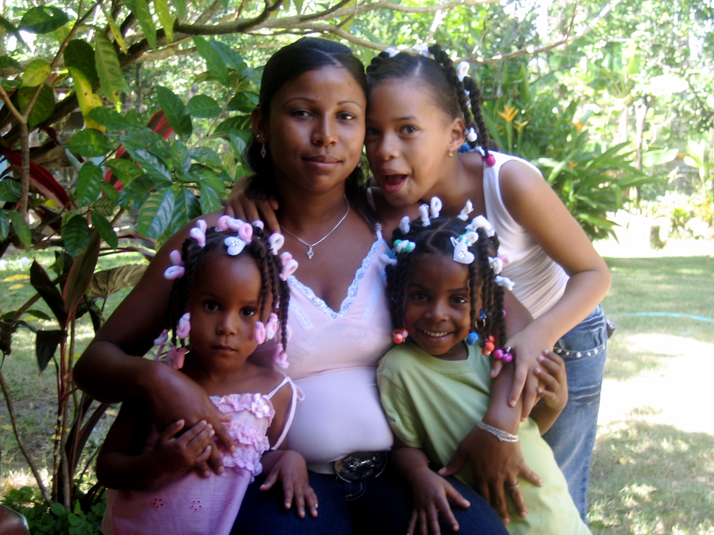
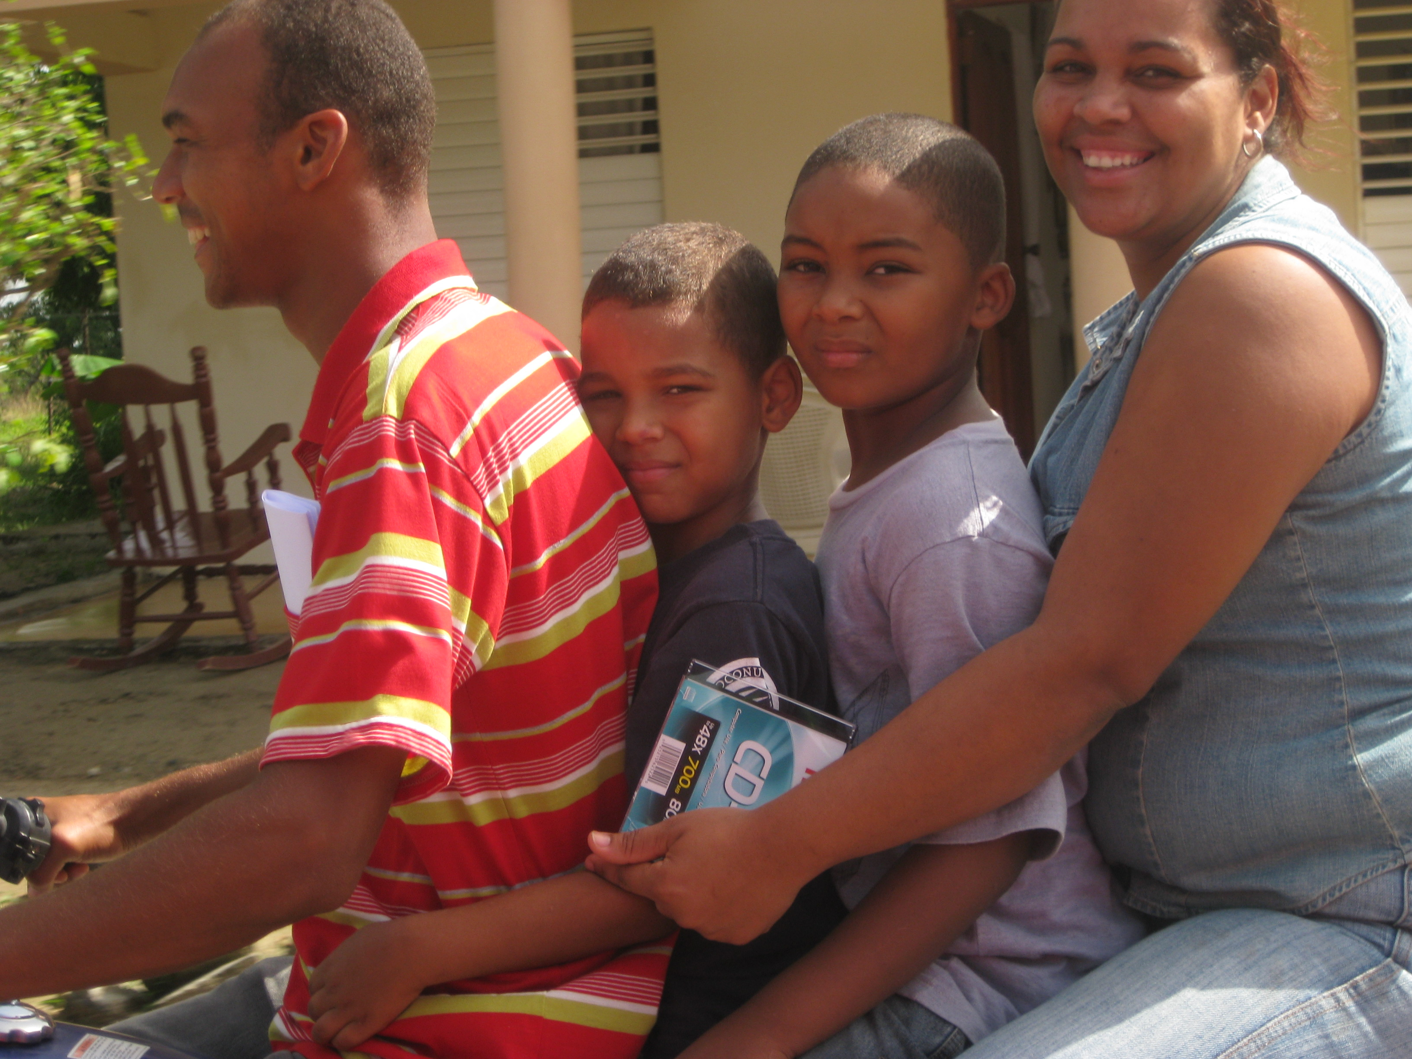
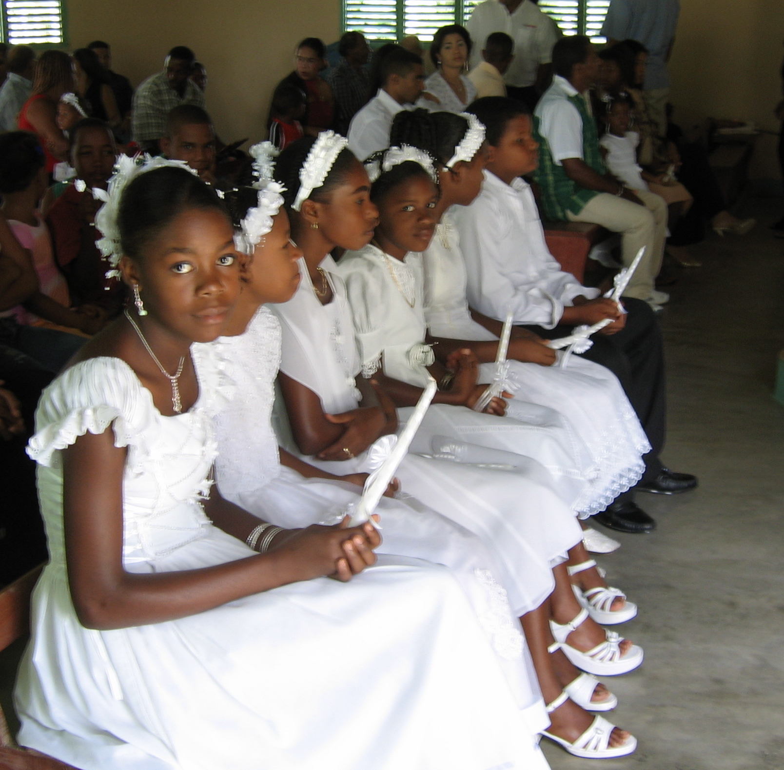
Language socialization
Acquisition of knowledge / beliefs through language-mediated interactions
Notes:
Dictates language use and interpretation

Slide 31
Language ideology and dominicanidad
The ‘best’ Spanish approximates European norms
  “I like how the Spaniards speak … I like their way of speaking, their accent and everything, I like that … they have better manner than us in speaking” (DR M, age 30)
  “The Spanish of Spain is more refined. The Spanish language came from Spain, didn’t it?” (DR M, age 54)
The ‘worst’ Spanish is believed to be spoken by those influenced by an African substratum
  “The region where they speak badly, where people speak half mixed up, is in Vaca Gorda, because there everyone is black—it’s like their tongue gets crossed, they’re half Haitianized, but they’re here as if they were Dominicans” (M, age 70+)
  “Over here in El Rodeo they have Haitian history; in this area they don’t speak Spanish very well” (M, age 55)

Slide 32
Shibboleth
‘Native’ Spanish-speaking ability distinguishes Haitians from Dominicans in the border region
  Cf., 1937 massacre ([ɾ] vs. [ʁ] in perejil ‘parsley’)
  “Your uncle Otilio was in Dajabón, picking up Haitians for immigration. Then, the truck was full, en route to take them to Haiti, and when they were going towards the border, there was a dark man sitting in the park. Otilio says, “Let me see, let me check on that dark man over there, to see.” Otilio got out and says to him, “Come here. Are you Dominican?” And the Haitian says, “Yes!” Otilio said, “If you are Dominican, you will repeat what I tell you.” The Haitian says, “Alright.” Otilio says, “Repeat this: Generalíssimo Rafael Leónidas Trujillo, benefactor of the new motherland, born in San Cristóbal, the town of perejil.” The Haitian says, “Why not just tell me to get in the truck.”
  (DR, M, 45)
Can Dominicans reliably identify fronterizo Haitians from Dominicans based on language alone?
Notes:
Parallels with Dominicans in New York.

Slide 33
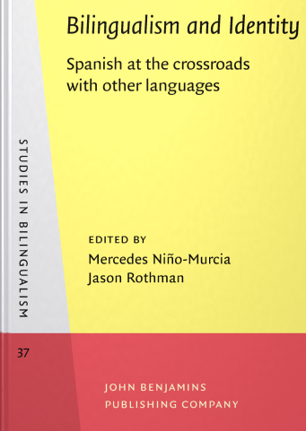
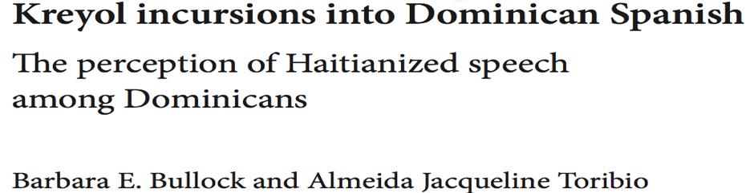
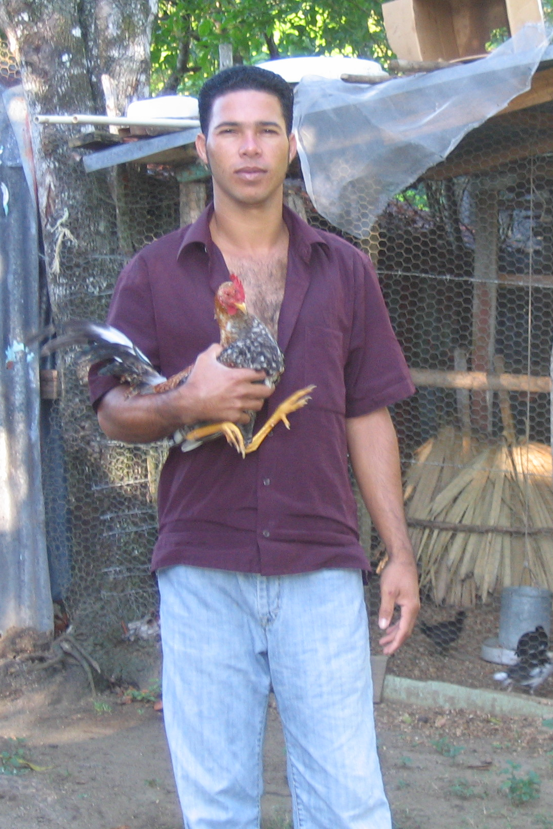
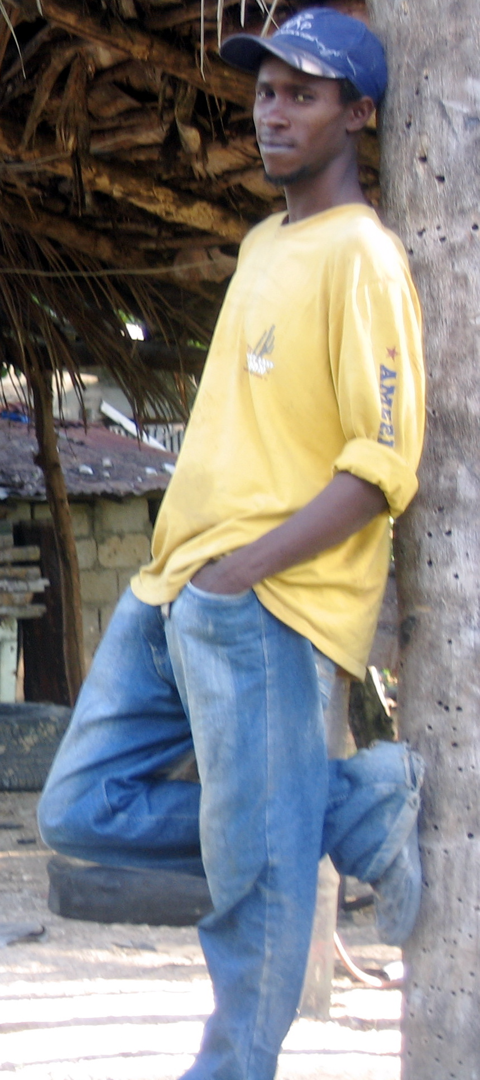
Participants: 60 university students
Verbal-guise technique
Narratives collected from 8 male informants
  2 Haitian immigrants
  6 speakers from the frontera

Slide 34
Task: verbal guise
Listen: narrative story-telling
  Esto era una vez que el Viejo Quilo tenía un gallo. El gallo le llamaban Quiquiriquí. El, el gallo cantaba todos los días por la mañana y él lo oía. El, un día no cantó. Dijo, pero qué es lo que le pasa a mi gallo que yo no lo oigo cantar? Se levantó y cogió al monte. Se encontró con un lobo que él le vio, como, lo oía cantar. Cuando él lo oyó cantar quiquiriquííííííí, él oyó que era como adentro del lobo. Cuando él se acercó al lobo el gallo sacó la cabecita. Cuando ahí él se incomodó, cogió su machete y rajó el lobo y sacó su gallo y se lo llevó para su casa.
Assess: brief survey
  Personality traits [Likert]
  Education; social class; profession; national and regional origin; skin color

Slide 35
Linguistic profiling
Significant differences for verbal guises
Low prestige accorded to speakers of those judged to be campesinos
    rural residence
    low education
    low social standing
Listeners believe these speakers to be ‘African’
    Dark phenotype
    Haitian

Slide 36
Language / identity in the Dominican Republic
The Spanish language serves as a marker of a national/racial status
  Dominican
  i.e., non-Haitian, i.e., non-black
  ‘Spanish’
  i.e., European, i.e., non-African
…. With movement to the U.S., Spanish serves as a marker of immigrant/ethnic grouping

Slide 37
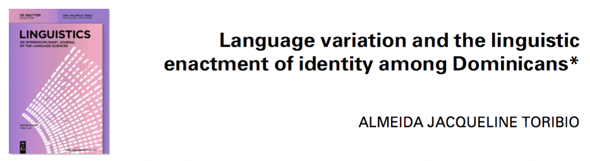
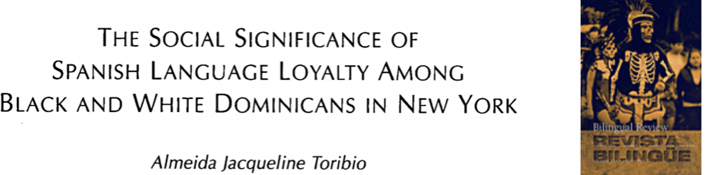
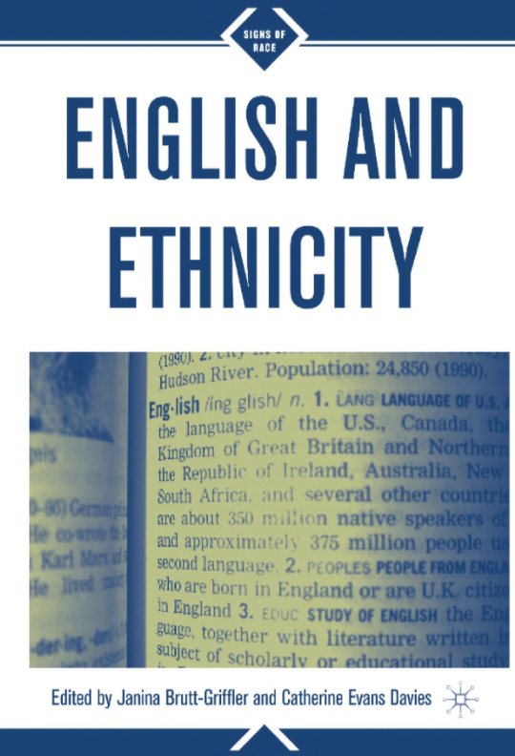
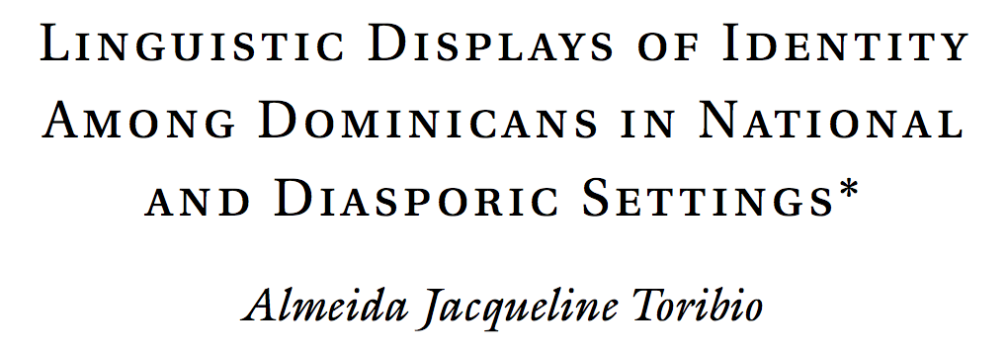
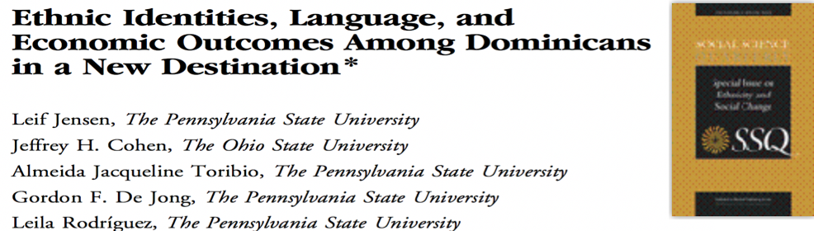

Slide 38
Stigma and (covert) prestige
Dominicans internalize the stigma attached to their Spanish variety
  “We Dominicans have the problem of speaking with orthographical errors, not only writing” (DR M, age 35)
  “Dominicans don’t speak Spanish well… All you see is Dominicans that are from el campo. Everybody knows right away that they’re Dominicans; you get embarrassed because of those people”
  (NY F, age 30)
  “And people say to me, ‘But you don’t talk like Dominicans’’’ (NY F, age 24)
Yet, in the U.S. they recognize and exploit it as expressing dominicanidad

Slide 39
Language as isomorphic with ethnicity
Felipe (NY M, age 32)
I took Manuel with me to the game and we’re practicing, and there’s a shortstop and he goes, he asked Manuel whether he speaks Spanish and Manuel said no. And I said, “Manuel don’t lie,” because I was speaking Spanish to him. And then he [the shortstop] made a comment, and I said, “Well, what do you categorize yourself as?” Like, “Italian?” and I said, “Well do you speak Italian?” He said no. I said, “Well I’m Spanish: ¿Cómo tú estás? Yo me siento muy bien. Mi nombre es Felipe.” He got so pissed. …You know, he’s got a little nice Infinity [automobile], he’s got some nice rims, he’s got a nice little Italian sticker on the car, Italian things inside the car. “You don’t know Italian.” I got my Dominican flag in there, I’m Dominican. I know Spanish.

Slide 40
Interpreting discrimination in the U.S.
Dominicans are ill-prepared for discrimination on grounds of race
  “We don’t consider ourselves black and we don’t consider ourselves white. White people don’t consider us white, we’re like peach. And the black people consider them [Dominicans] brown, so Dominicans are between black, brown, and peach” (NY M, age 11)
  “For the Whites we fall in the Black … Whites don’t distinguish between lighter and darker ones, rather conceptualizes everything within the same frame” (NY M, age 60+)
Seek to make themselves distinct from African-Americans

Slide 41
Unifying and separatist functions of language
Language binds Dominicans to their compatriots at home and abroad
Language isolates Dominicans from their African and African-American neighbors
  On the island, Spanish serves as a marker of a national/cultural status
  In the U.S., Spanish serves as a marker of ethnic grouping
    immigrant, i.e., exempted from the dualistic black/white U.S. classification

Slide 42
Salience of ethnolinguistic characteristics
When ethnic identity is perceived as important, Dominicans make themselves favorably distinct on dimensions such as language
Linguistic ‘Acts of identity’ : Dominicans accentuate their linguistic features—develop ethnolinguistic identities
Notes:
Le Page and Tabourte-Keller

Slide 43
Linguistic performances of White Dominicans
Manuel (NY M, age 11)
Sometimes African-Americans are, like, brown colored. And there are people in Dominican Republic who are brown colored. But some African-Americans don’t talk Spanish. So, you could tell if that person talks a lot, a lot of Spanish, you can tell that they’re not African-American…My friend looks like an African-American. But he says that his mom is from Dominican [Republic], and I was, like, “Give me some words in Spanish,” and he was, like, “Hola.” And he says some stuff and he looks like African-American, but then he showed me a picture from the Dominican [Republic] and I was, like, “Oh.”

Slide 44
Linguistic performances of Black Dominicans
José (NY M, age 8)
People, like, ask me if you know English and Spanish… I say, like, ”Yeah,” and then, like, one of the Spanish kids come, and then, like, I have to talk Spanish… and then if they say, “Yes,” that means I do know it, and if they say, “No,” it means I don’t speak Spanish. …[They are testing me] because they can know me well…They always find out [I’m not African-American] because they ask me weird questions, like, how old am I [in Spanish]. I get very confused and I forget everything.

Slide 45
Dominicans ‘doing identity work’
There is an interplay of socio-cultural associations and implications
Deploy Spanish and English to anticipate and serve oftentimes-contradictory social and identity outcomes
The context frames discursive events and affordances
Design and display ‘a network of identities’ on the basis of the preferences and predispositions of social context
Notes:
Coupland quote

Slide 46
Framing of performances
Mara (age 70+, commenting on Social Security benefits): Yo tengo que practicar mis palabritas en inglés para cuando yo vaya a la oficina del seguro
“I have to practice my English words for when I go to the social security office”
AJT: ¡Como cuando usted se hizo ciudadana! ¿Y qué usted les va decir?
“Like when you became a citizen. What will you say?”
Mara: Yo les voy a decir, <<I am American.>>
“I will say, <<…>>”

Slide 47
Mara (to two white passers-by): Buenos días.
“Good day”
AJT: ¡Ellos no hablan español!
“They don’t speak Spanish!”
Mara: Yo les dije así para que no fueran a creer que yo soy de esa gente negra de aquí.
“I said that so that they wouldn’t think that I am one of those black people from here”
AJT: (referencing benefits): Aquí se les paga igual a todos, blancos y negros también.
“Here they pay everyone the same, white and black too”
Mara: Yo prefiero que no me paguen.
“I’d prefer they not pay me”

Slide 48
Summary
Through the lens of language, Dominicans are shown to conform to and contest the ethnic and racial identities foregrounded in the wider socio-cultural frame as well as project new identities in (re)constructing socio-cultural contexts in new destinations

Slide 49
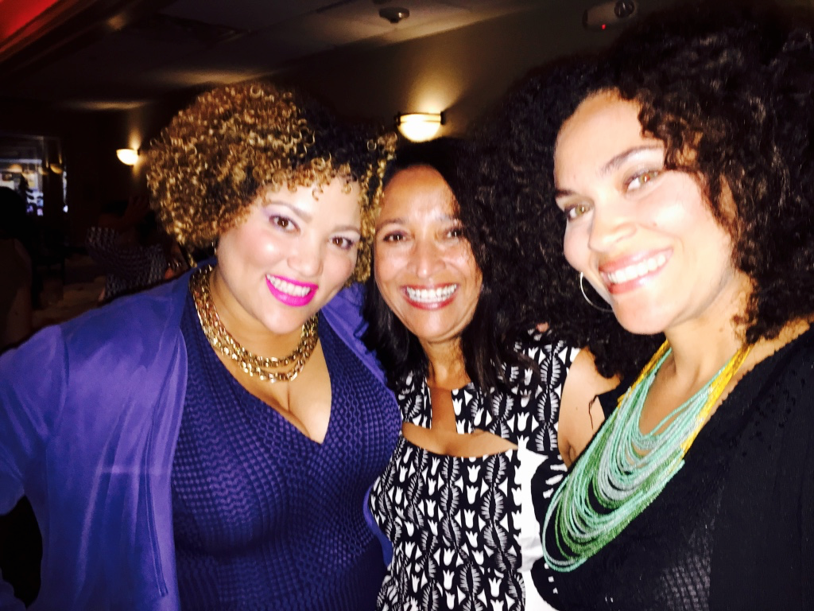
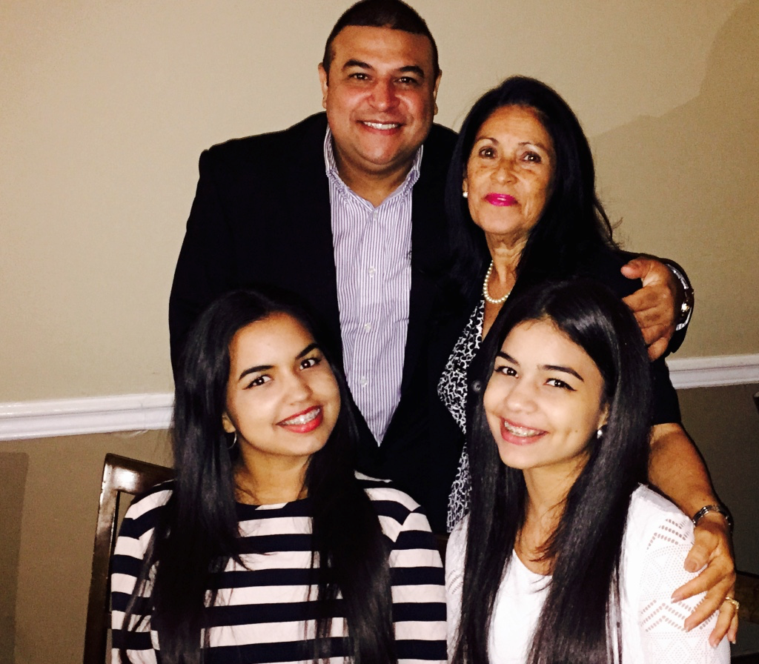
New discourses in New York?
The salience of Spanish and of race in the development of identity is not a static phenomenon among second-generation
  retain parents’ national identity
    with or without the hyphen
    with or without language
  solidarity with black peers
Notes:
Invites comparisons across generations

Slide 50
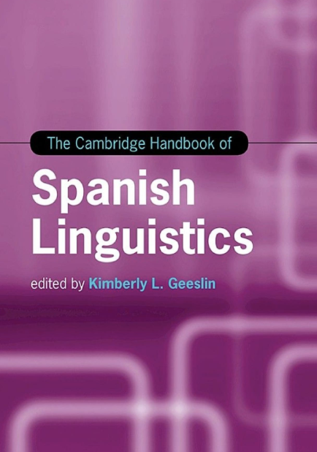
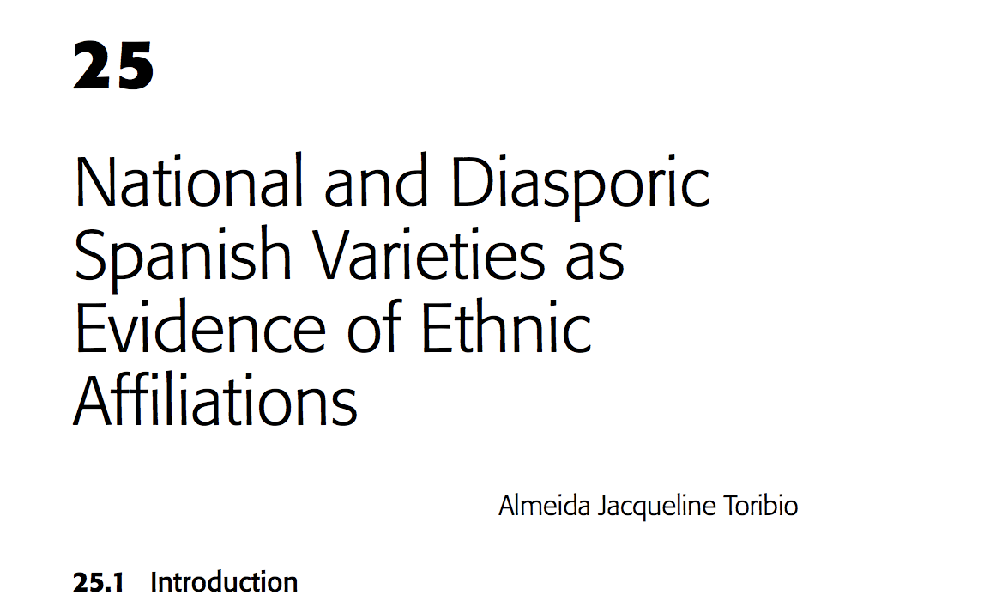
Recent research: Afro-Caribbean experience
Explore the notions of ethnicity and race that shape beliefs about language and language use among Afro-Hispanics
Alterations with movement from the Caribbean to U.S. metropolises

Slide 51

On-going research
What linguistic variables index ethnic and racial affiliations in the absence of recourse to the heritage language?
Is there an identifiable Dominican English, akin to Chicano English or African American English?
  Collaborator: Aris Moreno Clemons
Notes:
Increased attention from younger scholars …

Slide 52
Thank you / Gracias
Contact: toribio@austin.utexas.edu

