Slide 1

The use of gerund in Rhaeto-Romance: a diachronic perspective
Jelena Živojinović
jelena.zivojinovic@univr.it
RoLinC seminars, 12 October 2021

Slide 2
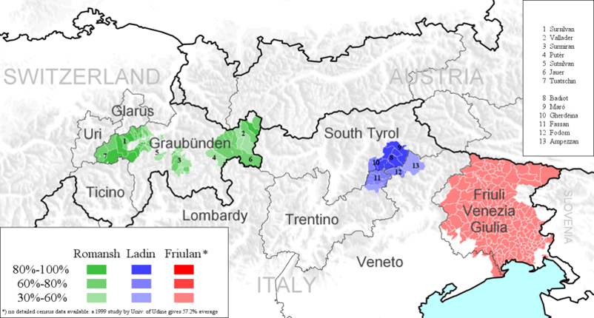
This map is based on a narrow understanding of that language, following Guntram A. Plangg: Ladinisch: Interne Sprachgeschichte I. Grammatik. In: Lexikon der Romanistischen Linguistik, III. Tübingen, Niemeyer 1989, ISBN 3-484-50250-9, p. 646–667

Slide 3
«Questione ladina»
Questione ladina is an academic debate on the composition of the Rhaeto-Romance group of languages.
the «unitarian» side (Krefeld 1994; Bauer 2007, among others) Ladin, Romansh and Friulan form a group. This claim is based on dialectometrical studies which make use of data extracted from linguistic atlases to calculate the similarity or distance among dialects;
the «negationist» side (Pellegrini 1982, 1991 for instance) Ladin, Romansh and Friulan are peripheral varieties of Veneto and Lombardo. Comparative study of phonological and morphological correspondences.

Slide 4
Purpose of research
to provide an exhaustive overview of the history of the category of gerund within the Romance group (from Latin to Present-day Rhaeto-Romance);
to provide an explanation for synchronic variation in the use of the gerund in Ladin, Romansh and Friulan on the basis of a diachronic investigation.

Slide 5
Roadmap
Classical Latin gerund as a starting point
Gerundial constructions in Late and Vulgar Latin
Gerundial constructions in Old Romance (Old Italian, Old French, Old Ladin/Friulan)

Slide 6
Roadmap
Classical Latin gerund as a starting point
Gerundial constructions in Late and Vulgar Latin
Gerundial constructions in Old Romance (Old Italian, Old French, Old Ladin/Friulan)
Data collection – methodology
Evidence from elicited and non-elicited data
General conclusions

Slide 7
The use of gerund in Latin

Slide 8
Gerund in Classical Latin
Latin gerund is a verbal noun, which appears in the cases of genitive, dative, accusative and ablative.
it is formed by present stem + suffix –nd- + grammatical case morpheme
it expresses active voice
it can be used with both active and deponent verbs
- it is in complementary distribution with the category of infinitive (appears in object or, more restrictedly, in subject position)

Slide 9
Gerund in Classical Latin
Its functions are the following:
- specification of the predicate in genitive
purpose through dative, though very rare
direction or aim via the accusative, when preceded by the preposition ad
adverbial function expressed through the ablative
Nom. | Utile est audire
Gen. | Cupiditas audiendi
Dat. | Operam dare audiendo
Acc. | Paratus ad audiendum
Abl. | Audiendo discimus

Slide 10
Gerund in Classical Latin – functional competitors
Case | Function in CL | Main competitor
Genitive | specification | Gerundive (e.g. Hostibus spes potiendi oppidi discessit ‘The enemies lost hope of taking over the town’) ‘ passive voice; expresses necessity
Dative | purpose | Gerundive (e.g. Ti. Gracchus [...] triumviros agris dividendis coloniisque deducendis creavit [...] ‘Tiberius Gracchus appointed triumvirs to divide the fields and to establish colonies’) ‘ passive voice; expresses necessity
Accusative | purpose / direction | ad + Gerundive (e.g. Catilina erat paratus ad dissimulanda omnia ‘Catiline was ready to hide everything’ ‘ passive voice; expresses necessity
Ablative | adverbial function | Gerundive (e.g. Omnis loquendi elegantia [...] augetur legendis oratoribus et poetis ‘Every elegance of speech is nhanced by reading oratories and poets’ ‘ passive voice; expresses necessity Ablativus absolutus (e.g. Id ea de causa faciebat quod cum tanta multitudine hostium, praesertim eo absente qui summam imperii teneret, nisi aequo loco aut oportunitate aliqua data legato dimicandum non existimabat. ‘He did this for this reason because he thought that with such a great multitude of enemies, especially the one who had the supreme command being absent, one should not fight as a lieutenant except in an appropriate place and given some security.) ‘ syntactically unconnected structure (to the main clause) Participium coniunctum (e.g. breui deinde ceteros tutores summouet Adranodorus, iuuenem iam esse dictitans Hieronymum ac regni potentem; deponendoque tutelam ipse ‘Subsequently Adranodorus dismissed the other tutors, saying that Hieronymus was by now a young man already capable of reigning; he himself then, by renouncing protection’) ‘ a different morpho-syntactic arrangement

Slide 11
Gerund and participle in Late and Vulgar Latin
Lack of research in the domain of Late Latin
Converbialization of the gerund - gradual loss of the genitive, dative and accusative case. The ablative survives in its adverbial function
Appearence of new participial absolute constructions (nominative and accusative absolute) – mainly expressing time and cause (cf. Väänänen 1985: 283)
1) nascente vulnus
be-born.PP.ABL.SG wound.NOM.SG
‘when the wound appears’
The bare present participle crystallizes in its adjectival function

Slide 12
Additional Vulgar Latin innovations
The use of juxtaposed stative verb + participle/gerund structures which anticipate the grammaticalized progressive periphrasis (cf. Bertinetto 2000):
esse + imperfective participle
2) [...] gemens et tremens eris [...]
‘You will be moaning and trembling [...]'
esse + ablative gerundive
3) […] erat Darius vociferando et congregando multitudinem
‘Darius was shouting and gathering the people'
stare + imperfective participle
4) […] stabant autem […] scribae constanter
accusantes eum […]
'Thus [...] the scribes were constantly accusing him [...]'
stare + ablative gerundive
5) stetit dux diu cunctando […]
'The chief was hesitating for a long while [...]'

Slide 13
The use of gerund in Old Romance

Slide 14
A glance at Old Italian
The gerund takes over the participial adnominal (participium coniuctum) and predicative functions (cf. De Roberto 2013):
6) E al palagio giunte a assai buona ora, ancora quivi trovarono i giovani giucando dove lasciati
gli avevano. (Dec, VI, Concl., 33, p.781)
‘And (because they) arrived early at the palace, they found the young people still playing (who
were still playing / while they were still playing), where they had left them’

Slide 15
A glance at Old Italian
The gerund takes over the participial adnominal (participium coniuctum) and predicative functions (cf. De Roberto 2013):
6) E al palagio giunte a assai buona ora, ancora quivi trovarono i giovani giucando dove lasciati
gli avevano. (Dec, VI, Concl., 33, p.781)
‘And (because they) arrived early at the palace, they found the young people still playing (who
were still playing / while they were still playing), where they had left them’
The gerund ovelaps with the category of infinitive when used as a substantival element, as a verbal complement without a preposition or in an argumentative or circumstantial clause (if preceded by a preposition).
7) Or so’ cusì desfatto, en tutto escuntraffatto, a onn’omo mette pagura vedenno mea figura
(Iacopone, VII, 158-162)
‘And I am so prostrate, all deformed, that every man is afraid of seeing my shape.’

Slide 16
A glance at Old Italian
The gerund takes over the participial adnominal (participium coniuctum) and predicative functions
(cf. De Roberto 2013):
6) E al palagio giunte a assai buona ora, ancora quivi trovarono i giovani giucando dove lasciati
gli avevano. (Dec, VI, Concl., 33, p.781)
‘And (because they) arrived early at the palace, they found the young people still playing (who
were still playing / while they were still playing), where they had left them’
The gerund is also used in juxtapositions with a stative/motion verb:
8) Or ti piaccia gradir la sua venuta / libertà va cercando ch’è sì cara, / come sa chi per lei vita
rifiuta (Dante, Purg., 1, 70-72)
‘So welcome her arrival: she is looking for freedom, which is so precious, as anyone who
sacrifices their life knows well.’

Slide 17
A glance at Old Italian
The gerund takes over the participial adnominal (participium coniuctum) and predicative functions
(cf. De Roberto 2013):
6) E al palagio giunte a assai buona ora, ancora quivi trovarono i giovani giucando dove lasciati
gli avevano. (Dec, VI, Concl., 33, p.781)
‘And (because they) arrived early at the palace, they found the young people still playing (who
were still playing / while they were still playing), where they had left them’
We also find ‘compromise’ structures standing between fully absolute structures and an adjunct.
9) La seconda moglie [Nerone] amò molto teneramente ed essendo [la moglie] gravida col ciclo
[Nerone] l’uccise (Fiori, 16-18)
‘Nero loved his second wife dearly and being the wife pregnant, Nero killed her with a kick.’

Slide 18
A glance at Old French
Old French displays a hybrid -ant form, incorporating both the functions of the CL ablative gerund and present participle and displaying a neutralized -a- theme vowel which absorbs all the conjugations.
10) devons tout estre en lui creant (Boron, 2328, cf. Jensen 2012:325)
‘we must all believe in him’

Slide 19
A glance at Old French
Old French displays a hybrid -ant form, incorporating both the functions of the CL ablative gerund and present participle and displaying a neutralized -a- theme vowel which absorbs all the conjugations.
10) devons tout estre en lui creant (Boron, 2328, cf. Jensen 2012:325)
‘we must all believe in him’
We also find absolute gerundial constructions, such as:
11) De paiz requerre desirant / unt au duc tramis lor message (Ducs de Normandie, 10928-10929,
cf. Aspland 1972:50)
‘Since they wanted to ask for peace, they sent their messenger to the duke’

Slide 20
A glance at Old French
Old French displays a hybrid -ant form, incorporating both the functions of the CL ablative gerund and present participle and displaying a neutralized -a- theme vowel which absorbs all the conjugations.
10) devons tout estre en lui creant (Boron, 2328, cf. Jensen 2012:325)
‘we must all believe in him’
In addition, we find motion verb + gerund structures, such as:
12) Looïs s’en vait fuiant a pié (Couronnement, 2311, cf. Aspland 1968)
‘Louis flees on foot’

Slide 21
A glance at Old Friulan
The literature on Old Rhaeto-Romance is very scarse. Among the few existing sources, we find traces of the adverbial use of the gerund in Old Friulan:
13) Questo si é lu miò articul, ch’iò sint in lu chiamin di Stephin a circha un’hora di notte, iò domandai
al Chargenl soldi 40. (Notary act by Valvasone, p. 217; cf. Casalicchio 2016a:11)
‘This is my act, namely that I, while I was on Stephin’s path at about one hour after sunset, I asked
to Chargenl 40 money coins’

Slide 22
A glance at Old Ladin
Old Ladin literature on the other hand only exhibits a complement function of the syncretic –an form:
14) N udóa káter seniaures tlupán tšofes (Lardschneider 1909)
‘Four men were seen picking flowers’ lit. ’One saw four men picking (while they were picking / who
were picking) flowers’

Slide 23
The use of gerund in Present-day Rhaeto-Romance

Slide 24
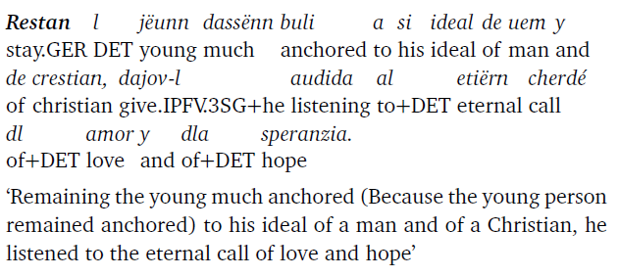
The use of gerund in Ladin
ADVERBIAL USE
The Ladin gerund is used in the adverbial function (despite its relatively low productivity) to
express manner, cause or time.
1)

Slide 25
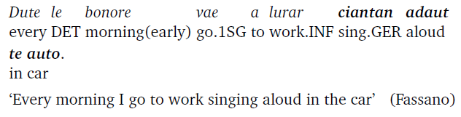
The use of gerund in Ladin
ADVERBIAL USE
The Ladin gerund is used in the adverbial function (despite its relatively low productivity) to
express manner, cause or time.
2)

Slide 26
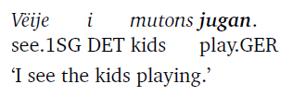
The use of gerund in Ladin
ii. PERCEPTIVE CONSTRUCTIONS
The Ladin gerund is used in perceptive constructions exclusively with the verbs udëi ‘to see’,
audì ‘to hear’, sentì ‘to smell’ or ‘to touch’ (cf. Casalicchio 2011, 2013).
3)

Slide 27
The use of gerund in Ladin
iii. ATTRIBUTIVE FUNCTION
The Ladin attributive functions is expressed via the –an form which is likely to be the outcome
of a phonological reduction resulting in the gerund/present participle overlap.
4) L ’è vegnù co la mans scorlan.
He AUX came with DET hand GER
‘He came with empty hands’ (Fassano)

Slide 28

The use of gerund in Romansh
ADVERBIAL USE
The adverbial gerund in Romansh indicates a circumstance or time. It is not highly productive.
5)

Slide 29
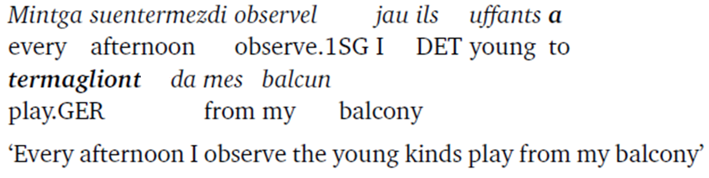
The use of gerund in Romansh
ii. PERCEPTIVE CONSTRUCTIONS
The perceptive gerunds are normally preceded by a preposition.
6)

Slide 30
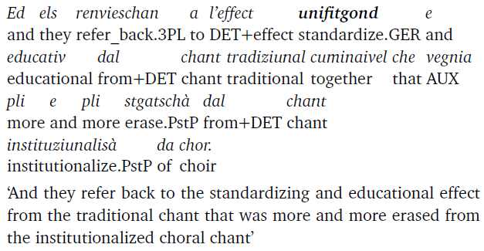
The use of gerund in Romansh
iii. ATTRIBUTIVE FUNCTION
The attributive function of the gerund in Romansh indicates an overlap between the gerundial and the
participial suffix.
7)

Slide 31
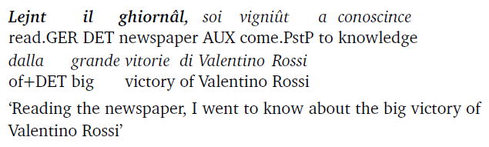
The use of gerund in Friulan
ADVERBIAL USE
The adverbial gerund in Friulan indicates a circumstance, time, cause or condition. It is a highly
productive form.
8)

Slide 32
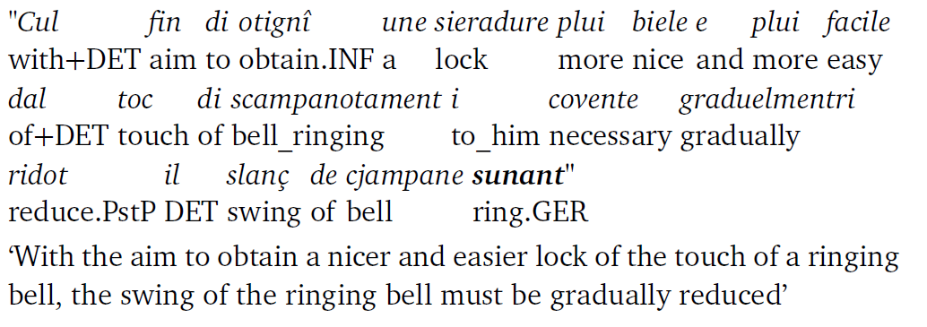
The use of gerund in Friulan
ii. ATTRIBUTIVE USE
The attributive use in Friulan is once again an indication of the present participle-gerund
syncretism.
9)

Slide 33
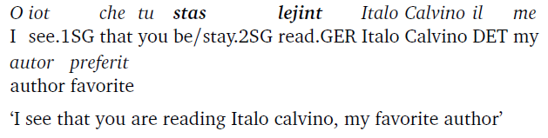
The use of gerund in Friulan
iii. PROGRESSIVE PERIPHRASIS
Friulan makes use of a grammaticalized gerundial progressive periphrasis.
10)

Slide 34
Methodology
3 corpora:
A corpus of fieldwork data (Moral), gathered in 3 main areas:
- Val Badia and Val di Fassa (Badiotto and Fassano varieties)
- Udine (Friulano)
- Canton Grisons (Swiss Romansh)
2. A corpus of modern written data (Mitten)
3. A corpus of ancient texts (Diachro)

Slide 35
Methodology
Data gathered through fieldwork
Administration of a translation task from Italian/German into the speaker’s local variety.

Slide 36
Methodology
Data gathered through fieldwork
Administration of a translation task from Italian/German into the speaker’s local variety.
Ladin test:
12 sentences, involving subordination, non-finite input
Main clause: progressive periphrasis
10) Sto mangiando un pezzo di torta.
‘I am eating a piece of cake’
Subordinate clause: adverbial function
11) Leggendo il giornale, sono venuto a conoscenza della grande vittoria
di Valentino Rossi.
‘I came across Valentino Rossi’s victory by reading the newspapers’

Slide 37
Methodology
Friulan and Swiss Romansh test:
-12 sentences, also involving subordination, perceptive constructions, the use of infinitive
15) Vincere un Oscar è il sogno di ogni attore.
‘Winning an Oscar is every actor’s dream.
16) Ogni pomeriggio guardo i ragazzi giocare dal mio balcone.
‘Every afternoon I watch the kids play from my balcony’
17) Stavo guardando la televisione quando ho sentito un rumore sospetto.
‘I was watching TV when I heard a suspicious noise’
Corpus of modern written data
4 genres (120 texts in total): a. newspapers articles, b. scientific articles, c. school texts, d. literary texts.

Slide 38
Data observation and analysis

Slide 39
Ladin observations
The Ladin Moral corpus shows a general preference for alternative non-finite (e.g. prepositional infinitives) or finite structures to the gerundial one.
8) Ita. Ho sporcato i pantaloni sedendomi sul pavimento.
Lad. I m ’à ijiè la braie canche i mo son sontada jò por funz.
I REFL AUX dirty DET pants when I REFL AUX sat down for floor
‘I dirtied my pants by sitting on the floor’ (Badiotto)
9) Ita. Ridendo e scherzando sono già le 3 di notte!
Lad. A grignar e a scherzar l’é jà le 3 de not!
to laugh.INF and to joke.INF it_is already DET 3 of night
‘Laughing and joking (to laugh and to joke) it is already 3am (of the night)’ (Fassano)

Slide 40
Ladin observations
2. Ladin does not use a progressive periphrasis in written texts. It semantically encodes the
progressive aspect, rather than (morpho-)syntactically.
10) Ita. Sto mangiando un pezzo di torta.
Lad. I mangi en toch de turta.
I eat.PRES.1SG a piece of cake
‘I am eating a piece of cake’ (Badiotto)
11) Stavo andando in bici quando ha cominciato a piovere.
I je cun la roda canche al à metü man da pluvëi.
I go.PRES.1SG with the bike when it AUX put hand to rain.INF
‘I was riding my bike when it started raining’ (Badiotto)

Slide 41
Ladin observations
3. Traditional gerund occurs predominantly in its adverbial function in non-elicited written texts (Mitten corpus).
12) Vardan i dac de la Stazion de Meteo Trentino de Pecé a Moena, loghèda a 1200 metres
look.GER DET data of DET station of weather Trentino of Pecé in Moena located at 1200 meters
de auteza, Claudio de Pavarin ne met dant desvalives etres dac e curiositèdes.
of height Claudio de Pavarin not put in-front-of differences between data and curiosity
‘Looking at the data of the Trentino de Pecé Weather Station in Moena, located at a height of 1200 meters,
Claudio de Pavarin does not privilege data over curiosity’

Slide 42
Ladin observations
4. Traditional gerund is also found in a small number of attributive or argument structures.
12) An vëiga les löms dl ciastel y an alda cherdon l’inom dla prinzëssa.
IMPS see.3SG DET lights of+DET castle and IMPS hear.3SG call.GER DET+name of+DET princess
‘One sees the lights of the castle and one hears the name of the princess being called’

Slide 43
Romansh observations
Romansh data present some range of variation.
Specifically, the circumstantial adverbial value is expressed through a gerund, whereas the causal value is expressed via a finite clause (Moral and Mitten corpus). The Diachro corpus data, however, expresses both the circumstance and the cause via a gerundial structure.
13) Legind la gasetta, hai jau survegnì cun la victoria da Valentino Rossi
read.GER DET journal AUX I discover.PstP with DET victory of Valentino Rossi
‘Reading the journal I received (the news/I acknowledged) of the victory of Valentino Rossi’
14) Perquai ch’jau fatsch ina dieta na dastg jau betg mangiar tschigulatta
because that+I do.1SG a diet not can I not eat.INF chocolate
‘Since I do diet (I am on a diet) I cannot eat chocolate’

Slide 44
Romansh observations
Perceptive constructions mainly involve structures with prepositional gerunds and infinitives.
Attributive and argument functions are not attested in the Diachro corpus.
15) Jau hai vis tai a vegnend.
I AUX see.prf.2sg you a GER
‘I saw you coming’
16) Jau ta hai vis a vegnir.
I you AUX see.PstP to come.INF
‘I saw you coming’

Slide 45
Romansh observations
3. Romansh does not make use of a gerundial progressive periphrasis, but it rather displays a locative prepositional-type of periphrasis.
17) Jau ves, ti legias gist Italo Calvino, mes autur preferí.
I see you read.pres.2sg ASP Italo Calvino my author favorite
18) Jau ves che ti es vid leger Italo Calvino, mes cudesch prefarí.
I see that you are vid read.inf Italo Calvino my writer favorite
‘I see you are reading Italo Calvino, my favorite author’

Slide 46
Romansh observations
3. Romansh does not make use of a gerundial progressive periphrasis, but it rather displays a locative prepositional-type of periphrasis.
However, we find juxtaposed motion verb + gerund structures in the Diachro corpus.
19) quellas ghiausas, las qualas vann strologand & infenschend della mutatioun
those accusations which go.3PL question.GER and damage.GER of+DET mutation
[...] della religioun ... catolica,
[...] of+DET religion catholic
‘those accusations which question and damage (are hostile to) the mutation of the catholic
religion’ lit. ‘those accusations which go questioning and damaging the mutation of the catholic religion

Slide 47
Friulan observations
The adverbial function is expressed via a gerundial structure (Moral, Mitten & Diachro), except for a limited amount of prepositional infinitives (Moral).
20) Finint di lavorà tard duçu i dîs, no hai mai timp di lâ in bançe.
finish.GER to work.INF late all DET days not AUX never time to go.INF in bank
‘Finishing to work late every day, I never have time to go to the bank’
21) I ai sporcjât i bregons cul sentami sul paviment.
I AUX dirtied DET pants by sit.inf-refl on ground
‘I dirtied my pants by sitting on the ground’

Slide 48
Friulan observations
2. There are no attestations of argument structures. The attributive function is attested in one Mitten
example.
22) «Cul fin di otignî une sieradure plui biele e plui facile dal toc di
with+DET aim to obtain.INF a lock more nice and more easy of+DET touch of
scampanotament i covente graduelmentri ridot il slanç de cjampane sunant»
bell_ringing to_him necessary gradually reduce.PstP DET swing of bell ring.GER
‘With the aim to obtain a nicer and easier lock of the touch of a ringing bell, the swing of the ringing
bell must be gradually reduced’

Slide 49
Friulan observations
3. The gerundial progressive periphrasis is widely attested across the Moral and Mitten corpora.
23) Stavi cjalant la television quanche hai sintût un rumôr sospiet.
was watch.GER DET tv when AUX heard a noise suspicous
‘I was watching the TV when I heard suspicious noise.’

Slide 50
Friulan observations
3. The gerundial progressive periphrasis is widely attested across the Moral and Mitten corpora.
23) Stavi cjalant la television quanche hai sintût un rumôr sospiet.
was watch.GER DET tv when AUX heard a noise suspicous
‘I was watching the TV when I heard suspicious noise.’
The continuous periphrasis is only attested in the Diachro corpus.
24) Chiante il vilan, e in fetis va tajant lu dur teren […]
sing.3SG DET peasant and in slices go.3SG cut.GER DET hard land
‘The peasant sings and goes cutting (slicing) the hard land’

Slide 51
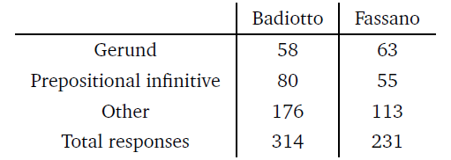
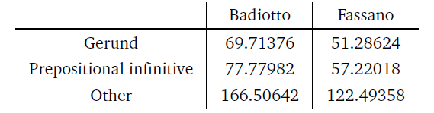
Some statistical observations
Contingency table for the chi-squared test. Comparison between Badiotto and Fassano, Moral corpus:
The expected results are the following:

Slide 52
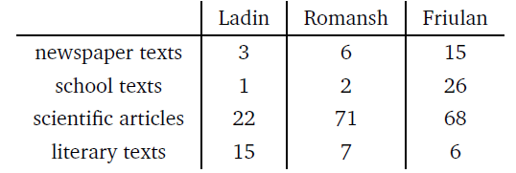
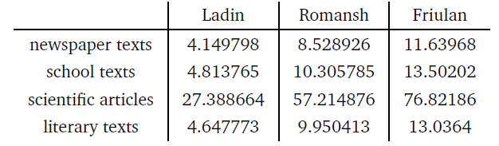
Some statistical observations
Contingency table for the chi-squared test. Comparison between Ladin, Romansh and Friulan, Mitten corpus:
The expected results are the following:

Slide 53
Conclusions
All three macro areas present to some extent a functional neutralization within the morphological suffix which is identified as the gerundial one (cf. Chiocchetti & Iori 2002, Forni 2019, Arquint 2020 Roseano & Madriz 2017 as the main relevant grammars);
the adverbial value is attested in all the examined varieties;
an additional functions which is attested to a certain degree in all three areas is the attributive one, indicating a mixed adverbial-participial nature of the gerund;
gerundial structures are used to express specific argument structures, i.e. the so-called pseudo-relative one, in Ladin and Romansh, but not in Friulan;
the gerundial form is also employed in grammaticalized periphrases, such as the continuous and the progressive periphrasis;
the gerundial continuous periphrasis is attested in the older stages of each variety (Lardschneider 1909 used as the integration of Ladin data attesting the end-of-the-19th century situation);
the gerundial progressive periphrasis is only attested in Friulan;
functions which are attested in the oldest stages seem to show the least variation, whereas the more recent the function, the greater the variation is.

Slide 54
Selected references
Arquint, Jachen Curdin. 2020. Elemaints d’üna grammatica cumparatistica dal rumantsch - idioms e rumantsch grischun. Chur: Societad Retorumantscha.
Aspland, CW. 1968. The So-Called Absolute Construction in Old French: Types - Voiant toz, Oiant toz. Journal of the Australasian Universities Language and Literature Association, 30, 151–168. 10.1179/aulla.1968.002.
Aspland, CW. 1972. The Old French Verbal form in -Ant Without En: Present Participle Or Gerund? Journal of the Australasian Universities Language and Literature Association, 37(1), 37–56. 10.1080/00012793.1972.11760520.
Bertinetto, P. M. (2000). The progressive in Romance, as compared with English. Empirical approaches to language typology, (6), 559-604.
Casalicchio, J. (2011). L'uso del gerundio con i verbi di percezione gardenesi. Istitut Ladin Micurà de Rü.
Casalicchio, J. (2013). Pseudorelative, gerundi e infiniti nelle varietà romanze: somiglianze (solo) superficiali e corrispondenze strutturali. Munich: LINCOM.
Casalicchio, J. (2016). Ricostruire la diacronia della sintassi ladino-dolomitica con l'aiuto di Joppi. Il caso dei costrutti percettivi. In: Ad limina Alpium. VI Colloquium Retoromanistich, Cormons, dai 2 ai 4 di Otubar dal 2014 (pp. 97-126). Società filologica friulana.
Chiocchetti, Nadia, & Iori, Vigilio. 2002. Gramatica del ladin fascian. Vich / Vigo di Fassa: Ist. Culturale Ladino.
Forni, Marco. 2019. Gramatica Ladin Gherdëina. San Martin de Tor: Istitut Ladin Micurá de Rü.
Ganzoni, Gian Paul. 1983. Grammatica ladina: grammatica sistematica dal rumantsch d’Engiadina Bassa per scolars e creschüts da lingua rumantscha e francesa. Chur: Ligia Romontscha.
Jensen, Frede. 2012. Old French and Comparative Gallo-Romance Syntax. 232. Berlin: De Gruyter.
Lardschneider, Archangelus. 1909. Versuch einer Syntax des Gröderischen. Ph.D. thesis, Universität Wien.
Roseano, Paolo, & Madriz, Anna. 2017. Scrivi par furlan. Udine: Societât filologjiche furlane.
Spescha, Arnold. 1989. Grammatica Sursilvana. Chur: Casa editura per mieds d’instrucziun.
Zof, Fausto. 2008. Gramatiche de lenghe furlane. Pasian di Prato: Editrice Leonardo.

Slide 55
Thank you!

